Slide 1






PYTHON DIWALI SALES ANALYSIS
Presented By Amit Gupta

Slide 2
ABSTRACT
This project uses Python to analyze Diwali sales data, uncovering key trends and patterns. By leveraging libraries like Pandas, NumPy, Matplotlib, and Seaborn, it provides insights to optimize marketing strategies and identify key sales drivers.

Slide 3
OVERVEIW
1 Introduction
4 Data Overview
7 Conclusion
2 Problem statement
5 Gender-wise Sales Analysis
8 Future Scope
3 Tools and Technologies
6 Occupation-wise Sales Analysis
9 Project learnings
10 Reference

Slide 4
INTRODUCTION
Identify Trends: Analyze Diwali sales data to uncover customer preferences.
Visualize Data: Use Python libraries for clear and impactful data visualizations.
Optimize Sales: Enhance inventory and marketing strategies for increased profitability.

Slide 5
TOOLS AND TECHNOLOGIES
Python offers a rich ecosystem of libraries that are highly useful for data analysis, machine learning, and visualization. Here are the most commonly used ones:
Pandas: A powerful library used for data manipulation and analysis. It allows for easy handling of CSV, Excel, and other file formats.
NumPy: A library for numerical computing. It is helpful for handling arrays and performing mathematical operations.
Matplotlib: A widely used library for creating static, animated, and interactive plots. It is useful for creating line charts, bar charts, histograms, etc.
Seaborn: Built on top of Matplotlib, Seaborn is a statistical data visualization library that simplifies the creation of complex visualizations like heatmaps, pair plots, etc.

Slide 6
DATA OVERVIEW
The dataset used in this analysis captures sales transactions during the Diwali festival, containing 11,251 rows and 15 columns. It includes key attributes such as:
User ID( as a primary key) | Customer name | Product ID
Gender | Age Group | Age
State | Zone | Marital Status

Slide 7
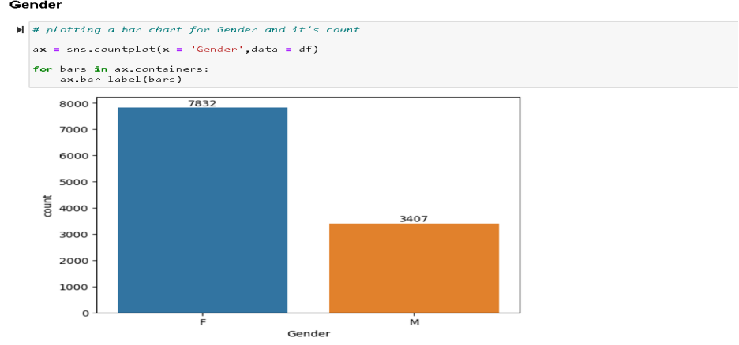
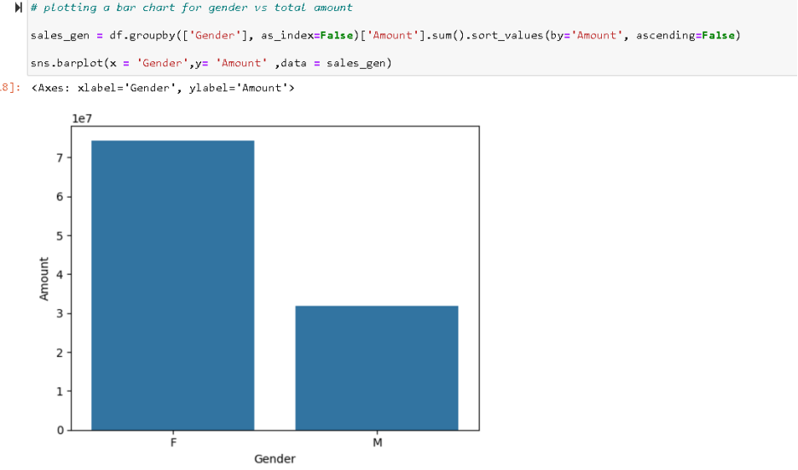
GENDER-WISE SALES ANALYSIS
Analyzing sales by gender helps in understanding purchasing patterns across males and females..
From above graphs we can see that most of the buyers are females and even the purchasing power of females are greater than men

Slide 8
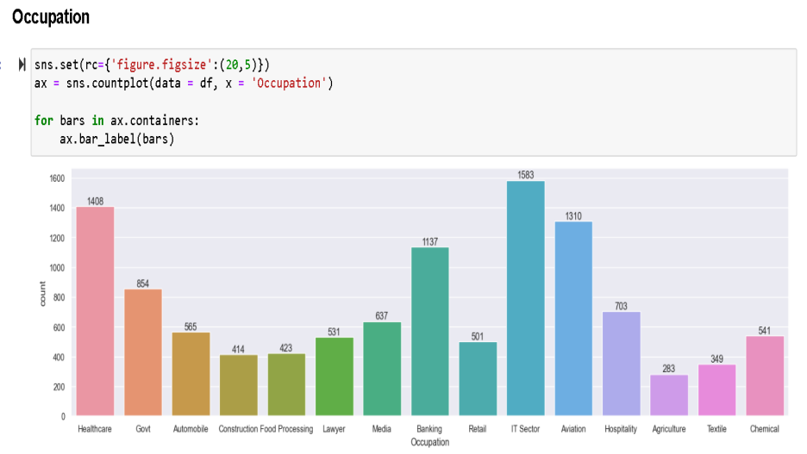
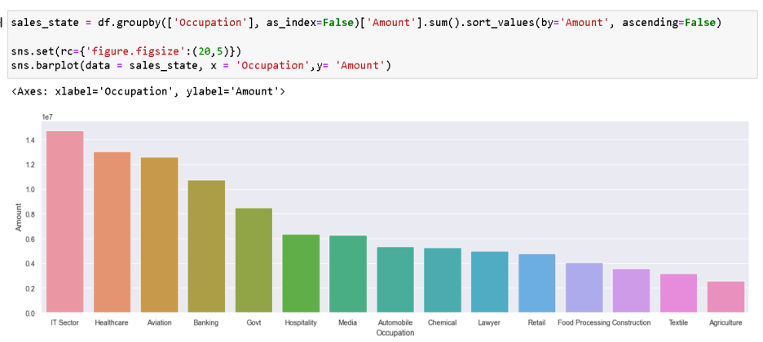
OCCUPATION WISE ANALYSIS
Identify the occupations that contribute the most to Diwali sales.
occupation vs amounts.
From above graphs we can see that most of the buyers are working in IT, Healthcare and Aviation sector

Slide 9
CONCLUSION
Key Insights: Identified high-potential customer segments for targeted marketing.
Optimized Planning: Enhanced inventory and resource allocation based on data.
Increased Profitability: Maximized sales during Diwali with data-driven decisions.
Sustained Growth: Demonstrated the power of data in driving long-term business success.

Slide 10
FUTURE SCOPE
Real-Time Data Integration: Leverage real-time sales data for dynamic insights and quicker decision-making.
Predictive Models: Use machine learning to forecast sales trends and customer preferences.
Sentiment Analysis: Apply NLP to customer feedback for actionable insights.
Recommendation Systems: Deliver personalized product suggestions based on purchase history.
Automation: Streamline data cleaning, analysis, and reporting for improved efficiency.
Scalability: Expand analysis across multiple festive seasons and regions for comprehensive insights.

Slide 11
PROJECT LEARNINGS
Data Preparation: Cleaned and manipulated data for analysis.
Exploratory Analysis: Conducted EDA using Pandas, Matplotlib, and Seaborn.
Customer Insights: Identified potential customers by state, occupation, gender, and age.
Sales Optimization: Analyzed top-selling products and categories to enhance inventory planning and meet demand.

Slide 12
REFERENCES
1. https://www.scribd.com/document/709808482/Diwali-Sales-Analysis-EDA-1696347982
2. https://www.academia.edu/RegisterToDownload/primaryOccupation

Slide 13
THANK
YOU

