Slide 1
SQL Ad-HOC
Requests
Project
Basic to Intermediate

Slide 2
objective
The objective of this project is extract basic to
intermediate level data
requirement requests using SQL queries. By which we can examines order trends, customer preferences, and sales performance to enhance strategic business decisions.

Slide 3
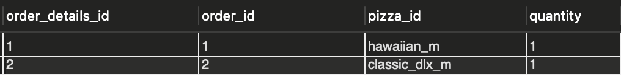
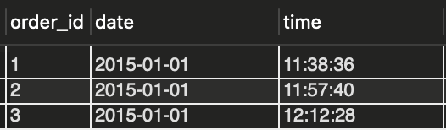
We have 1 Database having 4 tables: Pizzagalley & {order_details, orders, pizza_types & pizzas} respectively.
1. select * from order_details;
2. select * from orders;

Slide 4
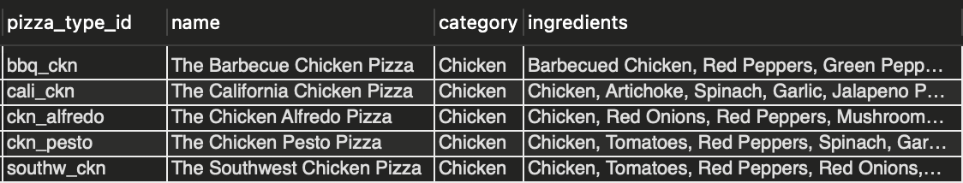
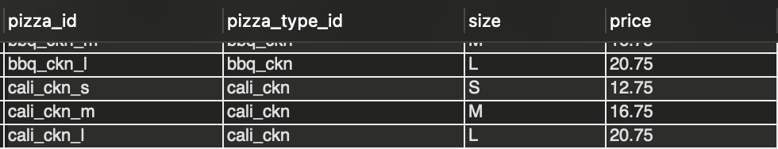
3. select * from pizza_type;
4. select * from pizzas;

Slide 5
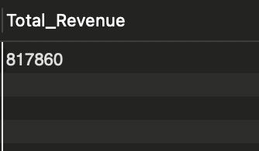
QUESTION 1: Calculate the total revenue generated from pizza sales.
SELECT
round(sum(quantity * price)) AS Total_Revenue
FROM
pizzas
INNER JOIN
order_details ON pizzas.pizza_id = order_details.pizza_id;

Slide 6
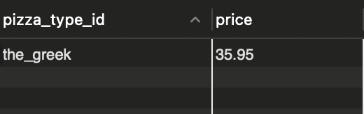
QUESTION 2: Identify the highest-priced pizza_type_id.
SELECT
pizza_type_id , price
FROM
pizzas
where
price = (select max(price) from pizzas);

Slide 7
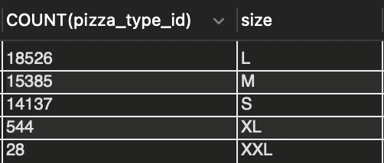
QUESTION 3: Identify the most common pizza size ordered.
SELECT
COUNT(pizza_type_id) , size
FROM
order_details
JOIN
pizzas ON pizzas.pizza_id = order_details.pizza_id
GROUP BY
size ;

Slide 8
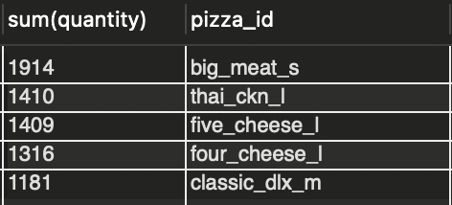
QUESTION 4: List the top 5 most ordered pizza_id along with their quantities.
SELECT
sum(quantity) , pizza_id
FROM
order_details
GROUP BY
pizza_id
ORDER BY
sum(quantity) desc
LIMIT 5;
.

Slide 9
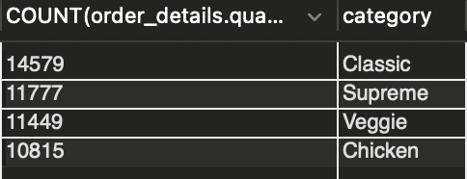
QUESTION 5:Join the necessary tables to find the total quantity of each pizza category ordered.
SELECT
COUNT(order_details.quantity), pizza_type.category
FROM
order_details
JOIN
pizzas ON order_details.pizza_id = pizzas.pizza_id
JOIN
pizza_type ON pizza_type.pizza_type_id = pizzas.pizza_type_id
GROUP BY
pizza_type.category
ORDER BY
COUNT(order_details.quantity) DESC;

Slide 10
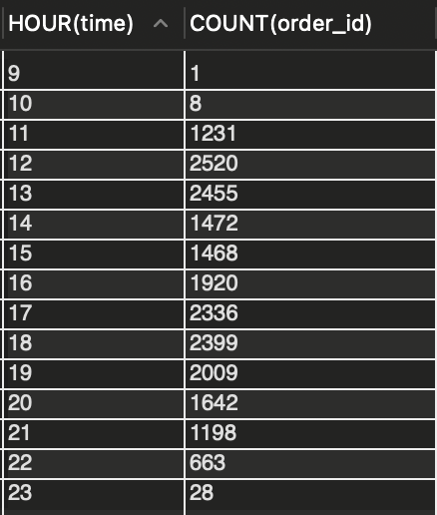
QUESTION 6: Determine the distribution of orders by hour of the day.
SELECT
HOUR(time), COUNT(order_id)
FROM
orders
GROUP BY HOUR(time;

Slide 11
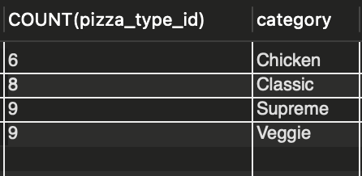
QUESTION 7: Join relevant tables to find the category-wise distribution of pizzas.
SELECT
COUNT(pizza_type_id), pizza_type.category
FROM
pizza_type
GROUP BY pizza_type.category;

Slide 12
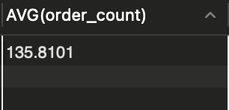
QUESTION 8:Group the orders by date and calculate the average number of pizzas ordered per day.
SELECT
AVG(order_count)
FROM
(SELECT
COUNT(orders.order_id) AS order_count, orders.date
FROM
order_details
JOIN orders ON orders.order_id = order_details.order_id
GROUP BY orders.date) AS TEMP;

Slide 13
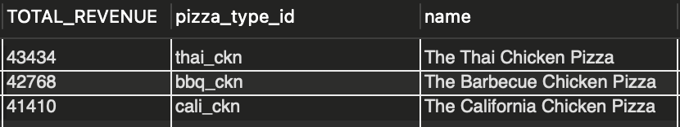
QUESTION 9: Determine the top 3 most ordered pizza types based on revenue.
SELECT
ROUND(SUM(pizzas.price * order_details.quantity),0) AS v TOTAL_REVENUE,pizzas.pizza_type_id,pizza_type.name
FROM
pizzas
JOIN
order_details ON order_details.pizza_id = pizzas.pizza_id
JOIN
pizza_type on pizza_type.pizza_type_id = pizzas.pizza_type_id
group by
pizzas.pizza_type_id,pizza_type.name
order by
TOTAL_REVENUE DESC
LIMIT 3;

