Slide 1
Real Time Fire and Flame Detection using Video Data Capture.
What is the problem?
The main problem addressed is the need for an effective method to detect fires and flames in real-time using video data.
Traditional fire detection methods, such as smoke detectors, are often ineffective in large, open spaces where smoke particles may not reach the sensors quickly. This is particularly problematic in environments like large auditoriums, tunnels, or outdoor areas.
What has been done earlier?
Previous Work:
Color-Based Detection: Earlier methods often relied solely on detecting the color of fire, which can lead to false alarms due to other objects having similar colors.
Motion Detection: Some approaches combined color detection with motion analysis to better identify fire-like behavior, but these methods still struggled with false positives.
Fourier Domain Analysis: Techniques like those by Healey et al. (1993) and others used Fourier Transform to detect periodic patterns in flames.
Hemant Sah, B421025

Slide 2
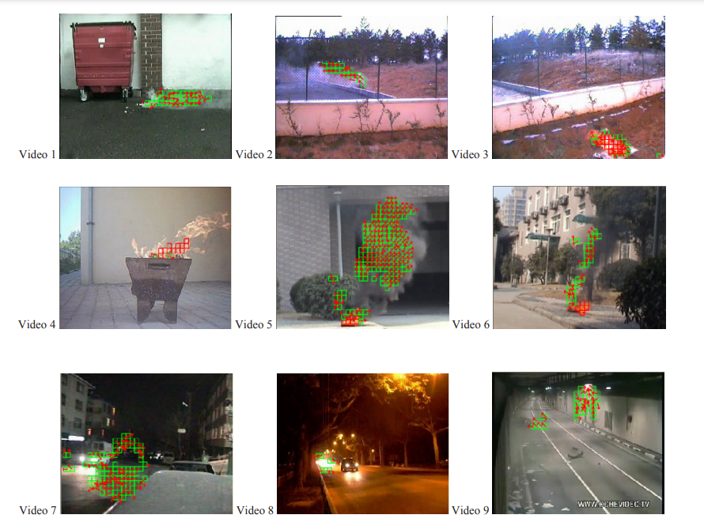

Slide 3
Real Time Fire and Flame Detection using Video Data Capture.
What are the remaining challenges? What novel solution proposed by the authors to solve the problem?
Remaining Challenges :
False Alarms: A major challenge was the high rate of false alarms in environments with objects that move and change color similarly to flames, such as reflections or light sources.
Detection Accuracy: Another challenge was improving the accuracy of flame detection by incorporating both spatial and temporal information about the fire’s behavior.
Novel Solution Proposed :
Wavelet Transform: The method applies a temporal wavelet transform to analyze the flickering behavior of potential flame regions in the video.
Spatial Wavelet Transform: Additionally, the spatial wavelet transform is used to analyze the color variations within the fire-colored regions, helping to further differentiate actual flames from other moving objects with similar color characteristics.
Combination of Clues: The final decision on whether a fire is present is made by combining motion analysis, color checks, and the results of wavelet analysis.
Hemant Sah, B421025

