Slide 1
ATLIQ HOSPITALITY ANALYSIS
Presented By : Amit Kumar

Slide 2
Table of Contents
Atliq Hospitality Challenge
Objective
Dashboard
Analysis
Conclusion
Appendix

Slide 3
Objective
Atliq Grands owns multiple 5-star Hotels across Delhi, Mumbai, Hyderabad & Bangalore
The objective is to find relevant insights for Atliq Grands to improve their business from the available data

Slide 4
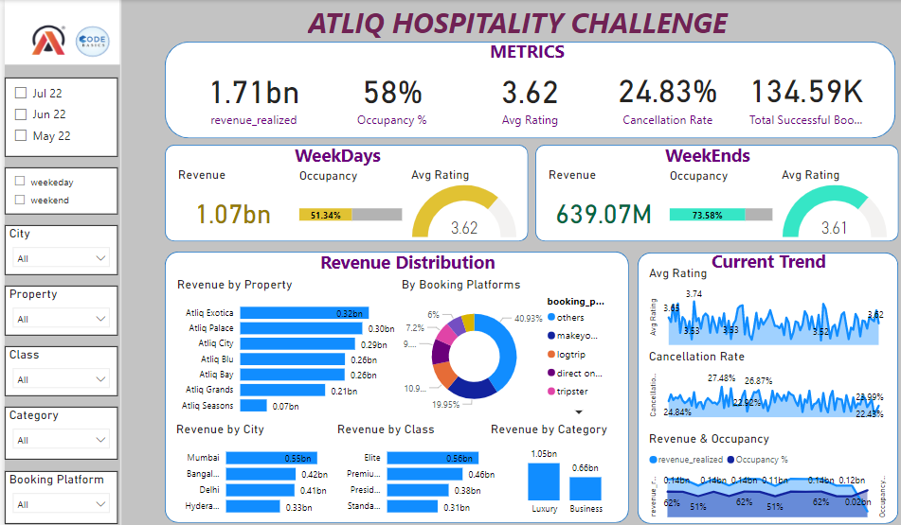
Dashboard
Atliq Exotica is the most profitable Property & Mumbai being the most profitable city
Hotel rooms are more occupied on weekends but Customer feedback remains almost the same for all days

Slide 5
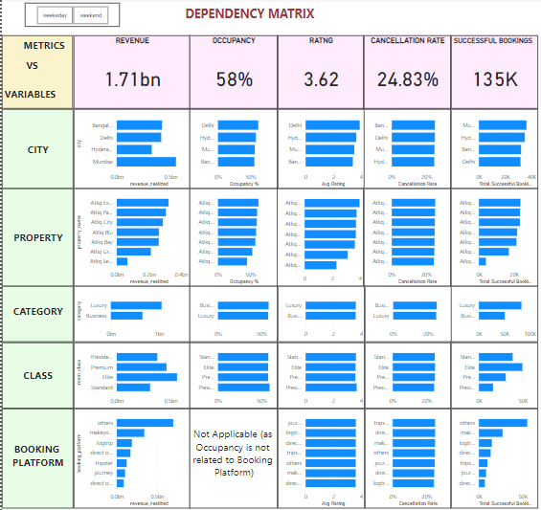
Analysis
Dependency Matrix
Average Rating & Occupancy are independent of - Room category, Class & Booking Platform, but it is dependent on City & Property
Cancellation rate is uniform & independent of all variables
Thus we need to focus on Revenue, Occupancy & Ratings against City & Property

Slide 6
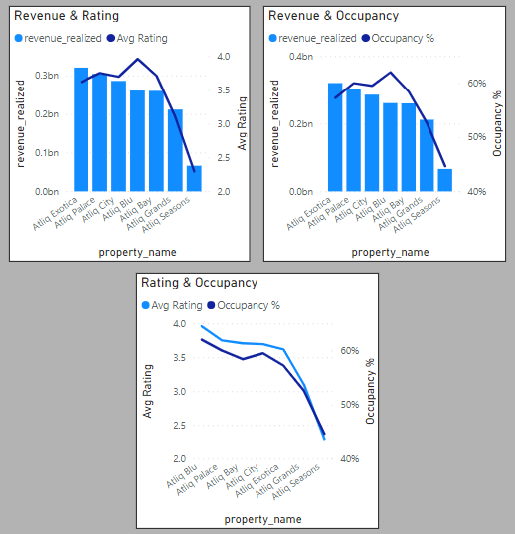
Analysis
Rating, Occupancy & Revenue
There is a direct correlation between Avg Rating, Occupancy % & Revenue
Thus, if Atliq improves its Customer Service, then Occupancy & Revenue will increase

Slide 7
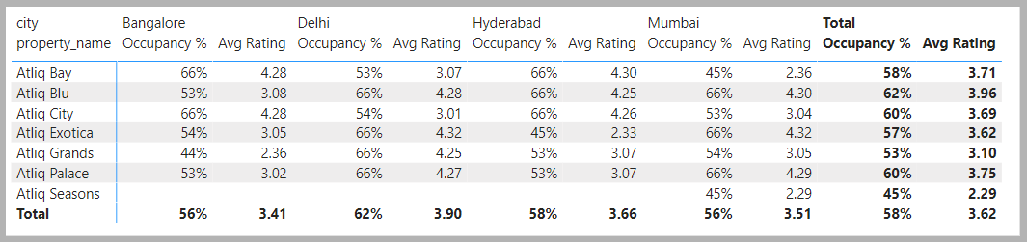
Analysis
Metrics
Atliq Exotica is the best performing property with the highest Revenue 0.32 B & rating of 3.62
Although amongst Exoticas, Atliq Exotica Hyderabad is not performing well on par with other cities with occupancy of 45% & rating 2.33
But as far as customer satisfaction is concerned, Atliq Blu is the best property with Highest Occupancy of 62% & Highest Average Rating 3.96
Atliq Seasons is the worst performing property with the lowest Revenue of 0.06 B (though it is only in Mumbai) with the lowest occupancy (44%) & lowest average rating of 2.29
Atliq needs a different strategy for Atliq Seasons & Atliq Exotica Hyderabad

Slide 8
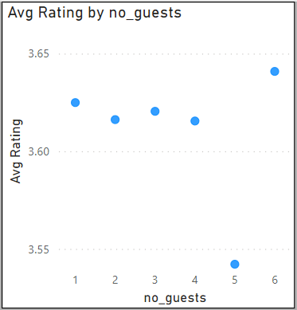
Analysis
Surprising trend
Average Ratings vs Number of guests comparison shows a surprise deviation in graph for 5 guest bookings
Atliq needs to investigate why bookings with 5 No. guests shows a sudden fall in ratings

Slide 9
Conclusion
Atliq needs to focus on increasing the Customer Satisfaction to improve its business
The critical hotels as far as customer satisfaction is concerned, are Atliq Seasons & Atliq Exotica Hyderabad
Atliq needs to investigate 5 No. guests booking

Slide 10
Appendix
There is a data cleaning process involved in file dim_hotels. City for the property no. 16559 is wrongly mentioned as Mumbai, since first 2 digits represent the city & 16 represents Delhi as its city.
Occupancy is assumed for the check_in day or the first day only, because there are many cases in the data where for a room on a particular day occupancy is 100%, but the checked in guests from previous days are still present in the room theoretically.
Revenue is considered for 1 day of stay only

Slide 11
THANK YOU

