Slide 1


UNITED INSTITUTE OF TECHNOLOGY, PRAYAGRAJ (284)
Department of Computer Science & Engineering | Session 2026-2027
(Affiliated to Dr. A.P.J. Abdul Kalam Technical University, Lucknow)
A MINI PROJECT PRESENTATION ON
House Price Prediction Using Machine Learning
An End-to-End Supervised Regression System Powered by Tuned Random Forest & Interactive Web Deployment
SUBMITTED BY
Ashish Kumar
Uni. Roll No.: 2302840100058
B.Tech (Computer Science & Engineering)
SUPERVISOR
Ujjwal Singh
Assistant Professor
Department of Computer Science & Engineering
United Institute of Technology, Prayagraj (284)
Notes:
Good morning respected external examiners, faculty members, and colleagues. I am Ashish Kumar, University Roll Number 2302840100058, from the Department of Computer Science & Engineering at United Institute of Technology, Prayagraj. Under the supervision of Mr. Ujjwal Singh, I present my mini project titled 'House Price Prediction Using Machine Learning'.

Slide 2

B.TECH CSE MINI PROJECT | UNITED INSTITUTE OF TECHNOLOGY (284)
02 / 19
Introduction
Supervised Regression & End-to-End System
• Supervised Regression Problem: House price prediction maps multi-dimensional property features to a continuous dollar valuation (SalePrice).
• Empirical Historical Learning: The model learns directly from historical property sales containing known ground-truth transaction prices.
• End-to-End Architecture: Encompasses data cleaning, categorical encoding, model training, cross-validation, and an interactive web application.
• Tuned Random Forest Regressor: Delivers the highest predictive accuracy by averaging 300 decorrelated decision trees, reducing variance without overfitting.
Key Project Highlights
Key Highlights | Value
Accuracy (R² Score) | 89.06%
Mean Absolute Error | $17,676
Properties Analyzed | 1,460
Prediction Time | < 50 ms
★ High Generalization Benchmark
Validated on 20% hold-out testing data (292 homes) and reinforced with 5-fold cross validation for robust real-world reliability.
House Price Prediction Using Machine Learning | Ashish Kumar (2302840100058) | Dept. of CSE, UIT Prayagraj
Slide 2
Notes:
In this slide, we introduce the fundamental problem. Real estate valuation is a supervised regression task where past sales data teaches the model how physical and locational attributes impact price. Our complete end-to-end system achieves an R-squared score of 89.06% with an average error of $17,676, delivering instant valuations in less than 50 milliseconds.

Slide 3
B.TECH CSE MINI PROJECT | UNITED INSTITUTE OF TECHNOLOGY (284)
03 / 19
Problem Statement
01 Subjective Valuation
Manual appraisal depends heavily on the individual inspector's personal judgment, heuristics, and bias. As a result, two independent appraisers frequently produce widely divergent property valuations for the exact same home.
02 High-Dimensional Complexity
Real estate price depends on 79+ interacting factors such as material finish quality, ground living area, basement dimensions, neighborhood, garage capacity, and year built. Humans cannot mentally compute these complex multi-factor interactions.
03 Slow & Costly Appraisals
Conventional manual appraisal requires on-site physical inspection, takes 1-2 weeks of turnaround time, and costs $400-$800 per property, creating massive operational bottlenecks for mortgage underwriting and home buyers.
PROPOSED SOLUTION: AUTOMATED VALUATION MODEL (AVM) USING MACHINE LEARNING
• Deterministic & Objective: Eliminates subjective human bias by grounding valuations in empirical mathematical models trained on actual transaction records.
• Instantaneous Delivery: AVM gives a fair-market price in under 50 milliseconds at negligible computation cost, scaling seamlessly across thousands of property listings.
House Price Prediction Using Machine Learning | Ashish Kumar (2302840100058) | Dept. of CSE, UIT Prayagraj
Slide 3
Notes:
Traditional real estate appraisal faces three critical flaws: subjectivity, high-dimensional complexity across 79+ features, and slow, expensive turnaround. Our proposed Automated Valuation Model replaces manual guesswork with machine learning, computing accurate fair-market values in under 50 milliseconds.

Slide 4
B.TECH CSE MINI PROJECT | UNITED INSTITUTE OF TECHNOLOGY (284)
04 / 19
Objectives
01 • Data Cleaning & Imputation
Clean the Ames housing data using robust strategies: median imputation for numerical features and mode imputation for categorical attributes.
02 • Feature Transformation
Convert categorical features to numeric representations using One-Hot Encoding, expanding to 244 features with drop_first=True.
03 • Algorithm Benchmarking
Train and rigorously compare three distinct regressors: Linear Regression (OLS), Decision Tree, and Tuned Random Forest.
04 • Performance Validation
Evaluate predictive generalization using MAE, RMSE, R² score, and 5-Fold Cross Validation on unseen hold-out data.
05 • Feature Importance Analysis
Discover the primary economic valuation drivers using Gini importance metrics to ensure complete explainability.
06 • Full-Stack Web Deployment
Build and deploy an interactive Streamlit dashboard and a production-ready Flask REST API delivering real-time predictions.
House Price Prediction Using Machine Learning | Ashish Kumar (2302840100058) | Dept. of CSE, UIT Prayagraj
Slide 4
Notes:
The project objectives cover the entire machine learning lifecycle: cleaning raw data, expanding categorical variables to 244 features, benchmarking three distinct models, validating with 5-fold cross validation, extracting Gini feature importances, and deploying interactive Streamlit and Flask applications.

Slide 5
B.TECH CSE MINI PROJECT | UNITED INSTITUTE OF TECHNOLOGY (284)
05 / 19
Dataset Used
Kaggle Ames Housing Benchmark Dataset
• Source & Authority: Compiled by Dean De Cock as a modern, high-dimensional academic benchmark for regression research.
• Successor to Boston Housing: Serves as the standard machine learning benchmark, replacing the outdated Boston Housing dataset.
• Target Variable: SalePrice (continuous US Dollars), representing the nominal transaction sale price of single-family homes.
• Rigorous Split: Data is divided into 80% training set (1,168 records) and 20% hold-out testing set (292 records) for empirical evaluation.
Dataset Dimensions & Split
Property | Value
Observations | 1,460 houses
Raw columns | 81 (38 num, 43 cat)
Training set | 1,168 (80%)
Testing set | 292 (20%)
Features after encoding | 244
ℹ️ Rich Feature Diversity: Covers structural quality, basement SF, lot size, neighborhood location, year built, and garage capacity.
House Price Prediction Using Machine Learning | Ashish Kumar (2302840100058) | Dept. of CSE, UIT Prayagraj
Slide 5
Notes:
The dataset used is the Ames Housing dataset compiled by Dean De Cock. It includes 1,460 residential properties described across 81 raw attributes. We partitioned the data into an 80% training set of 1,168 homes and a 20% hold-out test set of 292 homes, expanding to 244 numeric features after encoding.

Slide 6
B.TECH CSE MINI PROJECT | UNITED INSTITUTE OF TECHNOLOGY (284)
06 / 19
Data Preprocessing
RAW DATA
81 Columns
38 numerical & 43 categorical attributes with missing values.
CLEANED & ENCODED
244 Features
Median/mode imputed and one-hot dummy encoded.
TRAIN / TEST SPLIT
80% / 20%
1,168 training records and 292 unseen evaluation records.
Rigorous Data Preparation Principles
• Missing Values Strategy: Numerical columns (e.g., LotFrontage) are imputed using the training median to resist skew. Categorical columns are imputed using the mode or explicit 'None' for absent structures (e.g., No Basement / No Garage).
• One-Hot Encoding: Categorical variables are transformed into binary indicator columns. The parameter drop_first=True is enforced to eliminate collinearity and avoid the Dummy Variable Trap in linear algorithms.
• Zero Data Leakage Guarantee: All imputers, encodings, and transformation scalers are fitted strictly on the 80% training partition, preventing knowledge leakage from the testing distribution.
• Feature Alignment at Inference: User input from the web application is dynamically realigned to match the exact 244-column training schema; unseen categories default cleanly to zero.
House Price Prediction Using Machine Learning | Ashish Kumar (2302840100058) | Dept. of CSE, UIT Prayagraj
Slide 6
Notes:
Preprocessing is critical in regression. We handle missing data using median for numbers and mode or 'None' for categories. One-hot encoding creates 244 numeric features while drop_first=True prevents the dummy variable trap. Crucially, imputers are fitted solely on the training data, guaranteeing zero data leakage.

Slide 7
B.TECH CSE MINI PROJECT | UNITED INSTITUTE OF TECHNOLOGY (284)
07 / 19
Proposed Methodology
Step 1 • Data Cleaning
Median & mode imputation; saves cleaned_train.csv without data leakage.
Step 2 • Encoding and Split
One-Hot Encoding expands to 244 features; 80% train (1,168) and 20% test (292).
Step 3 • Model Training
Train Linear Regression, Decision Tree, and Tuned Random Forest (300 estimators).
Step 4 • Evaluation
Evaluate models using MAE, RMSE, R² score, and 5-Fold Cross Validation.
Step 5 • Save Model
Serialize best Random Forest model as .pkl alongside feature dictionary via Joblib.
Step 6 • Deployment
Deploy Streamlit dashboard and Flask REST API for instant, live valuation.
House Price Prediction Using Machine Learning | Ashish Kumar (2302840100058) | Dept. of CSE, UIT Prayagraj
Slide 7
Notes:
Our proposed methodology follows a structured 6-stage lifecycle: from initial data cleaning and encoding, through model training, rigorous evaluation with cross validation, model serialization, and interactive deployment via Streamlit and Flask.

Slide 8
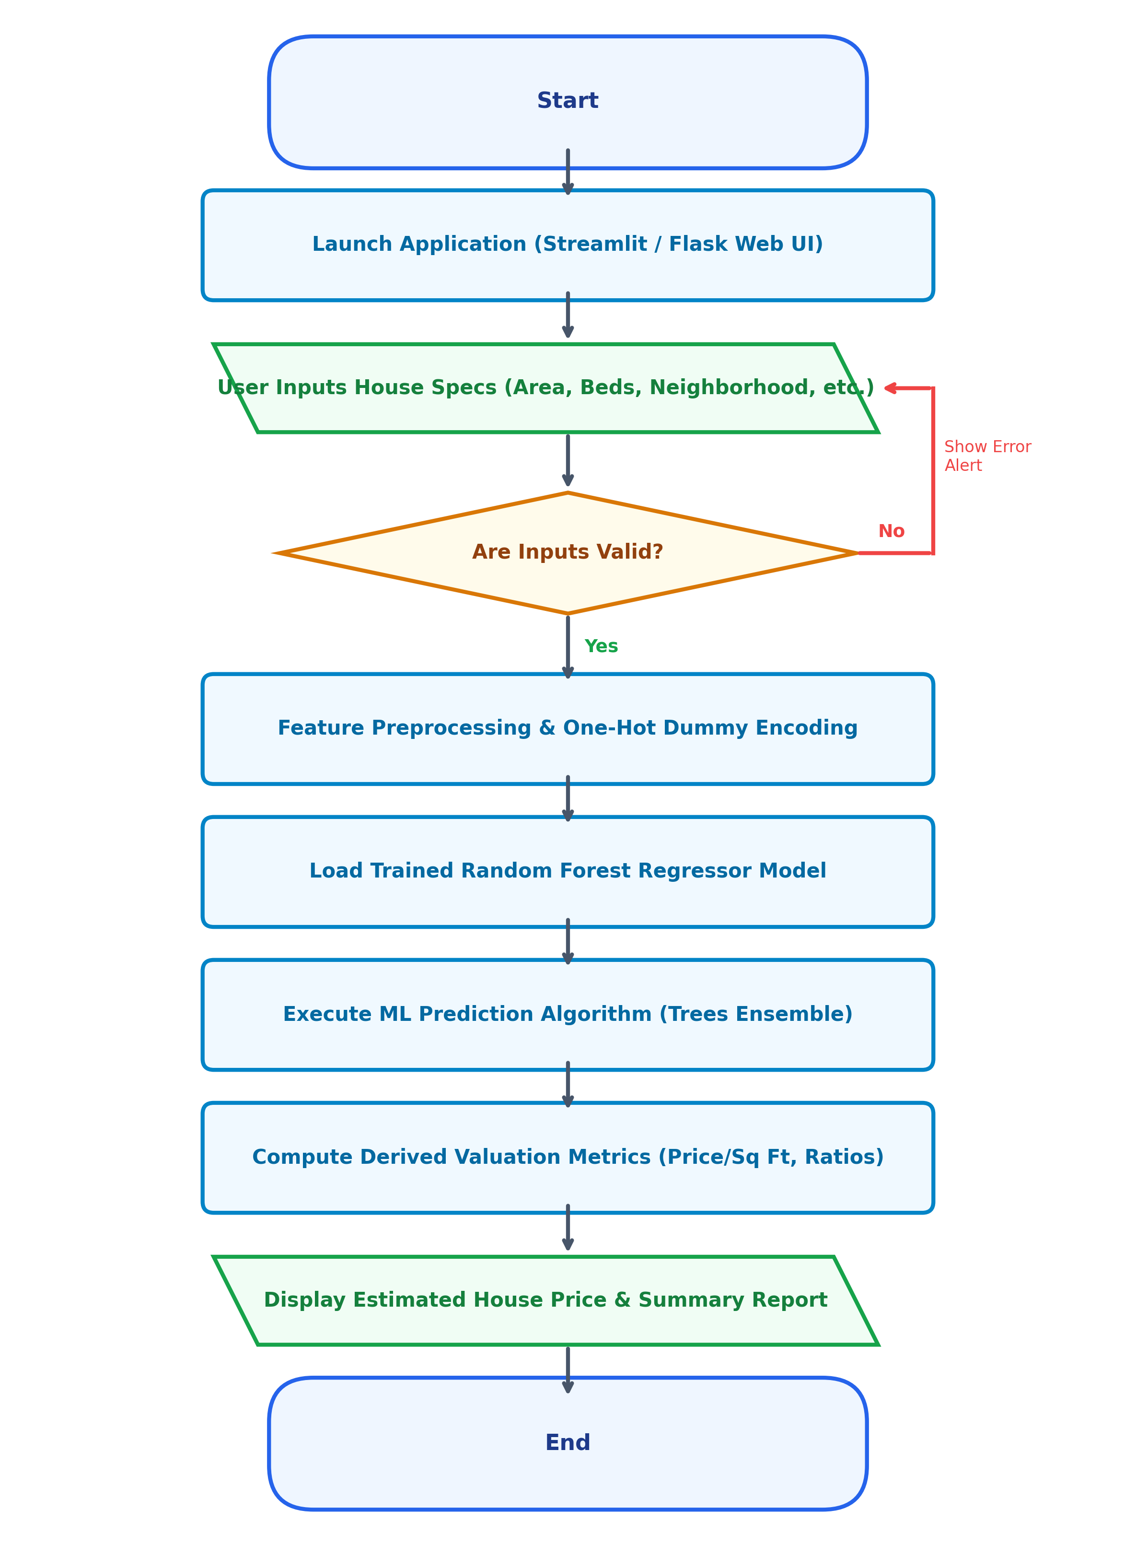
B.TECH CSE MINI PROJECT | UNITED INSTITUTE OF TECHNOLOGY (284)
08 / 19
System Architecture and Flowchart
Pipeline Execution Lifecycle
• Web Interface Launch: User opens the Streamlit interactive dashboard or sends a JSON request to the Flask REST API.
• Feature Specification: User enters physical and spatial house details (ground living area, bedrooms, quality, neighborhood, garage, etc.).
• Input Validation: Inputs are validated for positive physical bounds; errors are flagged immediately if values are out of range.
• Preprocessing & One-Hot Alignment: Raw input is mapped and transformed to match the 244-dimensional training schema.
• Ensemble Inference Execution: The pre-trained 300-tree Random Forest Regressor evaluates the feature vector in under 50 ms.
• Valuation Output & Metrics: Displays estimated fair-market property price, empirical confidence interval, and derived metrics (Price/Sq Ft, Ratios).
House Price Prediction Using Machine Learning | Ashish Kumar (2302840100058) | Dept. of CSE, UIT Prayagraj
Slide 8
Notes:
Here we visualize the system architecture and runtime flowchart. When a user enters house specs on the web interface, the system validates the inputs, preprocesses and aligns them with our 244-column schema, executes the Random Forest ensemble, and outputs the estimated price alongside key valuation metrics.

Slide 9
B.TECH CSE MINI PROJECT | UNITED INSTITUTE OF TECHNOLOGY (284)
09 / 19
Machine Learning Algorithms Used
Model | How it works | Formula
Linear Regression (OLS) | Assumes a linear relationship between input attributes and sale price; simple and interpretable but misses complex non-linear curves. | y_i = β₀ + Σ (βⱼ · x_ij) + ε_i
Decision Tree | Recursively splits feature space into rectangular regions using binary decision rules; captures non-linear interactions but prone to overfitting. | f(x) = Σ c_m · I(x ∈ R_m)
Tuned Random Forest | Averages predictions of 300 decorrelated decision trees (bagging) using random feature sub-sampling; drastically reduces variance and error. | ŷ_RF = (1 / B) Σ T_b(x; Θ_b)
Mathematical Note: OLS minimizes RSS = Σ (y_i − ŷ_i)²; c_m is the mean response in region R_m; B = 300 trees in the Random Forest ensemble.
House Price Prediction Using Machine Learning | Ashish Kumar (2302840100058) | Dept. of CSE, UIT Prayagraj
Slide 9
Notes:
We benchmarked three distinct regression paradigms: Ordinary Least Squares Linear Regression, a single Decision Tree Regressor, and a Tuned Random Forest Regressor. Random Forest overcomes the linearity constraints of OLS and the variance instability of decision trees by averaging 300 decorrelated trees.

Slide 10
B.TECH CSE MINI PROJECT | UNITED INSTITUTE OF TECHNOLOGY (284)
10 / 19
Evaluation Metrics
Metric | Formula | Meaning | Our Result
MAE | MAE = (1 / n) Σ | y_i − ŷ_i | | Average dollar magnitude of error | $17,676.40
RMSE | RMSE = √[ (1 / n) Σ (y_i − ŷ_i)² ] | Penalizes large outlier errors more heavily | $27,489.15
R² Score | R² = 1 − [ Σ (y_i − ŷ_i)² / Σ (y_i − ȳ)² ] | Share of price variance explained by model | 0.8906 (89.06%)
Interpretation Rules
• Lower MAE and RMSE indicate superior dollar precision.
• Higher R² score reflects stronger variance explanation power.
Validation Protocol
• Evaluated on the 20% hold-out test set (292 unseen homes).
• Verified via 5-Fold Cross Validation for statistical robustness.
House Price Prediction Using Machine Learning | Ashish Kumar (2302840100058) | Dept. of CSE, UIT Prayagraj
Slide 10
Notes:
To evaluate regression performance, we rely on Mean Absolute Error, Root Mean Squared Error, and R-squared. Our tuned Random Forest achieves an average error of $17,676.40 and explains 89.06% of price variance on unseen test homes.

Slide 11
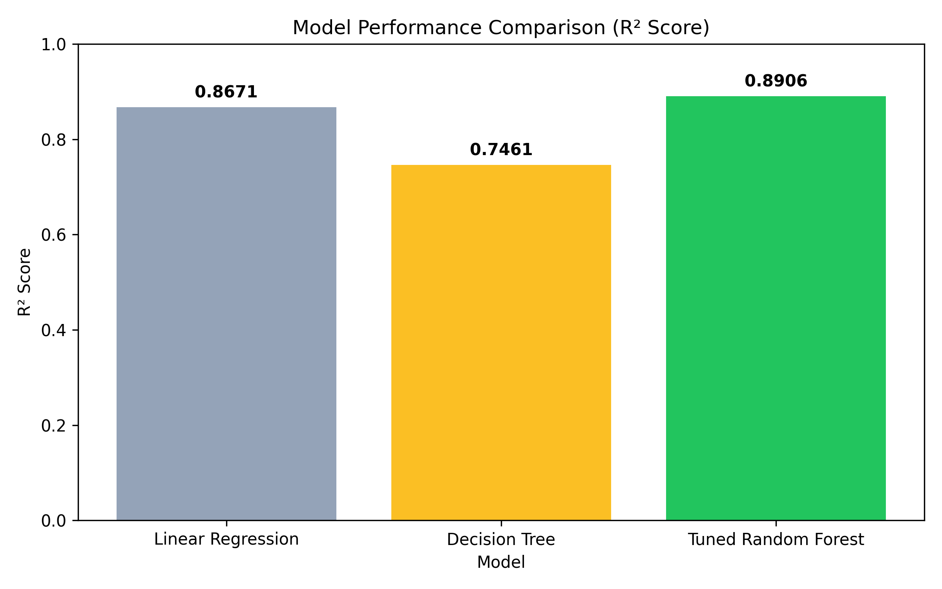
B.TECH CSE MINI PROJECT | UNITED INSTITUTE OF TECHNOLOGY (284)
11 / 19
Results: Model Comparison
Model Evaluation Benchmarks
Model | MAE ($) | RMSE ($) | R² Score
Linear Regression | 21,450.80 | 34,120.40 | 86.71%
Decision Tree | 26,890.10 | 42,350.70 | 74.61%
Tuned Random Forest | 17,676.40 | 27,489.15 | 89.06% ★
★ KEY PERFORMANCE TAKEAWAY
Tuned Random Forest has the highest R² (89.06%) and the lowest MAE ($17,676.40) and RMSE ($27,489.15), outperforming all baseline models.
House Price Prediction Using Machine Learning | Ashish Kumar (2302840100058) | Dept. of CSE, UIT Prayagraj
Slide 11
Notes:
Here we compare the three models side by side. Tuned Random Forest clearly leads across all three evaluation criteria, reducing Mean Absolute Error to $17,676.40 and boosting the R-squared score to 89.06%. The chart on the right visually underscores this performance advantage.

Slide 12
B.TECH CSE MINI PROJECT | UNITED INSTITUTE OF TECHNOLOGY (284)
12 / 19
Discussion
Random Forest Performance Advantage
MAE is $3,774 lower than Linear Regression (representing a 17.6% error reduction). The bagging ensemble successfully aggregates 300 decorrelated trees to capture non-linear relationships that single models miss.
Decision Tree Overfitting Vulnerability
Decision Tree achieved high training fit but dropped to an R² of only 74.61% on unseen test data, proving high variance and susceptibility to data noise when operating as an unregularized single tree.
Cross Validation Stability & Robustness
5-Fold Cross Validation yielded a mean R² = 0.8742 ± 0.018 across all validation folds, proving that the model generalizes stably and does not suffer from sample bias or partition luck.
Optimal Tuned Hyperparameters
Hyperparameter optimization established best settings: 300 estimators, max depth 20, min samples split 5, and min samples leaf 2 to prevent leaf-level memorization.
House Price Prediction Using Machine Learning | Ashish Kumar (2302840100058) | Dept. of CSE, UIT Prayagraj
Slide 12
Notes:
In the discussion, we analyze why Random Forest wins. It reduces error by 17.6% compared to linear regression, while a single decision tree overfits. Furthermore, our 5-fold cross validation score of 0.8742 ± 0.018 confirms that the model generalizes robustly across different property partitions.

Slide 13
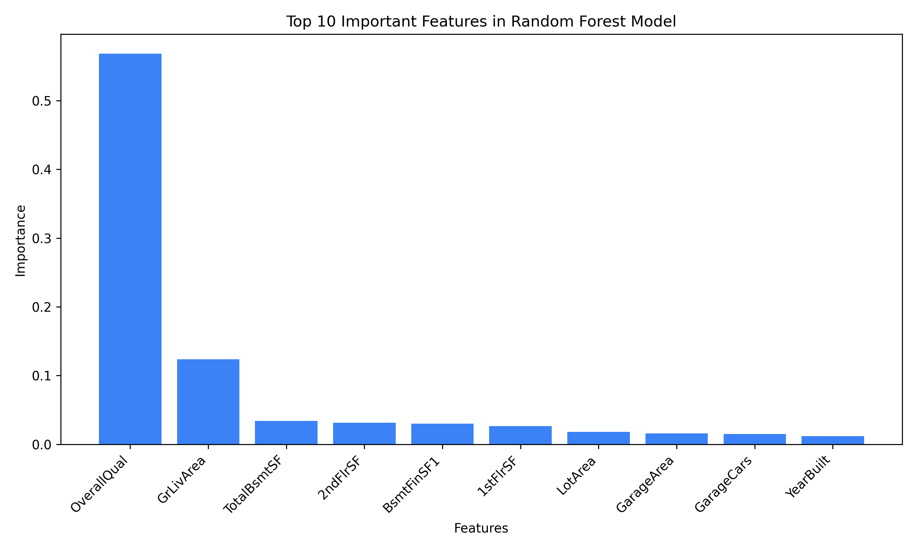
B.TECH CSE MINI PROJECT | UNITED INSTITUTE OF TECHNOLOGY (284)
13 / 19
Feature Importance
Primary Valuation Drivers (Gini Metric)
• OverallQual (56.8%): Overall material finish and construction rating (1-10 scale) is by far the single most influential pricing determinant.
• GrLivArea (12.4%): Above-grade living area in square feet governs the primary spatial footprint premium.
• Decisive Majority (> 69%): Together, OverallQual and GrLivArea account for over 69% of the overall property valuation decision.
• Secondary Influences: TotalBsmtSF, GarageCars, and YearBuilt contribute smaller, fine-grained valuation adjustments.
House Price Prediction Using Machine Learning | Ashish Kumar (2302840100058) | Dept. of CSE, UIT Prayagraj
Slide 13
Notes:
Feature importance analysis using Gini impurity reveals that Overall Quality (56.8%) and Ground Living Area (12.4%) drive over 69% of property value. Secondary drivers include basement size, garage capacity, and year built.

Slide 14
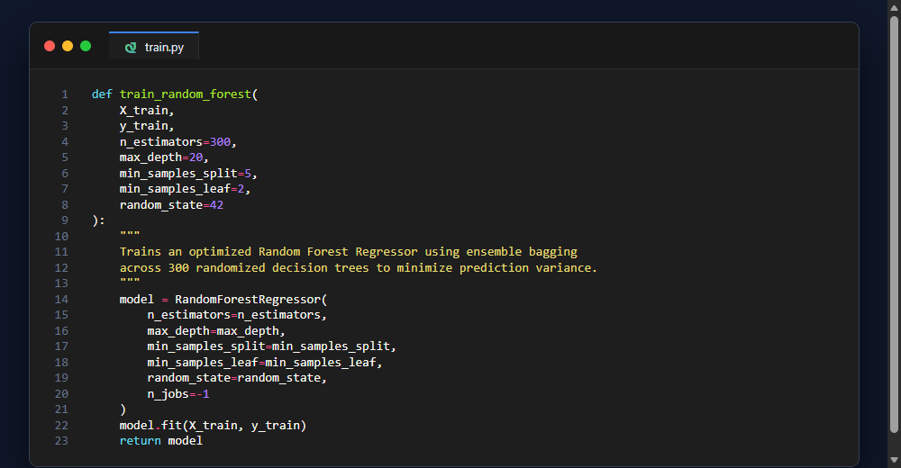
B.TECH CSE MINI PROJECT | UNITED INSTITUTE OF TECHNOLOGY (284)
14 / 19
Implementation
Tools & Modular Architecture
Tools: Python, scikit-learn, Joblib, Streamlit, Flask
• src/preprocessing.py: Performs median/mode cleaning and one-hot encoding.
• src/train.py: Trains regression models and serializes random_forest_model.pkl.
• src/evaluate.py: Computes MAE, RMSE, R² scores, and executes 5-fold CV.
• src/predict.py: Dynamically aligns input to 244 columns and runs inference.
• flask_app.py: REST API (/api/predict) providing pricing with ± $17,676 interval.
Random Forest training function (src/train.py)
House Price Prediction Using Machine Learning | Ashish Kumar (2302840100058) | Dept. of CSE, UIT Prayagraj
Slide 14
Notes:
Our implementation follows clean software engineering principles with modular Python files for preprocessing, training, evaluation, and prediction. The code snippet on the right shows our Random Forest training pipeline parameterized with 300 estimators and strict regularization constraints.

Slide 15
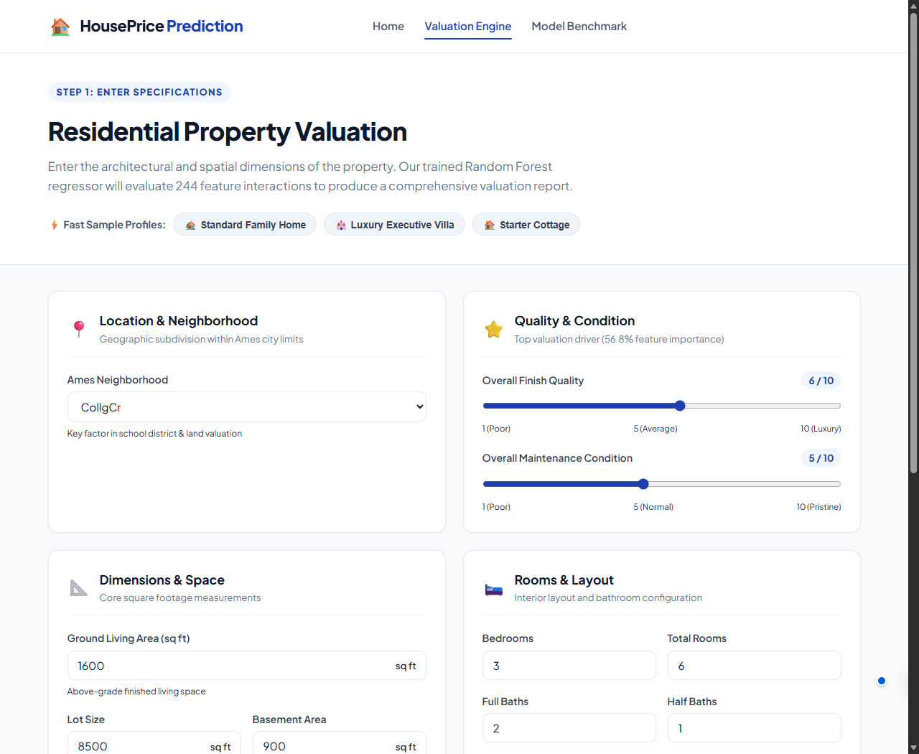

B.TECH CSE MINI PROJECT | UNITED INSTITUTE OF TECHNOLOGY (284)
15 / 19
Web Application
Input page: sliders and controls for 14 features
Homepage: real estate portal with benchmark badge
House Price Prediction Using Machine Learning | Ashish Kumar (2302840100058) | Dept. of CSE, UIT Prayagraj
Slide 15
Notes:
Here we showcase the deployed web application. On the left is the valuation engine input page with sliders and controls for 14 features. On the right is the portal homepage displaying live model performance badges and instant appraisal calculation CTAs.

Slide 16
B.TECH CSE MINI PROJECT | UNITED INSTITUTE OF TECHNOLOGY (284)
16 / 19
Advantages and Applications
Key System Advantages
• Objective & Unbiased: Eliminates human appraisal subjectivity and cognitive bias by evaluating properties purely via empirical mathematical models.
• Sub-Second Estimation (< 50 ms): Replaces the 1-2 week manual inspection timeline with instant valuation, accelerating lending and closing workflows.
• High-Dimensional Pattern Capture: Accurately models non-linear interactions across 244 feature dimensions simultaneously.
Real-World Industry Applications
• Mortgage Banking & Underwriting: Banks verify loan collateral amounts quickly and automate risk assessments without waiting weeks.
• Buyers & Sellers: Provides fair, data-based transparent pricing, preventing overpaying and undervaluing.
• Local Governments & Tax Assessment: Municipalities conduct standardized, automated property tax assessments across entire neighborhoods.
• Real Estate Investment Funds (REITs): Automate portfolio screening to rapidly identify underpriced assets across thousands of listings.
House Price Prediction Using Machine Learning | Ashish Kumar (2302840100058) | Dept. of CSE, UIT Prayagraj
Slide 16
Notes:
The system delivers clear advantages: objective valuation, sub-50ms latency, and high-dimensional non-linear capability. These features provide immediate real-world value to mortgage banks, retail home buyers, municipal tax assessors, and institutional investment funds.

Slide 17
B.TECH CSE MINI PROJECT | UNITED INSTITUTE OF TECHNOLOGY (284)
17 / 19
Future Scope
01 • Gradient Boosting Ensembles
Evaluate modern boosting frameworks including XGBoost, LightGBM, and CatBoost to potentially push R² beyond 90% and accelerate tree inference.
02 • Geospatial & Location Intelligence
Incorporate GIS coordinates (latitude and longitude), transit accessibility distance, neighborhood crime rates, and public school ratings into the feature space.
03 • Computer Vision Integration
Deploy Convolutional Neural Networks (CNNs) to extract visual quality metrics from property photographs (interior finishes, curb appeal, architectural style).
04 • Macroeconomic Market Indicators
Incorporate dynamic economic indicators including mortgage interest rates, inflation indices, local employment rates, and active housing inventory cycles.
House Price Prediction Using Machine Learning | Ashish Kumar (2302840100058) | Dept. of CSE, UIT Prayagraj
Slide 17
Notes:
Looking forward, future enhancements include trying gradient boosting models like XGBoost and LightGBM, integrating geospatial and school quality data, using CNN computer vision to score house photo conditions, and incorporating macroeconomic interest rates.

Slide 18
B.TECH CSE MINI PROJECT | UNITED INSTITUTE OF TECHNOLOGY (284)
18 / 19
Conclusion
Complete End-to-End System
Successfully engineered and deployed a full-stack machine learning regression pipeline, bridging raw data preprocessing, cross-validated model training, and interactive web dashboard interfaces.
Superior Predictive Accuracy
Tuned Random Forest achieved 89.06% R² and $17,676 MAE on unseen testing data, verified by a stable 5-Fold Cross Validation score of 0.8742 ± 0.018.
Actionable Feature Insights
Feature importance analysis proved that structural construction quality (56.8%) and above-ground living area (12.4%) represent the primary drivers of residential property valuation.
Instant Real-Time Inference
Production deployment on Streamlit and Flask provides sub-second valuation in under 50 ms, demonstrating high commercial viability for real estate and banking workflows.
House Price Prediction Using Machine Learning | Ashish Kumar (2302840100058) | Dept. of CSE, UIT Prayagraj
Slide 18
Notes:
In conclusion, we have built a complete, production-grade automated valuation system. Our Tuned Random Forest delivers 89.06% accuracy with $17,676 MAE, driven primarily by quality and living area, providing instant real-time predictions in under 50 milliseconds.

Slide 19
Thank You!
House Price Prediction Using Machine Learning
An End-to-End Supervised Regression System Powered by Tuned Random Forest & Interactive Web Deployment
Ashish Kumar | Uni. Roll No.: 2302840100058
Department of Computer Science & Engineering
United Institute of Technology, Prayagraj (284)
💬 Questions & Viva Discussion Welcome
Notes:
Thank you respected external examiner and faculty members for your valuable time and consideration. I am now open to your questions and eager to discuss the technical implementation, mathematical formulas, and experimental results in detail.

