Slide 1
Analysis of Bird Strikes in Aviation
A comprehensive analysis using Python

Slide 2
Introduction
This project analyzes bird strike incidents in aviation. The data is explored to understand various factors such as the time of strike, altitude, effect on the flight, and the cost incurred due to these incidents.

Slide 3
Data Overview
The dataset contains various attributes including:
- Aircraft type and model
- Airport and state information
- Altitude and phase of flight
- Wildlife species and number struck
- Impact on flight and indicated damage
- Cost incurred and number of people injured

Slide 4
Key Findings
Some key insights from the analysis include:
- The majority of bird strikes occur during the approach phase.
- Bird strikes are most common at lower altitudes.
- Certain airports report higher incidences of bird strikes.
- The cost incurred due to bird strikes can be substantial, especially when significant damage occurs.

Slide 5
Visualizations
Several visualizations were created to better understand the data, including:
- Bar charts showing the distribution of bird strikes across different airlines and airports.
- Line charts illustrating the yearly cost incurred due to bird strikes.
- Pie charts to analyze the phase of flight during which bird strikes occur.
- Bar charts exploring the impact of bird strikes at different altitudes.

Slide 6
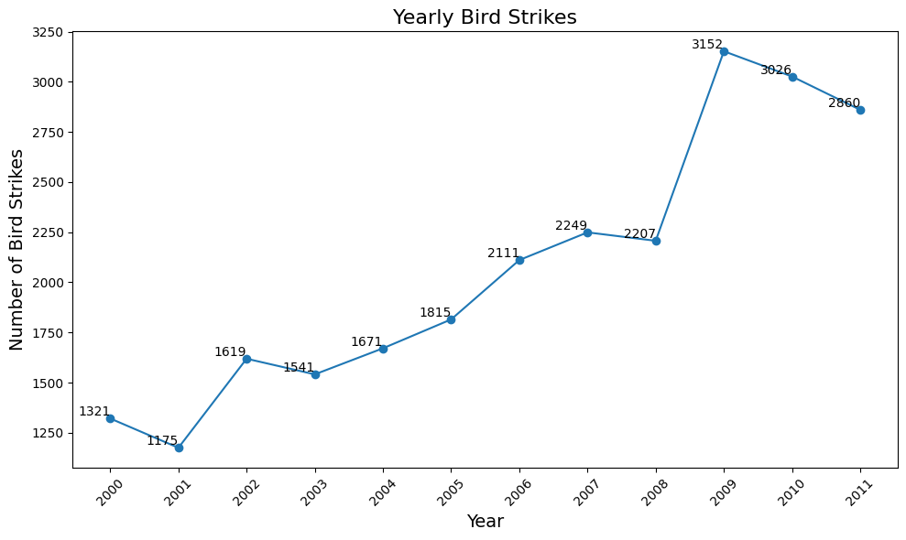
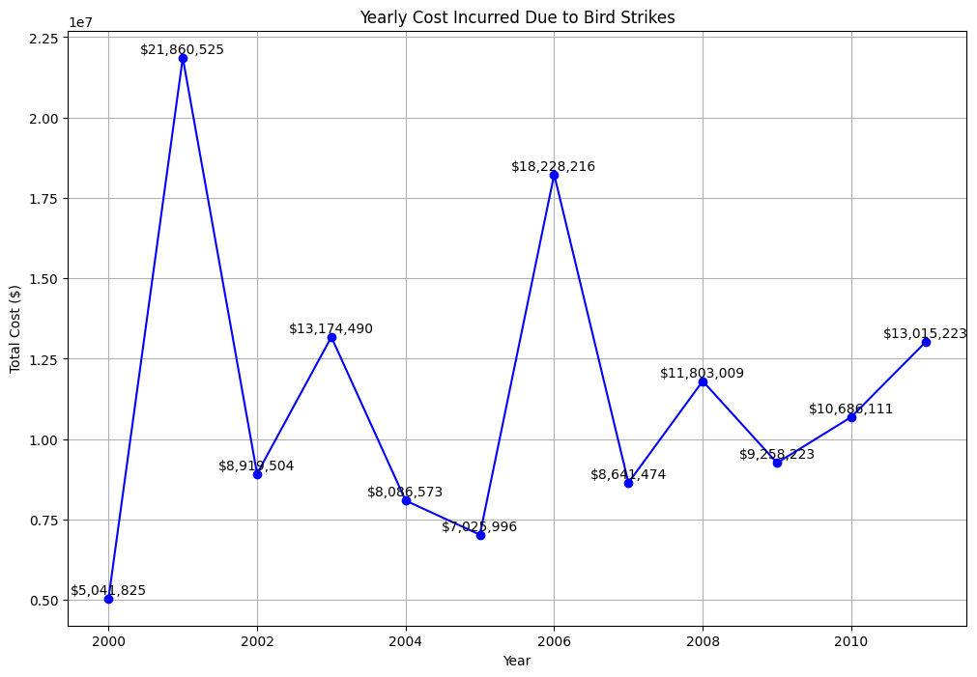

Slide 7
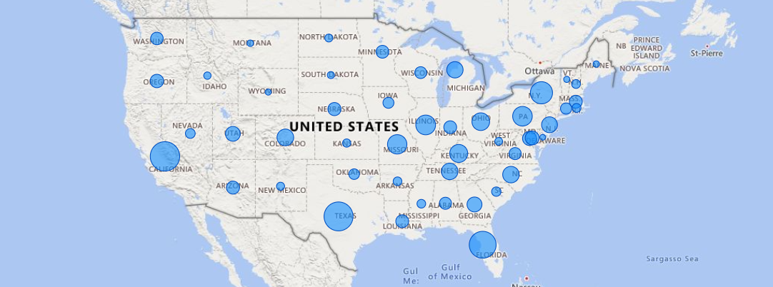
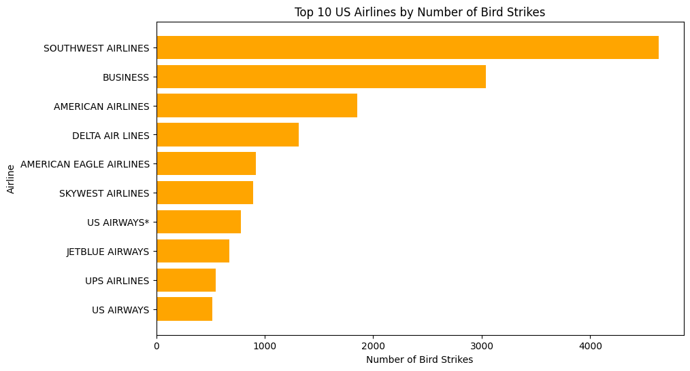
Bird Strikes By States In US

Slide 8
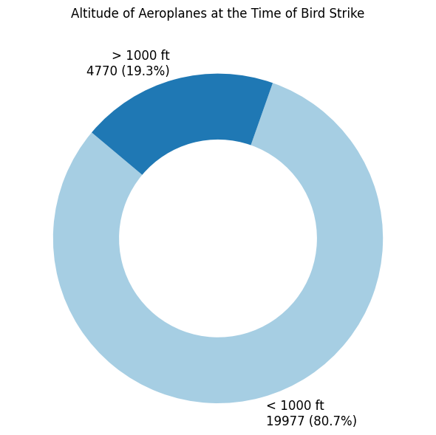
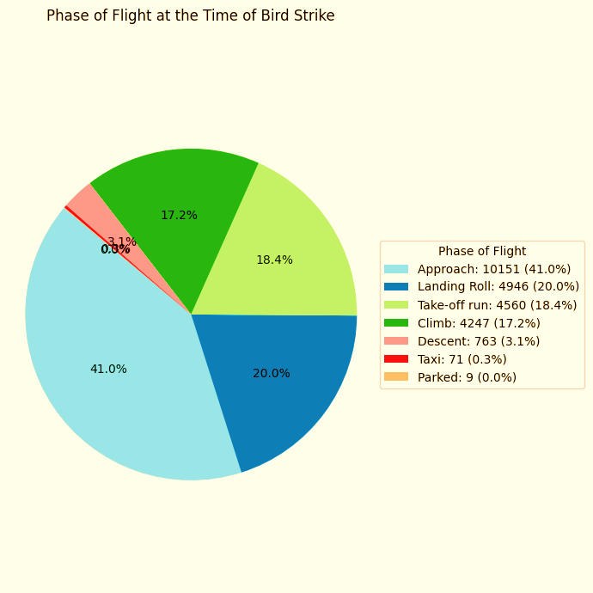
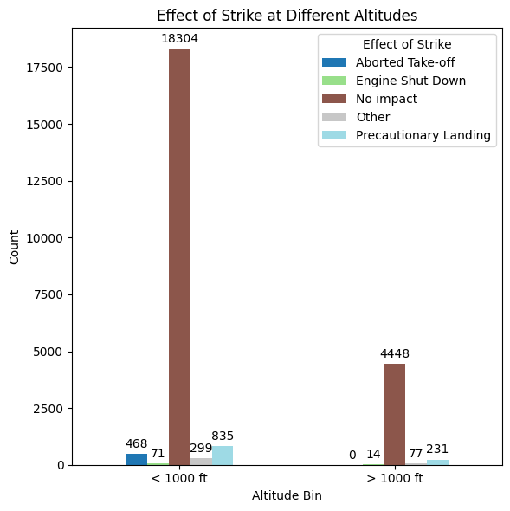
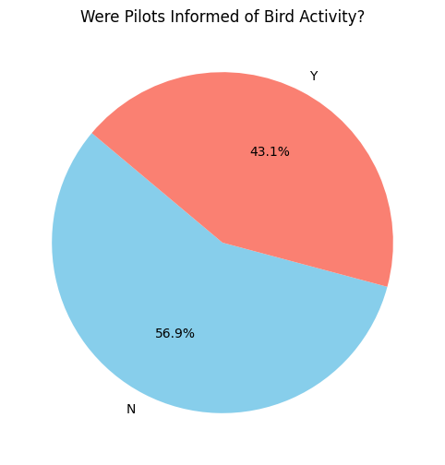

Slide 9
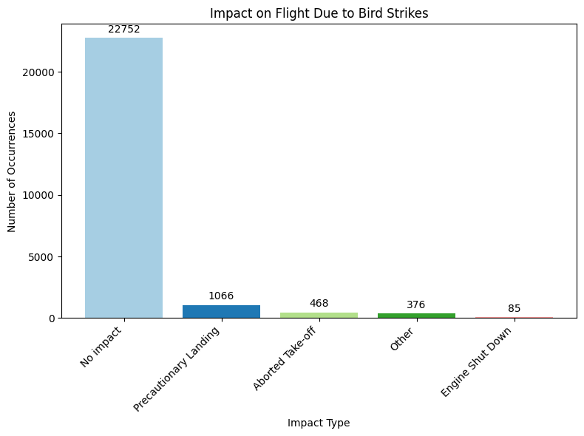
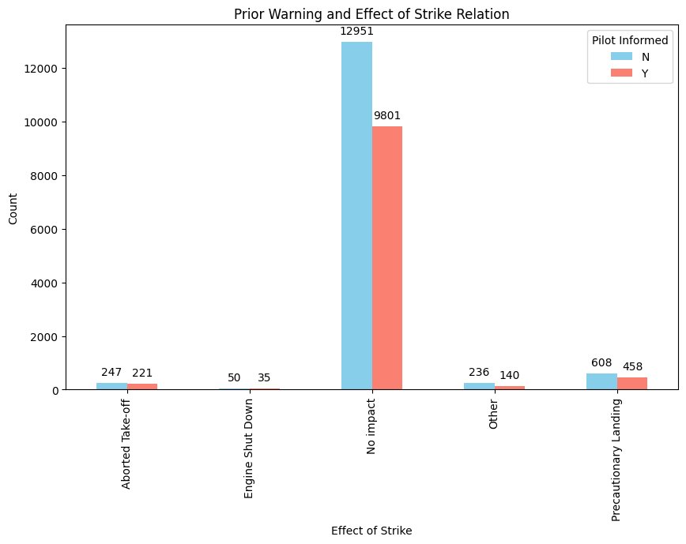

Slide 10
Conclusion
The analysis provides valuable insights that can help improve aviation safety by understanding and mitigating the risks associated with bird strikes. Future work could involve predictive modeling to anticipate bird strike events.

