Slide 1
Global Superstore Sales Dashboard Analysis
Analyzing Sales, Profit, and Key Performance Metrics

Slide 2
Overview
This project provides an analysis of sales, profit, and key performance metrics for a global superstore. Key areas of focus include:
- Geographic performance (region, state, city)
- Product category and sub-category analysis
- Customer segmentation analysis

Slide 3
Global Superstore Sales Dashboard
Summary of KPIs:
- Total Revenue, Total Profit, Total Quantity Sold
Overview of filters and main metrics:
- Sales and Profit trends by year
- Country-wise sales analysis
- Distribution by segment and category

Slide 4
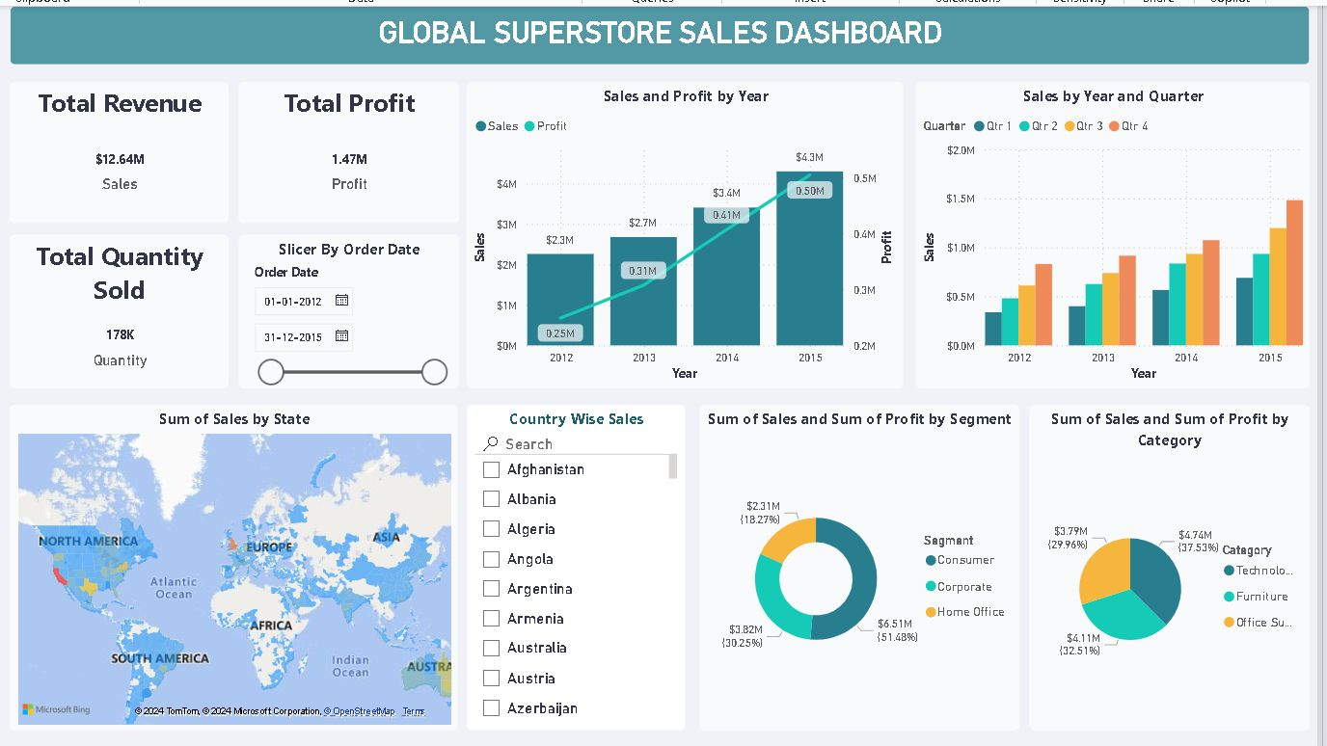

Slide 5
Region & State Level Analysis
Key Filters: Region, Year, State, City, Category, Sub-Category
Metrics displayed:
- Quantity and Profit by city
- Sales and Profit by state and category
- Profit trends by year and category

Slide 6
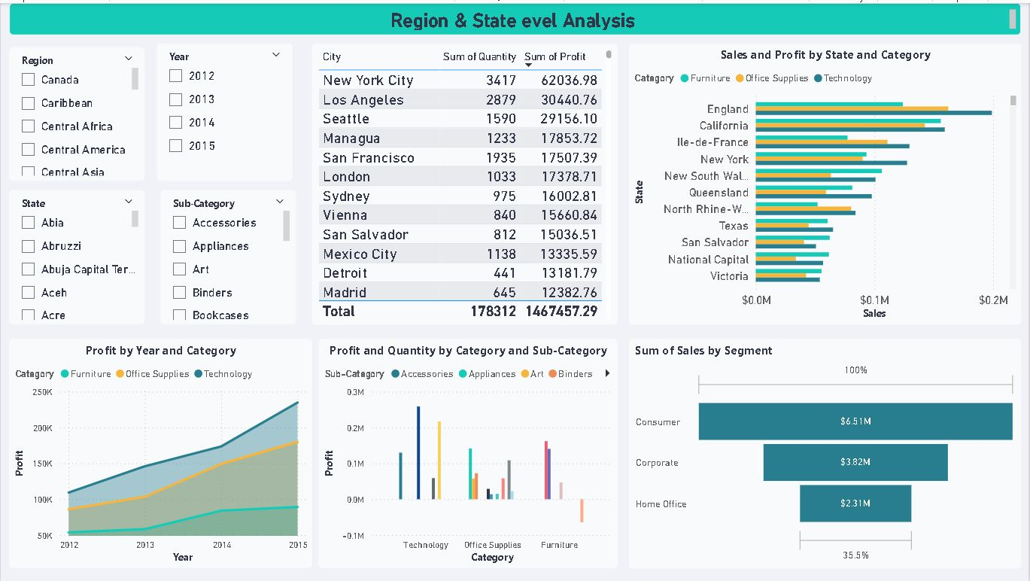

Slide 7
Category & Sub-Category Level Analysis
Overview of analysis by category (Furniture, Office Supplies, Technology) and sub-category.
Metrics displayed include:
- Sales, Profit, and Quantity by sub-category
- Trends by year and quarter

Slide 8
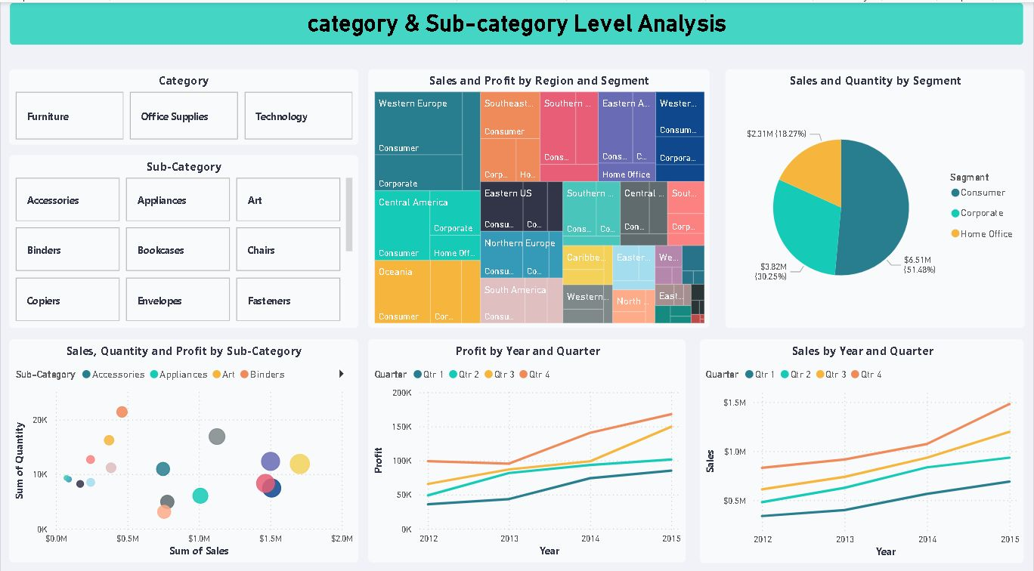

Slide 9
Technologies Used
Technologies utilized in this project:
- Power BI: For creating interactive dashboards
- CSV/Excel: Data sources for sales and profit information

Slide 10
Key Insights
- Top-performing regions and cities by sales and profit
- Yearly profitability and sales trends by category
- Revenue contributions by customer segments
- Seasonal sales trends by quarter

Slide 11
Usage Instructions
1. Clone the repository and load the Power BI file.
2. Open in Power BI Desktop.
3. Use slicers and filters for customized data views.
4. Hover over charts for detailed insights.

Slide 12
Conclusion
The dashboard offers valuable insights for business decision-making by showcasing trends in sales, profitability, and customer segmentation.
Future work could include additional visualizations and deeper analysis.

