Slide 1
Iris Flower Classification Project
Using Machine Learning Techniques

Slide 2
Introduction
Project Overview: Briefly introduce the project and its objectives.
Dataset: Describe the Iris dataset, including the three species (Iris-Setosa, Iris-Versicolor, Iris-Virginica) and the four features (Sepal Length, Sepal Width, Petal Length, Petal Width).

Slide 3
Data Exploration
Exploratory Data Analysis (EDA): Summarize key findings from the data exploration phase.
Distribution of features
Pairplot to visualize relationships between features
Insights about distinct features of Iris-Setosa

Slide 4
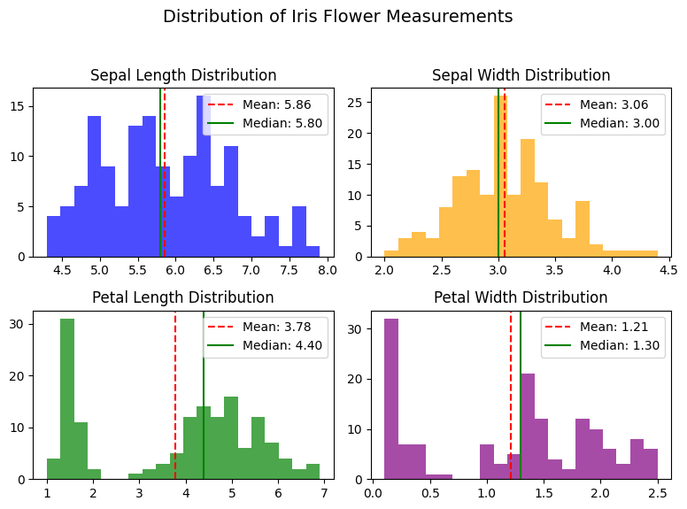
Distribution of features

Slide 5
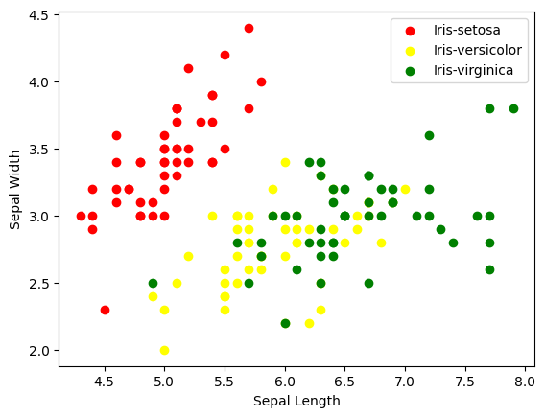
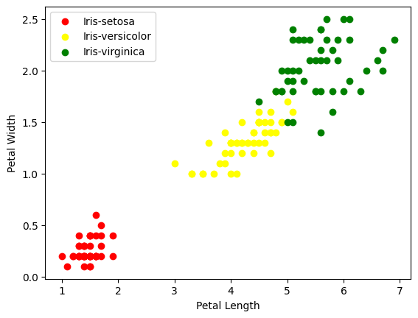
Pairplot to visualize relationships between features

Slide 6
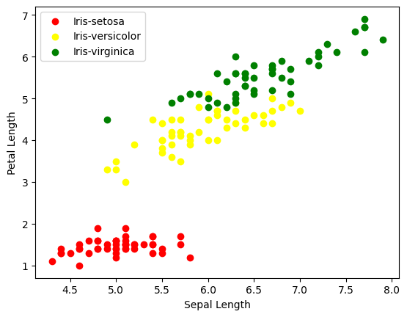
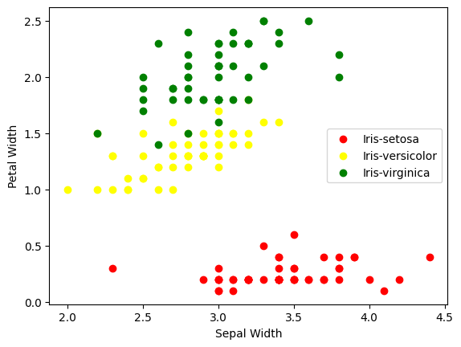

Slide 7
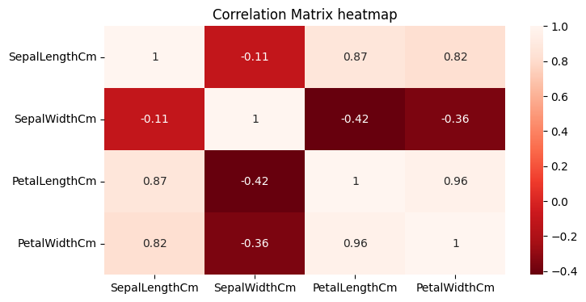
Correlation Heatmap

Slide 8
Data Preprocessing
Steps Taken:
Handling missing values
Encoding categorical variables
Splitting the dataset into training and testing sets

Slide 9
Model Selection
Models Evaluated:
Logistic Regression
Decision Tree
Random Forest
Support Vector Classifier (SVC)
XGBoost
Naive Bayes
Neural Network

Slide 10
Hyperparameter Optimization
Techniques Used:
GridSearchCV
RandomizedSearchCV
Repeated Stratified K-Fold Cross-Validation
Example: Show the hyperparameter grid and the best parameters found for one model.

Slide 11
Model Evaluation
Metrics Used:
Accuracy
Precision
Recall
F1 Score
ROC AUC Score
Primary Metric: Explain why recall and F1 score were chosen as the primary metrics.

Slide 12
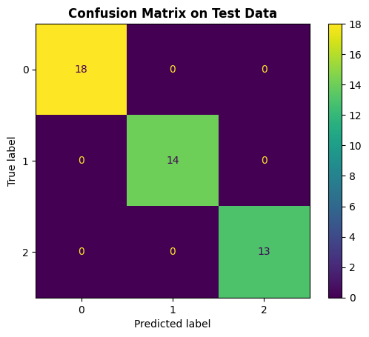
Logistic Regression/SVC/MLP Classifier/XGBClassifier classification report for test data
 | precision | recall | F1-score | suport
0 | 1.00 | 1.00 | 1.00 | 18
1 | 1.00 | 1.00 | 1.00 | 14
2 | 1.00 | 1.00 | 1.00 | 13

Slide 13
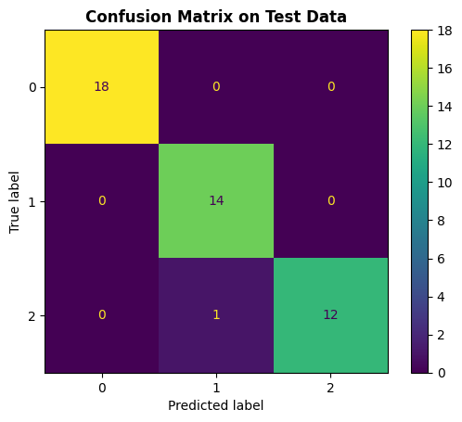
DecisionTree Clasifier/RandomForestClassifier/Naïve Bayes classification report for test data
 | precision | recall | F1-score | suport
0 | 1.00 | 1.00 | 1.00 | 18
1 | 0.93 | 1.00 | 0.97 | 14
2 | 1.00 | 0.92 | 0.96 | 13

Slide 14
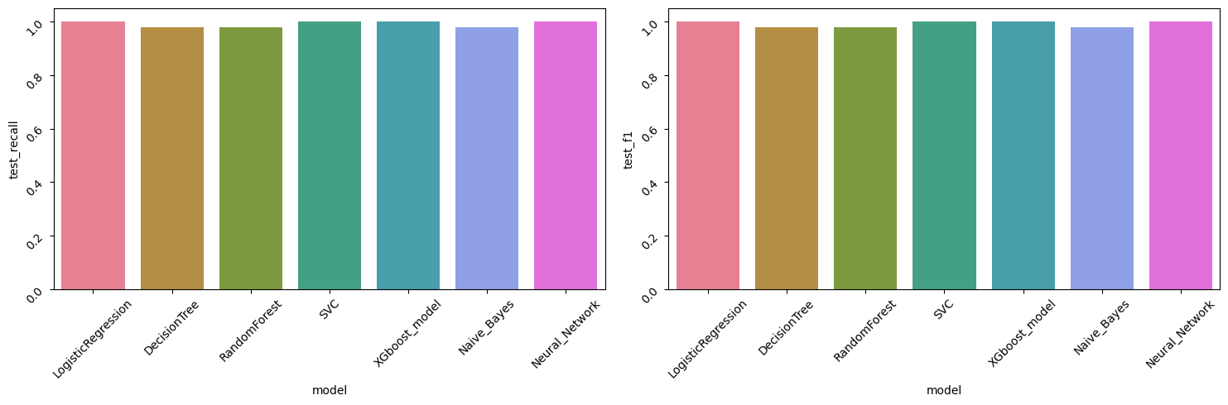
Results Comparison
Bar Charts: Display bar charts comparing test recall and test F1 scores for all models.
Conclusion: Highlight that Logistic Regression had the highest recall and F1 score.

Slide 15
Final Model Selection
Chosen Model: Logistic Regression/SVC/MLP Classifier/XGBClassifier
Reasoning: Emphasize the importance of recall in correctly identifying different Iris species.

Slide 16
Challenges and Future Work
Challenges:
Feature engineering
Model fine-tuning
Future Work:
Exploring advanced modeling techniques
Further improving classification accuracy

Slide 17
Practical Application
Use Cases:
Botany and horticulture
Automating the identification of Iris species based on physical characteristics

Slide 18
Conclusion
Summary: Recap the project's objectives, methods, and findings.
Impact: Discuss the practical implications and potential business impact of the model.

Slide 19
Q&A
Questions: Invite questions from the audience.

