Slide 1
Personalized Healthcare Recommendations Transforming Patient Care with Machine Learning

Slide 2
01
The Future of Healthcare is Personalized
Table of Contents
02
Key Objectives of the Project
03
The Power of Predictive Modeling
04
Enhancing Patient Care
05
The Importance of Data Integration
06
Dataset Preparation: The First Step
07
Uncovering Insights through EDA
08
Crafting Features that Matter
09
Model Selection and Training
10
Evaluating Model Performance
11
Implementing the Recommendation System
12
Thank You for Your Attention!

Slide 3
1
The Future of Healthcare is Personalized
Imagine a world where healthcare is tailored just for you. The Personalized Healthcare Recommendations project harnesses the power of machine learning to revolutionize patient care. By customizing healthcare advice based on individual data, we aim to create a healthier future for everyone. This project stands at the intersection of technology and healthcare, providing innovative solutions to improve patient outcomes. Join us as we explore how personalized healthcare can transform lives and empower patients to take control of their health. Together, we can make healthcare more effective, accessible, and personalized.

Slide 4
2
Key Objectives of the Project
Understanding the core objectives is essential. Our main aims are to develop predictive models, enhance patient care, and ensure effective data integration. Developing a predictive model will allow us to foresee potential health issues based on individual data. Enhancing patient care means providing tailored advice for lifestyle changes and treatment plans, improving overall well-being. Data integration is crucial; we aim to collect and process information from various sources for a comprehensive patient overview. These objectives will form the backbone of our personalized healthcare recommendations.

Slide 5
3
The Power of Predictive Modeling
At the heart of our project is the predictive model. Utilizing advanced algorithms, we aim to forecast health outcomes with precision. By analyzing demographic information and medical history, we can tailor recommendations that resonate with each patient. Predictive modeling enables proactive healthcare, shifting from reactive to preventive measures. The insights gained from this modeling can significantly impact patient lives, providing them with timely advice. In essence, we are paving the way for a healthier future through data-driven insights.

Slide 6
4
Enhancing Patient Care
Personalized advice is a game changer. We focus on individual lifestyle choices to recommend actionable changes. By considering biometric data and lab results, our recommendations become more relevant and impactful. Patients will receive advice on preventive measures tailored to their unique health profiles. This approach not only improves health outcomes but also fosters a sense of agency in patients regarding their health. Ultimately, enhancing patient care is about creating a more supportive healthcare environment.

Slide 7
5
The Importance of Data Integration
Data is the foundation of personalized healthcare. We aggregate data from electronic health records, wearable devices, and patient surveys. This integration ensures a holistic view of each patient, allowing for more tailored recommendations. Processing diverse data sources enhances the accuracy and relevance of our insights. A comprehensive patient profile is essential for effective personalized healthcare solutions. Through data integration, we unlock the potential for smarter healthcare delivery.

Slide 8
6
Dataset Preparation: The First Step
Before analysis, dataset preparation is critical. We collect and preprocess patient data, ensuring it's clean and normalized. Key features such as age, gender, and lifestyle factors are considered to form a robust dataset. This preparation lays the groundwork for subsequent analysis and modeling efforts. By ensuring high data quality, we can derive more accurate insights and recommendations. Preparation is not just a step; it's a launchpad for our analytical journey.

Slide 9
7
Uncovering Insights through EDA
Exploratory Data Analysis (EDA) is where we dive deep into the data. We use statistical methods and visualization to identify patterns. Through EDA, we can uncover correlations and predictive factors that inform our model development. This step transforms raw data into actionable insights, driving our understanding of patient health. Visualizing data helps us communicate findings and reinforces the significance of our models. Ultimately, EDA equips us with the knowledge needed to inform our personalized recommendations.

Slide 10
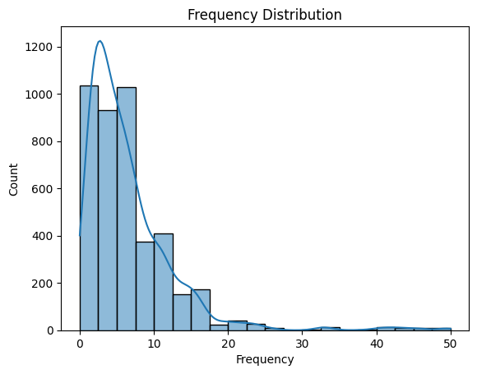
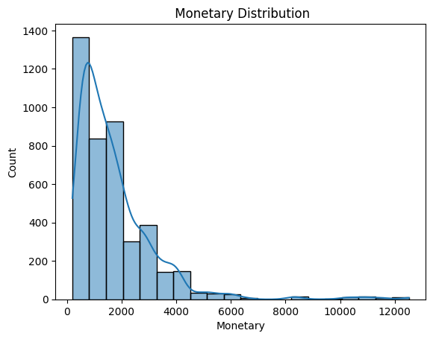
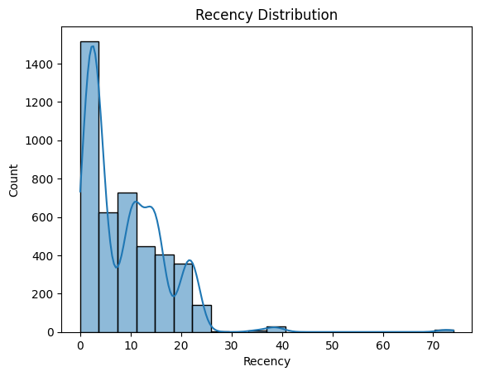
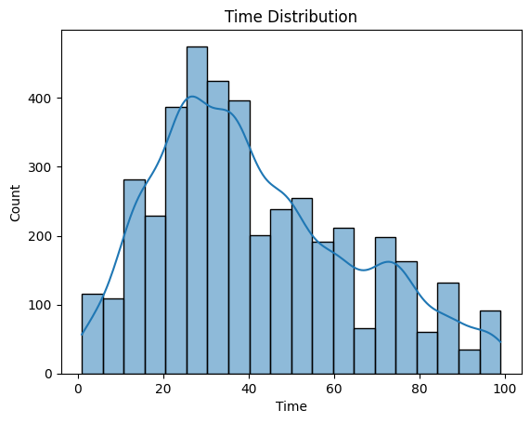

Slide 11
8
Crafting Features that Matter
Feature engineering is an art and science. We aim to enhance model accuracy by selecting and developing relevant features. Creating health indices and composite scores allows us to represent patient conditions effectively. Focused feature selection ensures that our models are both interpretable and powerful. By refining our dataset, we enhance our predictive capabilities and the overall reliability of our recommendations. Strong features lead to stronger models, driving better patient outcomes.

Slide 12
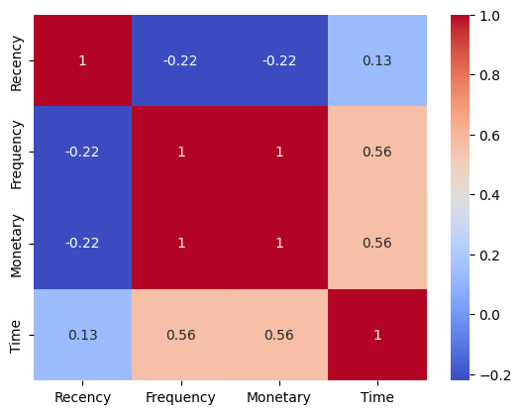
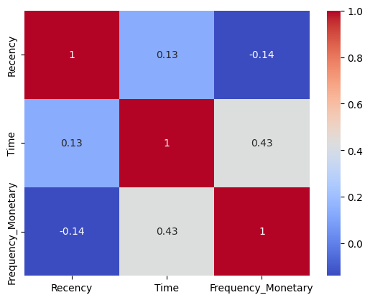
Correlation Before Vs After Feature Engineering

Slide 13
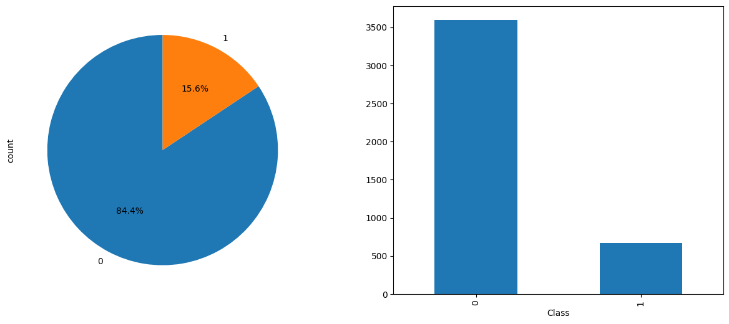
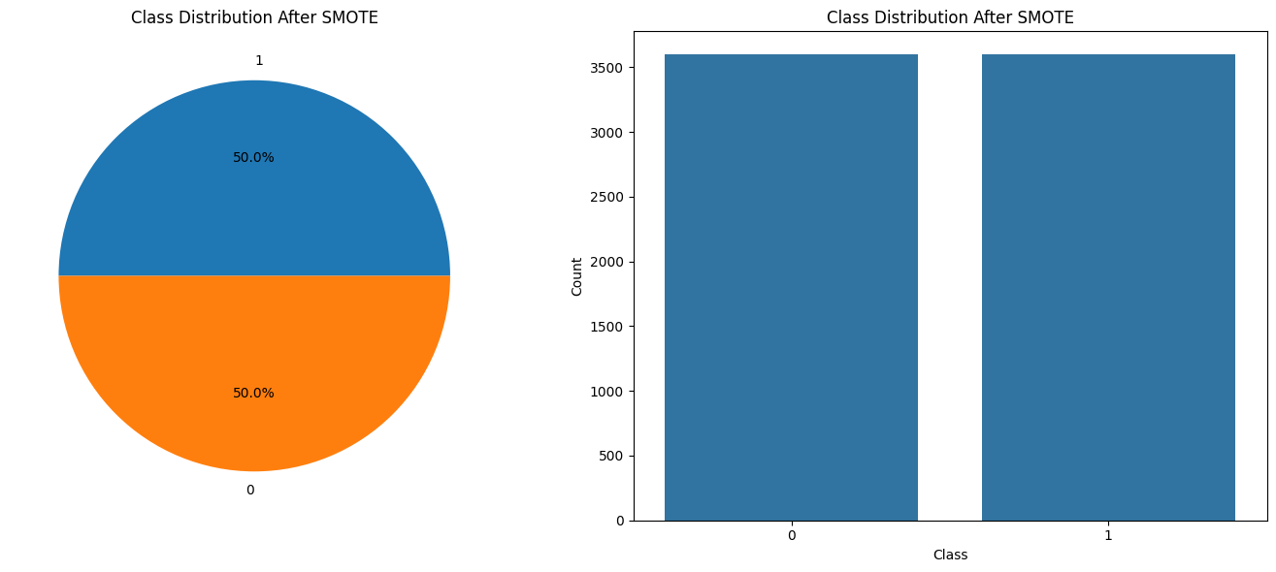
Handling Class Imbalance
One of the major issues when dealing with unbalanced datasets relates to the metrics used to evaluate their model. Using simpler metrics like accuracy score can be misleading. In a dataset with highly unbalanced classes, the classifier will always “predict” the most common class without performing any analysis of the features and it will have a high accuracy rate, obviously not the correct one.

Slide 14
9
Model Selection and Training
Our approach includes experimenting with various models: Logistic Regression, Random Forest, Gradient Boosting, and more. Training these models involves rigorous validation to identify the best performer based on accuracy and other metrics. We aim for precision, recall, and F1-score to ensure our models are not just accurate but also reliable. Model performance metrics guide us in selecting the most effective algorithms for our purpose. Training is a journey of discovery, uncovering the best solutions for personalized healthcare.

Slide 15
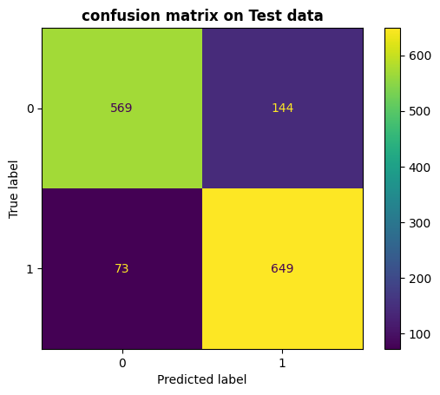
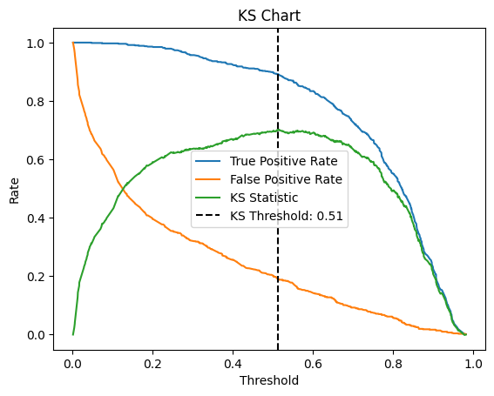
Classification Report of Best Performing Model
1. Xgboost Model
 | precision | recall | F1-score | support
0 | 89.00 | 80.00 | 84.00 | 713
1 | 82.00 | 90.00 | 86.00 | 722

Slide 16

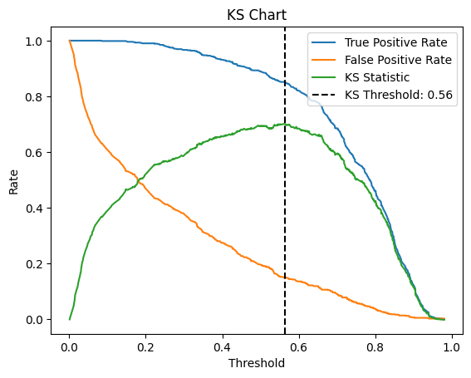
2. LGBM Classifier
 | precision | recall | F1-score | support
0 | 88.00 | 81.00 | 84.00 | 713
1 | 82.00 | 89.00 | 85.00 | 722

Slide 17

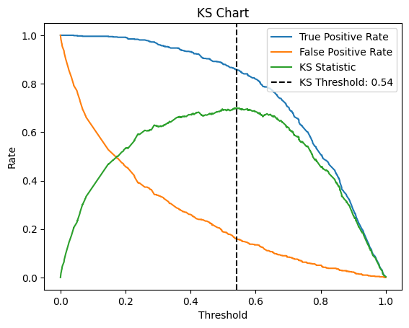
3. Random Forest Classifier
 | precision | recall | F1-score | support
0 | 87.00 | 81.00 | 84.00 | 713
1 | 83.00 | 88.00 | 85.00 | 722

Slide 18
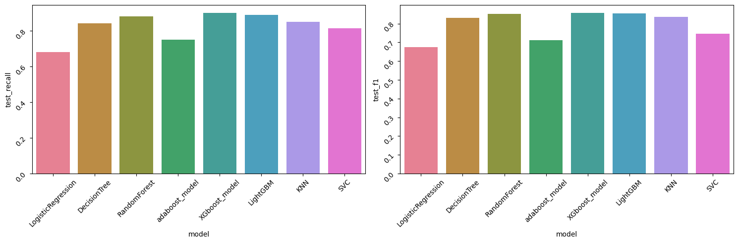
Evaluating Model Metrices

Slide 19
10
Evaluating Model Performance
Evaluation is crucial. We rigorously test our selected models using cross-validation and various datasets. Visualizing performance through confusion matrices and ROC curves ensures model reliability. Evaluating our model provides confidence in its effectiveness, paving the way for real-world application. Strong performance metrics demonstrate our commitment to quality and patient care. This rigorous evaluation process solidifies our recommendations as reliable and impactful.

Slide 20
11
Implementing the Recommendation System
Finally, we develop the algorithm that translates model predictions into actionable healthcare recommendations. This system aims to deliver personalized advice that patients can implement in their lives. The recommendation system is the practical application of our analysis, turning insights into actions. By focusing on individual needs, we empower patients to make informed health decisions. The implementation marks the culmination of our efforts towards personalized healthcare.

Slide 21
12
Thank You for Your Attention!
Thank you for joining us on this journey through personalized healthcare recommendations! We believe in the power of individualized healthcare and its ability to transform lives. Let’s work together to make healthcare more accessible and tailored to everyone’s needs. Your engagement is vital as we continue to innovate and improve patient care. Together, we can pave the way for a healthier world.

