Slide 1
Functional Requirements
Presented by: participant 4, Market Expert

Slide 2
Method
In our usability lab we observed the remote control use among 100 subjects
They also filled in a questionnaire.

Slide 3
Findings
75% of users find most remote controls ugly
80% of users would spend more money when a remote control would look fancy
80% of users would spend more money when a remote control would look fancy
80% of users would spend more money when a remote control would look fancy

Slide 4
Findings
The biggest frustrations users expressed:
  Remote controls are often lost somewhere in the room (50%)
  It takes too much time to learn how to use a new remote control (34%)
  Remote controls are bad for RSI (26%)

Slide 5
Findings
Questions asked:
Would you prefer an LCD screen on a multifunction remote control?
Would you pay more for speech recognition in a remote control?

Slide 6
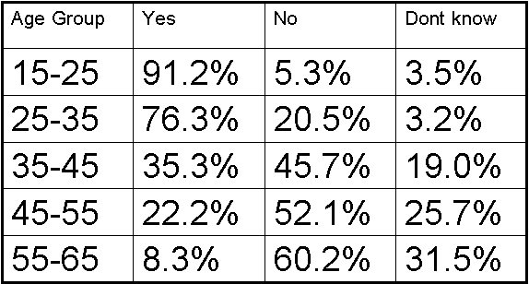
Results

Slide 7
Personal Preferences
Lightening in the dark
Not too many buttons
A way to find it easily

