Slide 1
REMOTE CONTROL
Presented by:
- Mark Twight, Rama Rao -

Slide 2
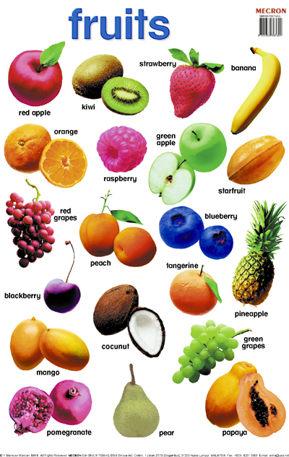
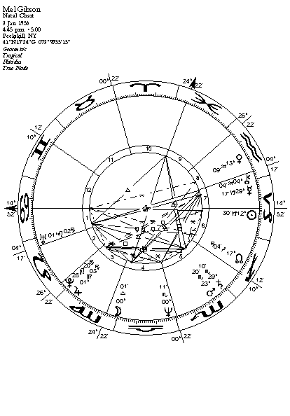

Slide 3

Perfect.
I’ll buy it.
Splendid.
Yes.
TITANIUM

Slide 4
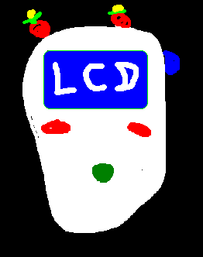
Prototype
Function
Position
Material
Form
Color

Slide 5
Function
Power ON/OFF
Volume control
LCD controls
Speech Recognizer
Location

Slide 6
Position
strawberry

Slide 7
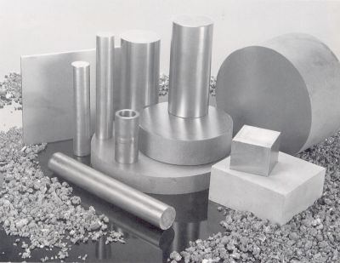
Material
Ultimate fruit-smelling spongy titanium alloy

Slide 8
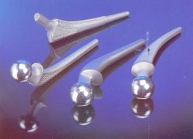
Form
- Simply perfect.

Slide 9
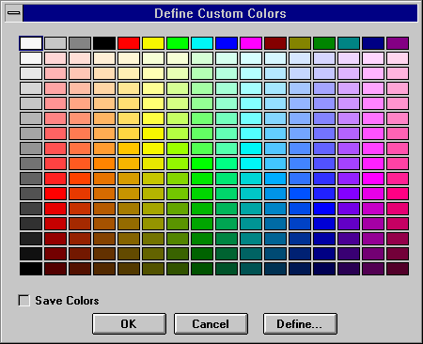
Color
Monday
Tuesday
Wednesday
Thursday
Friday
Saturday
Sunday
Sunday
Sunday
……

Slide 10
Party
Welcome.

