Slide 1
Interface Concept
Presented by: Mark Twight,
User Interface Designer

Slide 2
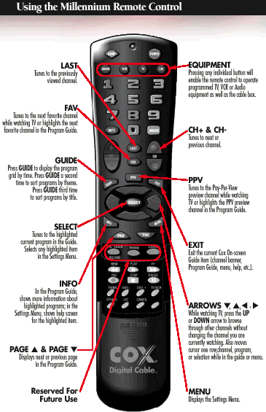
NO

Slide 3

Perfect.
I’ll buy it.
Splendid.
Yes.

Slide 4
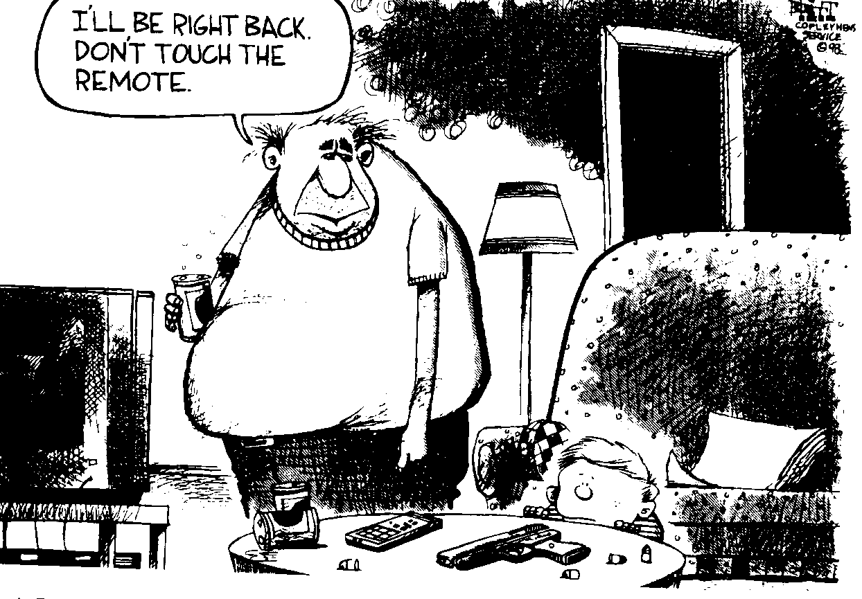
- SHOULD THE REMOTE CONTROL PROVIDE ANY ADVANCED REACTIONS?

