Slide 1
Functional Requirements
Presented by: Samy Bengio, Market Expert

Slide 2
Method
Ask the users themselves about
  What they like
  What they don’t like
  In current remote controls
  And what they DO with them

Slide 3
Findings
Users dislike the look-and-feel of current remote controls
  75% of users find most remote controls ugly
  80% of users would spend more money when a remote control would look fancy
  Current remote controls do not match well the operating behavior of the user
  75% of users said they zap a lot
  50% of users say they only use 10% of the buttons

Slide 4
The biggest frustrations users expressed
Remote controls are often lost somewhere in the room (50%)
It takes too much time to learn how to use a new remote control (34%)
Remote controls are bad for RSI (26%)

Slide 5
Functions used
Power not often but very relevant
Channel selection often and very relevant
Volume selection not often and very relev
Audio settings not often not relevant
Screen settings not often not relevant
Teletext not often but relevant
Channel settings not often not relevant

Slide 6
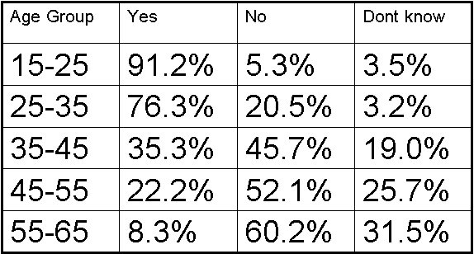
Speech Reco in the remote

