Slide 1
Working Design
Presented by: Christine
Industrial Designer

Slide 2
Method
Identify User requirements
  Turn television on and off the first time you press on the big button
  Easy to find and hold
Identify things that are popular
  iPod
  Nokia camera phone
Determine the materials to use

Slide 3
History
Zenith engineer Eugene Polley invented the "Flashmatic," which represented the industry's first wireless TV remote.
Introduced in 1955, Flashmatic operated by means of four photo cells, one in each corner of the TV screen. The viewer used a highly directional flashlight to activate the four control functions, which turned the picture and sound on and off and changed channels by turning the tuner dial clockwise and counter-clockwise.
While it pioneered the concept of wireless TV remote control, the Flashmatic had some limitations.
  It was a simple device that had no protection circuits and, if the TV sat in an area in which the sun shone directly on it, the tuner might start rotating.

Slide 4
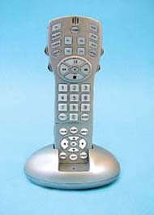
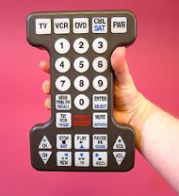
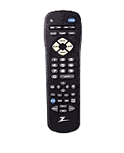
Findings

Slide 5
Components
Wire
Switch
Energy source
Bulb
Infrared bulb
Chip
Subcomponent

Slide 6
Personal Preferences
Inflatable (so that the size can vary according to user preferences)
Colorful or Transparent
Waterproof
Beeps (loudly) or plays a tune
Long battery life

