Slide 1
Trend Watching
Presented by: Marketing Expert

Slide 2
Method
<We have been giving sample questionnaires in various areas to be able to make decisions as to what consumers are looking for.>

Slide 3
Findings
The market trend is toward « fancy and feel good » style of remotes.
Consumers are looking for the « next » major inovation.
Easy to use has again become a major interest with consumers.
Consumers are willing to pay for new, exciting technology.

Slide 4
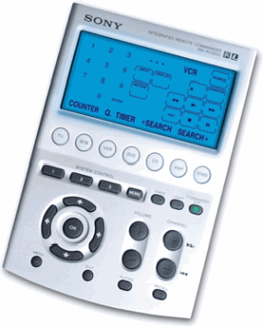
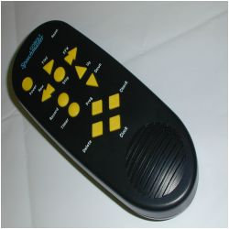
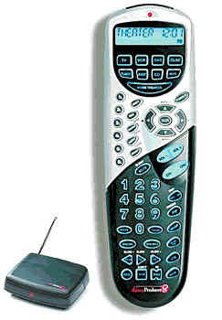
Personal Preferences

