Slide 1


B. Tech. Project AY 2026-27
ESE Presentation
Project ID: Group 12
Title of the Project: InfluenceIQ — Offline Decision-Discussion Detection with Source-Linked Meeting Review
Name of the Guide: Dr. Nivedita Mishra
Group Members:
  Anushka Chatterjee (23070126015)
  Amitkumar Racha (24070126501)
  Sahil Awatramani (23070126112)
  Shriyans Sahoo (23070126125)
20-10-2026
Department of Artificial Intelligence & Machine Learning

Slide 2

Introduction
  Meeting recordings preserve proposals, explanations and decisions, but finding the relevant passage means manually scrubbing through audio.
  Speech-recognition errors change the words an extractor sees; speaker-attribution errors credit a contribution to the wrong person.
  A useful review tool therefore needs an explicit evaluation target and a trace back to the original recording.
InfluenceIQ
An offline meeting-analysis system: local speech processing + a supervised discussion detector + source-linked evidence review.
47
AMI meetings with manual discussion annotations
4
classifier families compared under one split
597
automated regression tests passed
20-10-2026
Department of Artificial Intelligence & Machine Learning

Slide 3
Problem Statement
Given a meeting recording, locate the passages that belong to a decision discussion — offline, on local hardware — and present each suggestion with its original text, speaker and timestamp so a human can verify it.
Noisy inputs
Discussion ≠ decision
Multilingual meetings
ASR word errors and diarization errors propagate into every downstream label.
A passage can concern a decision without recording a final agreement or action.
Hindi and Hinglish speech must be handled honestly by an English-trained detector.
20-10-2026
Department of Artificial Intelligence & Machine Learning

Slide 4
Objectives of the Project
1
Offline workflow: Local speech recognition, diarization and optional slide (PPTX) alignment with no remote inference.
2
Discussion detector: Test whether ±40-act lexical context and a forest/linear score mix beat matched lexical classifiers.
3
Source-linked evidence: Keep segment IDs, verbatim text, speaker labels and timestamps with audio seek for review.
4
Speech-error analysis: Measure WER/CER and diarization error, including Hindi and Hinglish pilots.
5
Transparent reporting: Report rejected and negative results instead of a single combined accuracy figure.
20-10-2026
Department of Artificial Intelligence & Machine Learning

Slide 5
Project Plan with Timeline
1
Literature survey & scoping
2
Data preparation
3
Detector modelling
Meeting assistants, Whisper, diarization, multilingual benchmarks
AMI project-separated split; FLEURS Hindi & MUCS Hinglish samples
4 classifier families × 2 lexical representations
Period: add month(s)
Period: add month(s)
Period: add month(s)
4
Score combination
5
Speech & diarization pilots
6
Integration, testing & paper
Forest/linear mixture, smoothing and threshold on development data
ASR model comparison; diarization threshold calibration
Browser review, exports, 597-test regression, ESE report
Period: add month(s)
Period: add month(s)
Period: add month(s)
Phases run sequentially across AY 2026–27; each later phase builds on frozen selections from the previous one.
20-10-2026
Department of Artificial Intelligence & Machine Learning

Slide 6
Literature Review
Work | Focus | Relevance to InfluenceIQ
Tur et al. 2010 — CALO | Transcription + semantic interpretation | Broader assistant; we bound the task to discussion review
Radford et al. 2023 — Whisper | Multilingual ASR, weak supervision | Basis of the local faster-whisper recogniser
Bain et al. 2023 — WhisperX | Time-accurate long-form ASR | Motivates alignment; full pipeline not used
Bredin 2023; Plaquet & Bredin 2023 | pyannote diarization; overlap-aware powerset | Report speaker attribution separately
Macháček et al. 2023 | Streaming Whisper commit policies | We use bounded preview windows + full post-capture pass
DISPLACE 2023/24; Vistaar 2023 | Multilingual diarization; Indian-language ASR | Motivate code-switched meeting evaluation
MeetingBank 2023; ExplainMeetSum 2023 | Meeting summarisation; evidence-aligned summaries | We give extractive, source-linked suggestions instead
20-10-2026
Department of Artificial Intelligence & Machine Learning

Slide 7
Gap in the Research / Technology / Methodology
Weak traceability
Cloud dependence
Generated summaries rarely link each claim back to the exact segment, speaker and timestamp.
Most meeting assistants rely on remote inference, which conflicts with local, private review.
Non-comparable scores
Hidden error propagation
Published summarisation and diarization scores are not baselines for binary discussion membership.
ASR and diarization errors are seldom reported separately, and Hindi–English meetings are under-evaluated.
20-10-2026
Department of Artificial Intelligence & Machine Learning

Slide 8
Description of the Proposed Solution
Audio recording
Optional PPTX
  Recognition is cached separately from speaker attribution, so speaker fixes reuse saved words.
  Scores are ranking signals, not calibrated probabilities.
Local ASR + speakers
Text + available times
Source passages and slide links
Word cache · segment IDs · timestamps
Separate outputs
Rule-based decision events and exploratory influence scores
Learned English discussion review
Forest + linear scores · audio seek
Fig. Local processing and source-linked review (adapted from the report, Fig. 1)
20-10-2026
Department of Artificial Intelligence & Machine Learning

Slide 9
Requirement Analysis
Functional
Non-functional
  Upload or record meeting audio
  Local ASR and full-recording diarization
  Speaker renaming that reuses cached words
  PPTX text, table and notes extraction with passage-to-slide links
  Discussion suggestions with text, speaker, timestamp and seek
  Rule-based events: proposals, questions, objections, agreements, decisions, actions
  Exports that retain source information
  Offline: local CPU inference with 8-bit integer computation
  Traceability of every suggestion to its source
  Explicit stage status for unsupported languages or missing models
  Batched runtime feature extraction
  English/Hindi language constraint for automatic detection
  Reproducibility: split membership, source hashes and frozen selections retained
20-10-2026
Department of Artificial Intelligence & Machine Learning

Slide 10
Technology Stack
Speech recognition
Speaker diarization
faster-whisper: small, medium, large-v3-turbo · int8 on CPU · beam size 5
Sherpa-ONNX speaker backend, threshold calibrated to 0.9
Text features
Classifiers
TF-IDF: word 1–2-grams (12k) + character 3–5-grams (20k)
Logistic regression, Complement Naive Bayes, linear SVM, random forest
Slide processing
Review interface
PPTX text, tables, notes; lexical or embedding similarity
Browser review with audio seek; source-preserving exports
Datasets
Evaluation
AMI Meeting Corpus · FLEURS Hindi · MUCS 2021 Hinglish
P / R / F1, AP, MCC, ROC-AUC · WER / CER · DER / JER
20-10-2026
Department of Artificial Intelligence & Machine Learning

Slide 11
Design: Discussion Detector
Dialogue act
Score combination
1
Positive if ≥ 50% of its words lie in an annotated decision-discussion span
sᵢ = 0.75·fᵢ + 0.25·lᵢ
Local features
Smoothing and decision
2
Word + character TF-IDF, fitted on training text only
ŷᵢ = 1[ mean of sⱼ over N(i) ≥ 0.3577 ]
Context-40
  N(i): current act plus at most 5 acts on either side, within one meeting
  Weights, radius and threshold chosen on development data only
  Future context makes this an offline detector
3
Append lexical context from ±40 acts, never crossing meeting boundaries
Component scores
4
Random forest f(i) and logistic regression l(i)
20-10-2026
Department of Artificial Intelligence & Machine Learning

Slide 12
Development / Implementation
Partition | Meetings | Acts | Positive acts
Training | 29 | 20,339 | 5,862
Development | 6 | 3,739 | 1,117
Historical | 12 | 11,136 | 2,481
Matched search per classifier
  3 predefined parameter values per family
  Smoothing radii 0, 5, 15; 13 development-score quantile thresholds + 0.5
  Selection by pooled development F1
  Forest: 100 trees, min leaf size 2, depth grid; balanced bootstrap weights
  SVM: sigmoid calibration on 3 project-separated folds
  Mixture weights searched over 0, 0.25, 0.5, 0.75, 1
  AMI meetings split by project series; a series never spans two partitions
  Historical cohort = 3 independent series, so treated as exploratory, not a fresh test
  Historical labels excluded from fitting and threshold selection
20-10-2026
Department of Artificial Intelligence & Machine Learning

Slide 13
Testing & Debugging
597
Model changes tested and rejected
Trial | Dev F1 | Hist. F1 | Hist. AP | Outcome
Semantic / continuity features | — | — | — | No candidate passed
Calibrated forest + NB | 60.75 | 52.93 | 45.91 | Rejected
Refit on 35 meetings | — | 53.72 | 48.70 | Rejected
regression tests passed in the latest software run
Integration checks cover
batched scoring, meeting boundaries, source preservation, missing-model behaviour, report exports and browser review
  Non-regression rule: a change is kept only if it does not degrade the declared development metrics
  Cached real-transcript smoke checks confirm execution and traceability only
20-10-2026
Department of Artificial Intelligence & Machine Learning

Slide 14
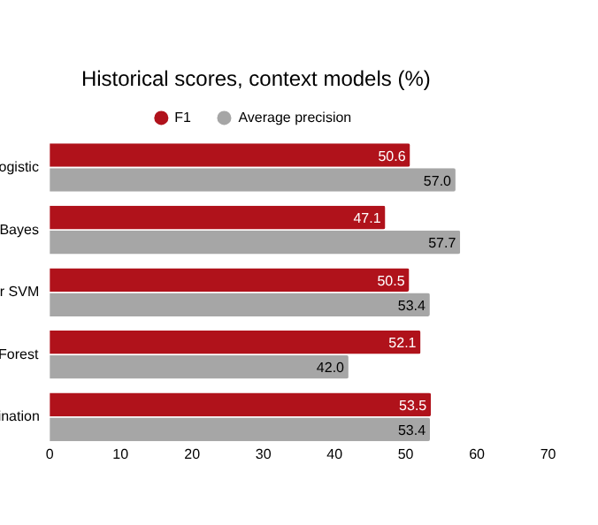
Project Outcome: Discussion Detection
39.94%
Precision
81.18%
Recall
53.54%
F1 on 11,136 acts
  +1.46 pp F1 over the matched forest; bootstrap interval −7.16 to +5.99 pp
  ROC-AUC 80.03%, MCC 0.386
20-10-2026
Department of Artificial Intelligence & Machine Learning

Slide 15
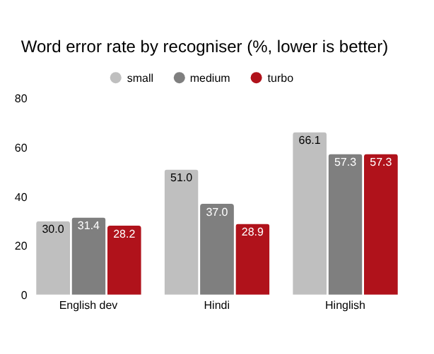
Project Outcome: Speech and Speakers
Diarization pilot (AMI excerpts)
Metric | Thr 0.5 | Thr 0.9
Diarization error % | 64.08 | 40.91
Jaccard error % | 69.60 | 60.45
Speech F1 % | 85.89 | 85.98
Speaker-count MAE | 8.50 | 1.50
Calibrating the threshold to 0.9 on development excerpts cuts fragmentation; speech-region detection barely changes.
Turbo cuts Hindi WER from 50.96% to 28.85%, but historical English worsens (61.61% → 63.91%), so small stays the default.
20-10-2026
Department of Artificial Intelligence & Machine Learning

Slide 16
Conclusion
  InfluenceIQ delivers offline meeting processing with source-linked discussion suggestions and human review.
  The development-selected forest/linear mix reaches 53.54% historical F1 on oracle transcripts, with precision and ranking trade-offs.
  Turbo ASR gives large Hindi gains but regresses on historical English, so model choice stays explicit.
  Negative trials, provenance and missing downstream metrics remain visible.
Future work
  Independent, group-separated, recording-level annotations
  Separate human-transcript, recognised-transcript and fully automatic evaluation
  Annotated slide references, decisions and contribution rankings
  Controlled runtime, memory and physical-phone measurements
20-10-2026
Department of Artificial Intelligence & Machine Learning

Slide 17
References
[1] G. Tur et al., “The CALO meeting assistant system,” IEEE Trans. ASLP, 2010.
[2] A. Radford et al., “Robust speech recognition via large-scale weak supervision,” ICML, 2023.
[3] M. Bain et al., “WhisperX: Time-accurate speech transcription of long-form audio,” Interspeech, 2023.
[4] H. Bredin, “pyannote.audio 2.1 speaker diarization pipeline,” Interspeech, 2023.
[5] A. Plaquet and H. Bredin, “Powerset multi-class cross entropy loss for neural speaker diarization,” Interspeech, 2023.
[6] D. Macháček et al., “Turning Whisper into real-time transcription system,” IJCNLP–AACL Demos, 2023.
[7] S. Baghel et al., “The DISPLACE challenge 2023,” Interspeech, 2023.
[8] S. B. Kalluri et al., “The second DISPLACE challenge,” Interspeech, 2024.
[9] K. Bhogale et al., “Vistaar: Diverse benchmarks and training sets for Indian language ASR,” Interspeech, 2023.
[10] Y. Hu et al., “MeetingBank: A benchmark dataset for meeting summarization,” ACL, 2023.
[11] H. Kim et al., “ExplainMeetSum: Explainable meeting summarization,” ACL, 2023.
[12] J. Carletta et al., “The AMI meeting corpus: A pre-announcement,” MLMI, LNCS 3869, 2006.
[13] A. Conneau et al., “FLEURS: Few-shot learning evaluation of universal representations of speech,” arXiv:2205.12446, 2022.
[14] A. Diwan et al., “MUCS 2021: Multilingual and code-switching ASR challenges,” Interspeech, 2021.
[15] OpenAI, “Whisper large-v3-turbo,” model card, accessed Oct. 2026.
20-10-2026
Department of Artificial Intelligence & Machine Learning

Slide 18
Photograph of the Presentation
20-10-2026
Department of Artificial Intelligence & Machine Learning

