Slide 1

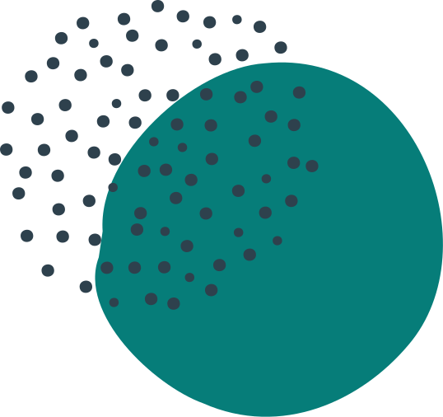
LEAG
LEARN ENGLISH AND GROW
Presentation by name
roll no..

Slide 2

Motivation for choosing this project
There are lots of English learning app in Google play store. you can download hundreds of them but still you will lag in speaking English when you face the real world. where you need confidence for talking with humans.
Now, question comes how they can start?
If you will start now speaking broken English then everyone will laugh
on you and hence confidence will be degraded by this. Also I had seen many my classmates who can score like 80+ in English subject but still they can't speak English in person.
So, here comes the REAL solution. I am working upon a project which can solve this real life problem. there you will find a huge space which may help you to enhance your confidence while speaking.

Slide 3
Introduction
English language play a crucial role in our day to day life.
English language is an official language which is used in many different countries across the world.
So it's very important to know English language in this era.
Now, with learning something new, there comes some problems in our path
We can spend lots of money and time to learn bookish knowledge
But how can we conquer real world ? Is it sufficient to learn all that present tense, past tense, future tense to speak so confidently in any interview, in any meeting, in public speaking events?
Answer is a straight no. Until or unless you get the confident to face the real world and speak whatever comes to mind in English with the fluency.
That's why I have designed this website named LEAG.
Here you will not find notes, quizzes, or any sort of bookish knowledge.
But people just like you who want to learn English and build that confident by interacting with you.
By speaking some broken English with you and ya they will not laugh on you ,rather they will be learning here with you.

Slide 4
EASY INTERACTION
DICTIONARY FEATURE
RESPONSIVE WEB DESIGN
You just have to create account here and then you can interact with people across the globe. And don't worry about what to say. Just consider that here you are to improve your speaking skills
We have the feature through which you can have dictionary in your hand. So that you can correct and improve your english vocabulary while
interaction.
It's responsive web design can adapt to the size of the visitor's viewport. The primarily benefit of responsive web design is that sites load quickly without any distortions, so users don't need to manually resize anything to view content.
TELL YOUR STORY
WRITE POSTS
COMMENT THAT YOU LIKE
Once you get familiar, you will find a space of posts where you can tell your story by writing posts it can be an inspiration for other people .
Telling your story helps you make sense of your life. Once you succeed to overcome your fear and able to speak with fluency then there comes the time to share your whole journey from coping up problems and achieving goals.
Like, comment, delete (Only personal posts) and share functionality.

Slide 5






FRONTEND
BACKEND
HTML,CSS,JAVASCRIPT,REACT JS
NODE.JS,EXPRESS JS,MONGODB,REST API
The front end of a website is the part that users interact with. Everything that you see when you’re navigating around the Internet, from fonts and colors to dropdown menus and sliders, is a combo of HTML, CSS and JavaScript being controlled by your computer’s browser.
So what makes the front end of a website possible? Where is all that data stored? This is where the back end comes in. The back end of a website consists of a server, an application, and a database.

Slide 6



Tools used
Visual Studio Code
Postman
Google Chrome

Slide 7
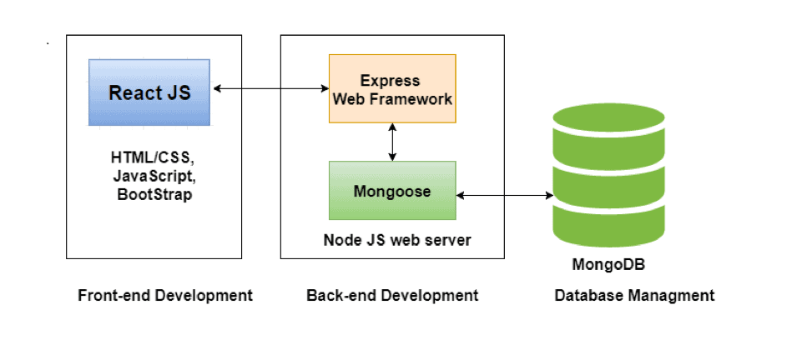
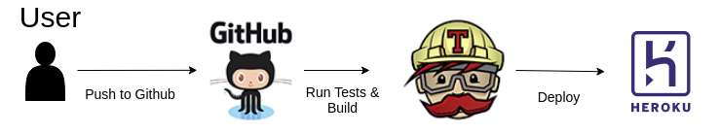
WORKFLOW
DEPLOYMENT PROCESS

Slide 8
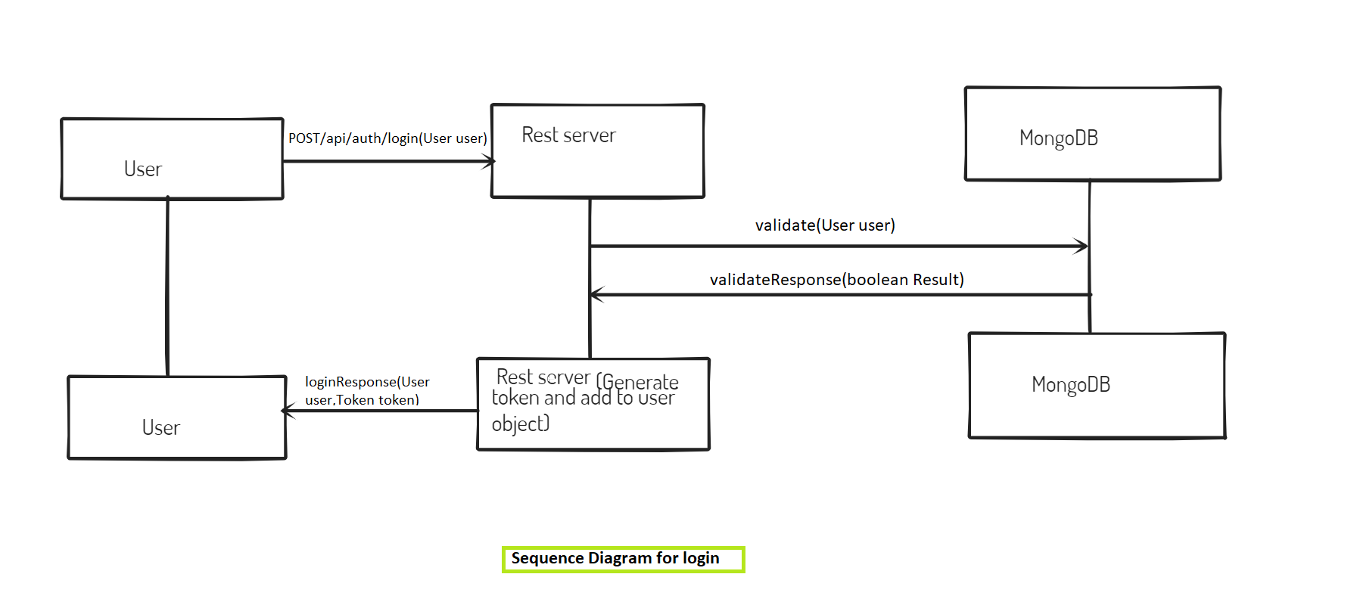
LOGIN FLOW

Slide 9
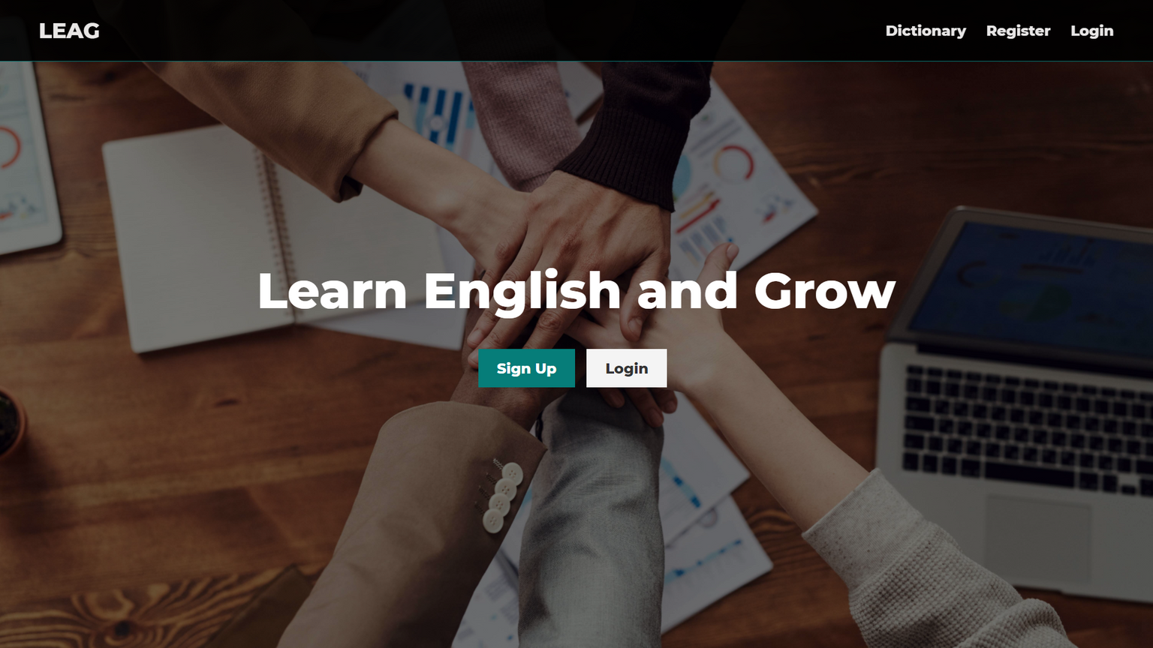
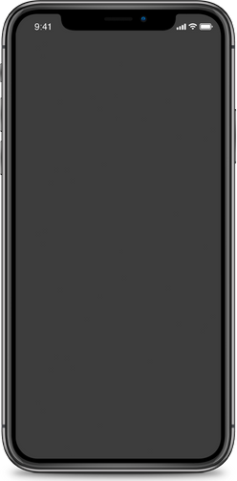
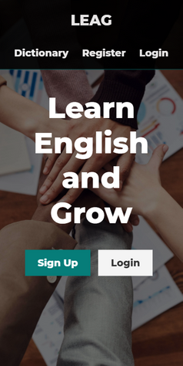
LANDING PAGE
MOBILE VIEW
DESKTOP VIEW

Slide 10
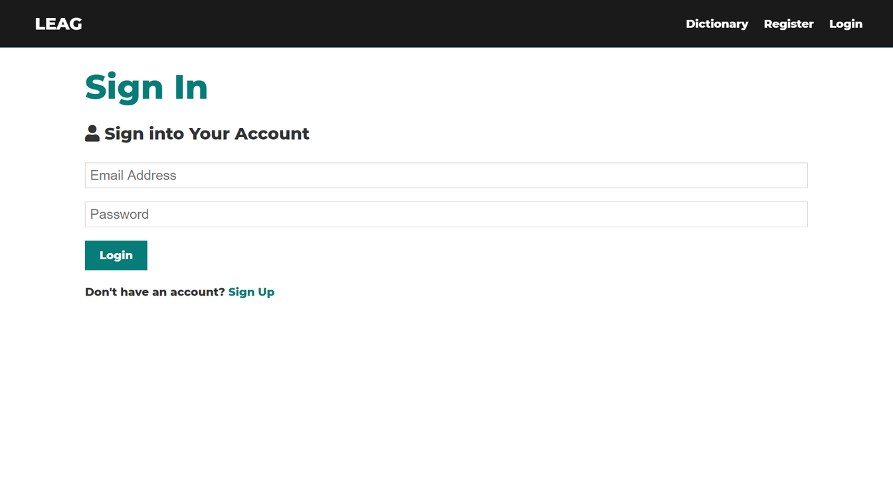
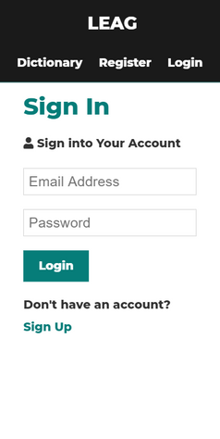
LOGIN PAGE
MOBILE VIEW
DESKTOP VIEW

Slide 11
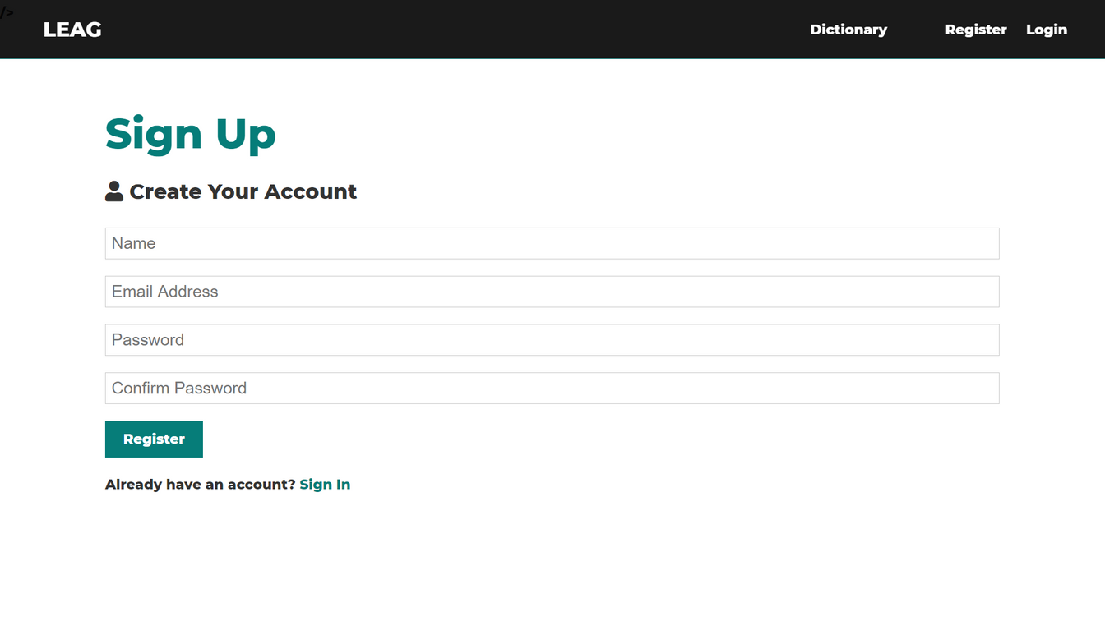
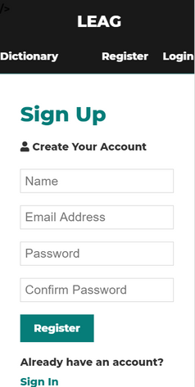
REGISTER PAGE
MOBILE VIEW
DESKTOP VIEW

Slide 12
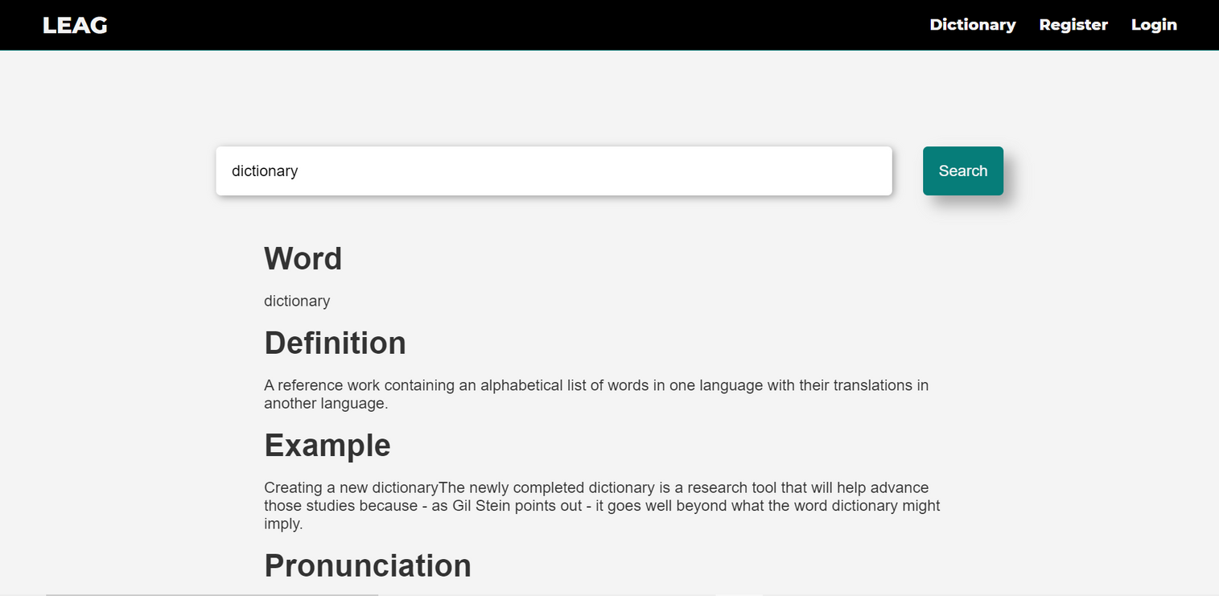
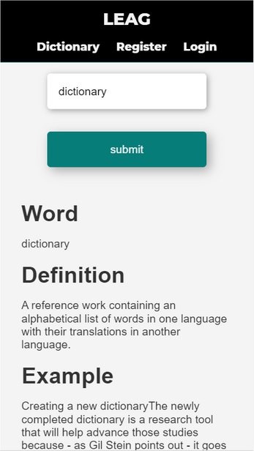
DICTIONARY
MOBILE VIEW
DESKTOP VIEW

Slide 13

http://welcometoleag.herokuapp.com
THANK YOU!
FINAL WORD

