Slide 1

Project Title - Car Market Trends Analysis using CarDekho Data A Data Analytics Case Study on Used Car Pricing Patterns
Name : Amit Kushwaha
AICTE Internship Student Registration ID : STU67a830e92f94c1739075817
B.Tech CE-AIML, 3nd Year
VOIS × Vodafone Idea Foundation Minor Project

Slide 2

PROBLEM STATEMENT
The used-car market in India is largely unorganized, so buyers and sellers lack a data-driven benchmark for fair pricing
Resale value depends on multiple interacting factors — age, fuel type, transmission, kms driven, ownership history — that are hard to judge manually
Goal: Analyze CarDekho's used-car listings to uncover the key drivers of resale price and quantify depreciation trends over time

Slide 3
Project Description
Dataset: 301 CarDekho listings (2003–2018), 9 attributes — Car_Name, Year, Selling_Price, Present_Price, Kms_Driven, Fuel_Type, Seller_Type, Transmission, Owner
Data cleaning: removed 2 duplicate rows → 299 clean records; verified zero missing values

Slide 4
Project Description
Feature engineering: created Car_Age (2024 − Year), Price_Depreciation (Present − Selling Price), and Depreciation_pct
EDA performed: distribution plots, categorical breakdowns, year-wise trends, boxplots, scatter plots, a correlation heatmap, and top-cars analysis
Encoded categorical features (Fuel, Seller, Transmission) numerically to compute their correlation with Selling Price

Slide 5

WHO ARE THE END USERS?
Used car buyers — benchmark a fair price before purchase
Individual sellers — set a realistic asking price for their vehicle
Car dealerships — price inventory competitively using data
CarDekho / online marketplaces — strengthen automated price-recommendation features
ML/data-analytics learners — reference case study for future price-prediction models

Slide 6

Technology Used
Language: Python 3
Environment: Jupyter Notebook
Libraries:
Pandas, NumPy – data cleaning, feature engineering, aggregation
Matplotlib, Seaborn – histograms, box plots, pie charts, heatmaps, scatter plots
Techniques: Exploratory Data Analysis (EDA), feature engineering, groupby aggregation, Pearson correlation analysis, categorical encoding

Slide 7
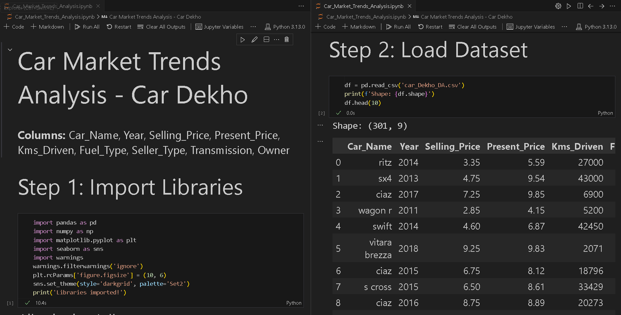
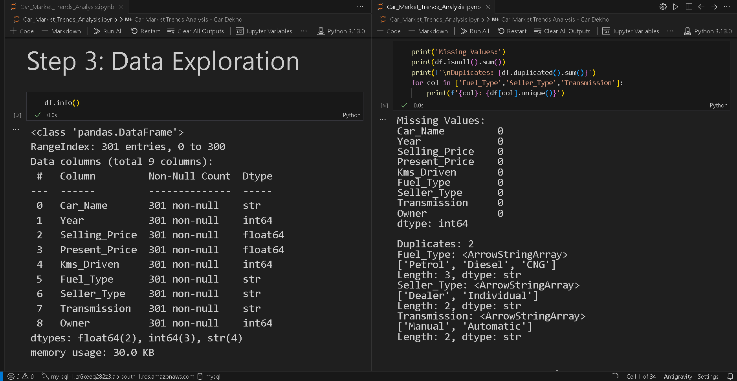
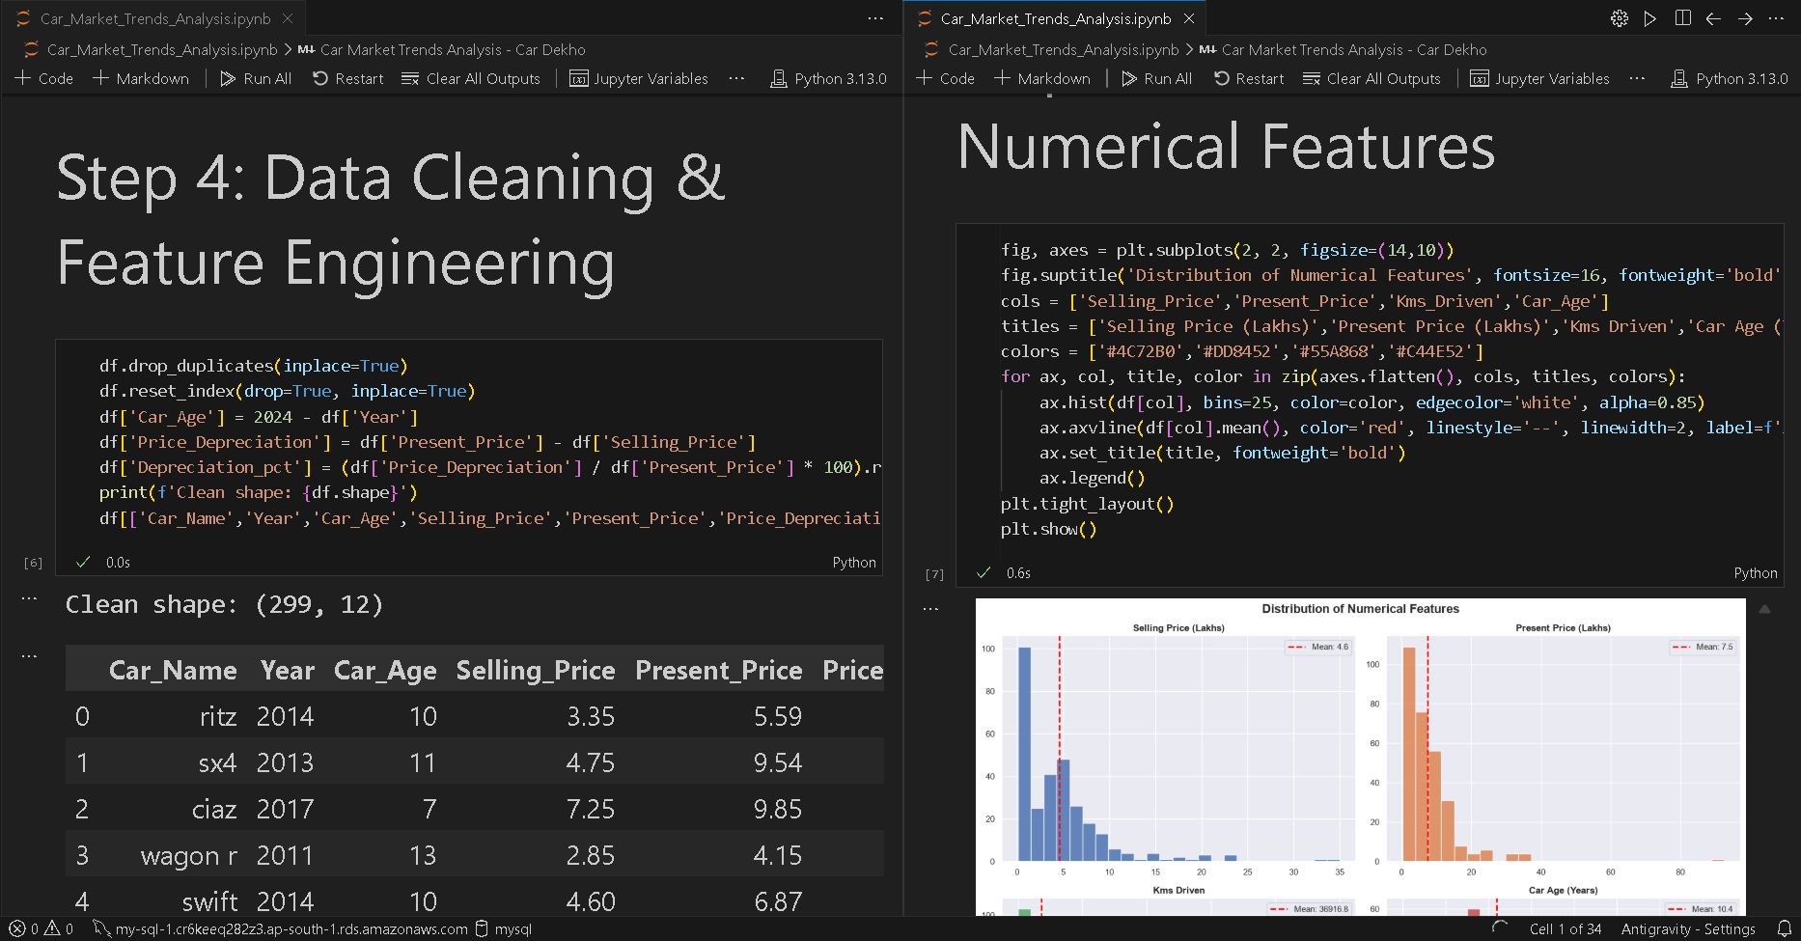
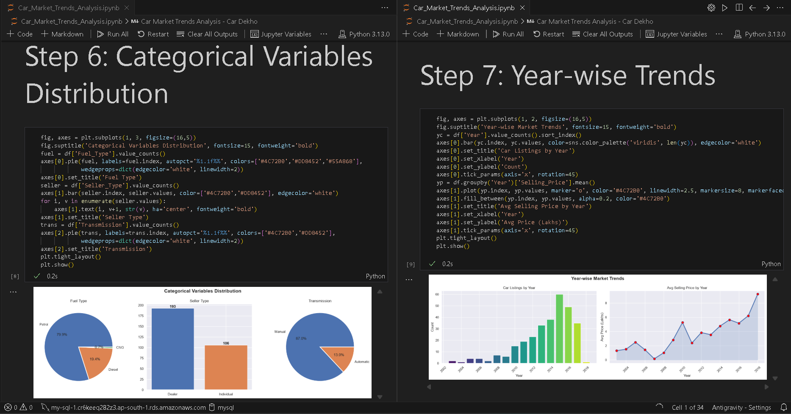
RESULTS

Slide 8
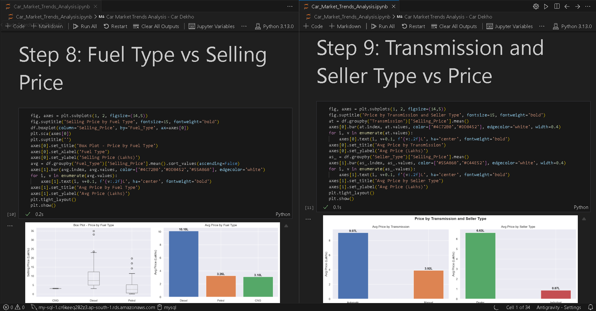
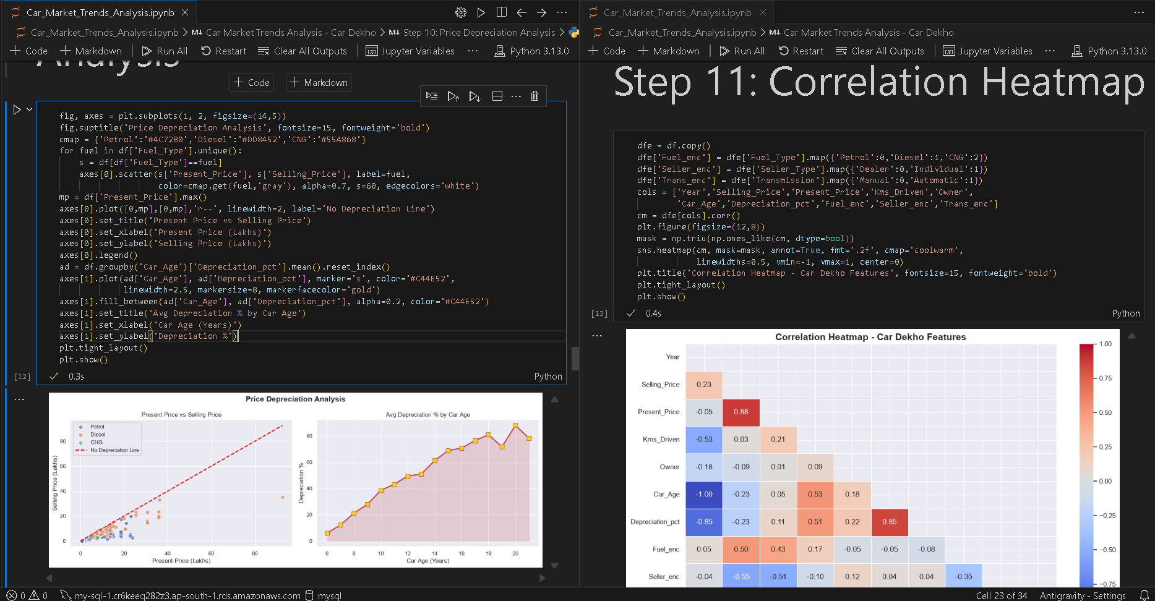
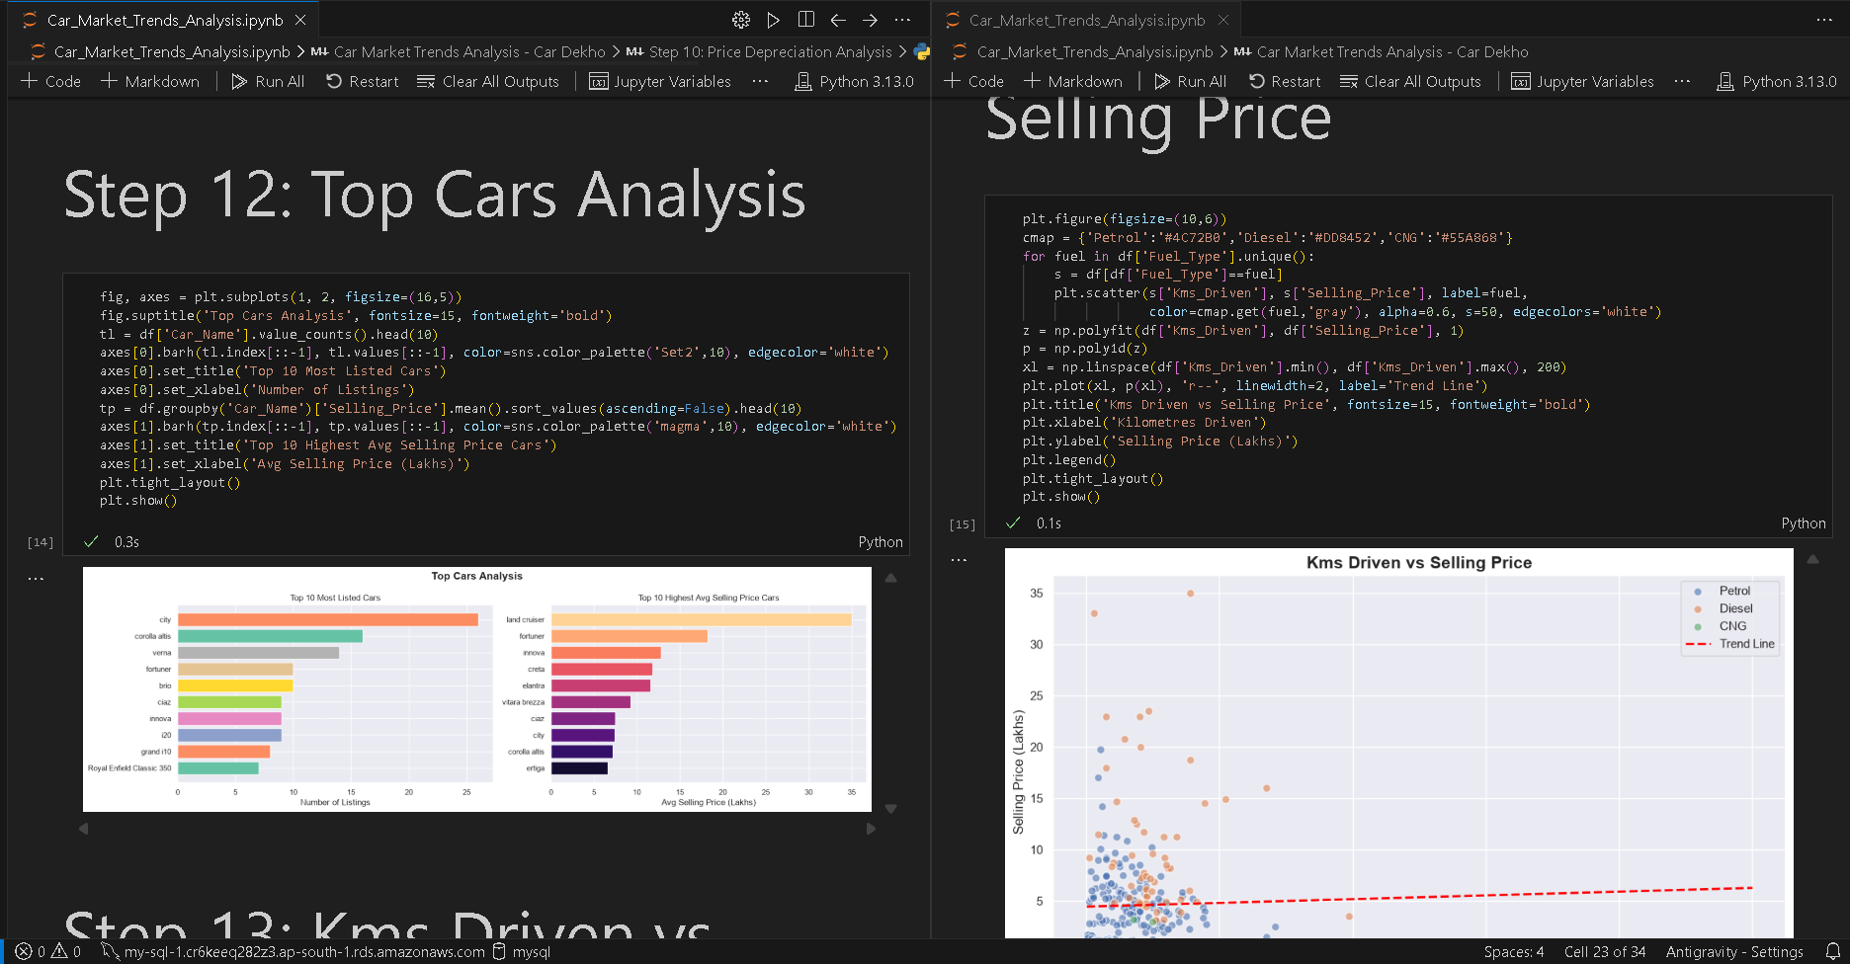
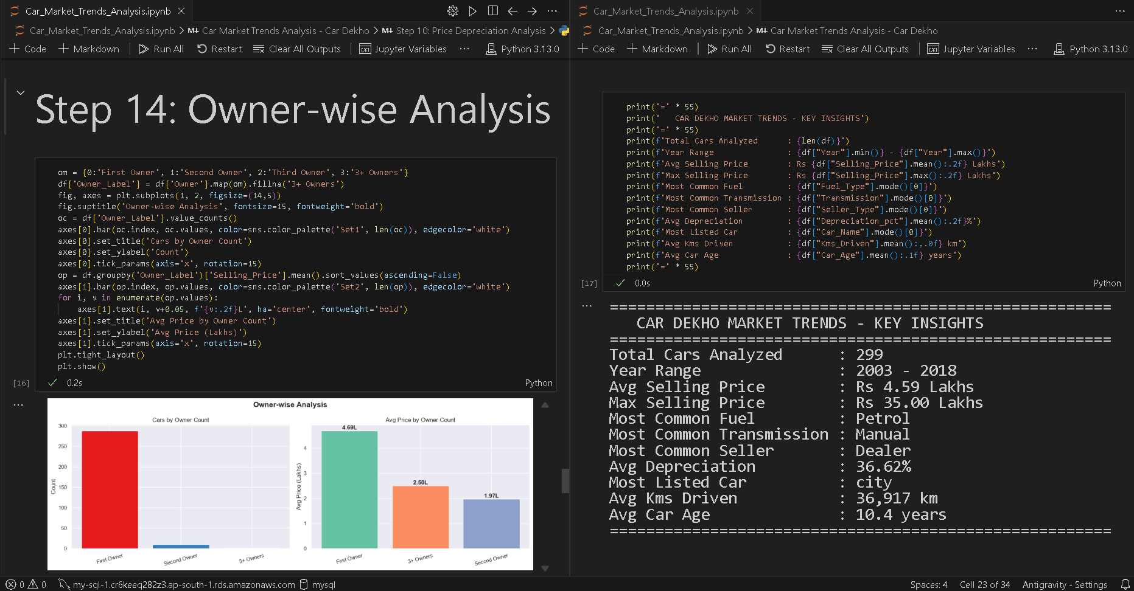

Slide 9
Dataset Summary (after cleaning, n = 299):
Year range: 2003–2018 | Avg selling price: ₹4.59L | Max: ₹35L
Avg kms driven: 36,917 km | Avg car age: 10.4 years | Avg depreciation: 36.62%
Most common fuel: Petrol | Most common transmission: Manual | Most listed car: City
Key Insights:
Petrol dominates listings; CNG cars are rare
Newer cars command significantly higher selling prices
Depreciation is steepest in early years — averaging 30–60% loss
Automatic cars sell at a clear premium over Manual
Dealers price cars higher on average than individual sellers
Higher kms driven correlates with lower selling price (negative correlation)
First-owner cars fetch the highest average resale price
Diesel cars command a premium over Petrol in the resale market
Demo Link

Slide 10
Thank you
Questions & Feedback Welcome
.
.
Email : a74441174@gmail.com
LinkedIn

