Slide 1

IOT • GPS • DATA SCIENCE
ESP32 GPS
Spatial Intelligence
Offline location logging, stop-point discovery
and route visualization
Presented by Amit Kumar & Aditya Dwevedi
ESP32 · NEO-6M GPS · MicroSD · Python
1

Slide 2
Project at a glance
An end-to-end pipeline from raw GPS fixes to meaningful places
01 COLLECT
02 STORE
03 DISCOVER
ESP32 reads latitude, longitude, speed, date and time from the NEO-6M GPS.
Each valid fix is appended to a CSV file on a MicroSD card—no internet required.
Python cleans data, computes movement metrics, clusters stops with DBSCAN and maps the route.
Core idea: turn a portable GPS logger into a lightweight location-intelligence system.
2

Slide 3
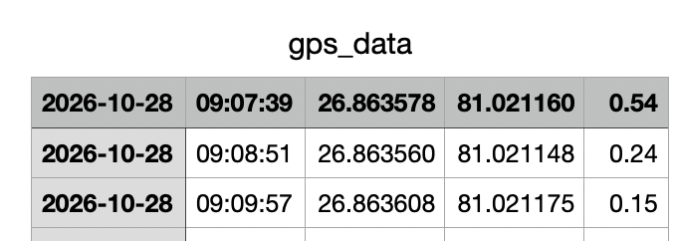
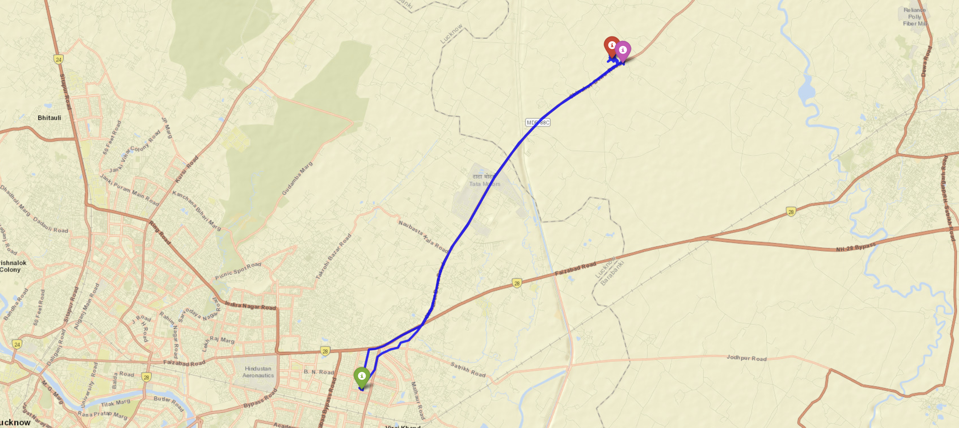
Problem & objectives
Why build an offline GPS logger?
• Raw GPS tracks contain noisy points and do not directly explain where a person stopped.
• Mobile data or cloud connectivity may be unavailable during collection.
• Repeated low-speed coordinates can reveal frequently visited places.
• Objective: capture a route locally, analyze it later, and inspect it on an interactive map.
INPUT
GPS fixes: timestamp + latitude + longitude + speed
OUTPUT
Route line, movement statistics and named stop clusters
3

Slide 4
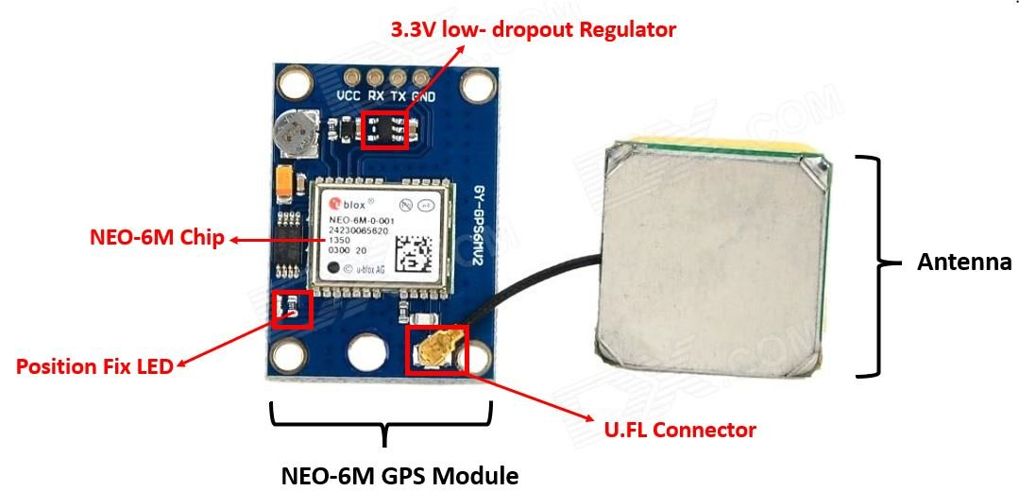
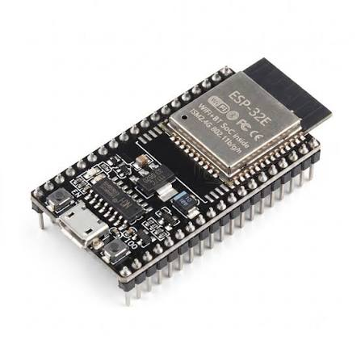
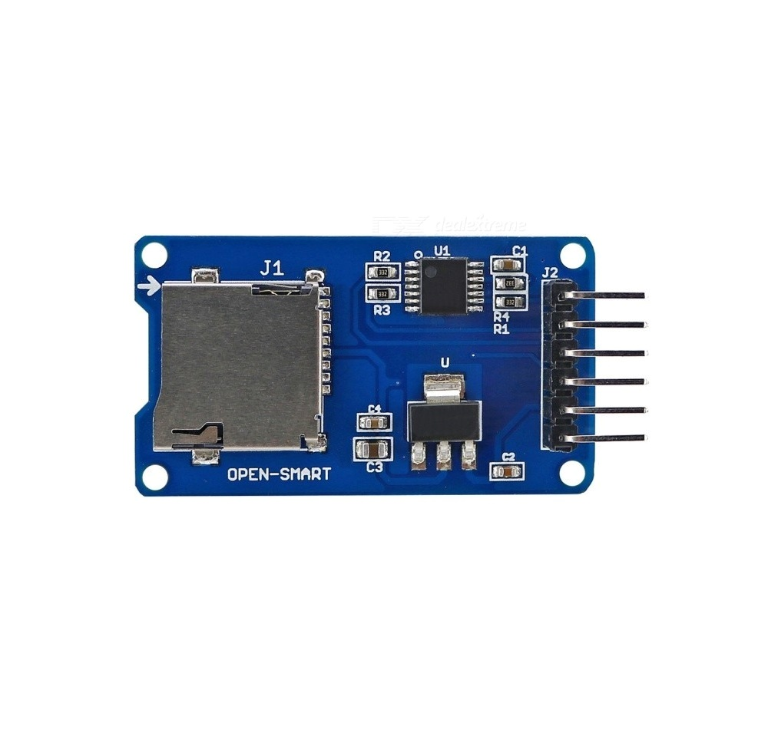
System architecture
Data flows from embedded hardware to offline analysis
NEO-6M GPS
ESP32
MicroSD
Python notebook
DBSCAN + Folium
NMEA serial stream
→
TinyGPS++ parsing
→
gps_data.csv
→
Cleaning + features
→
Clusters + map
Offline-first collection • Wi-Fi portal for local CSV retrieval • Analysis performed after data collection
4

Slide 5
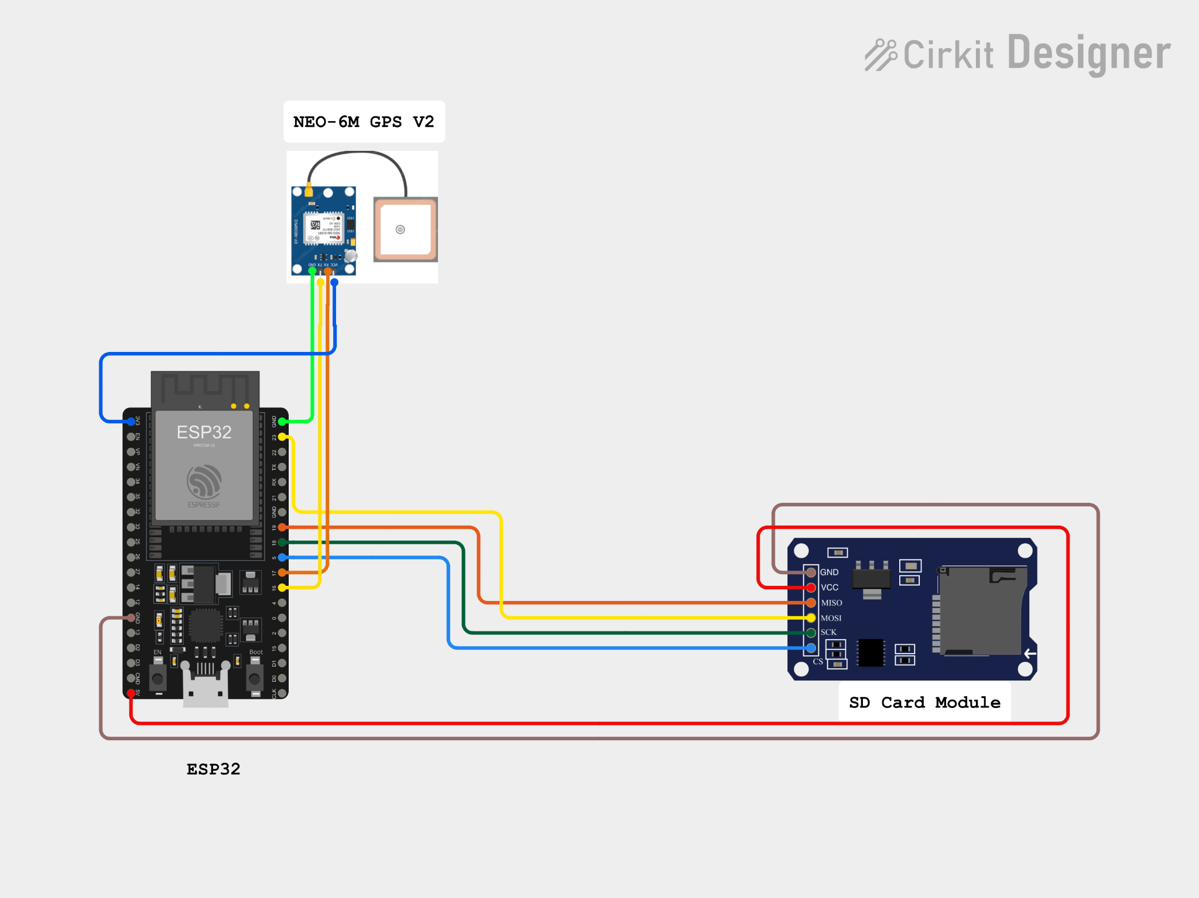
Hardware & wiring
ESP32 + NEO-6M GPS + MicroSD module
GPS SERIAL
NEO-6M TX → ESP32 GPIO16 (RX2)
NEO-6M RX ← ESP32 GPIO17 (TX2)
MICROSD SPI
CS: GPIO5 • SPI bus: SCK, MISO, MOSI
Shared ground and power connections
GPS receiver supplies position and time; SD card stores records locally.
ESP32 GPS SPATIAL INTELLIGENCE • PROJECT PRESENTATION
5

Slide 6
Firmware workflow
Arduino C++ • TinyGPS++ • SPI / SD • ESPAsyncWebServer
BOOT
Initialize serial, GPS and SD
↓
ACCESS POINT
Create local Wi-Fi network
↓
GPS FIX
Decode NMEA; wait for valid location/date/time
↓
LOG
Append CSV every 30 seconds
↓
DOWNLOAD
Captive portal serves CSV at /download
6

Slide 7
Data preparation & feature engineering
Notebook pipeline
LOAD + CLEAN
TIME + DISTANCE
MOVEMENT FEATURES
Read CSV; coerce numeric fields; remove invalid coordinates and speed anomalies (>150 km/h).
Build datetime; sort records; calculate geodesic step distances and cumulative kilometers.
Extract hour; retain speed and time deltas for movement analysis.
• Input fields: Date, Time, Latitude, Longitude, Speed
• Notebook uses Pandas, NumPy, GeoPy and Scikit-learn
• Recorded sample: 3,002 rows; no missing values in the provided run
7

Slide 8
Stop-point discovery with DBSCAN
Density-based clustering groups repeated low-speed GPS fixes
FILTER
CLUSTER
INTERPRET
Keep points with speed < 3 km/h to represent stop/dwell locations.
DBSCAN with Haversine distance; ε = 0.1 km; min_samples = 10.
Clusters become semantic places; noise label −1 is treated as transit/unclustered.
Haversine distance is appropriate for latitude/longitude coordinates on Earth.
Cluster labels in this recorded run were mapped to Home, Print Shop and University.
ESP32 GPS SPATIAL INTELLIGENCE • PROJECT PRESENTATION
8

Slide 9
Recorded-run results
Metrics reported by the supplied notebook
56.93 km
Total distance
26.45 h
Recorded duration
75.39 km/h
Maximum speed
9.95 km/h
Average moving speed
3 discovered places: Home (2,017 fixes) • Print Shop (79) • University (366)
Note: results reflect the sample data included with the notebook.
9

Slide 10
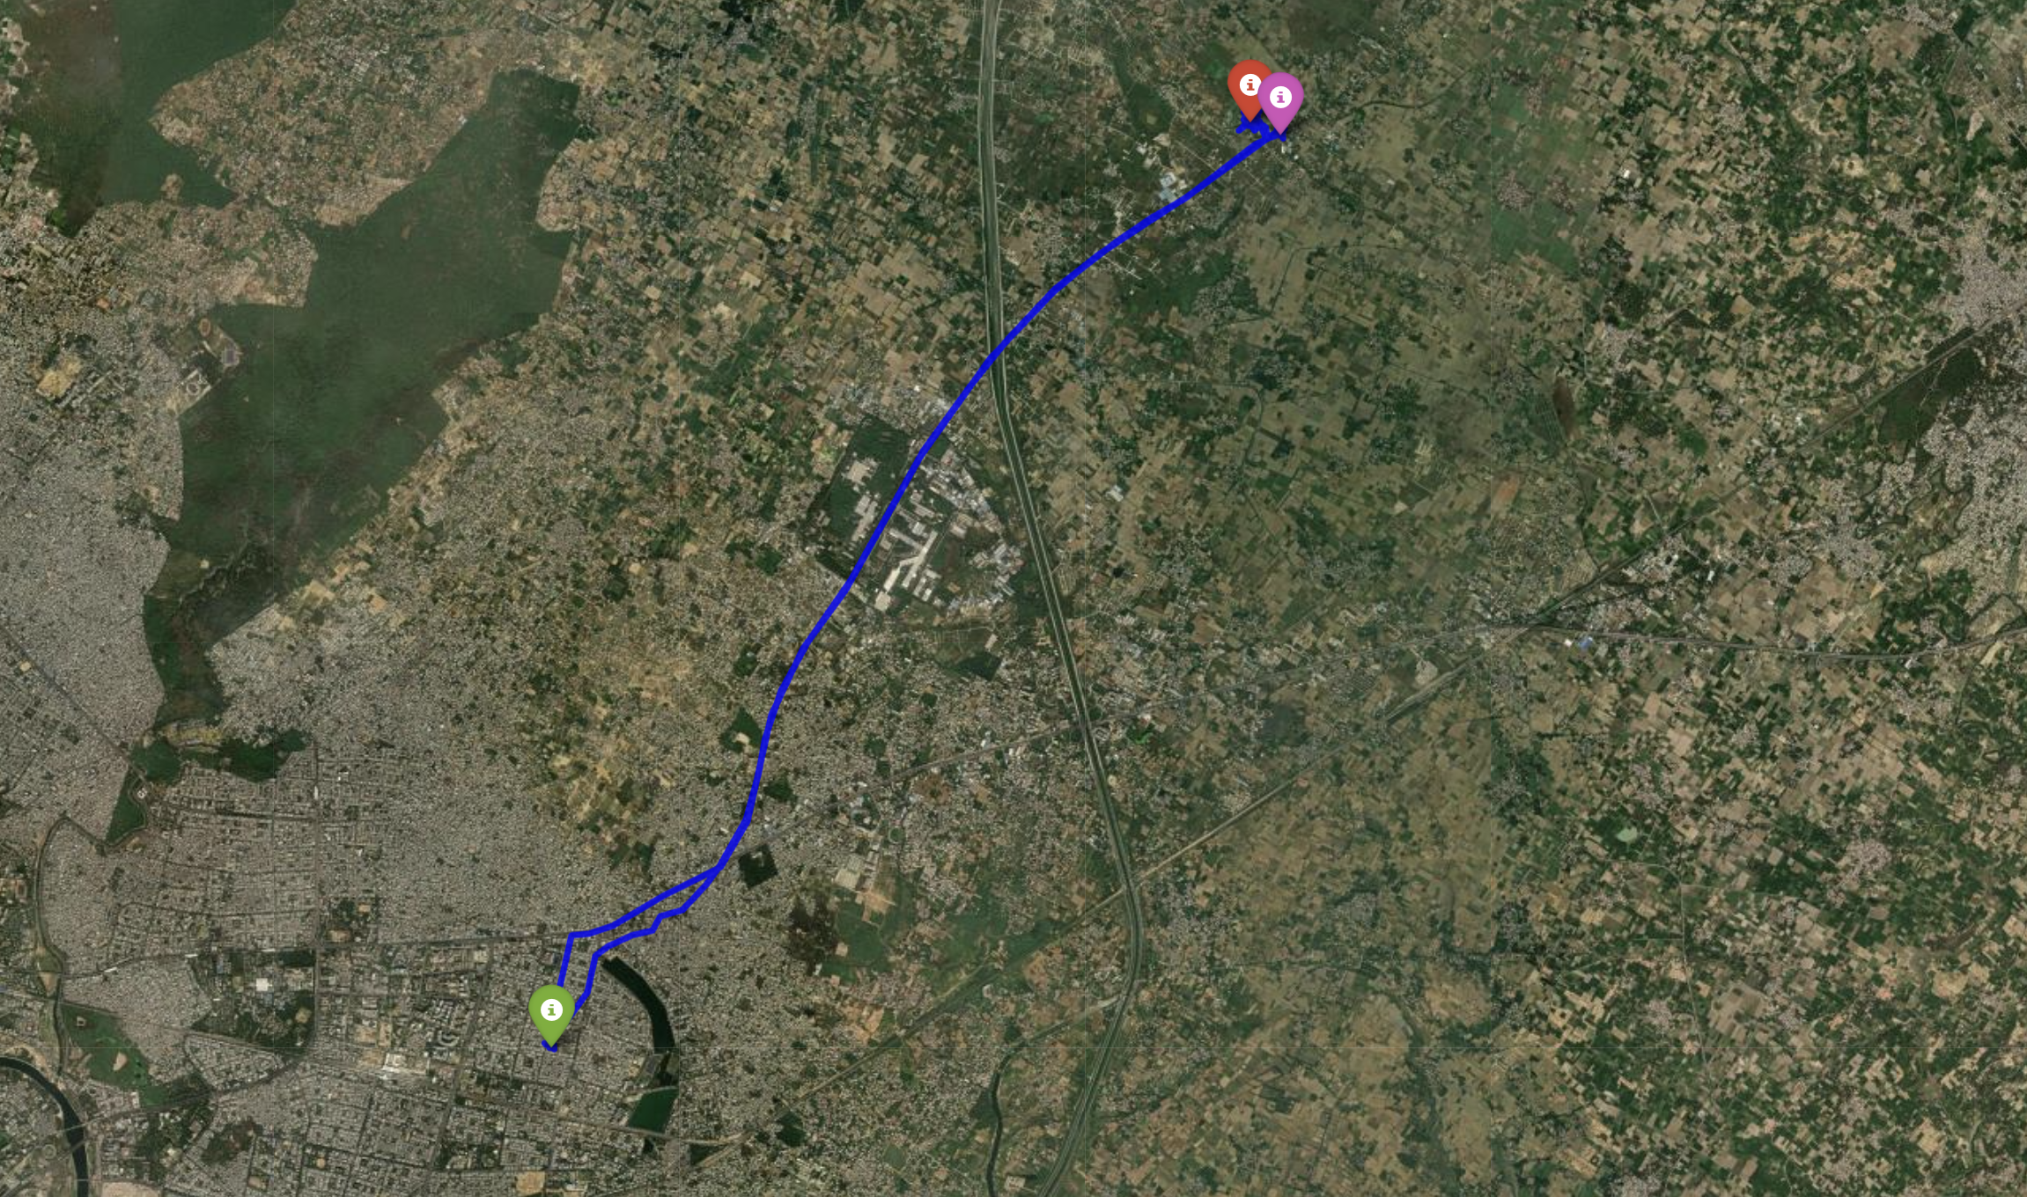
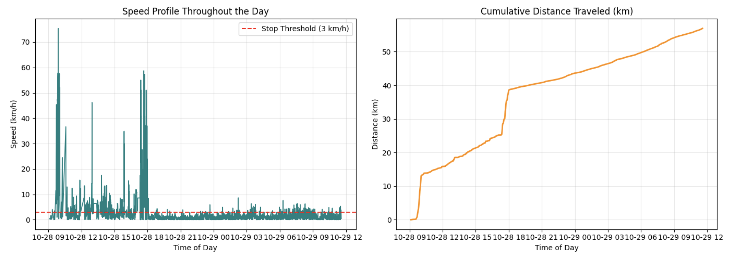
Visualization & insights
Two complementary views of the recorded journey
MOVEMENT CHARTS
INTERACTIVE MAP
Speed over time with a 3 km/h stop threshold; cumulative distance over time.
Folium route polyline with clustered place markers; switch street and satellite layers.
The map connects the raw trajectory with discovered locations, making the day’s movement easier to inspect.
10

Slide 11
Conclusion & future work
A compact offline logger with a complete analysis workflow
WHAT WORKS
NEXT IMPROVEMENTS
• Offline GPS capture and CSV storage
• Local Wi-Fi download portal
• Route metrics and stop clustering
• Interactive trajectory map
• Add CSV headers and logging status
• Improve time-gap and GPS-noise handling
• Automate place labels from dwell duration
• Add route segmentation and export reports
Thank you
Questions?
11

