Slide 1
Ancient Architecture Art, Forts, Paintings, Sculptures, Temples & Styles

Slide 2
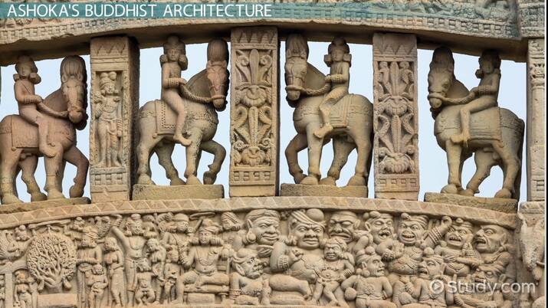
What is Ancient Architecture Ancient architecture means the buildings and structures made by early civilizations. It shows how people lived, worshipped, and protected themselves. These structures reflect culture, religion, and technology of the past.

Slide 3
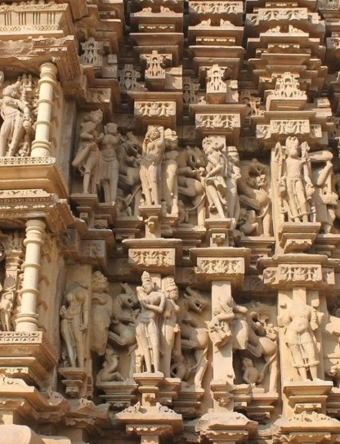
Key Features of Ancient Architecture
Ancient buildings were made using stone, wood, and metal.
Designs were symmetrical and well planned.
Carvings showed gods, kings, animals, and nature.
Religion and mythology strongly influenced designs.
Forts were built for safety and defence.

Slide 4
Art in Ancient Architecture
Art made ancient buildings beautiful and meaningful.
Murals and frescoes were painted on cave and temple walls.
Stone reliefs showed stories from history and mythology.
Inscriptions and calligraphy recorded important events.
Metal art was used on doors, pillars, and statues.

Slide 5
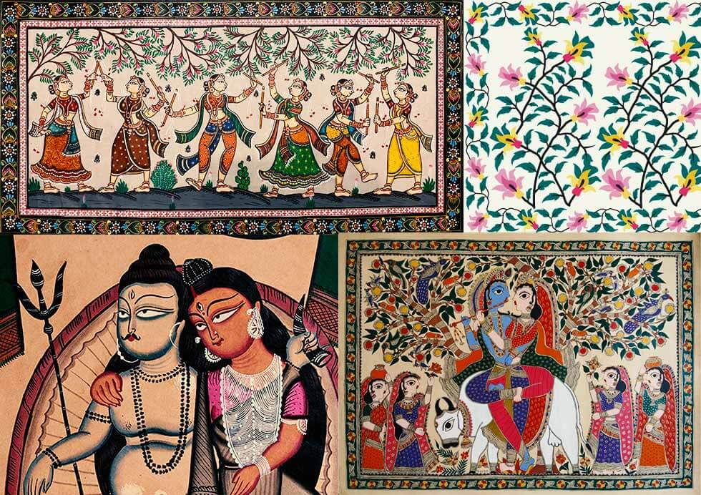
Ancient Paintings
Paintings were used to decorate caves and temples.
Cave paintings showed religious stories and daily life.
Murals were painted on large walls.
Miniature paintings were small and detailed artworks.
Examples:
Ajanta Cave Paintings, Madhubani Paintings

Slide 6
Ancient Sculptures
Sculptures were made from stone, metal, and wood.
They showed gods, rulers, and mythical creatures.
Some were carved inside rocks and caves.
Many sculptures were very large and detailed.
Examples:
Gomateshwara Statue, Great Sphinx of Giza

Slide 7
Conclusion Ancient architecture tells us about history and culture. It includes art, forts, temples, paintings, and sculptures. These structures inspire modern buildings even today. Ancient architecture is a proud heritage of humanity.

