Slide 1
INFORMAC
BY – DATA PEEPS
1. Mitali Bharali
2. Namratha Channabasavaiah
3. Amit Mutgi

Slide 2
Overview
The city of Los Angeles publishes data on Environment Health inspection and enforcement results from restaurants in the Los Angeles county. These data cover 85 of 88 cities and all unincorporated areas in the LA county.
There are two datasets available: (i) market inspection dataset: contains results of inspection; and (ii) market violations dataset: contains information on health code violations in restaurants. These data were last updated on January 16, 2019. Data dictionaries for the above two data sets are included below. Feel free to supplement the above information with other publicly-available information.

Slide 3
Understanding the problem: Problem Statement
Q 1
Q 2
Q 3
Q 4
What are the key factors in predicting health “scores” of the restaurants in Los Angeles county?
What are the most important factors in classifying restaurants into different “grades”?
Are there any relationships between various types of health code violations and scores/grades of a restaurant?
Are there any patterns in terms of how health scores of restaurants change over time?

Slide 4
Approach:

Slide 5
Timeline
Data Preprocessing
Visualize data for Anomalies
Heatmap for correlation | box plots for outliers
Removing NaN, duplicates
Transforming categorical into one hot encoding
Ensemble Learning Algos
Random Forest Feature Importance
Chi Square for categorical variable comparison

Slide 6
Understanding important aspects of Dataset
Activity Date
Date of health inspection
Converted month to interval data
Serial Number
Foreign key - used to join inspection and violation datasets
Zip Code /Location
Calculate distance ( in miles) from one reference location
Score - Grade
Correlated variables
Score used for regression; Grade for classification

Slide 7
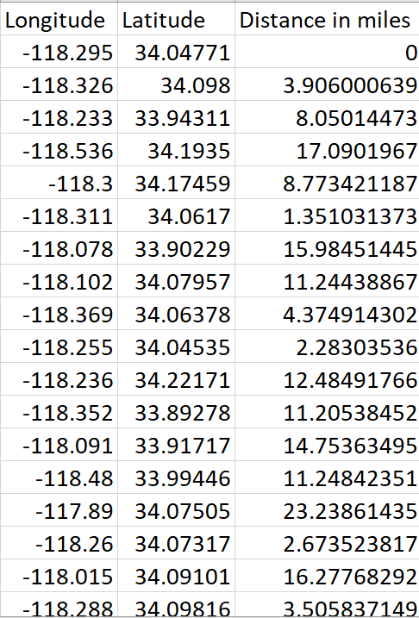
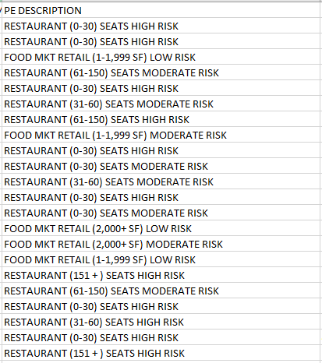
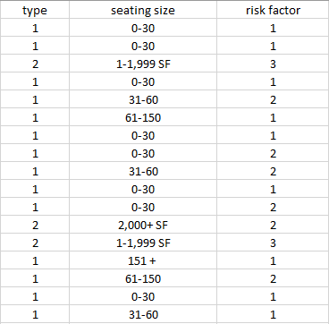
Pre-Processing
Calculated relative distance (in miles) of the restaurants and used them as interval data for modeling.
Program description is parsed to get establishment type, seating capacity and the risk factor

Slide 8
EXPLANATORY DATA ANALYSIS

Slide 9
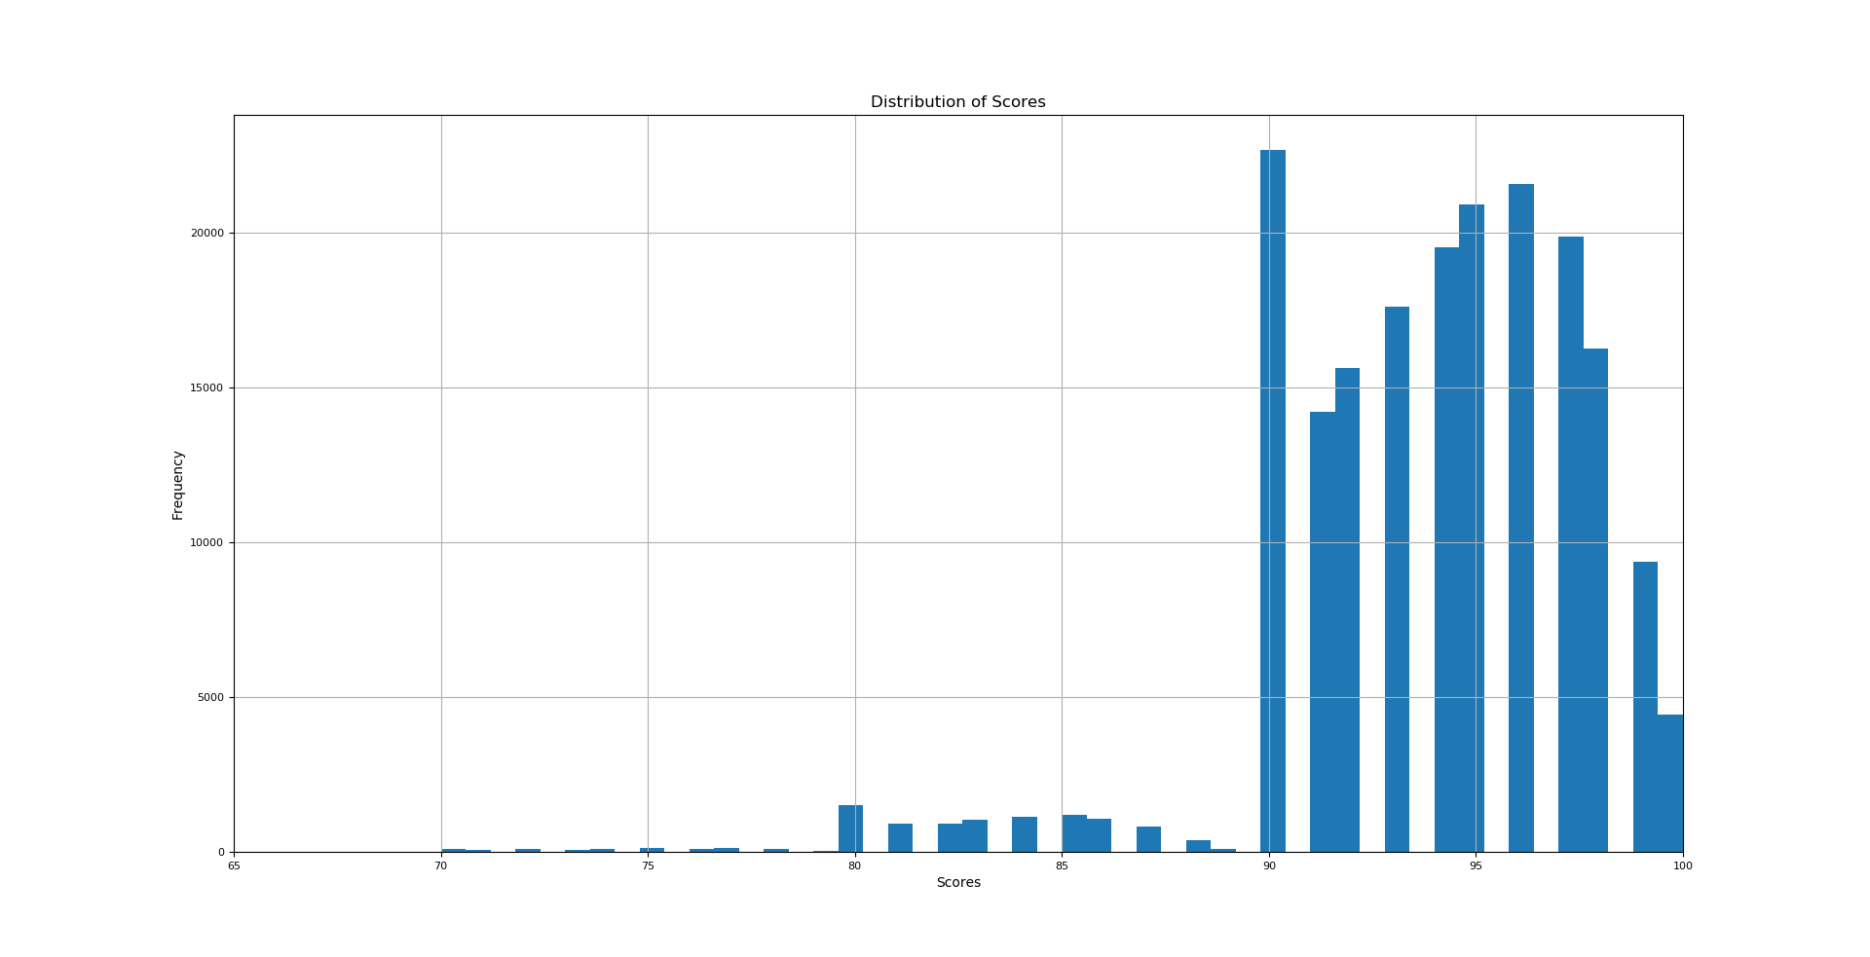

Slide 10
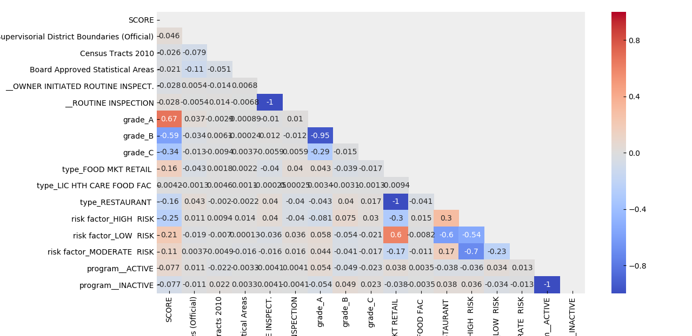
CORRELATION CHART

Slide 11
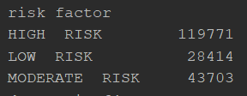
RESTAURANT COUNT ACCORDING TO RISK FACTOR

Slide 12
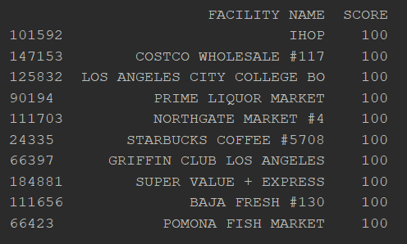
TOP 10 RESTAURANTS WITH HIGH SCORE

Slide 13
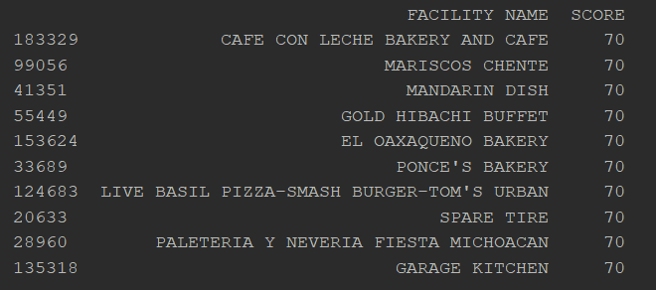
BOTTOM 10 RESTAURANTS

Slide 14
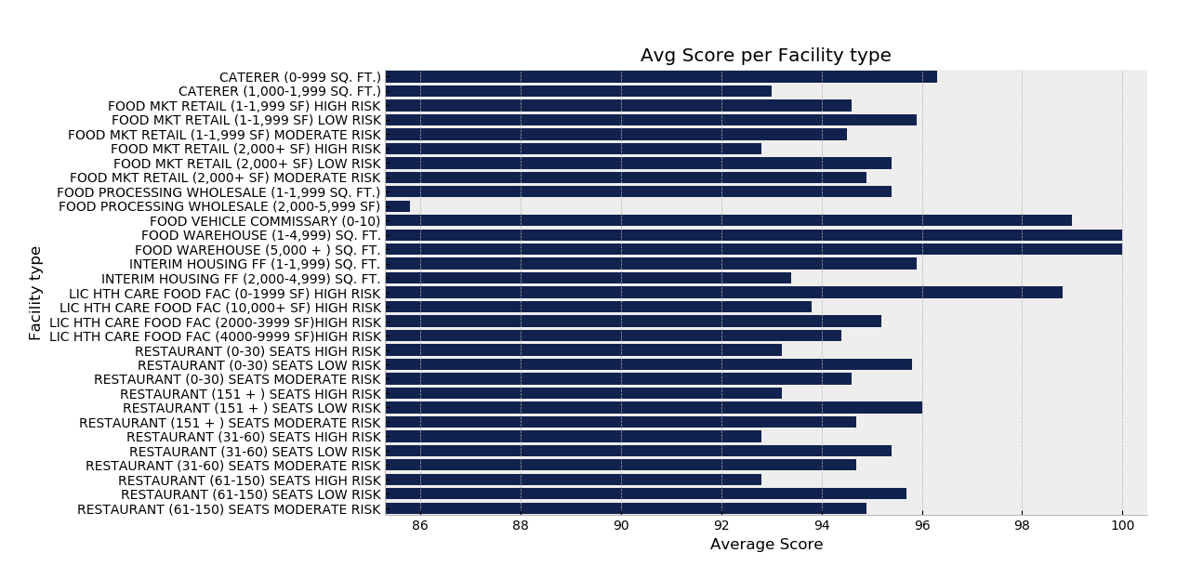
AVERAGE SCORE PER FACILITY TYPE

Slide 15
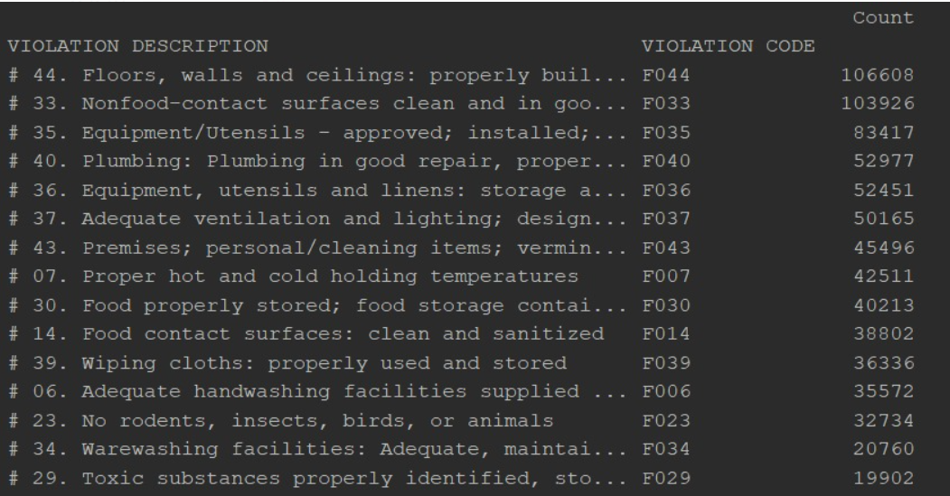
Top 15 violation codes

Slide 16
Q1:
Problem Statement : to predict the scores of the restaurants using random forest regression.
Target Variable : Score
Predictors : ‘PROGRAM STATUS’, ‘SERVICE CODE’, ‘Distance in miles’, ‘2011 Supervisorial District Boundaries Official ‘, ‘Census Tracts 2010’, ‘Board Approved Statistical Areas’, ‘type’, ‘risk factor’, ‘month’, and all one-hot encoded violation codes
Accuracy : 94.32%

Slide 17
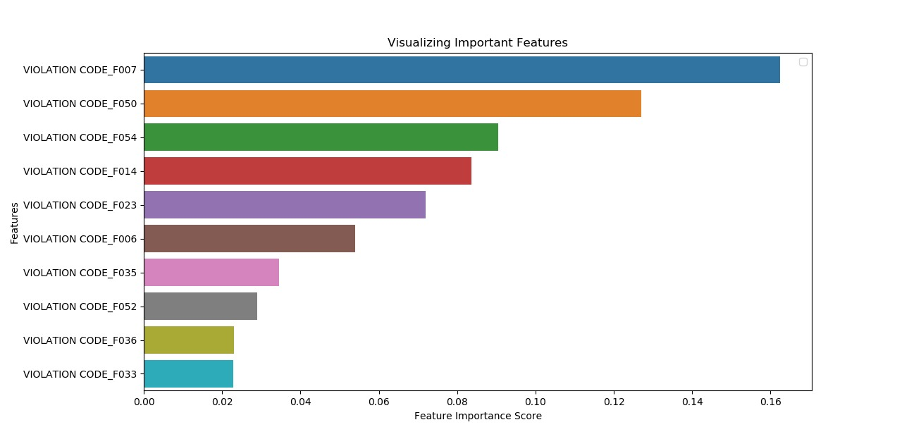
Key Factors In predicting health scores.

Slide 18
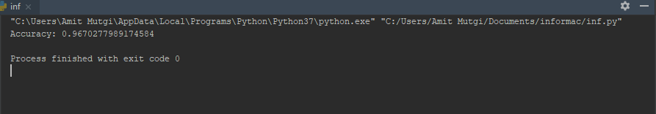
Q2 :
Problem statement : to classify the restaurants based on grade
Model : Building a classifier using Random Forest
Target Variable : Grade
Predictors : ‘PROGRAM STATUS’, ‘SERVICE CODE’, ‘Distance in miles’, ‘2011 Supervisorial District Boundaries Official ‘, ‘Census Tracts 2010’, ‘Board Approved Statistical Areas’, ‘type’, ‘risk factor’, ‘month’, and all one-hot encoded violation codes
Accuracy : 96.70 %

Slide 19
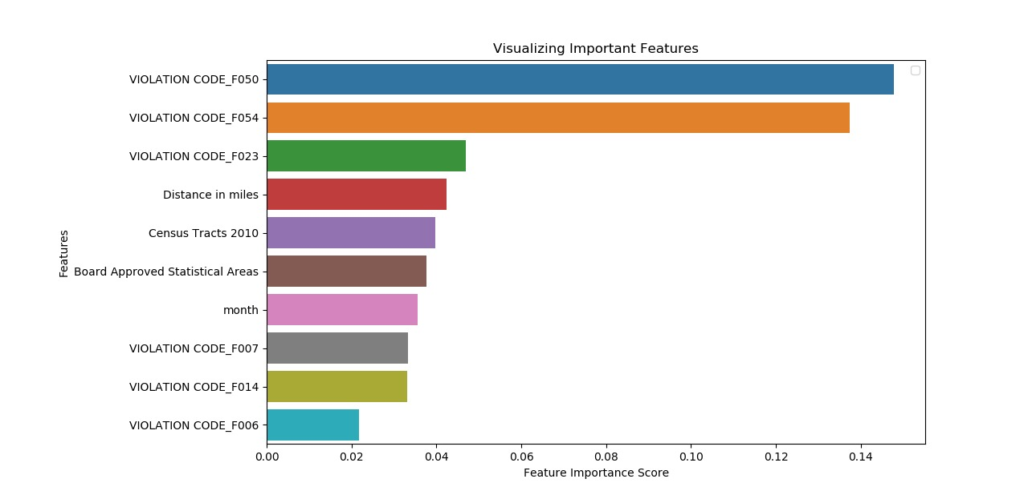
Key Factors In classifying restaurants into grades.

Slide 20
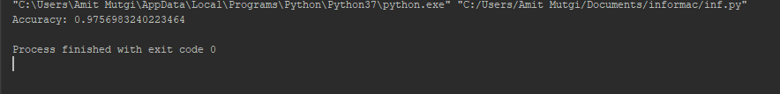
Selecting the top 10 features based on importance score
Re-generating the model on selected features :
Accuracy : 97.56 %
Removing the least important features results increased the accuracy. This is because of removal of misleading data and noise. Also, reduced training time increases the efficiency.

Slide 21
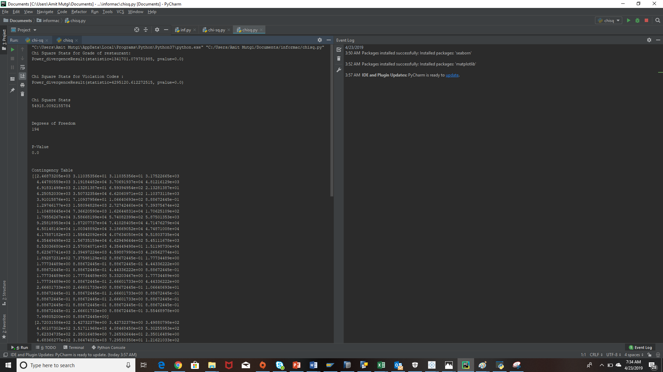
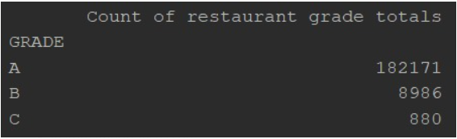
Q3.

Slide 22
Chi – square statistical test used since we are dealing with categorical variables
The results of the test will help us to understand whether a relation exists between the grades of the restaurant and violation codes.
Hypothesis :
Null hypothesis : Grades of the restaurant and violation codes are not related
Alternate hypothesis : There exists a relation between the grades & violation codes
The chi square statistic value compares the counts of categorical responses between the two independent group.
Considering 5% significance level, p value has a value less than 0.05, showing that it is significant and null hypothesis can be rejected.
We can conclude that there is a relationship between grades of the restaurant and violation codes.

Slide 23
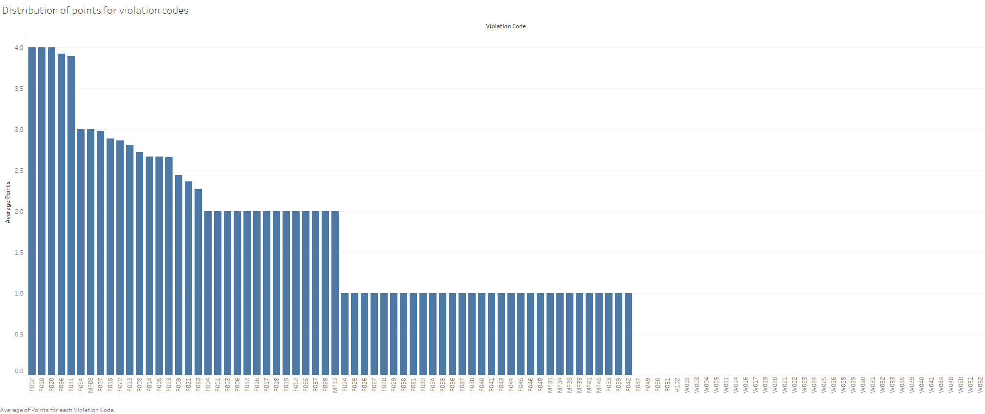
Distribution of points for violation codes

Slide 24
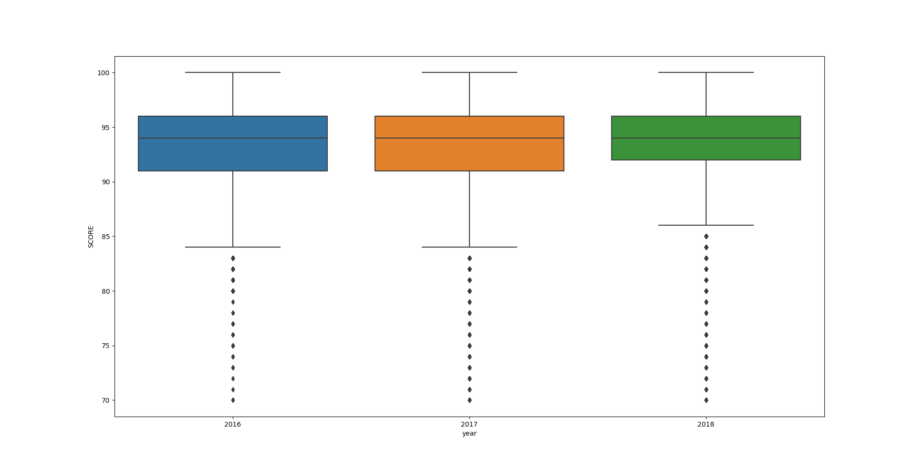
Q4. Variation of Score across Years

Slide 25
1. The scores have remained constant over the three years. 2. However in the year 2018 ,the restaurants having lower scored have improved . 3. This can be due to the fact that people prefer more hygienic restaurants.

Slide 26
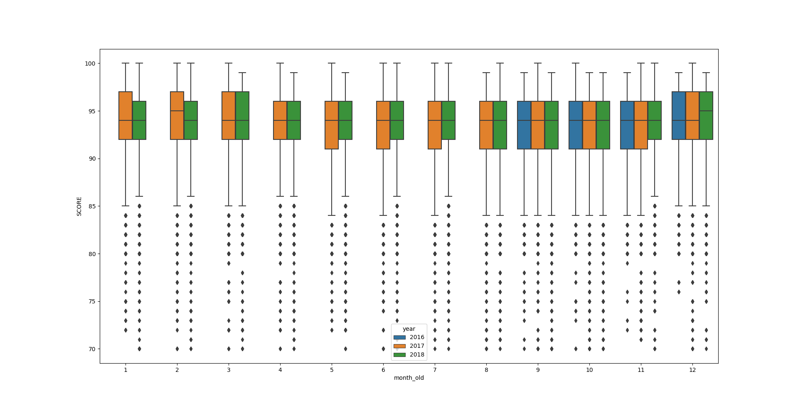
Variation of Scores Across Months and Year

Slide 27
1. January and February has seen a decline in score as compared to the previous year. 2. This can be due to weather changes in Los Angeles during January and February in the year 2018. 3. The median of score in December for 2018 has seen an increase.

Slide 28
Variation of score in Top 5 Facilities over the years.
FACILITY ID | FACILITY NAME
FA0006427 | LEVY PREMIUM FOODSERVICE LIMITED PARTNERSHIP
FA0019271 | LEVY Premium foodservice ,LP
FA0065100 | Legends Hospitality ,LLC
FA0170678 | Magic Mountain ,LLC
FA0170909 | Universal City Studios ,LLC

Slide 29
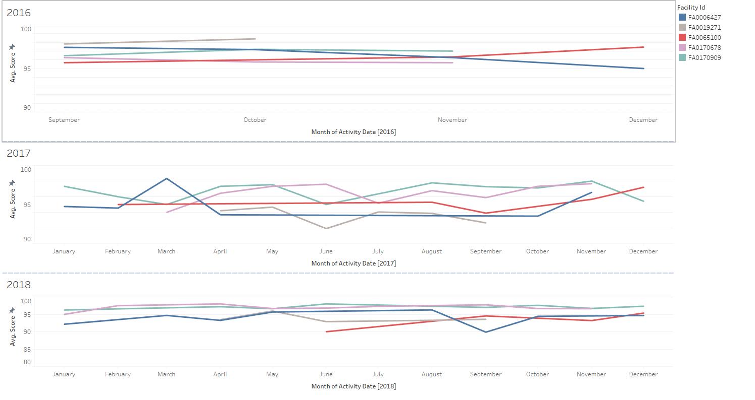

Slide 30
1.In the year 2016 Legends Hospitality ,LLC has seen a continuous increase in Score over the year and Levy Premium foodservice Limited Partnership has seen a decrease in the score. 2.Most of the Facilities see a dip of score in the month of June and July. 3.The scores have remained constant across the different facilities in the year 2018.

Slide 31
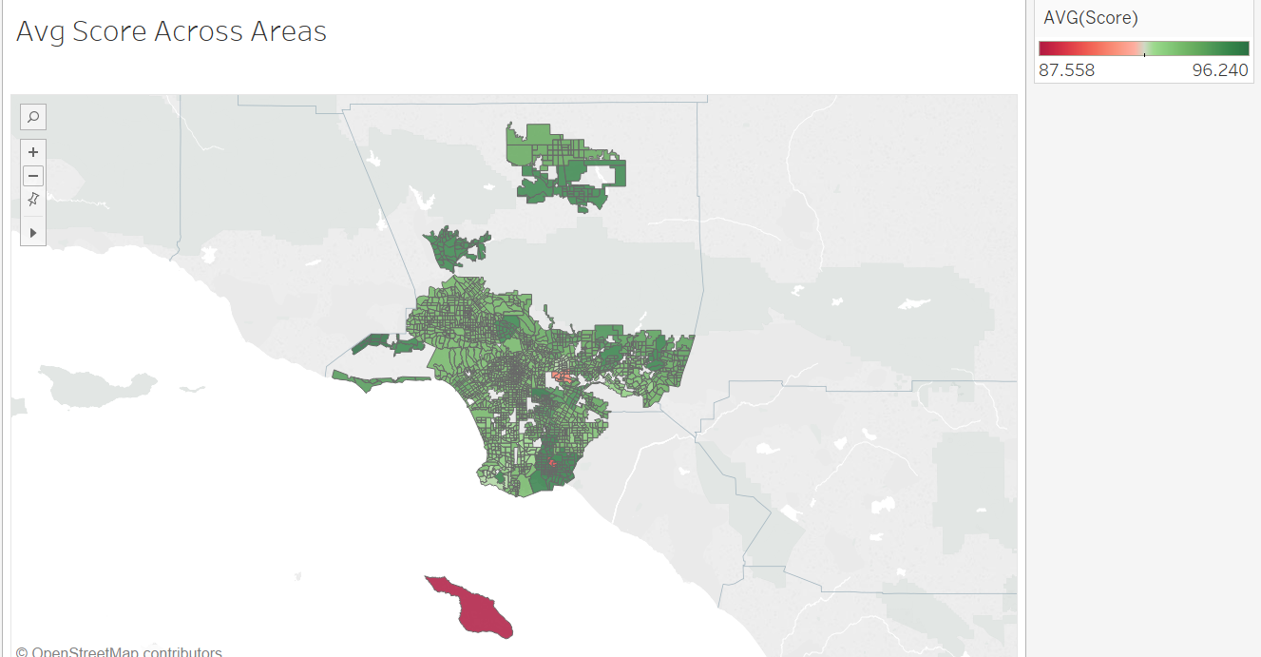
Avg Score across Different areas

Slide 32
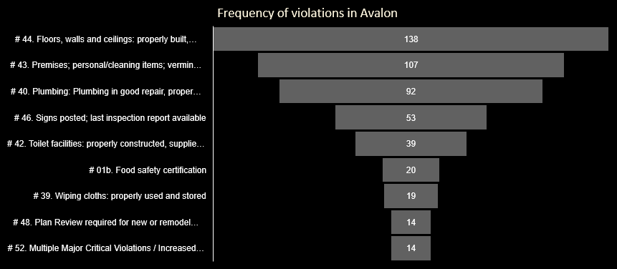
Business Recommendations for Avalon

Slide 33
General Recommendations
If your establishment receives a poor health inspection score, you can schedule a re-inspection in 5 - 45 days. This will give you time to correct the violations.
Figure out how each violation occurred and how you can prevent it from happening again.
Just like with your own self-inspection, review any violations and their proper corrective action with your staff.

Slide 34
Thank You

