Slide 1
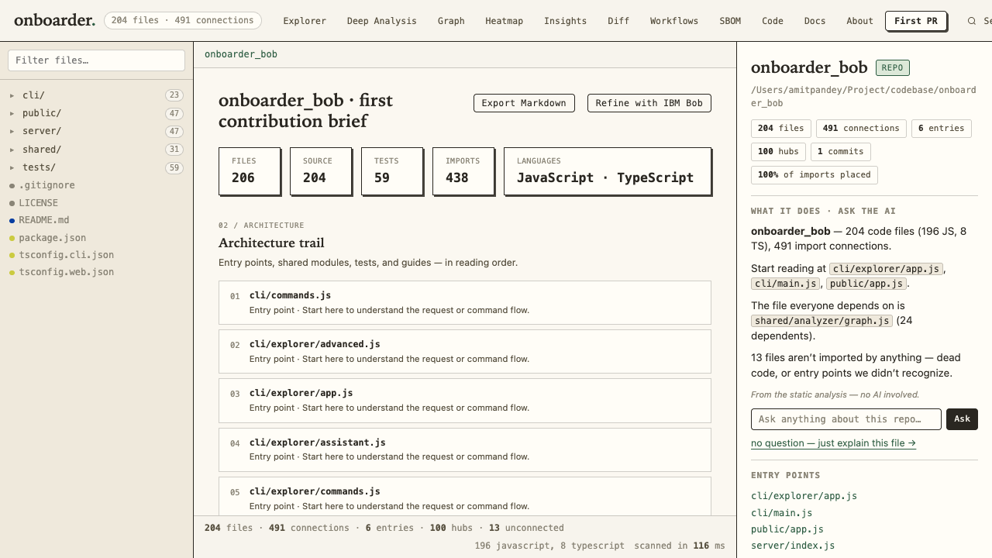
onboarder.
IBM BOB 2.0 HACKATHON
FROM REPOSITORY TO FIRST CONTRIBUTION
Onboarder Bob
Understand the code. Find a safe first PR. Refine the plan with IBM Bob.
Built on the original Onboarder
An interactive codebase map, grounded starter tasks, and an optional IBM Bob review in one familiar workflow.
ORIGINAL THEME + FEATURES
AMIT PANDEY / ONBOARDER BOB
01

Slide 2
onboarder.
IBM BOB 2.0 HACKATHON
THE PROBLEM
The first PR starts with orientation
New contributors need a clear map before they can choose a useful change.
01
Where does execution begin?
02
Which modules matter most?
03
What is a small, testable change?
AMIT PANDEY / ONBOARDER BOB
02

Slide 3
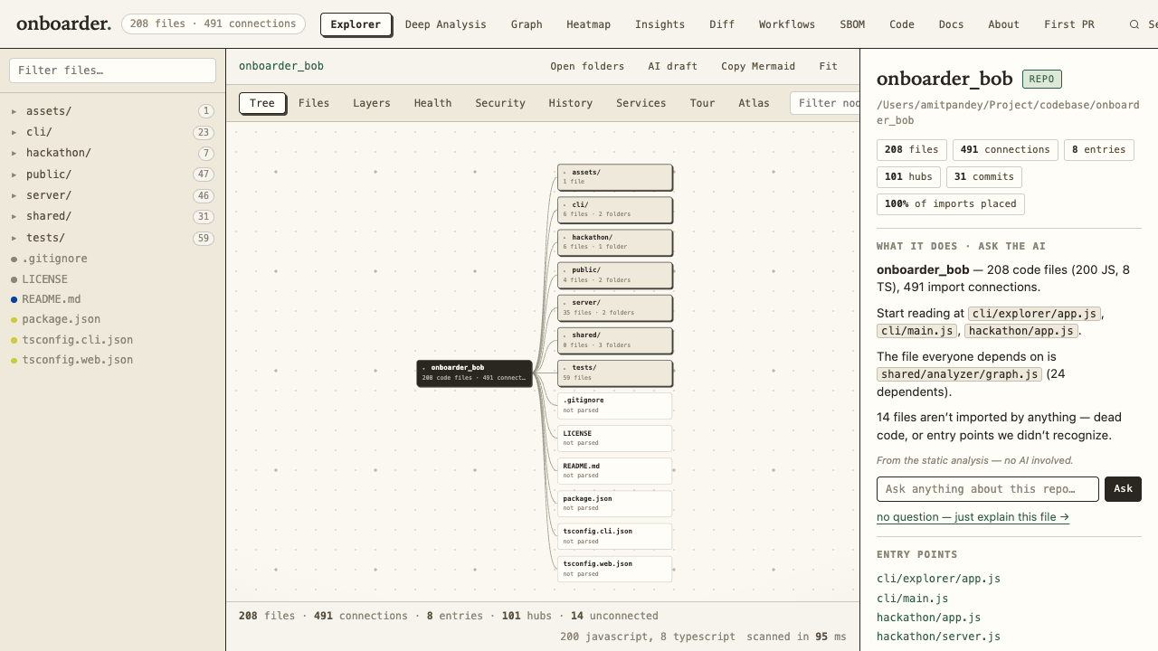
onboarder.
IBM BOB 2.0 HACKATHON
THE EXISTING FOUNDATION
Onboarder already maps the codebase
The hackathon build copies Amit’s existing project and keeps its Explorer, CLI, diagrams, search, and analysis.
204
code files scanned
491
connections mapped
AMIT PANDEY / ONBOARDER BOB
03

Slide 4
onboarder.
IBM BOB 2.0 HACKATHON
THE NEW WORKFLOW
Evidence before suggestions
The First PR view reads actual scanned files, traces imports, identifies gaps, and exports a Markdown brief.
438
imports traced
59
test files found
AMIT PANDEY / ONBOARDER BOB
04

Slide 5
onboarder.
IBM BOB 2.0 HACKATHON
IBM BOB IN THE PRODUCT
Bob refines the first PR
The optional button sends only the generated brief to the official Bob Shell in read-only ask mode.
1
2
3
Scan
Ground
Refine
Use Onboarder’s existing repository scanner.
Create file and line evidence plus starter tasks.
IBM Bob proposes sequence, checks, and uncertainty.
The Bob API key stays on the server. The local analysis works without it.
AMIT PANDEY / ONBOARDER BOB
05

Slide 6
onboarder.
IBM BOB 2.0 HACKATHON
BUILT + VERIFIED
Ready for a first contribution
An original project extended with IBM Bob, grounded in repository evidence.
691 passing tests
The copied project is separate from the original Onboarder. The full source and setup steps are public.
github.com/Amitpandey88/onboarder_bob
AMIT PANDEY / ONBOARDER BOB
06

