Slide 1
BITS Pilani presentation
Dr. Yashvardhan Sharma
Computer Science and Information Systems

Slide 2
SS ZG514/SE Z512
Object Oriented Analysis and Design
Lecture No.3

Slide 3
Unified Development Process [1]
Key features: Iterative development; OO analysis and design.
Development organized as a series of short iterations
Each iteration produces a working, executable, product that might not be a deliverable.
No rush to code. Also, not a long drawn design process.
Lots of visual modeling aids. Unified Modeling Language (UML) used.

Slide 4
Unified Development Process [2]
Early iterations seek feedback from the customer. Risk and value to customer is managed through early feedback.
Customer is engaged continuously in evaluation and requirements gathering.
Architecture is built during early iterations.

Slide 5
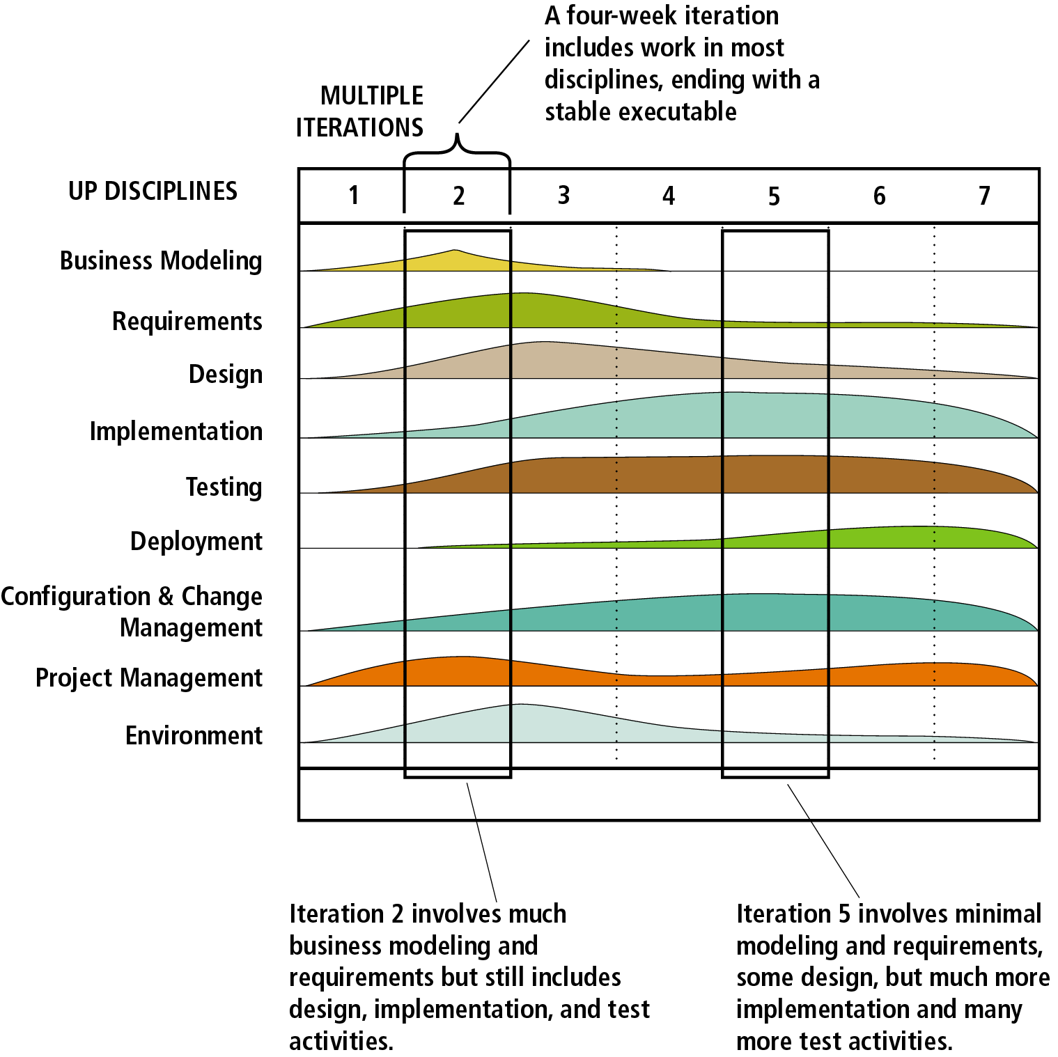
Unified Development Process [3]

Slide 6
The Unified Process
Component based - meaning the software system is built as a set of software components interconnected via interfaces
Uses the Unified Modeling Language (UML)
Use case driven
Architecture-centric
Iterative and incremental
This is what makes
the Unified process
Unique
Component: A physical and replaceable part of a system that conforms to and provides realization of a set of interfaces.
Interface: A collection of operations that are used to specify a service of a class or a component

Slide 7
The Unified Process
User’s
requirements
Software
Development
Process
Software
System
Based around the 4Ps - People, Project, Product, Process

Slide 8
The Unified Process
Use Case driven
A use case is a piece of functionality in the system that gives a user a result of value.
Use cases capture functional requirements
Use case answers the question: What is the system supposed to do for the user?

Slide 9
The Unified Process
Architecture centric
similar to architecture for building a house
Embodies the most significant static and dynamic aspects of the system
Influenced by platform, OS, DBMS etc.
Related as function (use case) and form (architecture)
Primarily serves the realization of use cases
The form must allow the system to evolve from initial development through future requirements (i.e. the design needs to be flexible)

Slide 10
The Unified Process
Iterative and Incremental
commercial projects continue many months and years
to be most effective - break the project into iterations
Every iteration - identify use cases, create a design, implement the design
Every iteration is a complete development process

Slide 11
An iterative and incremental process
Initial
Planning
Requirements
Planning
Analysis & Design
Management
Environment
Implementation
Evaluate
Deployment
Each iteration
results in executable
release
Test
(Kruchten, 1999)

Slide 12
Iterations
Iterations must be selected & developed in a planned way i.e. in a logical order - early iterations must offer utility to the users
iteration based on a group of use cases extending the usability of the system developed so far
iterations deal with the most important risks first
not all iterations are additive - some replace earlier “superficial” developments with a more sophisticated and detailed one.

Slide 13
Benefits of an iterative approach
Risks are mitigated earlier
Change is more manageable
Higher level of reuse
Project team can learn along the way
Better overall quality

Slide 14
Unified Software Development Process (UP)
Selects from best practices to
Provide a generic process framework
instantiate/specialize for specific application areas, organizations, project sizes, etc.
Define a set of activities (workflows)
transforms users’ requirements into a software system
Define a set of models
from abstract (user-level) to concrete (code)
Allow component-based development
software components interconnected via well-defined interfaces
use-case (UML) and risk driven
architecture-centric
iterative and incremental

Slide 15
Unified Process - Milestones
Milestone: a management decision point in a project that determines whether to authorize movement to the next iteration/phase
Inception phase - agreement among customers/developers on the system’s life cycle objectives
Elaboration phase - agreement on the viability of the life cycle architecture, business case and project plan
Construction phase - agreement on the acceptability of the software product both operationally and in terms of cost
Transition phase - final agreement on the acceptability of the software product

Slide 16
Lifecycle Phases
Inception – “Daydream”
Elaboration – “Design/Details”
Construction – “Do it”
Transition – “Deploy it”
Phases are not the classical requirements/ design/coding/implementation processes
Phases iterate over many cycles

Slide 17
Timeboxing
Management of a UP project.
Iterations are “timeboxed” or fixed in length.
Iteration lengths of between two to six weeks are recommended.
Each iteration period has its own development plan.
If all the planned activities cannot be completed during an iteration cycle, the completion date should not be extended, but rather tasks or requirements from the iteration should be removed and added to the next iteration cycle.

Slide 18
The Unified Process
The Unified Software Development Process is a definition of a complete set of activities to transform users’ requirements through a consistent set of artifacts into a software product
Look at the whole process
Life cycle
Artifacts
Workflows
Phases
Iterations
A process is described in terms of workflows where a workflow is a set of activities with identified artifacts that will be created by those activities

Slide 19
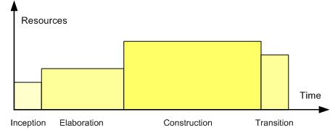
Phases in Unified Process
Profile of a typical project showing the relative sizes of the four phases of the Unified Process.

Slide 20
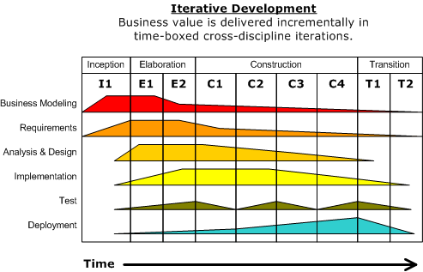
Diagram illustrating how the relative emphasis of different disciplines changes over the course of the project

Slide 21
UP phases are iterative & incremental
Inception
Feasibility phase and approximate vision
Elaboration
Core architecture implementation, high risk resolution
Construction
Implementation of remaining elements
Transition
Beta tests, deployment
Development cycle

Slide 22
Inception ➔ Elaboration ➔ …
During inception, establish business rationale and scope for project
Business case: how much it will cost and how much it will bring in?
Scope: try to get sense of size of the project and whether it’s doable
Creates a vision and scope document at a high level of abstraction
In elaboration, collect more detailed requirements and do high-level analysis and design
Inception gives you the go-ahead to start a project, elaboration determines the risks
Requirement risks: big danger is that you may build the wrong system
Technological risks: can the technology actually do the job? will the pieces fit together?
Skills risks: can you get the staff and expertise you need?
Political risks: can political forces get in the way?
Develop use cases, non-functional requirements & domain model

Slide 23
… ➔ Construction ➔ Transition
Construction builds production-quality software in many increments, tested and integrated, each satisfying a subset of the requirements of the project
Delivery may be to external, early users, or purely internal
Each iteration contains usual life-cycle phases of analysis, design, implementation and testing
Planning is crucial: use cases and other UML documents
Transition activities include beta testing, performance tuning (optimization) and user training
No new functionality unless it’s small and essential
Bug fixes are OK

Slide 24
UP artifacts
The UP describes work activities, which result in work products called artifacts
Examples of artifacts:
Vision, scope and business case descriptions
Use cases (describe scenarios for user-system interactions)
UML diagrams for domain modeling, system modeling
Source code (and source code documentation)
Web graphics
Database schema

Slide 25
Milestone for first Elaboration
At start of elaboration, identify part of the project to design & implement
A typical and crucial scenario (from a use case)
After first elaboration, project is, say, 1/5th done
Can then provide estimates for rest of project
Significant risks are identified and understood
How is such a milestone different from a stage in the waterfall model?

Slide 26
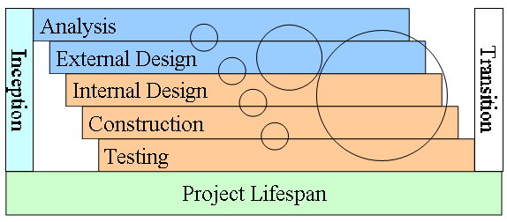
What does diagram imply about UP?
How can iterations reduce risk or reveal problems?

Slide 27
Inception Phase
Purpose
To establish the business case for a new system or for a major update of an existing system
To specify the project scope
Outcome
A general vision of the project’s requirements, i.e., the core requirements
– Initial use-case model and domain model (10-20% complete)
An initial business case, including:
– Success criteria (e.g., revenue projection)
– An initial risk assessment
– An estimate of resources required
Milestone: Lifecycle Objectives

Slide 28
Elaboration Phase
Purpose
To analyze the problem domain
To establish a sound architectural foundation
To address the highest risk elements of the project
To develop a comprehensive plan showing how the project will be completed
Outcome
Use-case and domain model 80% complete
An executable architecture and accompanying documentation
A revised business case, incl. revised risk assessment
A development plan for the overall project
Milestone: Lifecycle Architecture

Slide 29
Construction Phase
Purpose
To incrementally develop a complete software product which is ready to transition into the user community
Products
A complete use-case and design model
Executable releases of increasing functionality
User documentation
Deployment documentation
Evaluation criteria for each iteration
Release descriptions, including quality assurance results
Updated development plan
Milestone: Initial Operational Capability

Slide 30
Transition Phase
Purpose
To transition the software product into the user community
Products
Executable releases
Updated system models
Evaluation criteria for each iteration
Release descriptions, including quality assurance results
Updated user manuals
Updated deployment documentation
“Post-mortem” analysis of project performance
Milestone: Product Release

Slide 31
Best Practices and Key Concepts
Tackle high-risk and high-value issues in early iterations.
Continuously engage users for evaluation, feedback and requirements
Build a cohesive, core architecture in early iterations
Continuously verify quality; test early, often and realistically
Apply use cases where appropriate
Do some visual modeling (with the UML)
Carefully manage requirements
Practice change request and configuration management.

Slide 32
Questions
What are the four lifecycle phases of UP?
What happens in each?
What are the process disciplines?
What are some major differences between distinguishes UP and the waterfall model?

Slide 33
Requirements Engineering
"The hardest single part of building a software system is deciding what to build. ..No other part of the work so cripples the resulting system if done wrong. No other part is more difficult to rectify later."

Slide 34
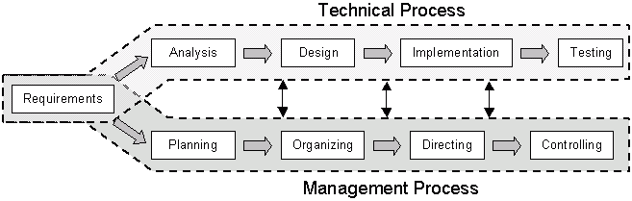
Requirements drive the technical and management processes

Slide 35
What is a Software Requirement
[IEEE 90] defines a requirement as:
(1) A condition or capability needed by a user to solve a problem or achieve an objective. (2) A condition or capability that must be met or possessed by a system or system component to satisfy a contract, standard, specification, or other formally imposed document. (3) A documented representation of a condition or capability as in (1) or (2).

Slide 36
What is this Phase For?
Major misconception
determining what client wants
“I know you believe you understood what you think I said, but I am not sure you realize that what you heard is not what I meant!”
Must determine client’s & user’s needs
chances for success slim if you don’t figure this out!

Slide 37
Requirements--What are They?
A requirement is a description of a system feature, capability, or constraint.
Classes of Requirements:
functional
nonfunctional (constraints)
Requirements Priority
essential (“shalls”)
highly desirable (“shoulds”)
desirable but low priority

Slide 38
Types of Requirements
Physical environment
Interfaces
Users and human factors
functionality
performance
documentation/training
data
resources
security
reliability
portability
maintenance
etc.

Slide 39
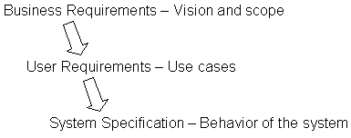
Levels of Requirements

Slide 40
Levels of Requirements
Business requirements - objectives of the customer or user of the system
User requirements - tasks the user needs to accomplish with the system.
System specification (functional requirements) - system behavior that will allow users to perform their tasks.

Slide 41
Levels of Requirements-Examples
Business requirement = Hospital needs to get drug information in the hands of pharmacists and doctors so they can make better decisions about which drugs to prescribe for patients.
User Requirement = The pharmacist should be able to enter a drug name and get back information about side affects, dosage and drug interactions.
System specification = The system will keep a database of drug names including scientific name, generic name and brand name. The system will return all drug names that match a full or partial name. If more than one drug name matches the user will have the option of selecting one of the drugs in the list.

Slide 42
Requirements Analysis [1]
What is it?
The process by which customer needs are understood and documented.
Expresses “what” is to be built and NOT “how” it is to be built.
Example 1:
The system shall allow users to withdraw cash. [What?]
Example 2:
A sale item’s name and other attributes will be stored in a hash table and updated each time any attribute changes. [How?]

Slide 43
Requirements Analysis [2]
C- and D-Requirements
C-: Customer wants and needs; expressed in language understood by the customer.
D-: For the developers; may be more formal.

Slide 44
Requirements Analysis [2]
Why document requirements?
Serves as a contract between the customer and the developer.
Serves as a source of test plans.
Serves to specify project goals and plan development cycles and increments.

Slide 45
Requirements Analysis [3]
Roadmap:
Identify the customer.
Interview customer representatives.
Write C-requirements, review with customer, and update when necessary.
Write D-requirements; check to make sure that there is no inconsistency between the C- and the D-requirements.

Slide 46
Requirements Analysis [4]
C-requirements:
Use cases expressed individually and with a use case diagram. A use case specifies a collection of scenarios.
Sample use case: Process sale.
Data flow diagram:
Explains the flow of data items across various functions. Useful for explaining system functions. [Example on the next slide.]
State transition diagram:
Explains the change of system state in response to one or more operations. [Example two slides later.]
User interface: Generally not a part of requirements analysis though may be included.

Slide 47
Data Flow Diagram
Employee Record
Overtime
rate
Get employee
file
Pay rate
Company records
*
Weekly
pay
Pay
ID
*
Overtime
pay
*
Regular
hours
Overtime
hours
Total pay
Worker
Deduct
taxes
Tax rates
Net pay
Check
Issue
paycheck

Slide 48
State Transition Diagram (STD)
Elevator example (partial):
EBP(e,f)
EBOFF (e,f)
EBON (e,f)
EBP(e,f)
EBOFF (e,f): Elevator e button OFF at floor f.
EBON (e,f): Elevator e button ON at floor f.
EBP(e,f): Elevator e button f is pressed.
EAF(e,f): Elevator e arrives at floor f.

Slide 49
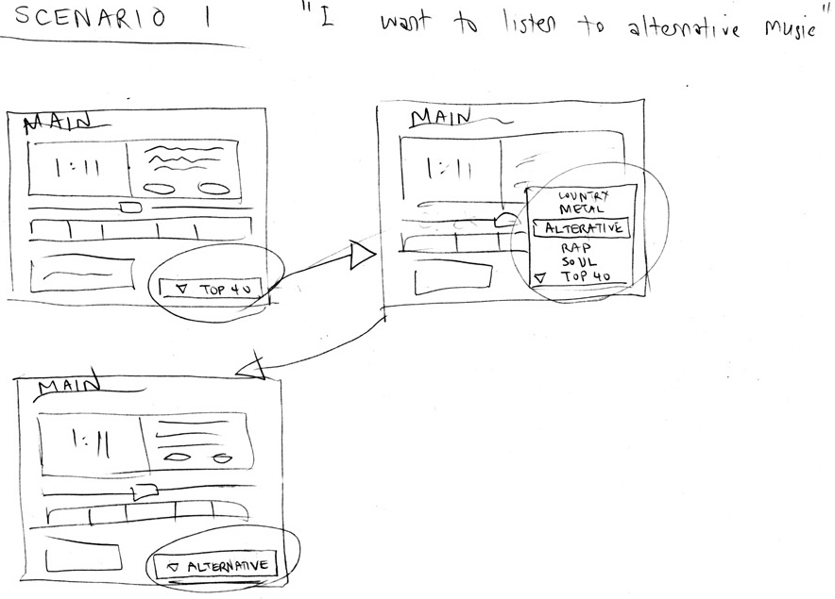
Scenarios
Illustrate the major events/actions to users
often use storyboards & paper prototypes

Slide 50
Rapid Prototyping
Allow users to “see” & use proposed solutions
Develop specification from the prototype/requirements
Prototype must be constructed & changed quickly
key functionality
omits things like scalability, error checking, saving, etc.
do not spend a lot of time perfecting the code/structure
it is OK if it hardly works or crashes every few minutes
plan to throw it away! because you will!
put in front of customer ASAP & modify in response

Slide 51
Requirements Analysis [5]
D-requirements:
Organize the C-requirements.
Create System sequence diagrams for use cases:
Obtain D-requirements from C-requirements and customer.
Outline test plans
Inspect
Validate with customer.
Release:

Slide 52
Requirements Analysis [6]
Organize the D-requirements.
Functional requirements
The blood pressure monitor will measure the blood pressure and display it on the in-built screen
Non-functional requirements
Performance
The blood pressure monitor will complete a reading within 10 seconds.
Reliability
The blood pressure monitor must have a failure probability of less than 0.01 during the first 500 readings.

Slide 53
Requirements Analysis [7]
(c) Interface requirements: interaction with the users and other applications
The blood pressure monitor will have a display screen and push buttons. The display screen will….
(d) Constraints: timing, accuracy
The blood pressure monitor will take readings with an error less than 2%.

Slide 54
Requirements Analysis [7]
Properties of D-requirements:
Traceability: Functional requirements
D-requirement → inspection report → design segment → code segment → code inspection report → test plan → test report
Traceability: Non-Functional requirements
Isolate each non-functional requirement.
Document each class/function with the related non-functional requirement.

Slide 55
Requirements Analysis [8]
Properties of D-requirements:
3. Testability
It must be possible to test each requirement. Example ?
4. Categorization and prioritization

Slide 56
Categorizing Requirements
How to categorize system functions?

Slide 57
Prioritizing (Ranking) Use Cases
Strategy :
pick the use cases that significantly influence the core architecture
pick the use cases that are critical to the success of the business
a useful rule of thumb - pick the use cases that are the highest risk!!!

Slide 58
Requirements Analysis [9]
Properties of D-requirements:
5. Completeness
Self contained, no omissions.
6. Error conditions
State what happens in case of an error. How should the implementation react in case of an error condition?

Slide 59
Requirements Analysis [10]
Properties of D-requirements:
7. Consistency
Different requirements must be consistent.
Example:
R1.2: The speed of the vehicle will never exceed 250 mph.
R5.4: When the vehicle is cruising at a speed greater than 300 mph, a special “watchdog” safety mechanism will be automatically activated.

