Slide 1
BITS Pilani presentation
Dr. Yashvardhan Sharma
Computer Science and Information Systems

Slide 2
SS ZG514/SE Z512
Object Oriented Analysis and Design
Lecture No.4

Slide 3
Today’s Agenda
Use Case Modeling

Slide 4
Use Case Model

Slide 5
The Use Case Model
Writing Requirements in Context
Identify user goals, corresponding system functions / business processes
Brief, casual, and “fully-dressed” formats
Iterative refinement of use cases

Slide 6
Use Cases
Use case - narration of the sequence of events of an actor using a system
UML icon for use case

Slide 7
Actors [1]
Actor - an entity external to the system that in some way participates in the use case
An actor typically stimulates the system with input events or receives outputs from the system or does both.
UML notation for actor:

Slide 8
Actors [2]
Primary Actor - an entity external to the system that uses system services in a direct manner.
Supporting Actor- an actor that provides services to the system being built.
Hardware, software applications, individual processes, can all be actors.

Slide 9
Use case and Scenario
Scenario: specific sequence of actions and interactions between actor(s) and system (= one story; success or failure)
Use Case: collection of related success and failure scenarios describing the actors attempts to support a specific goal

Slide 10
Use-Case Modeling
In use-case modeling, the system is looked upon as a black box whose boundaries are defined by its functionality to external stimuli.
The actual description of the use-case is usually given in plain text. A popular notation promoted by UML is the stick figure notation.
Both visual and text representation are needed for a complete view.
A use-case model represents the use-case view of the system. A use-case view of a system may consist of many Use-case diagrams.
An use-case diagram shows (the system), the actors, the use-cases and the relationship among them.

Slide 11
Components of Use-case Model
The components of a Use-case model are:
System Modeled
Actors
Use-cases
Stimulus
System Name
name
Use-case

Slide 12
System
As a part of the use-case modeling, the boundaries of the system are developed.
System in the use-case diagram is a box with the name appearing on the top.
Define the scope of the system that you are going to design with your (software scope)
Software Appln.

Slide 13
Actors
An actor is something or someone that interacts with the system.
Actor communicates with the system by sending and receiving messages.
An actor provides the stimulus to activate an Use-case.
Message sent by an actor may result in more messages to actors and to Use-cases.
Actors can be ranked: primary and secondary; passive and active.
Actor is a role not an individual instance.

Slide 14
Finding Actors
The actors of a system can be identified by answering a number of questions:
Who will use the functionality of the system?
Who will maintain the system?
What devices does the system need to handle?
What other system does this system need to interact?
Who or what has interest in the results of this system?

Slide 15
Use-cases
A Use-case in UML is defined as a set of sequences of actions a system performs that yield an observable result of value to a particular actor.
Actions can involve communicating with number of actors as well as performing calculations and work inside the system.
A Use-case
is always initiated by an actor.
provides a value to an actor.
must always be connected to at least one actor.
must be a complete description.

Slide 16
Finding Use-cases
For each actor ask these questions:
Which functions does the actor require from the system?
What does the actor need to do?
Could the actor’s work be simplified or made efficient by new functions in the system?
What events are needed in the system?
What are the problems with the existing systems?
What are the inputs and outputs of the system?

Slide 17
Describing Use-cases
Use-case Name:
Use-case Number: system#.diagram#.Use-case#
Authors:
Event(Stimulus):
Actors:
Overview: brief statement
Related Use-cases:
Typical Process description: Algorithm
Exceptions and how to handle exceptions:

Slide 18
Stories
Using a system to meet a goal; e.g. (brief format) --
Process Sale: A customer arrives at a checkout with items to purchase. The cashier uses the POS system to record each purchased item. The system presents a running
Total and line-item details. The customer enters payment information, which the system validates and records. The system updates inventory. The customer receives a
Receipt from the system and then leaves with the items.
Usually, writing the stories is more important than diagramming a use case model in UML

Slide 19
Example (casual format)
Handle Returns Main Success Scenario: A customer arrives at a checkout with items to return. The cashier uses the POS system to record each returned item… Alternate Scenarios: If they paid by credit, and the reimbursement transaction to their credit account is rejected, inform the customer and pay them with cash.
If the item identifier is not found in the system, notify the cashier and suggest manual entry of the identifier code
If the system detects failure to communicate with the external accounting system… (etc.)

Slide 20
The Primary Course-Success Scenario
Check Out Item:
1. Cashier swipes product over scanner, scanner reads UPC code.
2. Price and description of item, as well as current subtotal appear on the display facing the customer. The price and description also appear on the cashier’s screen.
3. Price and description are printed on reciept.
4. System emits an audible “acknowledgement” tone to tell the cashier that the UPC code was correctly read.

Slide 21
Alternate Courses -Failure Scenario
UPC Code Not Read:
If the scanner fails to capture the UPC code, the system should emit the “reswipe” tone telling the cashier to try again. If after three tries the scanner still does not capture the UPC code, the cashier should enter it manually.
No UPC Code:
If the item does not have a UPC code, the cashier should enter the price manually.

Slide 22
Observable Result of Value
“A key attitude in use case work is to focus on the question ‘How can using the system provide observable value to the user, or fulfill their goals?’, rather than merely thinking of requirements in terms of a list of features or functions”
Focus on business process, not technology features

Slide 23
Black Box Use Cases
Focus on “what”, not “how”
Good: The system records the sale
Bad: The system writes the sale to a database
Worse: The system generates a SQL INSERT statement…
Premature design decisions!
Analysis vs. Design = “What” vs. “How”

Slide 24
Degrees of Use Case Formality
Brief: one-paragraph summary, main success scenario
Casual: multiple, informal paragraphs covering many scenarios
Fully-Dressed: all steps and variations written in detail with supporting sections

Slide 25
NextGen POS Example
Starts on page 68 in the book (Larman)
A fully-dressed example

Slide 26
Fully-Dressed Format
Primary Actor
Stakeholders & Interests
Preconditions
Success Guarantee (Postconditions)
Main Success Scenario (Basic Flow)
Extensions
(Alternative Flows)
Special Requirements
Technology and Data Variations
Frequency of Occurrence
Open Issues

Slide 27
Details…
Stakeholders and Interests
Important: defines what the use case covers (“all and only that which satisfies the stakeholders’ interests”)
Preconditions
What must always be true before beginning a scenario in the use case (e.g., “user is already logged in”)

Slide 28
Details…[2]
Success Guarantees (Postconditions)
What must be true on successful completion of the use case; should meet needs of all stakeholders
Basic Flow
Records steps: interactions between actors; a validation (by system); a state change (by system)

Slide 29
Details…[3]
Extensions (Alternative Flows)
Scenario branches (success/failure)
Longer/more complex than basic flow
Branches indicated by letter following basic flow step number, e.g. “3a”
Two parts: condition, handling
Special Requirements
Non-functional considerations (e.g., performance expectations)

Slide 30
Details…[4]
Technology & Data Variations
Non-functional constraints expressed by the stakeholders (e.g., “must support a card reader”)

Slide 31
Identify Use Cases
Capture the specific ways of using the system as dialogues between an actor and the system.
Use cases are used to
Capture system requirements
Communicate with end users and Subject Matter Experts
Test the system

Slide 32
Specifying Use Cases
Create a written document for each Use Case
Clearly define intent of the Use Case
Define Main Success Scenario (Happy Path)
Define any alternate action paths
Use format of Stimulus: Response
Each specification must be testable
Write from actor’s perspective, in actor’s vocabulary

Slide 33
Identification of Use Cases [1]
Method 1 - Actor based
Identify the actors related to the system
Identify the scenarios these actors initiate or participate in.
Method 2 - Event based
Identify the external events that a system must respond to
Relate the events to actors and use cases
Method 3 – Goal based
[Actors have goals.]
Find user goals. [Prepare actor-goal list.]
Define a use case for each goal.

Slide 34
Identification of Use Cases[2]
To identify use cases, focus on elementary business processes (EBP).
An EBP is a task performed by one person in one place at one time, in response to a business event. This task adds measurable business value and leaves data in a consistent state.

Slide 35
Use Cases and Goals
Q1: “What do you do?”
Q2: “What are your goals?”
Which is a better question to ask a stakeholder?
Answer: Q2. Answers to Q1 will describe current solutions and procedures; answers to Q2 support discussion of improved solutions

Slide 36
Finding Actors, Goals & Use Cases
Choose the system boundary
Software, hardware, person, organization
Identify the primary actors
Goals fulfilled by using the system
Identify goals for each actor
Use highest level that satisfies EBP
Exception: CRUD (next slide)
Define use cases that satisfy goals

Slide 37
Create, Retrieve, Update, Delete (CRUD)
E.g., “edit user”, “delete user”, …
Collapse into a single use case (e.g., Manage Users)
Exception to EBP
Don’t take place at the same place/time
But since it’s so common, it would inflate the number of use cases to model each action as a separate use case

Slide 38
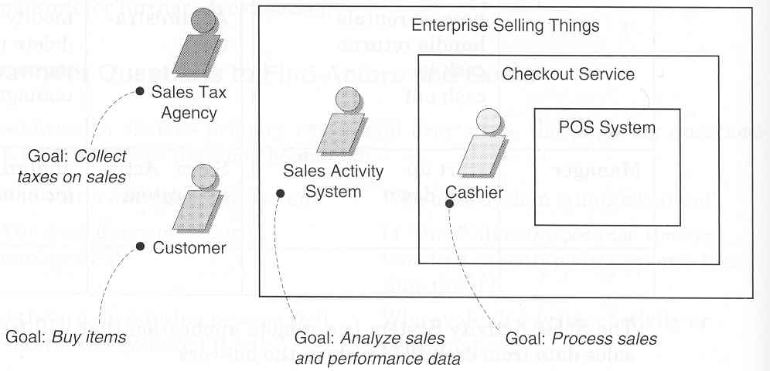
Actors, Goals & Boundaries

Slide 39
Back to POST - Actors
Actors:
Cashier
Customer
Supervisor
Choosing actors:
Identify system boundary
Identify entities, human or otherwise, that will interact with the system, from outside the boundary.
Example: A temperature sensing device is an actor for a temperature monitoring application.

Slide 40
POST - Use Cases: First Try
Cashier
Log In
Cash out
Customer
Buy items
Return items

Slide 41
Common mistake
Representing individual steps as use cases.
Example: printing a receipt (Why is this being done ?)

Slide 42
High level vs. Low Level Use cases[1]
Consider the following use cases:
Log out
Handle payment
Negotiate contract with a supplier
These use cases are at different levels. Are they all valid? To check, use the EBP definition.
Use Cases can be defined at different levels of granularity

Slide 43
High level vs. Low Level Use cases [2]
Log out: a secondary goal; it is necessary to do something but not useful in itself.
Handle payment: A necessary EBP. Hence a primary goal.
Negotiate contract: Most likely this is too high a level. It is composed of several EBPs and hence must be broken down further.

Slide 44
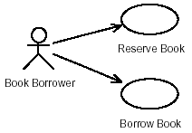
• Use case diagrams in UML are very easy to understand
without knowing UML in detail!
– Actors (external users of the system - also includes other systems)
– Use cases (how the system can be used by the user)
Example
Book Borrower can Reserve Book and Borrow Book – the only two operations defined

Slide 45
Use Case Diagram - Example
Process sale
Payment
Authorization
service
Cashier
Handle returns
<<actor>>
Tax calculator
Process rental
Manage security
<<actor>>
Accounting system
System administrator
Manage users
Use Case Diagram: illustrates a set of use cases for a system.

Slide 46
More on Use Cases
Narrate use cases independent of implementation
State success scenarios (how do you determine the success of a use case).
A use case corresponds to one or more scenarios.
Agree on a format for use case description
Name a use case starting with a verb in order to emphasize that it is a process (Buy Items, Enter an order, Reduce inventory)

Slide 47
Exception handling
Document exception handling or branching
What is expected of the system when a “Buy Item” fails ?
What is expected of the system when a “credit card” approval fails ?

Slide 48
A sample Use Case
Use case: Buy Items
Actors: Customer, Cashier
Description: A customer arrives at a checkout with
items to purchase. The cashier records
the purchase items and collects payment.

Slide 49
Ranking Use Cases
Use some ordering that is customary to your environment
Example: High, Medium, Low
Example: Must have, Essential, Nice to have
Useful when deciding what goes into an increment
POST example:
Buy Items - High
Refund Items - Medium (Why?)
Shut Down POST terminal - Low

Slide 50
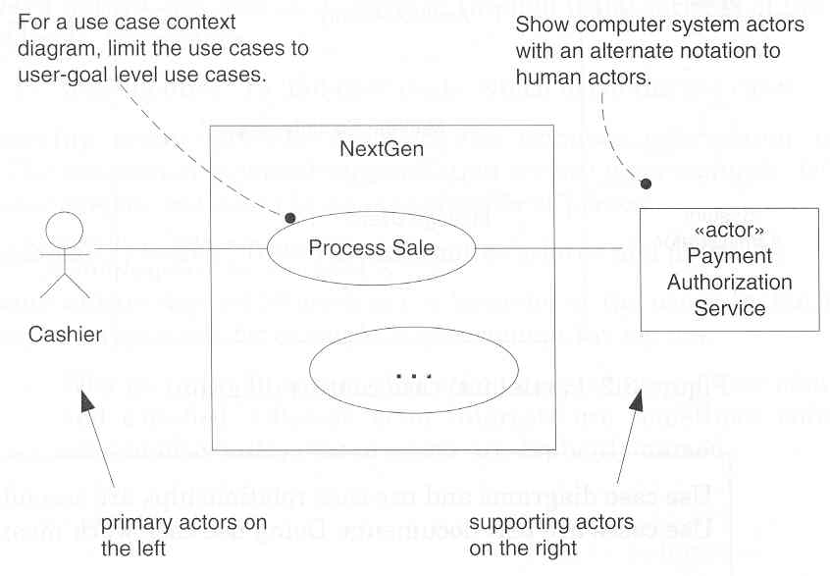
Notation Guidelines

Slide 51
Use Case Tips
Keep them Simple.
Don’t worry about capturing all the use cases.
Don’t worry about finding all the details
They are going to change tomorrow.
They are Just in Time Requirement.

Slide 52
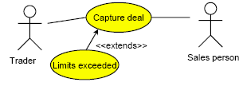
Extend
Use the extend relationship when you have a use case that is similar to another use case but does a bit more.
In this example the basic use case is Capture deal.
• In case certain limits for a deal are exceeded the additional use case Limits exceeded is performed.

Slide 53
Extend
Extensions are used instead of modeling every extra case by a single use case.
Extensions are used instead of creating a complex use case that covers all variations.
How do you address case variation?
• Capture the simple, normal use case first.
• For every step in that use case ask: “What could go wrong here?“
• Plot all variations as extensions of the given use case.

Slide 54
<<extend>> relationships represent exceptional or seldom invoked cases.
The exceptional event flows are factored out of the main event flow for clarity.
Use cases representing exceptional flows can extend more than one use case.
The direction of a <<extend>> relationship is to the extended use case
Note direction
of arrow
Passenger
PurchaseTicket
<<extend>>
<<extend>>
<<extend>>
OutOfOrder
<<extend>>
TimeOut
<<extend>> shown
with dotted line
Cancel
NoChange

Slide 55
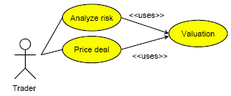
Include
The Include relationship occurs when you have a chunk of behavior that is similar across several use cases.

Slide 56
Include and Extend
The similarities between extend and Include are that they both imply factoring out common behavior from several use cases to a single use case that is
• used by several other use cases or
• extended by other use cases.
Apply the following rules:
• Use extend, when you are describing a variation on normal behavior.
• Use Include when you want to split off repeating details in a use case.

Slide 57
Note direction
and type
of arrow
Record completion
of an advert
Staff Member
Change a client
contact
Manger is a
Specialization
of Staff Member
Generalization
of functionality
Assign individual staff to work on a campaign
Assign staff to work on a campaign
Manager
Assign team of staff to work on a campaign
Manager can do everything
that Staff Member can do, and more.

Slide 58
Drawing System Sequence Diagrams

Slide 59
System Behavior
Objective
identify system events and system operations
create system sequence diagrams for use cases

Slide 60
System Behavior and UML Sequence Diagrams
It is useful to investigate and define the behavior of the software as a “black box”.
System behavior is a description of what the system does (without an explanation of how it does it).
Use cases describe how external actors interact with the software system. During this interaction, an actor generates events.
A request event initiates an operation upon the system.

Slide 61
System Behavior and System Sequence Diagrams (SSDs)
A system sequence diagram is a picture that shows, for a particular scenario of a use case, the events that external actors generate, their order, and possible inter-system events.
All systems are treated as a black box; the diagram places emphasis on events that cross the system boundary from actors to systems.

Slide 62
System sequence diagram-Example Process Sale scenario
:System
:Cashier
makeNewsale()
enterItem(itemID, quantity)
Description, total
[* more items]
Box to enclose
an iteration area.
endSale()
total with taxes
makePayment(amount)
change due, receipt

Slide 63
SSD and Use Cases
:System
:Cashier
makeNewSale()
Simple cash-only Process Sale Scenario
1. Customer arrives at a POS checkout
with goods to purchase.
2. Cashier starts a new sale.
3. Cashier enters item identifier.
4. System records sale line item, and
presents item description, price and
running total.
cashier repeats steps 3-4 until
indicates done.
5. System presents total with taxes
calculated.
…
addLineItem(itemID, quantity)
description, total
*[more items]
endSale()
total with taxes
makePayment(amount)
change due, receipt

Slide 64
System sequence diagrams [1]
SSD drawing occurs during the analysis phase of a development cycle; dependent on the creation of the use cases and identification of concepts.
A system sequence diagram illustrates events from actors to systems and the external response of the system
UML notation - Sequence Diagram not System Sequence Diagram.

Slide 65
System sequence diagrams [2]
One diagram depicts one scenario. This is the main success scenario.
Frequent or complex alternate scenarios could also be illustrated.
A system is treated as a black box.
SSD is often accompanied by a textual description of the scenario to the left of the diagram.

Slide 66
System sequence diagram [3]
Identify the system boundary…what is inside and what is outside.
System event: An external event that directly stimulates the (software) system.
Events are initiated by actors.
Name an event at the level of intent and not using their physical input medium or interface widgets.
enterItem() is better than scan().
Keep the system response at an abstract level.
description, total is preferred over display description and total on the POS screen.

Slide 67
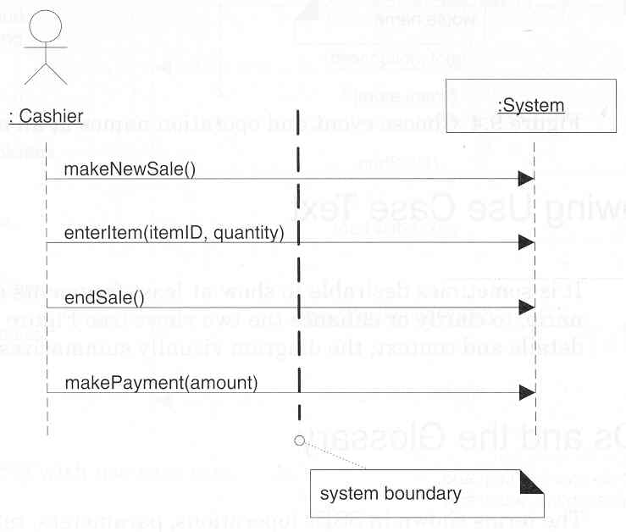
The System Boundary
[Larman, 2002]

Slide 68
Agate Case Study
Agate is an advertising agency in Birmingham. Agate deals with other companies that it calls clients. A record is kept of each client company. Clients have advertising campaign, and a record is kept of every campaign. Each campaign includes one or more adverts. Agate nominates members of creative team, which work on campaign.
One member of the creative team manages each campaign. Staff may be working on more than one project at a time. When a campaign starts, the manager responsible estimates the likely cost of the client and agrees it with the client. A finish date may be set for a campaign at any time, and may be changed. When the campaign is completed, an actual completion date and the actual cost are recorded. When the client pays, the date paid is recorded. The manager checks the campaign budget periodically.
The system should also hold the staff grades and calculate staff salaries.

Slide 69
Sample Requirements List
No. | Requirement | Use Case(s)
1. | To record names, address and contact details for each client. | Add a new client
2. | To record the details of each campaign for each client. This will include the title of the campaign, planned start and finish dates, estimated costs, budgets, actual costs and dates, and the current state of completion. | Add a new campaign
3. | To provide information that can be used in the separate accounts systems for invoicing clients for campaigns. | Record completion of a campaign
4. | To record payments for campaign that are also recorded in the separate accounts system. | Record client payment
5. | To record which staff are working on which campaigns, including the campaign manager for each campaign. | Assign staff to work on a campaign

