Slide 1
BITS Pilani presentation
Dr. Yashvardhan Sharma
Computer Science and Information Systems

Slide 2
SS ZG514/SE Z512
Object Oriented Analysis and Design
Lecture No.9

Slide 3
Today’s Agenda
Object Oriented Design
GRASP Patterns

Slide 4
Four More GRASP Patterns
Polymorphism
Indirection
Pure Fabrication
Protected Variations

Slide 5
Polymorphism
Problem:
How to handle alternatives based on type. Pluggable software components -- how can you replace one server component with another without affecting the client?
Solution:
When related alternatives or behaviors vary by type (class), assign responsibility for the behavior – using polymorphic operations – to the types for which the behavior varies. In this context, polymorphism means giving the same name to similar or related services

Slide 6
Polymorphism
One way to handle type-based alternatives is with conditionals: if…else or switch…case statements
For example, the sqrt function has polymorphic variants for float and double
(how does it really work?)
(other examples?)

Slide 7
Polymorphism – Pluggable Components
Tax calculator uses a standard interface, the TaxCalculatorAdapter, to call any of the actual calculators.

Slide 8
Pure Fabrication
What object should have responsibility when you don’t want to violate High Cohesion and Low Coupling or other goals, but solutions offered by Expert (for example) aren’t appropriate?
Having classes that represent only domain-layer concepts leads to problems.

Slide 9
Pure Fabrication
Assign a highly cohesive set of responsibilities to a convenience class that does not represent a domain object, but which supports high cohesion, low coupling, and reuse.
Called “fabrication” because it is “made up,” not immediately obvious

Slide 10
Pure Fabrication
Database operations are often put in a convenience class. Saving a Sale object might, by Expert, belong in the Sale class
Using a “fabricated” class increases the cohesion in Sale and reduces the coupling
The idea of “persistent storage” is not a domain concept

Slide 11
Object Design
By representational decomposition
By behavioral decomposition
Most objects represent things in the problem domain, and so are derived by the former
Sometimes it is useful to group methods by a behavior or algorithm, even if the resulting class doesn’t have a real-world representation

Slide 12
Object Design
TableOfContents would represent an actual table of contents.
TableOfContentsGenerator is a pure fabrication class that creates tables of contents.

Slide 13
Contraindications
This can be overused. Information Expert is often a better choice, since it has the information. Use with caution.

Slide 14
Indirection Pattern
Problem is how to de-couple objects so that low coupling is supported and the chance of reuse is increased? A related issue is to avoid writing special-purpose code too high up in your application.
Solution is to create an intermediate object that “talks” to both sides.

Slide 15
Indirection
Example is the TaxCalculatorAdapter. These provide a consistent interface to disparate inner objects and hide the variations
“Most problems in computer science can be solved by adding another layer of indirection.”
“Many performance problems can be solved by removing another layer of indirection.”

Slide 16
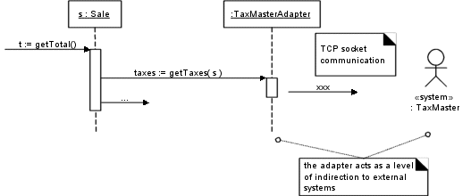
TaxCalculatorAdapter – acts as intermediaries to external tax calculators

Slide 17
Protected Variations
Problem : How to design objects, subsystems, and systems so that the variations or instability in these elements does not have an undesirable impact on other elements.
Solution: identify points of predicted variation or instability; assign responsibilities to create a stable interface around them

Slide 18
Protected Variations
Example –NextGen POS: The prior external tax calculator problem and its solution with Polymorphism illustrate Protected Variations
The point of instability or variation is the different interfaces or APIs of external tax calculators
By adding a level of indirection, an interface, and using polymorphism with various ITaxCalculatorAdapter implementations, protection within the system from variations in external APIs is achieved.
Internal objects collaborate with a stable interface; the various adapter implementations hide the variations to the external systems.

Slide 19
Protected Variations
Many other patterns and concepts in software design derive from this, including data encapsulation, polymorphism, data-driven designs, interfaces, virtual machines, etc.

Slide 20
Data-Driven Designs
These include techniques such as reading codes, values, class file paths, class names and so on from an external source to “parameterize” a system at run time
Also includes style sheets, metadata, reading window layouts, etc.

Slide 21
Protected Variations example
The tax calculator problem illustrates this. The point of instability is the different interfaces of different calculators
This pattern protects against variations in external APIs

Slide 22
Service Lookup
Includes techniques such as using naming services (like JNDI (Java Naming and Directory Interface) in Java)
Protects clients from variations in the location of services
Special case of data-driven design

Slide 23
Interpreter-Driven Designs
Include rule interpreters that execute rules read from an external source, script or language interpreters that read and run programs, virtual machines, constraint logic engines, etc.
Allows changing the behavior of a system via external logic
SQL stored functions; Excel formulas

Slide 24
Reflective or Meta-Level Designs
Getting metadata from an external source.
Special case of data-driven design

Slide 25
Uniform Access
Syntactic construct so that both a method and field access are expressed the same way
For example aCircle.radius may invoke a radius() method or simply refer to the radius field.

Slide 26
Standard Languages
Stick with standards such as SQL provide protection against a proliferation of varying languages.

Slide 27
Liskov Substitution Principle
“What is wanted here is something like the following substitution property: If for each object o1 of type S there is an object o2 of type T such that for all programs P defined in terms of T, the behavior of P is unchanged when o1 is substituted for o2 then S is a subtype of T

Slide 28
Liskov Substitution Principle
Translating: software that refers to a type T should work properly with any subclass of T

Slide 29
Don’t Talk to Strangers
Original version of Protected Variations. A method should only send messages to:
The this object (self)
A parameter of the method
An attribute of this
An element of a collection which is an attribute of this
An object created within the method.

Slide 30
Possible Problems with PV
Overgeneralization: trying to protect against future variations by writing code that can be extended, when these variations will never happen

Slide 31
Information Hiding
Private variables
Hide information about the design from other modules, at the points of difficulty or likely change. (David Parnas)

Slide 32
Open-Closed Principle
Modules should be both open (for extension) and closed (to modification in ways that affect clients.)
OCP includes all software components, including methods, classes, subsystems, applications, etc.

Slide 33
OO Design Rules

Slide 34
Object-Oriented Design Process in the Unified Approach
Notes:
During the design phase, we must elevate the model into actual objects that can perform the required task. There is a shift in emphasis from the application domain to implementation. The classes identified during analysis provide us a framework for the design phase. In this part, we discuss business, view, and access layers classes.

Slide 35
OO Design Axioms
An axiom = is a fundamental truth that always is observed to be valid and for which there is no counterexample or exception.
A theorem = is a proposition that may not be self-evident but can be proven from accepted axioms. Therefore, is equivalent to a law or principle.
A theorem is valid if its referent axioms & deductive steps are valid.
A corollary = is a proposition that follows from an axiom or another proposition that has been proven

Slide 36
Suh’s design axioms to OOD :
Axiom 1 : The independence axiom. Maintain the independence of components
Axiom 2 : The information axiom. Minimize the information content of the design.
Axiom 1➔ states that, during the design process, as we go from requirement and use-case to a system component, each component must satisfy that requirement, without affecting other requirements
Axiom 2 ➔ concerned with simplicity.

Slide 37
Occam’s razor rule of simplicity in OO terms
The best designs usually involve the least complex code but not necessarily the fewest number of classes or methods. Minimizing complexity should be the goal, because that produces the most easily maintained and enhanced application. In an object-oriented system, the best way to minimize complexity is to use inheritance and the system’s built-in classes and to add as little as possible to what already is there.

Slide 38
Corollaries
May be called Design rules, and all are derived from the two basic axioms :
The origin of collaries as shown in figure 2. Corollaries 1,2 and 3 are from both axioms, whereas corollary 4 is from axiom 1 and corollaries 5 & 6 are from axiom 2.

Slide 39
Origin of corollaries
Corollary 4
Corollary 1
Axiom 1
Corollary 2
Axiom 2
Corollary 3
Corollary 6
Corollary 5

Slide 40
Corollary 1 : Uncoupled design with less information content.
Highly cohesive objects can improve coupling because only a minimal amount of essential information need be passed between objects
Main goal ➔ maximize objects cohesiveness among objects & sw components → to improve coupling
Strong coupling among objects complicates a system, since the class is harder to understand or highly interrelated with other classes.
Degree or strength of coupling between two components is measured by the amount & complexity of information transmitted between them

Slide 41
Tightly Coupled Object

Slide 42
OO design has 2 types of coupling : Interaction coupling and Inheritance coupling
Interaction coupling ➔ the amount & complexity of messages between components.
Desirable to have a little interaction.
Minimize the number of messages sent & received by an object

Slide 43
Types of Coupling
Degree of coupling | Name | Description
Very High | Content Coupling | Connection involves direct reference to attributes or methods of another object
High | Common Coupling | Connection involves two objects accessing a ‘global data space’, for both to read & write
Medium | Control Coupling | Connection involves explicit control of the processing logic of one object by another
Low | Stamp coupling | Connection involves passing an aggregate data structure to another object, which uses only a portion of the components of the data structure
Very low | Data coupling | Connection involves either simple data items or aggregate structures all of whose elements are used by the receving object. ( this is the goal of an architectural design)

Slide 44
Inheritance coupling ➔ coupling between super-and subclasses
A subclass is coupled to its superclass in terms of attributes & methods
High inheritance coupling is desirable
Each specialization class should not inherit lots of unrelated & unneeded methods & attributes

Slide 45
Cohesion
Need to consider interaction within a single object or sw component➔ Cohesion
Cohesion ➔ reflects the ‘single-purpose ness’ of an object ( see corollaries 2 & 3 )
Method cohesion → a method should carry only one function.
A method carries multiple functions is undesirable

Slide 46
Corollary 2 : Single purpose
Each class must have a purpose & clearly defined
Each method must provide only one service

Slide 47
Corollary 3 : Large number of simple classes.
Keeping the classes simple allows reusability
A class that easily can be understood and reused (or inherited) contributes to the overall system
Complex & poorly designed class usually cannot be reused
Guideline ➔ The smaller are your classes, the better are your chances of reusing them in other projects. Large & complex classes are too specialized to be reused
The emphasis OOD places on encapsulation, modularization, and polymorphism suggests reuse rather than building anew
Primary benefit of sw reusability ➔Higher productivity

Slide 48
Corollary 4 : Strong mapping.
There must be a strong association between the analysis’s object and design’s object
OOA and OOD are based on the same model
As the model progresses from analysis to implementation, more detailed is added

Slide 49
Corollary 5 : Standardization.
Promote standardization by designing interchangeable components and reusing existing classes or components
The concept of design patterns might provide a way to capture the design knowledge, document it, and store it in a repository that can be shared and reused in different applications

Slide 50
Corollary 6 : Design with inheritance.
Common behavior (methods) must be moved to super classes.
The super class-subclass structure must make logical sense

Slide 51
OO Design Axioms
1. The independence axiom. Maintain the independence
of components.
2. The information axiom. Minimize the complexity (information content) of the design.
• Design rules (axioms):
– Design highly cohesive objects that require low coupling (1, 2).
– Each class should have a single purpose (1, 2).
– A large number of simpler classes enhances reusability (1, 2).
– Map strongly from objects in the analysis to objects in the design (1).
– Promote standardization by reusing classes and building to standard interfaces (2).
– Design for inheritance—move common behavior to superclasses (2).

Slide 52
Restructuring the Design
Factoring
Separate aspects of a method or class into a new method or class
Normalization
Identifies classes missing from the design
Challenge inheritance relationships to ensure they only support a generalization/specialization semantics

Slide 53
Optimizing the Design
Review access paths
Review attributes of each class
Review direct and indirect fan-out
Consider execution order of statements in often-used methods
Avoid recomputation by creating derived attributes and triggers

Slide 54
Five Rules For Identifying Bad Design
If it looks messy then it's probably a bad design
If it is too complex then it's probably a bad design
If it is too big then it's probably a bad design
If people don't like it then it's probably a bad design
If it doesn't work then it's probably a bad design

Slide 55
Avoiding Design Pitfalls
Keep a careful eye on the class design and make sure that an object's role remains well defined
If an object loses focus, you need to modify the design
single purpose

Slide 56
Avoiding Design Pitfalls
Move some functions into new classes that the object would use
uncoupled design with less information content
Break up the class into two or more classes
large number of simple classes

Slide 57
Class Diagrams

Slide 58
Class Diagrams
In the system design of a system, a number of classes are identified and grouped together in a class diagram which helps to determine the static relations between those objects
With detailed modeling, the classes of the conceptual design are often split in a number of subclasses
In order to further describe the behavior of systems, these diagrams can be complemented by state diagram or UML state machine
Also instead of class diagrams, Object role modeling can be used if you just want to model the classes and their relationships

Slide 59
Class Diagrams
The main building block in object oriented modeling
They are used both for general conceptual modeling of the systematics of the application, and for detailed modeling translating the models into programming code
The classes in a diagram represent both the main objects and/or interactions in the application and the objects to be programmed
In the diagram these classes are represented with boxes which contain three parts

Slide 60
Class notation
A class diagram exhibits classes and their
associations used in an application.
Contrast this with a conceptual model which
shows domain concepts and their associations.
ClassName
attributes
methods
A class
Note: you can include visibility attributes: + for public, – for private, # for protected, ~ package (default)

Slide 61
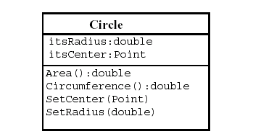
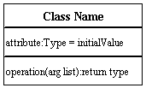
Classes
Classes are the building blocks in object-oriented programming. Illustrate classes with rectangles divided into compartments. Place the name of the class in the first partition (centered, bolded, and capitalized), list the attributes in the second partition, and write operations into the third.

Slide 62
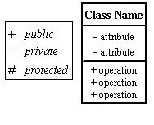
Visibility
Use visibility markers to signify who can access the information contained within a class. Private visibility hides information from anything outside the class partition. Public visibility allows all other classes to view the marked information. Protected visibility allows child classes to access information they inherited from a parent class.

Slide 63
Structural Modeling: Core Elements

Slide 64
Structural Modeling: Core Elements (cont’d)
¹ An extension mechanism useful for specifying structural elements.

Slide 65
Structural Modeling: Core Relationships

Slide 66
Structural Modeling: Core Relationships (cont’d)

Slide 67
Relationships
Association : An Association is a bi-directional connection between classes (e.g. the "hires/works for" relationship between an "employee" class and a "boss" class). It is represented by a solid line. This line can be qualified with the name of relationship, and can also feature multiplicity rules (eg. one-to-one, one-to-many, many-to-many) for the relationship.

Slide 68
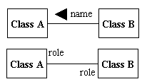
Associations
Associations represent static relationships between classes. Place association names above, on, or below the association line. Use a filled arrow to indicate the direction of the relationship. Place roles near the end of an association. Roles represent the way the two classes see each other. Note:It's uncommon to name both the association and the class roles.

Slide 69
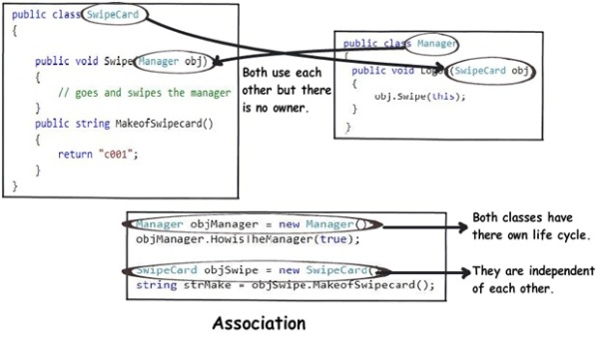

Slide 70
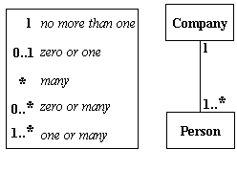
Multiplicity (Cardinality)
Place multiplicity notations near the ends of an association. These symbols indicate the number of instances of one class linked to one instance of the other class. For example, one company will have one or more employees, but each employee works for one company only.

Slide 71

Constraint
Place constraints inside curly braces {}.
Simple Constraint

Slide 72
Relationships
Aggregation: Aggregations indicate a whole-part relationship, and are known as "has-a" relationships. An aggregation is represented as a line connecting the related classes with a diamond next to the class representing the whole.

Slide 73
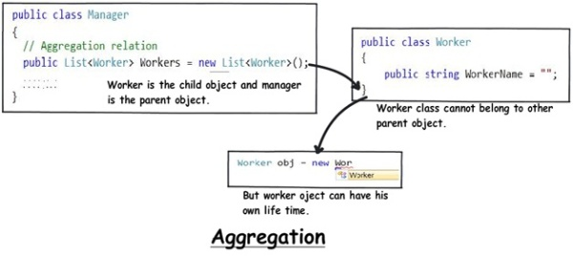

Slide 74
Relationships
Composition: If a class cannot exist by itself, and instead must be a member of another class, then that class has a Composition relationship with the containing class. A Composition relationship is indicated by a line with a filled diamond.

Slide 75
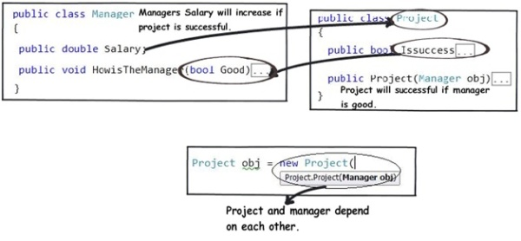
Composition

Slide 76
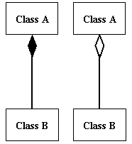
Composition and Aggregation
Composition is a special type of aggregation that denotes a strong ownership between Class A, the whole, and Class B, its part. Illustrate composition with a filled diamond. Use a hollow diamond to represent a simple aggregation relationship, in which the "whole" class plays a more important role than the "part" class, but the two classes are not dependent on each other. The diamond end in both a composition and aggregation relationship points toward the "whole" class or the aggregate.

Slide 77
Component-based Development
The contribution of object-orientation:
Encapsulation of internal details makes it easier to use components in systems for which they were not designed
Generalization hierarchies make it easier to create new specialized classes when they are needed
Composition and aggregation structures can be used to encapsulate components

Slide 78
Composition and Aggregation
Special types of association, both sometimes called whole–part
A campaign is made up of adverts:
Campaign
1
0..*
Advert
Unfilled diamond signifies aggregation

Slide 79
Composition and Aggregation
Aggregation is essentially any whole–part relationship
Semantics can be very imprecise
Composition is ‘stronger’:
Each part may belong to only one whole at a time
When the whole is destroyed, so are all its parts

Slide 80
Composition and Aggregation
An everyday example
Clearly not composition
Students could be in several classes
If class is cancelled, students are not destroyed!
Class
1..*
0..*
Student

Slide 81
Composition and Aggregation
Another everyday example
This is (probably) composition
Ingredient is in only one meal at a time
If you drop your dinner on the floor, you probably lose the ingredients too
Meal
1
1..*
Ingredient
Filled diamond signifies composition

Slide 82
Adding Structure
Add generalization structures when
Two classes are similar in most details, but differ in some respects
May differ
In behaviour (operations or methods)
In data (attributes)
In associations with other classes

Slide 83
Adding Structure
Two types of staff:
Have qualifications recorded
Can be client contact for campaign
Bonus based on campaigns they have worked on
Creative
Qualifications are not recorded
Not associated with campaigns
Bonus not based on campaign profits
Admin

Slide 84
Adding Structure
StaffMember
{abstract}
staffName
staffNo
staffStartDate
calculate Bonus( )
assignNewStaffGrade( )
getStaffDetails( )
AdminStaff
CreativeStaff
calculateBonus( )
qualification
calculateBonus( )
assignStaffContact( )

Slide 85
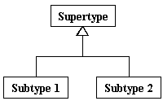
Generalization
Generalization is another name for inheritance or an "is a" relationship. It refers to a relationship between two classes where one class is a specialized version of another. For example, Honda is a type of car. So the class Honda would have a generalization relationship with the class car.

Slide 86
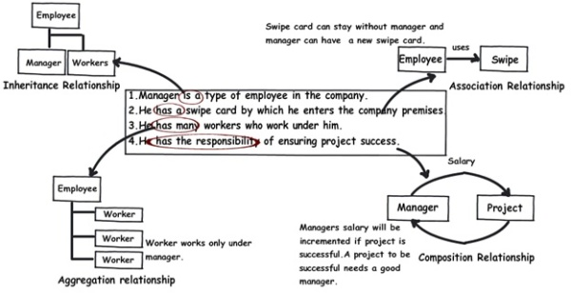

Slide 87

Relationships
Dependency: When a class uses another class, perhaps as a member variable or a parameter, and so "depends" on that class, a Dependency relationship is formed. A Dependency is a relationship where the client does not have semantic knowledge of the supplier. It can be used, for example to show the relationship between an "encoder" class and a "generic Algorithm" class that is inserted in runtime to help it encode a stream. A dependency is shown as a dashed line pointing from the client to the supplier.

Slide 88
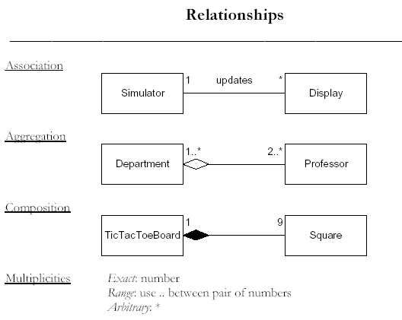
Relationships

Slide 89
Statechart diagrams

Slide 90
Statechart diagrams
Describe the dynamic behavior of an individual object as a finite state machine.
How to model object life cycles using statecharts
How to develop statechart diagrams from interaction diagrams
How to model concurrent behaviour in an object

Slide 91
UML Statechart Diagram
A statechart diagram (also called a state diagram) shows the sequence of states that an object goes through during its life in response to outside stimuli and messages.

Slide 92
State
‘A state is a condition during the life of an object or an interaction during which it satisfies some condition, performs some action or waits for some event....
Conceptually, an object remains in a state for an interval of time. However, the semantics allow for modelling "flow-through" states which are instantaneous as well as transitions that are not instantaneous.’
(OMG, 2001)

Slide 93
State Transition Diagrams
State transition diagrams are a useful tool for constructing the individual classes. Specifically, they aid in two important ways in “fleshing out” the structure of the class:
method development -- State transition diagrams provide the “blueprints” for developing the algorithms that implement methods in the class
attribute identification – Attributes contain the state information needed for regulating the behaviors of the instances of the class
When constructing state transition diagrams, take care to ensure that the post-conditions stipulated in the contracts are enforced.

Slide 94
UML Statechart Diagram Notation
Event trigger
with parameters
State1
Event1(attr) [condition]/action
State2
do/activity
entry/action
exit/action
Guard
condition
Also: internal transition
and deferred events

Slide 95
Basic UML Statechart Diagram
“top” state
State
Initial
pseudostate
top
Trigger
Ready
Transition
stop
/ctr := 0
Done
Action
stop
Final
state

Slide 96
Types of Event
A change event occurs when a condition becomes true
A call event occurs when an object receives a call to one of its operations either from another object or from itself
A signal event occurs when an object receives a signal (an asynchronous communication)
An elapsed-time event is caused by the passage of a designated period of time after a specified event (frequently the entry to the current state)

Slide 97
UML - Statechart Diagram Example
Event
State
Initial state
button1&2Pressed
button2Pressed
Blink
Increment
Hours
Hours
Transition
button1Pressed
button1&2Pressed
Blink
button2Pressed
Increment
Minutes
Minutes
button1Pressed
button2Pressed
Stop
Blink
Increment
Blinking
Seconds
Seconds
button1&2Pressed
Final state
Statechart diagrams for objects with interesting dynamic behaviour - represent behaviour as states and transitions

Slide 98
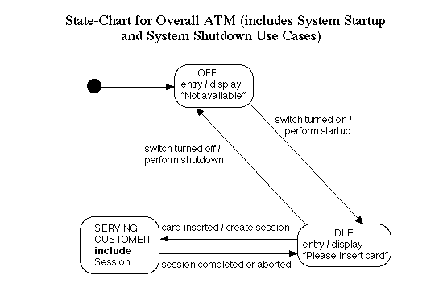

Slide 99
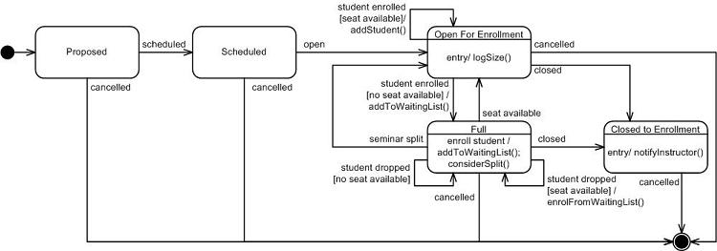
A seminar class during registration

Slide 101
Nested Substates
The transition from the initial pseudostate symbol should not be labelled with an event but may be labelled with an action, though it is not required in this example
The Active state of Campaign showing nested substates
Active
extendCampaign()
/modify Budget()
advertsApproved()
/authorize()
Advert Preparation
Running Adverts
Scheduling
confirmSchedule()
campaignCompleted()
/prepareFinalStatement()
Notes:
In the nested statechart within the Active state, there is an initial state symbol with a transition to the first substate that a Campaign object enters when it becomes active. The transition from the initial pseudostate symbol to the first substate (Advert Preparation) should not be labelled with an event but it may be labelled with an action, though it is not required in this example. It is implicitly fired by any transition to the Active state. A final pseudostate symbol may also be shown on a nested state diagram. A transition to the final pseudostate symbol represents the completion of the activity in the enclosing state (i.e. Active) and a transition out of this state triggered by the completion event. This transition may be unlabelled (as long as this does not cause any ambiguity) since the event that triggers it is implied by the completion event.

Slide 102
Nested States
The submachine Running is referenced using the include statement
The Active state of Campaign with the detail hidden
Active
include / Running
Hidden decomposition indicator icon

Slide 103
The Active State with Concurrent Substates
Active
Running
extendCampaign()
/modify Budget()
advertsApproved()
/authorize()
Advert Preparation
Running Adverts
confirmSchedule()
Scheduling
campaignCompleted()
/prepareFinalStatement()
Monitoring
surveyComplete()
Survey
Evaluation
runSurvey()

Slide 104
Synchronized Concurrent Threads.
Synchronization bar
Explicitly showing how an event triggering a transition to a state with nested concurrent states causes specific concurrent substates to be entered
Shows that the composite state is not exited until both concurrent nested statecharts are exited

Slide 105
Problem Statement: Control for a Toy Car
Power is turned on
Car moves forward and car headlight shines
Power is turned off
Car stops and headlight goes out.
Power is turned on
Headlight shines
Power is turned off
Headlight goes out.
Power is turned on
Car runs backward with its headlight shining.
Power is turned off
Car stops and headlight goes out.
Power is turned on
Headlight shines
Power is turned off
Headlight goes out.
Power is turned on
Car runs forward with its headlight shining.

Slide 106
Find the Functional Model: Do Use Case Modeling
Use case 1: Move car forward
Entry condition: Car is stationary, headlights are off
Flow of events
Driver turns power on
Exit condition:
Car runs forward with its headlight shining.
Use case 2: Stop forward moving car
Entry condition: Car moves forward, headlights on
Flow of events:
Driver turns power off, car stops, headlights go out.
Exit condition: Car stationary, headlights are out.

Slide 107
Use case 3: Move car backward
Entry condition: Car is stationary, headlights off
Flow of events:
Driver turns power on
Exit condition: Car moves backward, headlights on
Use case 4: Stop backward moving car
Entry condition: Car moves backward, headlights on
Flow of events:
Driver turns power off, car stops, headlights go out.
Exit condition: Car stationary, headlights are out.

Slide 108
Toy Car: Object Model
Car
Power
Headlight
Wheel
Status: (On, Off)
Status: (On, Off)
Motion: (For
ward,
Backward,
TurnOn()
Switch_On()
Stationary)
TurnOff()
Switch_Off()
Star
t_Moving()
Stop_Moving()

Slide 109
Toy Car: Dynamic Model
Wheel
Headlight
Forward
Off
power
power
off
on
power
power
off
on
Stationary
Stationary
On
power
power
on
off
Backward

Slide 110
Component Diagram
Order.java
SpecialOrder.java
Customer.java
NormalOrder.java
Components

Slide 111
Component Diagram
Used in:
Model the components of a system.
Model database schema.
Model executables of an application.
Model system's source code

Slide 112
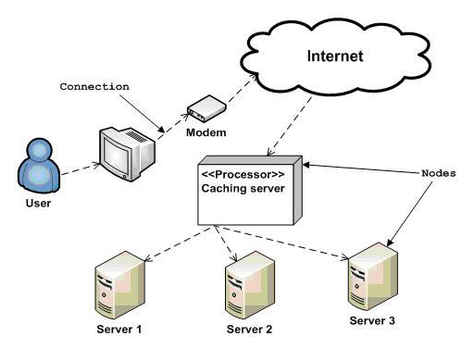
Deployment Diagram

Slide 113
Deployment Diagram
Used in:
To model the hardware topology of a system.
To model embedded system.
To model hardware details for a client/server system.
To model hardware details of a distributed application.
Forward and reverse engineering.

Slide 114
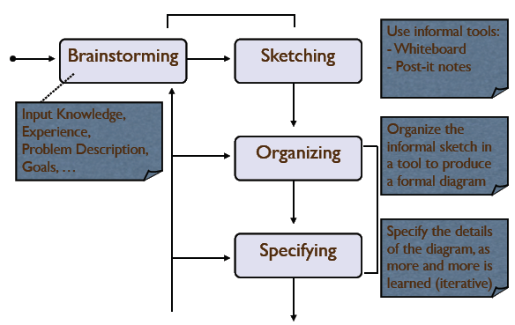
A Process for Making Models...

Slide 115
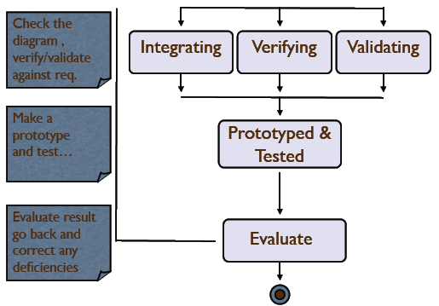
A Process for Making Models...

