Slide 1
Object Oriented Analysis & Design Module-6 (RL 6.2.1)
Harvinder S Jabbal

Slide 2
What is Responsibility Assignment Problem?

Slide 3
Responsibilities and Methods
The focus of object design is to identify classes and objects, decide what methods belong where and how these objects should interact.
Responsibilities are related to the obligations of an object in terms of its behavior.
Two types of responsibilities:
Doing:
Doing something itself (e.g. creating an object, doing a calculation)
Initiating action in other objects.
Controlling and coordinating activities in other objects.
Knowing:
Knowing about private encapsulated data.
Knowing about related objects.
Knowing about things it can derive or calculate.

Slide 4
Responsibilities and Methods
Responsibilities are assigned to classes during object design. For example, we may declare the following:
“a Sale is responsible for creating SalesLineItems” (doing)
“a Sale is responsible for knowing its total” (knowing)
Responsibilities related to “knowing” are often
inferable from the Domain Model (because of the attributes and associations it illustrates)

Slide 5
Responsibilities and Methods
The translation of responsibilities into classes and methods is influenced by the granularity of responsibility.
For example, “provide access to relational databases” may involve dozens of classes and hundreds of methods, whereas “create a Sale” may involve only one or few methods.
A responsibility is not the same thing as a method, but methods are implemented to fulfill responsibilities.
Methods either act alone,
or collaborate with other
methods and objects.

Slide 6
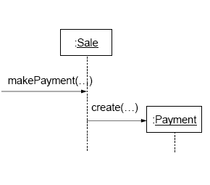
Responsibilities and Interaction Diagrams
Within the UML artifacts, a common context where these responsibilities (implemented as methods) are considered is during the creation of interaction diagrams.
Sale objects have been given the responsibility to create Payments, handled with the makePayment method.

Slide 7
Acknowledgement
Slides are based on Course Text Books:
Applying UMP and Patterns (An Introduction to Object-Oriented Analysis and Design and Iterative Development) : Craig Larman
UMP Distilled (A Brief Guide to the Standard Object Modeling Langauge) : Martin Fowler
Design Patterns (Elements of Reusable Object-Oriented Software) : GoF-
Erich Gama | Richard Helm |
Rapph Johnson | John Vlissides.

