Slide 1
BITS Pilani presentation
Dr. Yashvardhan Sharma
Computer Science and Information Systems

Slide 2
SS ZG514/SE Z512
Object Oriented Analysis and Design
Lecture No.10

Slide 3
Today’s Agenda
Object Oriented Design
GoF Patterns

Slide 4
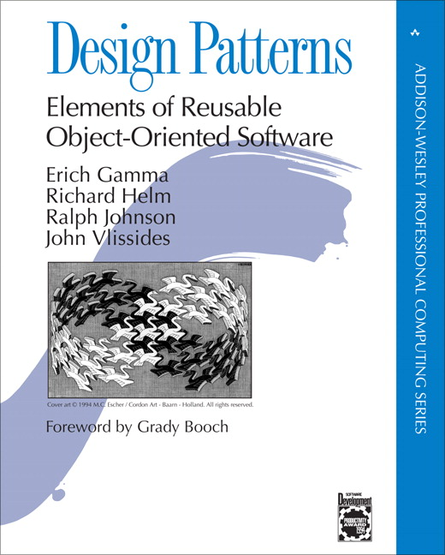
1995

Slide 5
The “gang of four” (GoF)
Design Patterns book catalogs 23 different patterns
Solutions to different classes of problems, in C++ & Smalltalk
Problems and solutions are broadly applicable, used by many people over many years
Patterns suggest opportunities for reuse in analysis, design and programming
GOF presents each pattern in a structured format
What do you think of this format? Pros and cons?

Slide 6
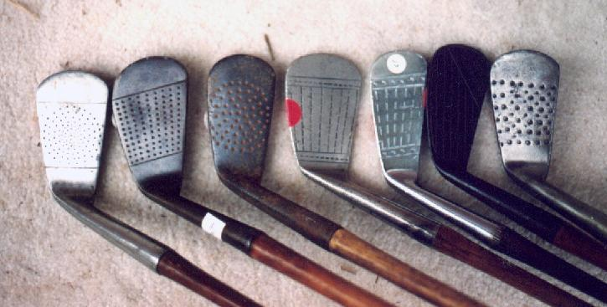
Elements of Design Patterns
Design patterns have 4 essential elements:
Pattern name: increases vocabulary of designers
Problem: intent, context, when to apply
Solution: UML-like structure, abstract code
Consequences: results and tradeoffs

Slide 7
Design Patterns are NOT
Data structures that can be encoded in classes and reused as is (i.e., linked lists, hash tables)
Complex domain-specific designs (for an entire application or subsystem)
If they are not familiar data structures or complex domain-specific subsystems, what are they?
They are:
“Descriptions of communicating objects and classes that are customized to solve a general design problem in a particular context.”

Slide 8
Three Types of GoF Patterns
Creational patterns:
Deal with initializing and configuring objects
Structural patterns:
Composition of classes or objects
Decouple interface and implementation of classes
Behavioral patterns:
Deal with dynamic interactions among societies of objects
How they distribute responsibility

Slide 9
Benefits of Design Patterns
Improves communication between designers by use of pattern names vs. the details of the patterns.
Captures experience of solving a type of problem.
Provide a way of reusing design.
Provide a mechanism for making designs more reusable.
Provides a mechanism for systematizing the reuse of things that have been seen before.
Can be used to teach good design.

Slide 10
A Problem
In a graphical editor, by clicking on an object, one can obtain a copy of the original object. Obtaining a copy of an existing object is a common design problem in on-line compositions.
We can provide a design solution to solve this problem, and reuse this design whenever similar situation arises.

Slide 11
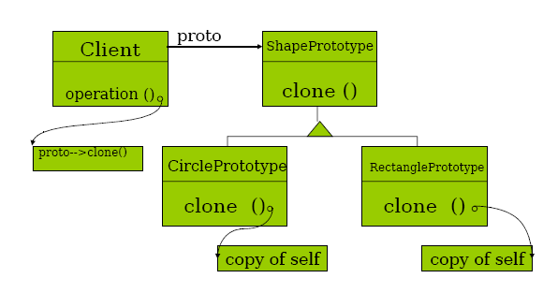
The Solution

Slide 12
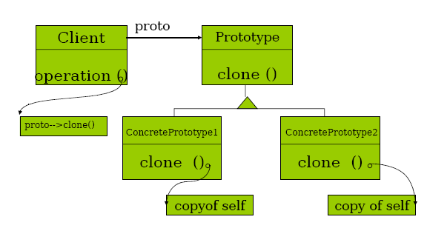
The Design Pattern: Prototype

Slide 13
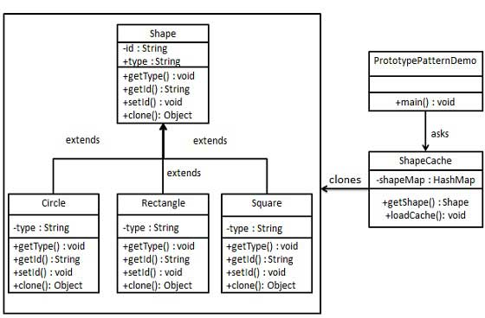

Slide 14
Describing a Design Pattern
Specify the generic problem that is solved
Motivate the design pattern solution with the help of an example
Provide the structure for the pattern
Discuss collaborations between classes
Discuss other issues related to the pattern such as trade-offs, implementation techniques etc.

Slide 15
Template provided by Erich Gamma et. al
Pattern name, its classification
Intent, Motivation, Applicability
Structure, Participants, Collaborations
Consequences, Implementation, Sample code,
Known uses
Related patterns

Slide 16
Organization
Patterns:
Behavioral: concerned about ways in which objects interact
Observer
Structural: concerned about the composition of objects and classes
Façade
Creational : concerned about ways to create new objects
Abstract Factory
Factory Method
Singleton
Excellent reference:
Design Patterns book by Erich Gamma, et al., Addison-Wesley, 1994.

Slide 17
Software Design – Templates
What are templates?
They provide (generic) solutions – often for more than one instance of a problem.
These solutions can be (contextually) reused with minor adaptations.
Templates are contextual but generic solutions that are re-usable with minor adaptations.

Slide 18
Software Design – Templates
Observations:
There are some differences among templates
Problem contexts are different:
Low level design (close to coding)
Medium level design
High level design (close to architecture)
Often leads to different granularities!

Slide 19
Software Design – Templates
Low level templates:
Fine grained;
Often no additional work required to use.
Implementation (say language or OS) specific
a.k.a IDIOMS
Almost always work as advertised!
Examples:
(Iteration & Arrays),
(Sharing & Indirection)
(Program Structuring in C)

Slide 20
Software Design – Templates
Medium level templates:
Not so fine-grained;
Adaptations often required for specific situation/problem.
May lead to minor problems when mis-applied.
a.k.a (DESIGN) PATTERNS
Examples:
( Browser – Composite Pattern)
( Set Enumeration – Iterator Pattern)

Slide 21
Software Design – Templates
High level templates:
Coarse-grained.
Often require lot of customization and implementation to achieve desired result.
Often Specific to problem domain.
When mis-applied lead to disastrous results!
a.k.a (ARCHITECTURAL) FRAMEWORKS
Examples:
(Document Publishing – Pipe & Filter Architecture)

Slide 22
Patterns vs. Frameworks
Frameworks are partially completed software systems that may be targeted at a specified type of application
However patterns
are more abstract and general than frameworks
cannot be directly implemented in a particular software environment
are more primitive than frameworks

Slide 23
((Software) Design) Patterns
Definition:
Contextual Design solutions of medium granularity that can be re-used in recurring design problems with minimal adaptation.
Usage:
Documentation of (Expert) Knowledge of Design solutions.
Purpose:
Communication and Persistence for Re-use.

Slide 24
((Software) Design) Patterns
Why study patterns?
“to organize implicit knowledge about how people solve recurring problems when they go about building things”
– Christopher Alexander,
(Architect by profession;
Father of modern study of patterns)

Slide 25
Design Patterns [1]
A solution to a problem that occurs repeatedly in a variety of contexts.
Each pattern has a name.
Use of each pattern has consequences.

Slide 26
Design Patterns [2]
Generally at a “higher level” of abstraction.
Not about designs such as linked lists or hash tables.
Generally descriptions of communicating objects and classes.

Slide 27
Key Principles
Key principles that underlie patterns
abstraction
encapsulation
information hiding
modularization
separation of concerns

Slide 28
Key Principles
Coupling and cohesion
Sufficiency, Completeness and primitiveness
Separation of policy and implementation
Separation of interface and implementation
Single point of reference
Divide and conquer
Buschmann et al. (1996)

Slide 29
Patterns Documentation
Name
Classification
Motivation
Problem Scenario
Applicability
Situations
Structure
Graphical representation
Often just the classes in the pattern
Participants
Collaborations
How participants collaborate to carry out responsibilities?
Implementation
Consequences
Related Patterns

Slide 30
Patterns Classification
Basic Classification
by Purpose
Creational vs. Structural vs. Behavioral
by Scope
Object vs. Class
Domain Level Classification:
Patterns in Telecom Software
Patterns in Distributed Computing

Slide 31
Creational Patterns
Concerned with the construction of object instances
Separate the operation of an application from how its objects are created
Gives the designer considerable flexibility in configuring all aspects of object creation

Slide 32
Creational Patterns: Singleton
How does one ensure that only one instance of the company class is created?
Company
companyName
companyAddress
companyRegistrationNumber
getCompanyDetails( )

Slide 33
Creational Patterns: Singleton
Solution—restrict access to the constructor!
Company
- companyInstance
Class-scope
- companyName
(or static) attribute
- companyAddress
- companyRegistrationNumber
Class-scope
+ getCompanyInstance( )
(or static) operation
+ getCompanyDetails( )
- Company( )
Private constructor
The use of class-scope operations allows global access

Slide 34
Structural Patterns
Concerned with the way in which classes and objects are organized
Offer effective ways of using object-oriented constructs such as inheritance, aggregation and composition to satisfy particular requirements

Slide 35
Structural Patterns: Composite
How can we present the same interface for a media clip whether it is composite or not?
MediaClip
play( )
VideoClip
SoundClip
play( )
play( )

Slide 36
Structural Patterns: Composite
How can we incorporate composite structures?
AdSequence
Delegates to
play( )
addClip( )
removeClip( )
getChild( )
the
play
()
operation in
the
components.
1
play
()
is
polymorphically
redefined
*
*
VideoClip
SoundClip
play( )
play( )

Slide 37
Composite applied to Agate
Advert
MediaClip
play( )
addClip( )
removeClip( )
getChild( )
*
{Ordered}
play
()
is
polymorphically
redefined
1
VideoClip
SoundClip
AdSequence
Collection of
mediaClipCollection
MediaClip
play( )
play( )
object identifiers
play( )
addClip( )
removeClip( )
getChild( )
changeSequence( )
Delegates to
for all m in mediaClipCollection
the
play
()
m.play()
operation in
the
components.

Slide 38
Composite Pattern General Form
Client
Component
{Ordered}
anOperation( )
addComponent( )
removeComponent( )
getChild( )
*
anOperation
()
is
polymorphically
redefined
1
Leaf
OtherLeaf
Composite
Collection of
componentCollection
Component
anOperation( )
anOperation( )
object identifiers
anOperation( )
addComponent( )
removeComponent( )
getChild( )
Delegates to
for all c in componentCollection
the
anOperation()
c.anOperation()
operation in
the
components.

Slide 39
Behavioural Patterns
Address the problems that arise when assigning responsibilities to classes and when designing algorithms
Suggest particular static relationships between objects and classes and also describe how the objects communicate

Slide 40
Patterns
Software context:
Most of the work originated in SmallTalk community.
SmallTalk was a programming language:
Object Oriented
Meant for rapid prototyping
Came with (what are known today as) IDE and API
IDE elements were in SmallTalk!
(Concrete) Precursor to modeling, frameworks and patterns!

Slide 41
Patterns – MVC framework
SmallTalk’s user interface framework
Model - refers to data model
View – refers to external views or presentation of data.
Controller – refers to module relating reactions of view or presentation to changes in data.

Slide 42
Observer Pattern [1]
Need to separate presentational aspects with the data, i.e. separate views and data.
Classes defining application data and presentation can be reused.
Change in one view automatically reflected in other views. Also, change in the application data is reflected in all views.
Defines one-to-many dependency amongst objects so that when one object changes its state, all its dependents are notified.

Slide 43
Observer Pattern – Classification & Applicability
A behavioral (object) pattern:
Concerns objects and their behavior.
Applicability
Vary and reuse 2 different abstractions independently.
Change to one object requires change in (one or more) other objects – whose identity is not necessarily known

Slide 44
Observer Pattern [2]
Relative Percentages
A B C D
A
X 15 35 35 15
D
Y 10 40 30 20
B
C
Z 10 40 30 20
A
B
C
D
A=10%
B=40%
C=30%
D=20%
Application data
Change notification
Requests, modifications

Slide 45
Observer Pattern
Model – View paradigm can be generalized:
A view is an observer
A model is an subject that is observed.
A subject may have any number of observers.
Referred to as the observer pattern, also Publish-Subscribe or Dependents

Slide 46
Observer Pattern [3]
observers
Subject
Observer
attach (Observer)
Update()
detach (Observer)
For all x in observers{
x → Update(); }
Notify ()
Concrete Observer
subject
Concrete Subject
Update()
GetState()
observerState
SetState()
observerState=
subject → getState();
subjectState

Slide 47
Observer Pattern - Participants
Subject
Has a list of observers;
interfaces for attaching/detaching an observer
Observer
An updating interface for objects that gets notified of changes in a subject.
ConcreteSubject
Stores state of interest to observers
Sends notification when state changes.
ConcreteObserver
Implements updating interface.

Slide 48
Class collaboration in Observer
:ConcreteSubject
:ConcreteObserver-1
:ConcreteObserver-2
SetState()
Notify()
Update()
GetState()
Update()
GetState()

Slide 49
Observer Pattern - Implementation
interface Observer {
void update (Observable sub, Object arg)
}
Java terminology for Subject.
class Observable {
…
}
public void addObserver(Observer o) {}
public void deleteObserver (Observer o) {}
public void notifyObservers(Object arg) {}
public boolean hasChanged() {}

Slide 50
Observer Pattern - Implementation
public PiChartView implements Observer {
A Concrete Observer.
void update(Observable sub, Object arg) {
// repaint the pi-chart
}
}
class StatsTable extends Observable{
public boolean hasChanged() {
// override to decide when it is considered changed
}
}

Slide 51
When to use the Observer Pattern?
When an abstraction has two aspects: one dependent on the other. Encapsulating these aspects in separate objects allows one to vary and reuse them independently.
When a change to one object requires changing others and the number of objects to be changed is not known.
When an object should be able to notify others without knowing who they are. Avoid tight coupling between objects.

Slide 52
Observer Pattern: Consequences
Abstract coupling between subject and observer. Subject has no knowledge of concrete observer classes. (What design principle is used?)
Support for broadcast communication. A subject need not specify the receivers; all interested objects receive the notification.
Unexpected updates: Observers need not be concerned about when the updates are to occur. They are not concerned about each other’s presence. In some cases this may lead to unwanted updates.

Slide 53
Facade Pattern: Problem
Client Classes
Need to communicate
with
Subsystem classes

Slide 54
Facade Pattern: Solution
Client Classes
Facade
Subsystem classes

Slide 55
Facade Pattern: Why and What?
Subsystems often get complex as they evolve.
Need to provide a simple interface to many, often small, classes.
But not necessarily to ALL classes of the subsystem.
Façade provides a simple default view good enough for most clients.
Facade decouples a subsystem from its clients.
A façade can be a single entry point to each subsystem level. This allows layering.

Slide 56
Facade Pattern: Participants and Communication
Participants: Façade and subsystem classes
Clients communicate with subsystem classes by
sending requests to façade.
Façade forwards requests to the appropriate subsystem classes.
Clients do not have direct access to subsystem classes.

Slide 57
Facade Pattern: Benefits
Shields clients from subsystem classes; reduces the number of objects that clients deal with.
Promotes weak coupling between subsystem and its clients.
Helps in layering the system. Helps eliminate circular dependencies.

Slide 58
Example: A compiler
Compiler
Compile()
Invocations
Stream
Scanner
Token
BytecodeStream
Parser
Symbol
CodeGenerator
PnodeBuilder
Pnode
StatementNode
ExpressionNode
RISCCodegenerator
StackMachineCodegenerator

Slide 59
Façade Pattern: Code [1]
class Scanner {
// Takes a stream of characters and produces a stream of tokens.
public:
Scanner (istream&);
virtual Scanner();
virtual Token& Scan();
Private:
istream& _inputStream;
};

Slide 60
Façade Pattern: Code [2]
class parser {
// Builds a parse tree from tokens using the PNodeBuilder.
public:
Parser ();
virtual ~Parser()
virtual void Parse (Scanner&, PNodeBuilder&);
};

Slide 61
Façade Pattern: Code [3]
class Pnodebuilder {
// Builds a parse tree incrementally. Parse tree
// consists of Pnode objects.
public:
Pnodebuilder ();
// Node for a variable.
virtual Pnode* NewVariable (
Char* variableName
) const;
virtual Pnode* NewAssignment (
// Node for an assignment.
Pnode* variable, Pnode* expression
) const;
Private:
// Similarly...more nodes.
Pnode* _node;
};

Slide 62
Façade Pattern: Code [4]
class Pnode {
// An interface to manipulate the program node and its children.
public:
// Manipulate program node.
virtual void GetSourcePosition (int& line, int& index);
// Manipulate child node.
virtual void Add (Pnode*);
virtual void Remove (Pnode*);
// ….
virtual void traverse (Codegenerator&);
// Traverse tree to generate code.
protected:
PNode();
};

Slide 63
Façade Pattern: Code [5]
class CodeGenerator {
// Generate bytecode.
public:
// Manipulate program node.
virtual void Visit (StatementNode*);
virtual void Visit (ExpressionNode*);
// ….
Protected:
CodeGenerator (BytecodeStream&);
BytecodeStream& _output;
};

Slide 64
Façade Pattern: Code [6]
void ExpressionNode::Traverse (CodeGenerator& cg) {
cg.Visit (this);
ListIterator<Pnode*> i(_children);
For (i.First(); !i.IsDone(); i.Next();{
i.CurrentItem()→Traverse(cg);
};
};

Slide 65
Façade Pattern: Code [7]
class Compiler {
// Façade. Offers a simple interface to compile and
// Generate code.
public:
Could also take a CodeGenerator
Parameter for increased generality.
Compiler();
virtual void Compile (istream&, BytecodeStream&);
}
void Compiler:: Compile (istream& input, BytecodeStream& output) {
Scanner scanner (input);
PnodeBuilder builder;
Parser parser;
parser.Parse (scanner, builder);
RISCCodeGenerator generator (output);
Pnode* parseTree = builder.GetRootNode();
parseTree→Traverse (generator);
}

Slide 66
Facade Pattern: Another Example from POS [1]
Assume that rules are desired to invalidate an action:
Suppose that when a new Sale is created, it will be paid by a gift certificate
Only one item can be purchased using a gift certificate.
Hence, subsequent enterItem operations must be invalidated in some cases. (Which ones?)
How does a designer factor out the handling of such rules?

Slide 67
Facade Pattern: Another Example [2]
Define a “rule engine” subsystem (e.g. POSRuleEngineFacade).
It evaluates a set of rules against an operation and indicates if the rule has invalidated an operation.
Calls to this façade are placed near the start of the methods that need to be validated.
Example: Invoke the façade to check if a new salesLineItem created by makeLineItem is valid or not. (See page 370 of Larman.)

