Slide 1
BITS Pilani presentation
Dr. Yashvardhan Sharma
Computer Science and Information Systems

Slide 2
SS ZG514/SE Z512
Object Oriented Analysis and Design
Lecture No.11

Slide 3
Today’s Agenda
Object Oriented Design
GoF Patterns

Slide 4
Adapter Pattern
Context
You want to use an existing class (adaptee) without modifying it.
The context in which you want to use the class requires target interface that is different from that of the adaptee.
The target interface and the adaptee interface are conceptually related.
Solution
Define an adapter class that implements the target interface.
The adapter class holds a reference to the adaptee. It translates target methods to adaptee methods.
The client wraps the adaptee into an adapter class object

Slide 5
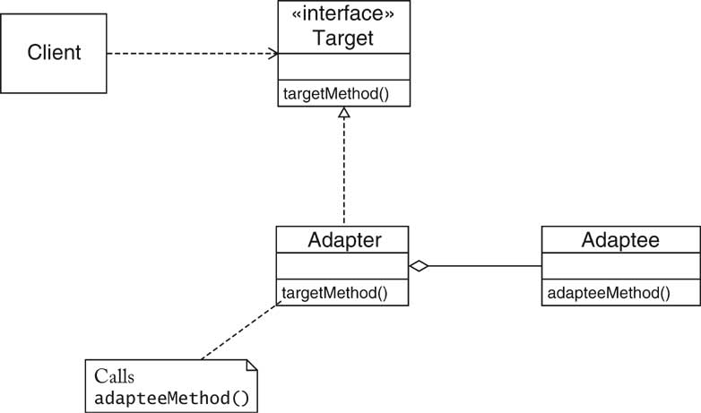

Slide 6
Name in Design Pattern | Actual Name (Icon->Component)
Adaptee | Icon
Target | JComponent
Adapter | IconAdapter
Client | The class that wants to add icons into a container
targetMethod() | paintComponent(), getPreferredSize()
adapteeMethod() | paintIcon(), getIconWidth(), getIconHeight()

Slide 7
public class IconAdapter extends JComponent
{
private Icon icon; // Make icon a part of Iconadapter
public IconAdapter(Icon icon)
{
this.icon = icon;
}
public void paintComponent(Graphics g) // Overriding the method
{
icon.paintIcon(this, g, 0, 0); // calling method of icon
}
public Dimension getPreferredSize() // Overriding the method
{
return new Dimension(icon.getIconWidth(),
icon.getIconHeight());
}
}

Slide 8
public class IconAdapterTester
{
public static void main(String[] args)
{
Icon icon = new CarIcon(300);
JComponent component = new IconAdapter(icon);
JFrame frame = new JFrame();
frame.add(component, BorderLayout.CENTER);
frame.setDefaultCloseOperation(JFrame.EXIT_ON_CLOSE);
frame.pack();
frame.setVisible(true);
}
}

Slide 9
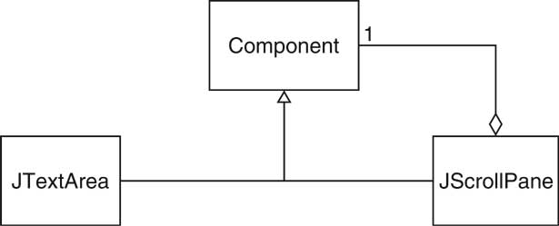
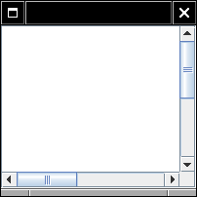
Scroll Bars
Scroll Bars can be added to components to display more information that can be shown on screen.
Adding a Scroll bar
JTextArea area = new JTextArea(10,25);
JScrollPane scroller = new JScrollPane(area);
3. Scroll bars adds/enhances functionality to the underlying component.
4. Adding/Enhancing Functionality is called Decoration.
5. JScrollPane Decorates a Component and is again a Component.

Slide 10
Decorator Pattern
Context
Component objects can be decorated (visually or behaviorally enhanced)
The decorated object can be used in the same way as the undecorated object
The component class does not want to take on the responsibility of the decoration
There may be an open-ended set of possible decorations
Solution
Define an interface type that is an abstraction for the component
Concrete component classes realize this interface type.
Decorator classes also realize this interface type.
A decorator object manages the component object that it decorates
When implementing a method from the component interface type,
the decorator class applies the method to the decorated component and
combines the result with the effect of the decoration.

Slide 11
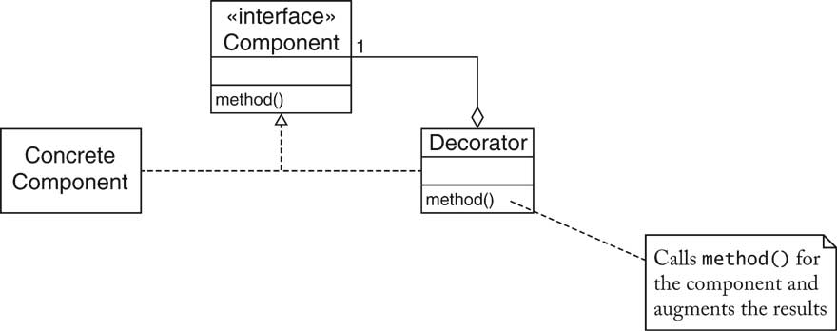
Name in Design Pattern | Actual Name (scroll bars)
Component | Component
ConcreteComponent | JTextArea
Decorator | JScrollPane
method() | a method of Component (e.g. paint)

Slide 12
The COMMAND Pattern
Context
You want to implement commands that behave like objects (i) because you need to store additional information with
commands
(ii) because you want to collect commands
Solution
Define a command interface type with a method to execute the command.
Supply methods in the command interface type to manipulate the state of command objects.
Each concrete command class implements the command interface type.
To invoke the command, call the execute method.

Slide 13
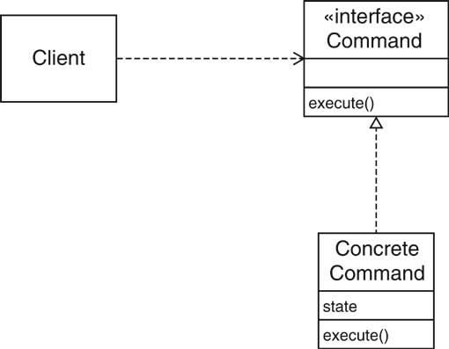

Slide 14
Action Interface
Action interface lets the user to implement commands
Extends ActionListener. Stores Name of the action and an icon
Important Methods :
Method Summary
void | addPropertyChangeListener(PropertyChangeListener listener) Adds a PropertyChange listener.
Object | getValue(String key) Gets one of this object's properties using the associated key.
boolean | isEnabled() Returns the enabled state of the Action.
void | putValue(String key, Object value) Sets one of this object's properties using the associated key.
void | removePropertyChangeListener(PropertyChangeListener listener) Removes a PropertyChange listener.
void | setEnabled(boolean b) Sets the enabled state of the Action.

Slide 15
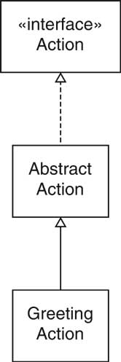

Slide 16
Proxies
Proxy: a person who is authorized to act on another person s behalf
2. Example: Delay instantiation of object
3. Expensive to load image
4. Not necessary to load image that user doesn't look at
5. Proxy defers loading until user clicks on tab

Slide 17
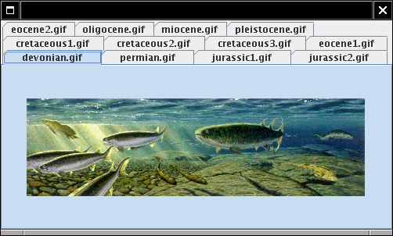
Deferred Image Loading

Slide 18
Normally, programmer uses image for label: JLabel label = new JLabel(new ImageIcon(imageName));
Use proxy instead: JLabel label = new JLabel(new ImageProxy(imageName));
paintIcon loads image if not previously loaded public void paintIcon(Component c, Graphics g, int x, int y) { if (image == null) image = new ImageIcon(name); image.paintIcon(c, g, x, y); }
Another use for proxies: remote method invocation

Slide 19
Context
A class (the real subject) provides a service that is specified by
an interface type (the subject type)
There is a need to modify the service in order to make it more
versatile.
Neither the client nor the real subject should be affected
by the modification.
Solution
Define a proxy class that implements the subject interface type. The proxy holds a reference to the real subject, or otherwise knows how to locate it.
The client uses a proxy object.
Each proxy method invokes the same method on the real subject and provides the necessary modifications.

Slide 20
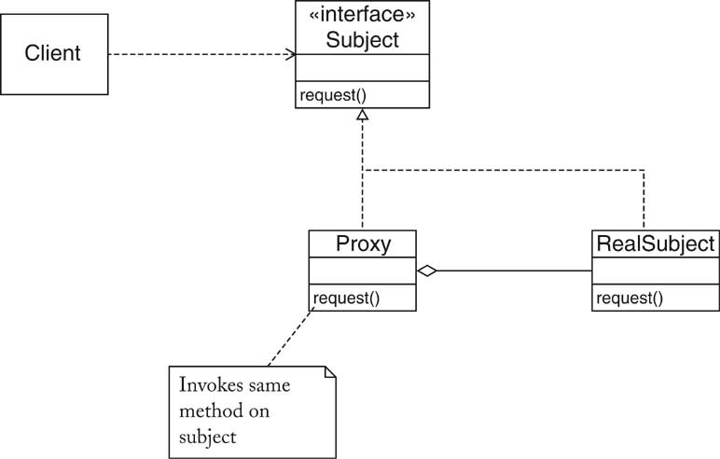

Slide 21
Strategy Pattern
Context:
A class can benefit from different variants for an algorithm
Clients sometimes want to replace standard algorithms with custom versions

Slide 22
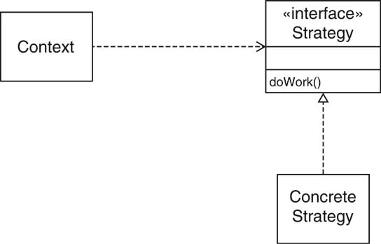
Solution
Define an interface type that is an abstraction for the algorithm
Actual strategy classes realize this interface type.
Clients can supply strategy objects
Whenever the algorithm needs to be executed, the context class calls the appropriate methods of the strategy object

Slide 23
Example : Sorting
Name in Design Pattern | Actual Name (sorting)
Context | Collections
Strategy | Comparator
ConcreteStrategy | a class that implements Comparator
doWork() | compare

Slide 24
Example : Layout Managers
Name in Design Pattern | Actual Name (layout management)
Context | Container
Strategy | LayoutManager
ConcreteStrategy | a layout manager such as BorderLayout
doWork() | a method such as layoutContainer

Slide 25
Some Typical Applications where Strategy can be helpful
Saving Files in Different Formats
file.setFormat(<Name of Format>);
file.save();
Compress Files using different algorithms
Various Encryption/Decryption Schemes

Slide 26
Factory
Context/Problem
Who should be responsible for creating objects when there are special considerations, such as complex logic,a desire to separate the creation responsibilities for better cohesion, and so forth
Solution
Create a Pure Fabrication object called a Factory that handles the creation

Slide 27
EXAMPLE
Let’s suppose an application asks for entering the name and sex of a person.
If the sex is Male (M)
it displays welcome message saying Hello Mr. <Name>
if the sex is Female (F)
it displays message saying Hello Ms <Name>

Slide 28
Factory Pattern
Factory Pattern returns an instance of one of several possible classes depending upon the data provided to it.
Generally all classes that it returns have a common parent class and common methods

Slide 29
X
X
+do_X
XFactory
Produces different instance of X depending upon the value of arguments
+XFactory()
+getClass(int):X
XY
XZ
+XY
+do_X
+XZ
+do_X
X getClass(int ){ };

Slide 30
class Namer
{
String last;
String first;
public String getFirst()
{ return first; }
public String getLast()
{ return last; }
}
}
class FirstFirst extends Namer
{
FirstFirst(String s)
{
int i = s.lastIndexOf(" ");
if( i > 0)
{
first = s.substring(0,i).trim();
last = s.substring(i+1).trim();
}
else
{
first ="";
last = s;
}
}
}

Slide 31
class LastFirst extends Namer
{
LastFirst(String s)
{
int i = s.lastIndexOf(",");
if( i > 0)
{
last = s.substring(0,i).trim();
first= s.substring(i+1).trim();
}
else
{
first ="";
last = s;
}
}
}
class NameFactory
{
Namer namer;
Namer getNamer(String s)
{
int i = s.indexOf(",");
if(i > 0) return new LastFirst(s);
else
return new FirstFirst(s);
}
}

Slide 32
Advantages of Factory Objects
Separate the responsibility of complex creation into cohesive helper objects.
Hide potentially complex creation logic
Allow introduction of performance-enhancing memory management strategies,such as object caching or recycling.

Slide 33
The FACTORY METHOD Pattern
Context
A type (the creator) creates objects of another type (the product).
Subclasses of the creator type need to create different kinds of product objects.
Clients do not need to know the exact type of product objects.
Solution
Define a creator type that expresses the commonality of all creators.
Define a product type that expresses the commonality of all products.
Define a method, called the factory method, in the creator type. The factory method yields a product object.
Each concrete creator class implements the factory method so that it
returns an object of a concrete product class.

Slide 34
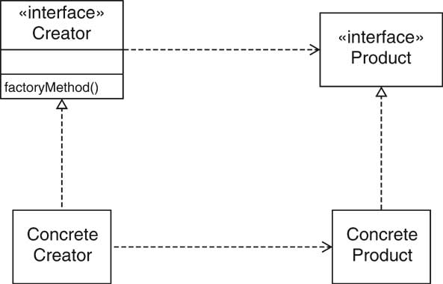

Slide 35
Name in Design Pattern | Actual Name (iterator)
Creator | Collection
ConcreteCreator | A subclass of Collection
factoryMethod() | iterator()
Product | Iterator
ConcreteProduct | A subclass of Iterator (which is often anonymous)

Slide 36
Abstract Factory - Intent
“Provide an interface for creating families of related or dependent objects without specifying their concrete classes.”
provide a simple creational interface for a complex family of classes
Client does not have to know any of those details.
avoid naming concrete classes
Clients use abstract creational interfaces and abstract product interfaces. Concrete classes can be changed without affecting clients.
Clients can stay blissfully unaware of implementation details
This is critically important!

Slide 37
Motivating Examples
Provide different “look and feel” without affecting client -- see motif, presentation manager example in text.
Design neural network layers to contain the technology for their own construction, allowing networks to focus on learning strategies.

Slide 38
Intent
Provide an interface for creating families of related or dependent objects without specifying their concrete classes.
A hierarchy that encapsulates: many possible "platforms", and the construction of a suite of "products".
The new operator considered harmful.
Problem
If an application is to be portable, it needs to encapsulate platform dependencies. These "platforms" might include: windowing system, operating system, database, etc. Too often, this encapsulation is not engineered in advance, and lots of #ifdef case statements with options for all currently supported platforms begin to procreate like rabbits throughout the code.

Slide 39
Applicability
Use the Abstract Factory Pattern if:
clients need to be ignorant of how servers are created, composed, and represented.
clients need to operate with one of several families of products
a family of products must be used together, not mixed with products of other families, e.g., there are constraints on the way objects are composed.
you provide a library and want to show just the interface, not implementation of the library components.
Giving customers your product header files may disclose some of your proprietary value.

Slide 40
Abstract Factory Structure

Slide 41
Participants
AbstractFactory
provide an interface for building product objects
ConcreteFactory
implements the creation functionality for a specific product family
AbstractProduct
provides an interface for using product objects
ConcreteProduct
created by a ConcreteFactory, implements the AbstractProduct interface for a specific product family
Client
uses only abstract interfaces so is independent of the implemen-tation.

Slide 42
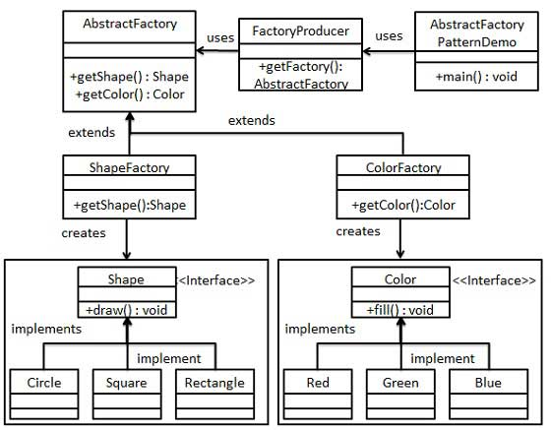

Slide 43
Why Visitors?
The Visitor pattern is one among many design patterns aimed at making object-oriented systems more flexible
The issue addressed by the Visitor pattern is the manipulation of composite objects.
Without visitors, such manipulation runs into several problems as illustrated by considering an implementation of integer lists, written in Java

Slide 44
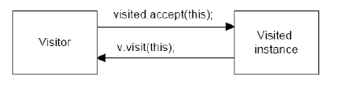
There is only one way that an outside class can gain access to another class
by calling its public methods.
In the Visitor case, visiting each class means that you are calling a method already installed for this purpose, called accept.
The accept method has one argument: the instance of the visitor, and in return, it calls the visit method of the Visitor, passing itself as an argument.

Slide 45
Visitor Pattern
Provides Mechanism for adding new operations to the already provided interface.
Extensible mechanism for supporting new features in library classes
Adding more methods is disruptive
<< Interface>>
Element
Concrete
Element1
Concrete
Element2
Concrete
Element3

Slide 46
Each accept method takes a visitor as argument.
The interface Visitor has a header for each of the basic classes.
The advantage is that one can write code that manipulates objects of existing classes without recompiling those classes.
The price is that all objects must have an accept method.

Slide 47
Each Element class support a single method:
Void accept(Visitor v)
Visitor interface:
Public interface visitor
{
Void visitElementType1(ElementType1 elmt);
Void visitElementType2(ElementType2 elmt);
Void visitElementType3(ElementType3 elmt);
Void visitElementTypen(ElementTypen elmt);}

Slide 48
Public class ElementType1
{ v.visitElementType1(this);
}
…..
}

Slide 49
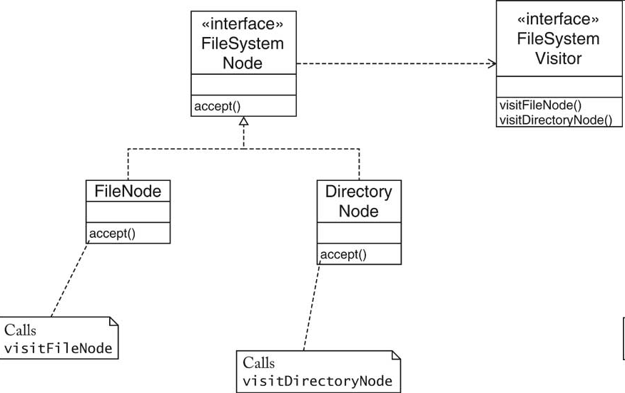
Example

Slide 50
The VISITOR Pattern
Context
An object structure contains element classes of multiple types, and you want to carry out operations that depend on the object types.
The set of operations should be extensible over time.
The set of element classes is fixed.

Slide 51
Solution
Define a visitor interface type that has methods for visiting elements of each of the given types.
Each element class defines an accept method that invokes the matching element visitation method on the visitor parameter.
To implement an operation, define a class that implements the visitor interface type and supplies the operations action for each element type.

Slide 52
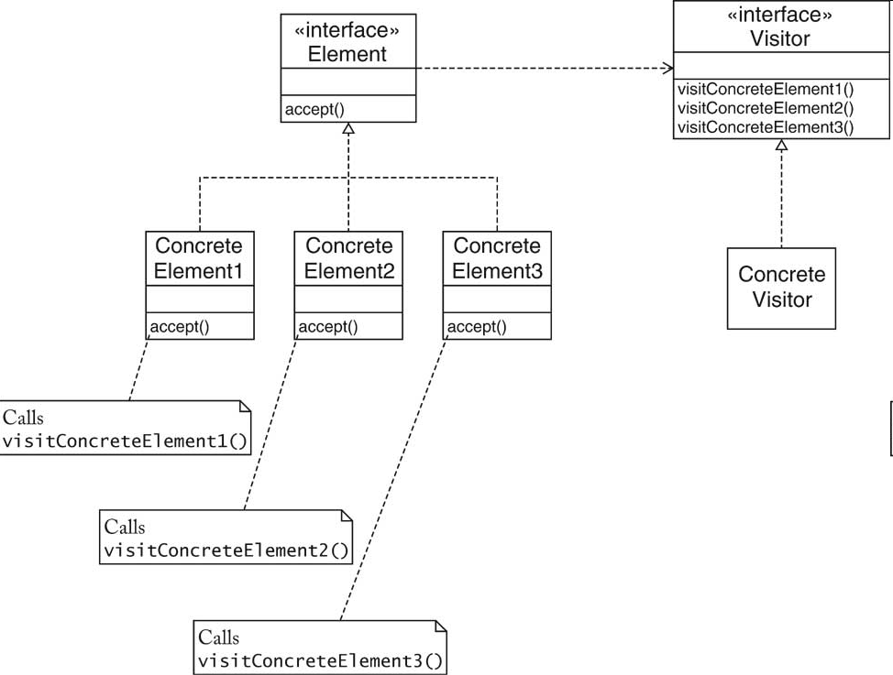

Slide 53
The VISITOR Pattern
Name in Design Pattern
Actual Name (file system visitor)
Element
FileSystemNode
ConcreteElement
FileNode, DirectoryNode
Visitor
FileSystemVisitor
ConcreteVisitor
PrintVisitor

Slide 54
Before Using Patterns
Before using a pattern to resolve the problem ask
Is there a pattern that addresses a similar problem?
Does the pattern trigger an alternative solution that may be more acceptable?
Is there a simpler solution? Patterns should not be used just for the sake of it

Slide 55
Before Using Patterns
Is the context of the pattern consistent with that of the problem?
Are the consequences of using the pattern acceptable?
Are there constraints imposed by the software environment that would conflict with the use of the pattern?

Slide 56
Using Patterns
After selecting a suitable pattern
Read the pattern to get a complete overview
Study the Structure, Participants and Collaborations of the pattern in detail
Examine the Sample Code to see an example of the pattern in use

Slide 57
Using Patterns
Choose names for the pattern’s participants (i.e. classes) that are meaningful to the application
Define the classes
Choose application specific names for the operations
Implement operations that perform the responsibilities and collaborations in the pattern

Slide 58
Toolkits and Frameworks
Main body of an
Application
Reuse the main body of an
Application and write the code it calls
Calls a procedure or
A method
Defines the architecture
Of the application
Toolkit
Framework
Toolkits: Collection of related and reusable classes
e.g. C++ I/O stream library
Framework: A set of cooperating classes that make up a reusable design for a specific class of applications e.g. drawing, compilers, CAD/CAM etc.

Slide 59
Toolkits and Frameworks
Advantages and disadvantages of using frameworks.
1. When using frameworks, what defines the architecture of the application?
2. What is more difficult to design: Application, toolkit, or frameworks?
3. How do changes in framework effect an application?
4. How do design patterns differ from frameworks?

Slide 60
1. Is this a valid implementation of a singleton? Explain your answer.
public class Singleton {
private static Singleton s_singleton = new Singleton();
private Singleton() {}
private static Singleton getInstance() {
return s_singleton;
}
}
Answer: This class is impossible to access because all the methods, including the constructor are private. The getInstance() method need to be public and static otherwise you have no chance to access the class.

Slide 61
2. Does the following code fragment implement the Factory Method design pattern?
public class XMLReaderFactory {
// This method returns an instance of a class
// that implements the XMLReader interface.
// The specific class it creates and returns is
// based on a system property.
public static XMLReader createXMLReader();
}
public interface XMLReader {
public void setContentHandler(ContentHandler handler):
public void parse(InputStream is);
}
Answer: Not really. The XMLReaderFactory it creates a class XMLReader that is independent of the client but it does not define an abstract factory method so it does not follow literally the Factory Method Design Pattern.

Slide 62
You want to implement a text paragraph. A paragraph is a sequence of lines. Each line is represented by a string. The Paragraph class provides method that appends a line to the end of the paragraph with a format algorithm (e.g., left-align or centered) which can be selected at runtime. It also has to be possible to add new format algorithms to the program without modifying the Paragraph class. Which design pattern could you use?
strategy

