Slide 1
BITS Pilani presentation
Dr. Yashvardhan Sharma
Computer Science and Information Systems

Slide 2
SS ZG514/SE Z512
Object Oriented Analysis and Design
Lecture No.4

Slide 3
Today’s Agenda
Use Case Modeling
System Sequence Diagrams
Activity Diagrams
Domain Model

Slide 4
Identify Use Cases
Capture the specific ways of using the system as dialogues between an actor and the system.
Use cases are used to
Capture system requirements
Communicate with end users and Subject Matter Experts
Test the system

Slide 5
Specifying Use Cases
Create a written document for each Use Case
Clearly define intent of the Use Case
Define Main Success Scenario (Happy Path)
Define any alternate action paths
Use format of Stimulus: Response
Each specification must be testable
Write from actor’s perspective, in actor’s vocabulary

Slide 6
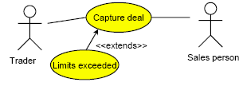
Extend
Use the extend relationship when you have a use case that is similar to another use case but does a bit more.
In this example the basic use case is Capture deal.
• In case certain limits for a deal are exceeded the additional use case Limits exceeded is performed.

Slide 7
Extend
Extensions are used instead of modeling every extra case by a single use case.
Extensions are used instead of creating a complex use case that covers all variations.
How do you address case variation?
• Capture the simple, normal use case first.
• For every step in that use case ask: “What could go wrong here?“
• Plot all variations as extensions of the given use case.

Slide 8
<<extend>> relationships represent exceptional or seldom invoked cases.
The exceptional event flows are factored out of the main event flow for clarity.
Use cases representing exceptional flows can extend more than one use case.
The direction of a <<extend>> relationship is to the extended use case
Note direction
of arrow
Passenger
PurchaseTicket
<<extend>>
<<extend>>
<<extend>>
OutOfOrder
<<extend>>
TimeOut
<<extend>> shown
with dotted line
Cancel
NoChange

Slide 9
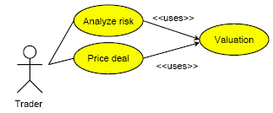
Include
The Include relationship occurs when you have a chunk of behavior that is similar across several use cases.

Slide 10
Include and Extend
The similarities between extend and Include are that they both imply factoring out common behavior from several use cases to a single use case that is
• used by several other use cases or
• extended by other use cases.
Apply the following rules:
• Use extend, when you are describing a variation on normal behavior.
• Use Include when you want to split off repeating details in a use case.

Slide 11
Note direction
and type
of arrow
Record completion
of an advert
Staff Member
Change a client
contact
Manger is a
Specialization
of Staff Member
Generalization
of functionality
Assign individual staff to work on a campaign
Assign staff to work on a campaign
Manager
Assign team of staff to work on a campaign
Manager can do everything
that Staff Member can do, and more.

Slide 12
Drawing System Sequence Diagrams

Slide 13
System Behavior
Objective
identify system events and system operations
create system sequence diagrams for use cases

Slide 14
System Behavior and UML Sequence Diagrams
It is useful to investigate and define the behavior of the software as a “black box”.
System behavior is a description of what the system does (without an explanation of how it does it).
Use cases describe how external actors interact with the software system. During this interaction, an actor generates events.
A request event initiates an operation upon the system.

Slide 15
System Behavior and System Sequence Diagrams (SSDs)
A system sequence diagram is a picture that shows, for a particular scenario of a use case, the events that external actors generate, their order, and possible inter-system events.
All systems are treated as a black box; the diagram places emphasis on events that cross the system boundary from actors to systems.

Slide 16
System sequence diagram-Example Process Sale scenario
:System
:Cashier
makeNewsale()
enterItem(itemID, quantity)
Description, total
[* more items]
Box to enclose
an iteration area.
endSale()
total with taxes
makePayment(amount)
change due, receipt

Slide 17
SSD and Use Cases
:System
:Cashier
makeNewSale()
Simple cash-only Process Sale Scenario
1. Customer arrives at a POS checkout
with goods to purchase.
2. Cashier starts a new sale.
3. Cashier enters item identifier.
4. System records sale line item, and
presents item description, price and
running total.
cashier repeats steps 3-4 until
indicates done.
5. System presents total with taxes
calculated.
…
addLineItem(itemID, quantity)
description, total
*[more items]
endSale()
total with taxes
makePayment(amount)
change due, receipt

Slide 18
System sequence diagrams [1]
SSD drawing occurs during the analysis phase of a development cycle; dependent on the creation of the use cases and identification of concepts.
A system sequence diagram illustrates events from actors to systems and the external response of the system
UML notation - Sequence Diagram not System Sequence Diagram.

Slide 19
System sequence diagrams [2]
One diagram depicts one scenario. This is the main success scenario.
Frequent or complex alternate scenarios could also be illustrated.
A system is treated as a black box.
SSD is often accompanied by a textual description of the scenario to the left of the diagram.

Slide 20
System sequence diagram [3]
Identify the system boundary…what is inside and what is outside.
System event: An external event that directly stimulates the (software) system.
Events are initiated by actors.
Name an event at the level of intent and not using their physical input medium or interface widgets.
enterItem() is better than scan().
Keep the system response at an abstract level.
description, total is preferred over display description and total on the POS screen.

Slide 21
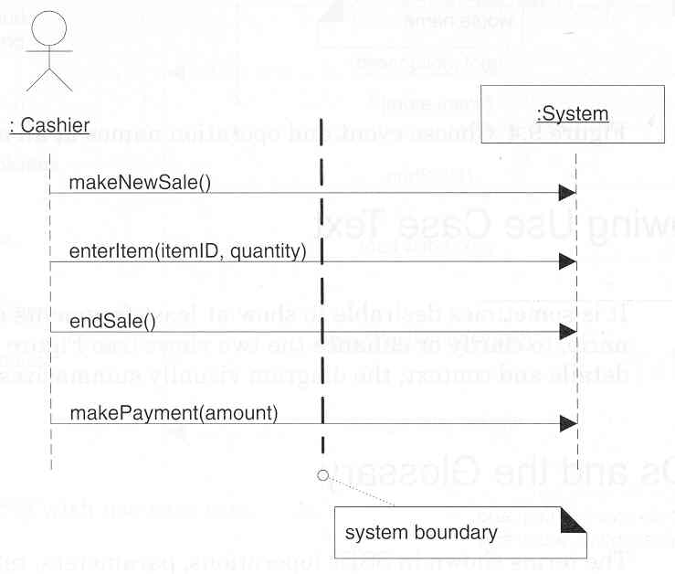
The System Boundary
[Larman, 2002]

Slide 22
Agate Case Study
Agate is an advertising agency in Birmingham. Agate deals with other companies that it calls clients. A record is kept of each client company. Clients have advertising campaign, and a record is kept of every campaign. Each campaign includes one or more adverts. Agate nominates members of creative team, which work on campaign.
One member of the creative team manages each campaign. Staff may be working on more than one project at a time. When a campaign starts, the manager responsible estimates the likely cost of the client and agrees it with the client. A finish date may be set for a campaign at any time, and may be changed. When the campaign is completed, an actual completion date and the actual cost are recorded. When the client pays, the date paid is recorded. The manager checks the campaign budget periodically.
The system should also hold the staff grades and calculate staff salaries.

Slide 23
Sample Requirements List
No. | Requirement | Use Case(s)
1. | To record names, address and contact details for each client. | Add a new client
2. | To record the details of each campaign for each client. This will include the title of the campaign, planned start and finish dates, estimated costs, budgets, actual costs and dates, and the current state of completion. | Add a new campaign
3. | To provide information that can be used in the separate accounts systems for invoicing clients for campaigns. | Record completion of a campaign
4. | To record payments for campaign that are also recorded in the separate accounts system. | Record client payment
5. | To record which staff are working on which campaigns, including the campaign manager for each campaign. | Assign staff to work on a campaign

Slide 25
Activity Diagrams
Purpose
to model a task (for example in business modelling)
to describe a function of a system represented by a use case
to describe the logic of an operation
to model the activities that make up the life cycle in the Unified Process
Model dynamic behavior of a system as a flowchart.
Description of a business process, by activities and their I/O.

Slide 26
Drawing Activity Diagrams
Purpose
Draw the activity flow of a system. Activity can be described as an operation of the system.
Describe the sequence from one activity to another.
Describe the parallel, branched and concurrent flow of the system.
Captures dynamic behavior of the system as like other behavioral diagrams but activity diagram show message flow from one activity to another.

Slide 27
UML Activity Diagram
An activity diagram is a variation or special case of a state machine, in which the states are activities representing the performance of operations and the transitions are triggered by the completion of the operations.
An activity diagram shows actions and control flow is drawn from one operation to another. This flow can be sequential, branched or concurrent.
Understand the rules and style guidelines for activity diagram
Be able to create functional models using activity diagrams.
Activity diagrams deals with all type of flow control by using different elements like fork, join etc.

Slide 28
BPM With Activity Diagrams
A number of activities support a business process across several departments
Activity diagrams model the behavior in a business process
Sophisticated data flow diagrams
Addresses Parallel concurrent activities and complex processes

Slide 29
How to draw Activity Diagram
Before drawing an activity diagram we must have a clear understanding about the elements used in activity diagram.
The main element of an activity diagram is the activity itself. An activity is a function performed by the system.
After identifying the activities we need to understand how they are associated with constraints and conditions.

Slide 30
Diagrams in UML
UML diagrams consist of:
icons
two-dimensional symbols
paths
Strings
UML diagrams are defined in the UML specification.
Write Chapter
Plan Chapter
Produce First Draft
Revise Draft
[not satisfied]
[satisfied]
Add Exercises
Add References
to Bibliography

Slide 31
Notation of Activity Diagrams
Activities
rectangle with rounded ends
meaningful name
Transitions
arrows with open arrowheads
Add a New Client
Assign Staff Contact

Slide 32
Notation of Activity Diagrams
Start state
black circle
Decision points
diamond
Guard conditions
in square brackets
Final state
black circle in white circle
Add a New Client
Assign Staff Contact
[no campaign to add]
[campaign to add]
Add New
Campaign

Slide 33
Notation of Activity Diagrams
Add a New Client
Alternative notation for branching:
alternative transitions are shown leaving the activity with guard conditions
Note that guard conditions do not have to be mutually exclusive, but it is advisable that they should be
Assign Staff Contact
[no campaign to add]
[campaign to add]
Add New
Campaign

Slide 34
UML Activity Decision

Slide 35
Branching Nodes
merge node
decision node
guards

Slide 36
Notation of Activity Diagrams
Object flows
dashed arrow
Objects
rectangle
with name of object underlined
optionally shows the state of the object in square brackets
:Campaign
[Active]
Record completion
of a campaign
:Campaign
[Completed]

Slide 37
Notation of Activity Diagrams
Swimlanes
vertical columns
labelled with the person, organisation or department responsible for the activities in that column
Campaign Manager
Accountant
Client
Record Completion
of a campaign
Issue invoice
Pay invoice
Record client
payment

Slide 38
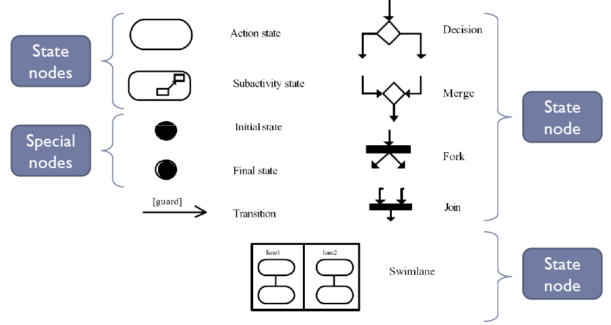
Subset of structural elements of ADs

Slide 39
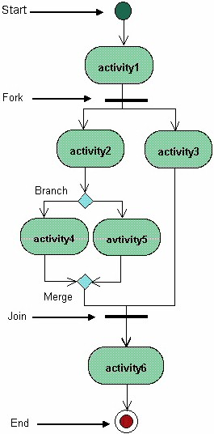

Slide 40
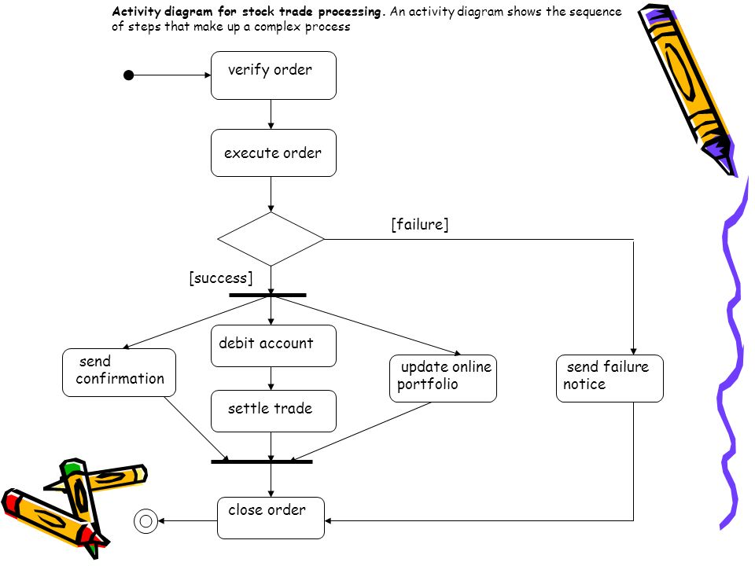

Slide 41
Drawing Activity Diagrams
What is the purpose?
This will influence the kind of activities that are shown
What is being shown in the diagram?
What is the name of the business process, use case or operation?
What level of detail is required?
Is it high level or more detailed?

Slide 42
Drawing Activity Diagrams
Identify activities
What happens when a new client is added in the Agate system?
Add a New Client
Assign Staff Contact
Add New Campaign
Assign Staff to Campaign
Organise the activities in order with transitions

Slide 43
Drawing Activity Diagrams
Add a New Client
Assign Staff Contact
Add New
Campaign
Assign Staff
to Campaign

Slide 44
Drawing Activity Diagrams
Identify any alternative transitions and the conditions on them
sometimes there is a new campaign to add for a new client, sometimes not
sometimes they will want to assign staff to the campaign, sometimes not
Add transitions and guard conditions to the diagram

Slide 45
Drawing Activity Diagrams
Add a New Client
Assign Staff Contact
[no campaign to add]
[campaign to add]
Add New
Campaign
[no staff to assign]
[staff to assign]
Assign Staff
to Campaign

Slide 46
Drawing Activity Diagrams
Identify any processes that are repeated
they will want to assign staff to the campaign until there are no more staff to add
Add transitions and guard conditions to the diagram

Slide 47
Drawing Activity Diagrams
Add a New Client
Assign Staff Contact
[no campaign to add]
[campaign to add]
Add New
Campaign
[no staff to assign]
[staff to assign]
Assign Staff
to Campaign
[no more staff to assign]
[more staff to assign]

Slide 48
Drawing Activity Diagrams
Are all the activities carried out by the same person, organisation or department?
If not, then add swimlanes to show the responsibilities
Name the swimlanes
Show each activity in the appropriate swimlane

Slide 49
Administrator
Campaign Manager
Add a New Client
Assign Staff Contact
[no campaign to add]
[campaign to add]
Add New
Campaign
[no staff to assign]
[staff to assign]
Assign Staff
to Campaign

Slide 50
Swimlanes.
Notes:
Actions maybe organized into swimlanes, each separated from neighboring swimlanes by vertical solid lines on both sides. Each swimlane represents responsibility for part of the overall activity and may be implemented by one or more objects. The relative ordering of the swimlanes has no semantic significance but might indicate some affinity.

Slide 51
Drawing Activity Diagrams
Are there any object flows and objects to show?
these can be documents that are created or updated in a business activity diagram
these can be object instances that change state in an operation or a use case
Add the object flows and objects

Slide 52
Object Nodes
Data and objects are shown as object nodes.
object node state
object node

Slide 53
Administrator
Campaign Manager
Add a New Client
:Client
[New]
Assign Staff Contact
[no campaign to add]
[campaign to add]
:Campaign
Add New
Campaign
[no staff to assign]
[Commissioned]
[staff to assign]
Assign Staff
to Campaign

Slide 54
Domain Model

Slide 55
Domain model: What is it?
Illustrates meaningful concepts in the problem domain.
Usually expressed in the form of static diagrams (in Rational Rose this implies a high-level class diagram).
Is a representation of real-world things; not software components (of the system under development).
No operations are defined or specified in the domain model.
The model shows concepts, associations between concepts, and attributes of concepts.
Serves as a source of designing software objects.

Slide 56
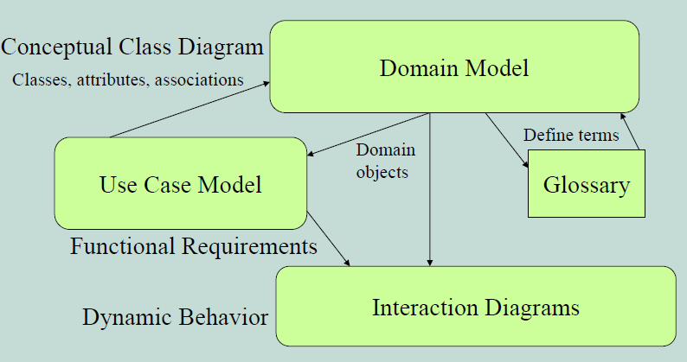
Domain Model Relationships

Slide 57
Why do a domain model?
Gives a conceptual framework of the things in the problem space
Helps you think – focus on concepts
Provides a glossary of terms – noun based
It is a static view - meaning it allows us convey time invariant business rules
Further foundation for use case/workflow modeling
Based on the defined structure, we can describe the state of the problem domain at any time.

Slide 58
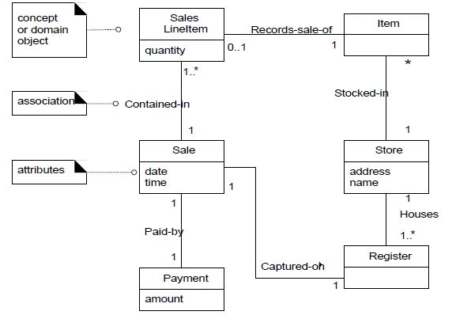
Partial Domain Model of POST

Slide 59
A Domain Model is the most important OO artifact
Its development entails identifying a rich set of conceptual classes, and is at the heart of object oriented analysis.
It is a visual representation of the decomposition of a domain into individual conceptual classes or objects.
It is a visual dictionary of noteworthy abstractions.

Slide 60
Domain Models within in UP
Domain Model is primarily created during elaboration iterations not in inception phase, when the need is highest to understand the noteworthy concepts and map some to software classes during design work.

Slide 61
Decomposition:
A central distinction between Object-oriented analysis and structured analysis is the division by objects rather than by functions during decomposition.
During each iteration, only objects in current scenarios or different concepts are considered for addition to the domain model.

Slide 62
Features of a domain model
Domain classes – each domain class denotes a type of object.
Attributes – an attribute is the description of a named slot of a specified type in a domain class; each instance of the class separately holds a value.
Associations – an association is a relationship between two (or more) domain classes that describe links between their object instances. Associations can have roles, describing the multiplicity and participation of a class in the relationship.
Additional rules – complex rules that cannot be shown with symbolically can be shown with attached notes.

Slide 63
Domain model: How to construct?
Objectives
identify concepts (conceptual classes) related to current development cycle requirements
create initial conceptual (domain) model
Add Associations necessary to record relationships for which there is a need to preserve some memory
add the attributes necessary

Slide 64
Domain classes?
Each domain class is an idea/thing/object. It is a descriptor for a set of things that share common features. Classes can be:-
Business objects - represent things that are manipulated in the business e.g. Order.
Real world objects – things that the business keeps track of e.g. Contact, Site.
Events that transpire/revealed - e.g. sale and payment.

Slide 65
Think of Conceptual Classes in terms of:
Symbol—words or images representing a conceptual class.
Intension—the definition of a conceptual class.
Extension—the set of examples to which the conceptual class applies.
Symbols and Intensions are the practical considerations when creating a domain model.

Slide 66
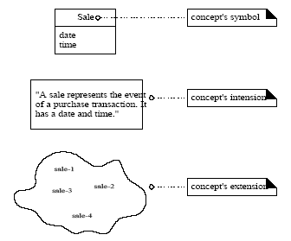
Symbol - Intension - Extension

Slide 67
Conceptual Class Identification:
It is better to overspecify a domain with lots of fine-grained conceptual classes than it is to underspecify it.
Unlike data modeling, it is valid to include concepts for which there are no attributes, or which have a purely behavioral role rather than an informational role.

Slide 68
Conceptual Class Identification:
Strategies to Identify Conceptual Classes:
Reuse or modify existing domain model
There are many published, well-crafted domain models. Like Inventory, Finance, Healthcare etc.
Use a conceptual class category list
Make a list of all candidate conceptual classes
Identify noun phrases
Identify nouns phrases in textual descriptions of a
domain ( use cases, or other documents)

Slide 69
Finding concepts: Category List
Finding concepts using the concept category list :
Physical objects: register, airplane, blood pressure monitor
Places: airport, hospital, Store
Catalogs: Product Catalog

Slide 70
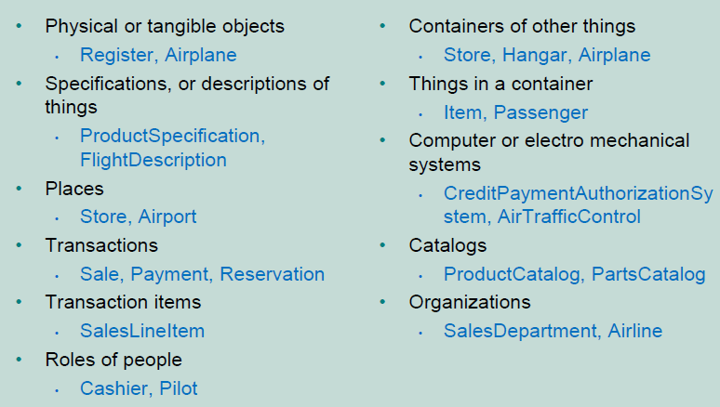
Conceptual Classes Category List

Slide 71
Where identify conceptual classes from noun phrases (NP)
Vision and Scope, Glossary and Use Cases are good for this type of linguistic analysis
However:
Words may be ambiguous or synonymous
Noun phrases may also be attributes or parameters rather than classes:
If it stores state information or it has multiple behaviors, then it’s a class
If it’s just a number or a string, then it’s probably an attribute

Slide 72
Finding concepts using Noun Phrases: refer to use cases
Examine use case descriptions.
Example: Process Sale use case:
Main success scenario:
Customer arrives at a POS checkout counter.
Cashier starts a new sale.
Cashier enters an item ID.
System records sale line item. It then presents a description of the item, its price, and a running total.
….
….
Possible source of confusion: Is it an attribute or a concept?
If X is not a number or a text then it probably is a conceptual class.

Slide 73
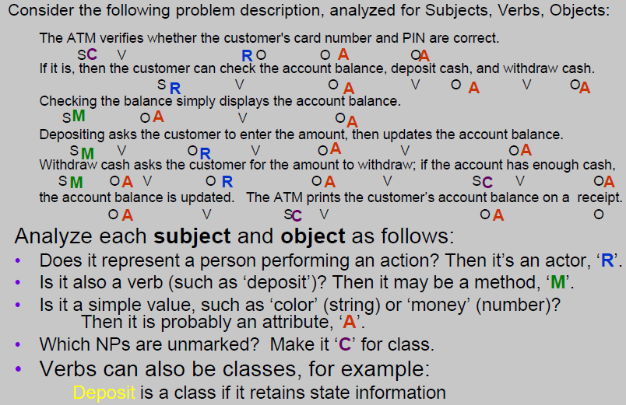
From NPs to classes or attributes

Slide 74
Finding concepts: Examples
Are these concepts or attributes?
Store
Flight
Price
Use terms familiar to those in the problem domain.
POST or register?
Concepts from “Unreal” world ?
Example – Telecommunications (requires a high
degree of abstraction)
Message, Connection
Port, Dialog, Route, Protocol

Slide 75
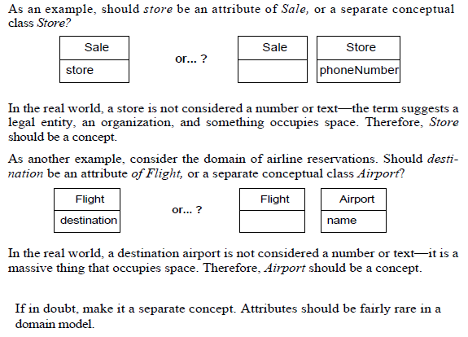
Finding concepts: Examples

Slide 76
What about Sales Receipt?
Should it be included in the model?
– Its common in the real world system
– It’s a sales report. Reports not explicitly stated
in the use cases have little value in this model.
– However, when a Customer wishes to return an
item, it is an important object in the domain.
– Since this develop cycle doesn’t include the Return
Items use case, we’ll leave it out of this CM

Slide 77
Concepts in POST domain
POST
Item
Sale
Store
Payment
SalesLineItem
Product Specification
ProductCatalog
Customer
Cashier
Manager

Slide 78
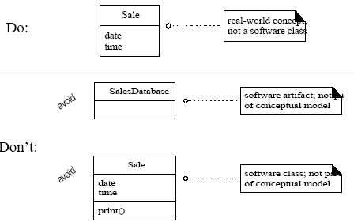
Do’s and Don’ts in Conc. Model

