Slide 1
BITS Pilani presentation
Dr. Yashvardhan Sharma
Computer Science and Information Systems

Slide 2
SS ZG514/SE Z512
Object Oriented Analysis and Design
Lecture No.6

Slide 3
Today’s Agenda
Object Oriented Analysis
Ways to do Object Oriented Analysis
Domain Model

Slide 4
Understanding Analysis
In software engineering, analysis is the process of converting the user requirements to system specification.
System specification (logic structure) is the developer’s view of the system.
Function-oriented analysis – concentrating on the decomposition of complex functions to simple ones.
Object-oriented analysis – identifying objects and the relationship between objects.

Slide 5
Understanding Analysis
The goal in Analysis is to understand the problem
and to begin to develop a visual model of what you are trying to build, independent of implementation and technology concerns.
Analysis focuses on translating the functional requirements into software concepts.
The idea is to get a rough cut at the objects that comprise our system, but focusing on behavior (and therefore encapsulation).
We then move very quickly, nearly seamlessly into “design” and the other concerns.

Slide 6
Analysis Versus Design
Focus on understanding the problem
Idealized Behavior
System structure
Functional requirements
A small model
Focus on understanding the solution
Operations and Attributes
Performance
Close to real code
Object lifecycles
Non-functional requirements
A large model
Analysis
Design

Slide 7
Overview of Analysis
Analysis is an iterative process… make a ‘first cut’ conceptual model and then iteratively refine it as your understanding of the problem increases.
Brief Steps in the object analysis process
1. Identifying the classes
2. Identifying the classes attributes
3. Identifying relationships and collaborations between classes

Slide 8
Object Oriented Analysis
Identifying objects:
Using concepts, CRC cards etc.
Organising the objects:
classifying the objects identified, so similar objects can later be defined in the same class.
Identifying relationships between objects:
this helps to determine inputs and outputs of an object.
Defining objects internally:
information held within the objects.

Slide 9
Three ways to do Object Oriented Analysis
Conceptual model (Larman)
Produce a “light” class diagram.
CRC cards (Beck, Cunningham)
Index cards and role playing.

Slide 10
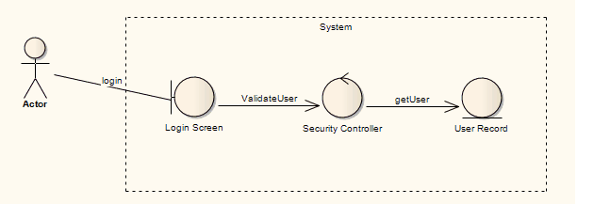
Three ways to do Object Oriented Analysis (1)
Analysis model with stereotypes (Jacobson). Stereotypes used are:
Boundaries (for a system boundary (for example, a Login screen))
Entities (the element is a persistent or data element)
Control ( to specify an element is a controller of some process).

Slide 11
Object Identification
Textual analysis of use-case information
Nouns suggest classes
Creates a rough first cut
Common object list
Incidents
Roles

Slide 12
Case study: a resort reservation system
Design the software to handle reservations at Blue Lake Resort. The resort comprises several cottages and two meeting rooms. Cottages can comprise from one to three beds. The first meeting room has a capacity of 20 persons, the second, 40 persons. Cottages can be booked by the night; meeting rooms can be booked by the hour. Rates for cottages are expressed per person, per night; rates for meeting rooms are expressed per hour.

Slide 13
Case study: a resort reservation system
Clients can book cottages and meeting rooms in advance by providing a phone number and a valid credit card information. Customers can express preferences for specific cottages. Cancellation of reservations is possible but requires 24 hours notice. An administrative charge applies to all cancellations. Every morning, a summary of the bookings for the previous day is printed out and the related information is erased from the computer; a list of the cottages and meeting rooms that will require cleaning is printed.

Slide 14
Identification of Classes[1]
Step 1: identify candidate classes
Using nouns: extract objects from the nouns in the requirements
Data flow: start with inputs and determine what objects are needed to transform the inputs to the outputs

Slide 15
Identification of Classes[2]
Using the things to be modeled: identify individual or group things such as persons, roles, organizations, logs, reports… in the application domain that is to be modeled; map to corresponding classes.

Slide 16
Identification of Classes[3]
Using previous experience: object-oriented domain analysis, application framework, class hierarchies, and personal experience

Slide 17
Noun identification
Identify candidate classes by extracting all nouns out of the requirements/ specifications of the system.
Don’t be too selective at first; write down every class that comes to mind. A selection process will follow.

Slide 18
Noun identification: Case Study
Design the software to handle reservations at Blue Lake Resort. The resort comprises several cottages and two meeting rooms. Cottages can comprise from one to three beds. The first meeting room has a capacity of 20 persons, the second, 40 persons. Cottages can be booked by the night; meeting rooms can be booked by the hour. Rates for cottages are expressed per person, per night; rates for meeting rooms are expressed per hour.

Slide 19
Noun identification: Case Study
Clients can book cottages and meeting rooms in advance by providing a phone number and a valid credit card information. Customers can express preferences for specific cottages. Cancellation of reservations is possible but requires 24 hours notice. An administrative charge applies to all cancellations. Every morning, a summary of the bookings for the previous day is printed out and the related information is erased from the computer; a list of the cottages and meeting rooms that will require cleaning is printed.

Slide 20
Keeping the right candidate classes
Having made a tentative list of classes, eliminate unnecessary or incorrect classes according to the following criteria:
Redundant classes: nouns that express the same information
Irrelevant classes: nouns that have nothing to do with the problem
Vague classes: nouns with ill-defined boundaries or which are too broad
Attributes: nouns referring to something simple with no interesting behavior, which is simply an attribute of another class
Events or operations: nouns referring to something done to the system (sometimes events or operations are to be kept: check if they have state, behavior and identity).
Outside the scope of the system: nouns that do not refer to something inside the system

Slide 21
Refined list: Case Study
Good classes: Cottage, Meeting room, Client
Bad classes: Software, Blue Lake Resort, Bed, Capacity, Night, Hour, Rate, Phone number, Credit card information, Customer, Preference, Cancellation, Notice, Administrative charge, Morning, Day, Information, Computer
Don’t know: Reservation, Resort, Summary, List

Slide 22
More Class Identification Tips
Adjectives can suggest different kinds of objects or different use of the same object. If the adjectives indicate different behavior then make a new class.
Be wary of sentences in the passive voice, or those whose subjects are not part of the system. Recast the sentence in the active voice and see if it uncovers other classes. e.g.: "a summary of the bookings for the previous day is printed out". Missing from this sentence is the subject or who is doing the printing.

Slide 23
More Class Identification Tips
Keeping two lists (strong candidates and weaker ones) is a useful technique to avoid losing information while still sorting between things you are sure about and things that have yet to be settled. Additional techniques in Step 2 (identifying responsibilities and attributes) and Step 3(identifying relationships and attributes) will help.

Slide 24
ATM Case Study
Design the software to support a computerized banking network including both human cashiers and automatic teller machine (ATMs) to be shared by a consortium of banks. Each bank provides its own computer to maintain its own accounts and process transactions against them. Cashier stations are owned by individual banks and communicated directly with their own bank’s computers. Human cashiers enter account and transaction data.

Slide 25
ATM Case Study (Cont.)
Automatic teller machines communicate with a central computer that clears transactions with the appropriate banks. An automatic teller machine accepts a cash card, interacts with the user, communicates with the central system to carry out the transaction, dispenses cash, and prints receipts. The system requires appropriate recordkeeping and security provisions. The system must handle concurrent accesses to the same account correctly.
The banks will provide their own software for their own computers; you are to design the software for the ATMs and the network. The cost of the shared system will be apportioned to the banks according to the number of customers with cash cards.

Slide 26
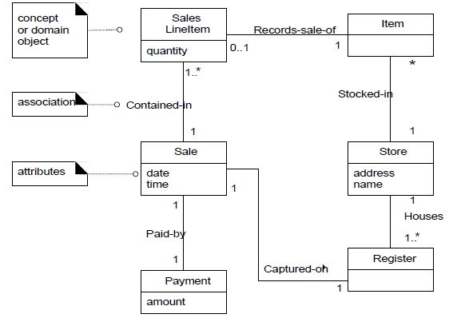
Partial Domain Model of POST

Slide 27
A Domain Model is the most important OO artifact
Its development entails identifying a rich set of conceptual classes, and is at the heart of object oriented analysis.
It is a visual representation of the decomposition of a domain into individual conceptual classes or objects.
It is a visual dictionary of noteworthy abstractions.

Slide 28
Domain Models within in UP
Domain Model is primarily created during elaboration iterations not in inception phase, when the need is highest to understand the noteworthy concepts and map some to software classes during design work.

Slide 29
Decomposition:
A central distinction between Object-oriented analysis and structured analysis is the division by objects rather than by functions during decomposition.
During each iteration, only objects in current scenarios or different concepts are considered for addition to the domain model.

Slide 30
Features of a domain model
Domain classes – each domain class denotes a type of object.
Attributes – an attribute is the description of a named slot of a specified type in a domain class; each instance of the class separately holds a value.
Associations – an association is a relationship between two (or more) domain classes that describe links between their object instances. Associations can have roles, describing the multiplicity and participation of a class in the relationship.
Additional rules – complex rules that cannot be shown with symbolically can be shown with attached notes.

Slide 31
Domain model: How to construct?
Objectives
identify concepts (conceptual classes) related to current development cycle requirements
create initial conceptual (domain) model
Add Associations necessary to record relationships for which there is a need to preserve some memory
add the attributes necessary

Slide 32
Domain classes?
Each domain class is an idea/thing/object. It is a descriptor for a set of things that share common features. Classes can be:-
Business objects - represent things that are manipulated in the business e.g. Order.
Real world objects – things that the business keeps track of e.g. Contact, Site.
Events that transpire/revealed - e.g. sale and payment.

Slide 33
Think of Conceptual Classes in terms of:
Symbol—words or images representing a conceptual class.
Intension—the definition of a conceptual class.
Extension—the set of examples to which the conceptual class applies.
Symbols and Intensions are the practical considerations when creating a domain model.

Slide 34
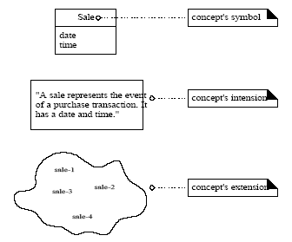
Symbol - Intension - Extension

Slide 35
Conceptual Class Identification:
It is better to overspecify a domain with lots of fine-grained conceptual classes than it is to underspecify it.
Unlike data modeling, it is valid to include concepts for which there are no attributes, or which have a purely behavioral role rather than an informational role.

Slide 36
Conceptual Class Identification:
Strategies to Identify Conceptual Classes:
Reuse or modify existing domain model
There are many published, well-crafted domain models. Like Inventory, Finance, Healthcare etc.
Use a conceptual class category list
Make a list of all candidate conceptual classes
Identify noun phrases
Identify nouns phrases in textual descriptions of a
domain ( use cases, or other documents)

Slide 37
Finding concepts: Category List
Finding concepts using the concept category list :
Physical objects: register, airplane, blood pressure monitor
Places: airport, hospital, Store
Catalogs: Product Catalog

Slide 38
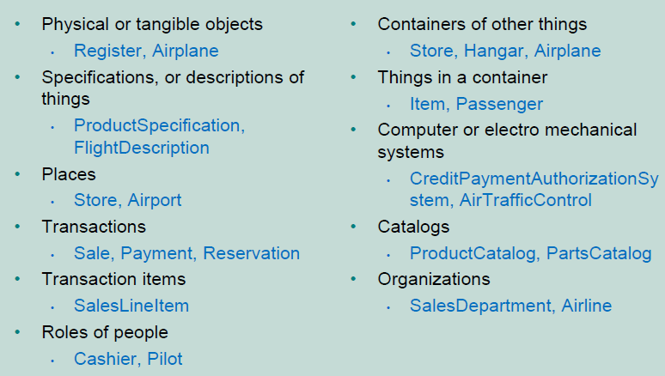
Conceptual Classes Category List

Slide 39
Where identify conceptual classes from noun phrases (NP)
Vision and Scope, Glossary and Use Cases are good for this type of linguistic analysis
However:
Words may be ambiguous or synonymous
Noun phrases may also be attributes or parameters rather than classes:
If it stores state information or it has multiple behaviors, then it’s a class
If it’s just a number or a string, then it’s probably an attribute

Slide 40
Finding concepts using Noun Phrases: refer to use cases
Examine use case descriptions.
Example: Process Sale use case:
Main success scenario:
Customer arrives at a POS checkout counter.
Cashier starts a new sale.
Cashier enters an item ID.
System records sale line item. It then presents a description of the item, its price, and a running total.
….
….
Possible source of confusion: Is it an attribute or a concept?
If X is not a number or a text then it probably is a conceptual class.

Slide 41
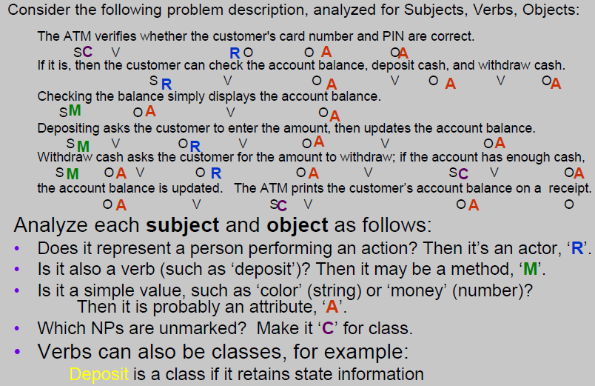
From NPs to classes or attributes

Slide 42
Finding concepts: Examples
Are these concepts or attributes?
Store
Flight
Price
Use terms familiar to those in the problem domain.
POST or register?
Concepts from “Unreal” world ?
Example – Telecommunications (requires a high
degree of abstraction)
Message, Connection
Port, Dialog, Route, Protocol

Slide 43
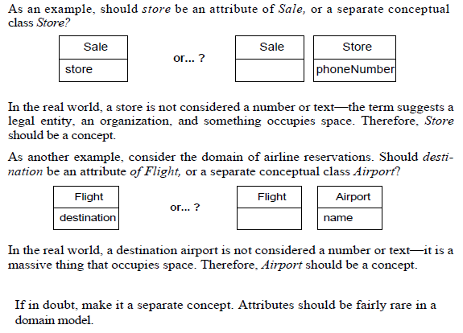
Finding concepts: Examples

Slide 44
What about Sales Receipt?
Should it be included in the model?
– Its common in the real world system
– It’s a sales report. Reports not explicitly stated
in the use cases have little value in this model.
– However, when a Customer wishes to return an
item, it is an important object in the domain.
– Since this develop cycle doesn’t include the Return
Items use case, we’ll leave it out of this CM

Slide 45
Concepts in POST domain
POST
Item
Sale
Store
Payment
SalesLineItem
Product Specification
ProductCatalog
Customer
Cashier
Manager

Slide 46
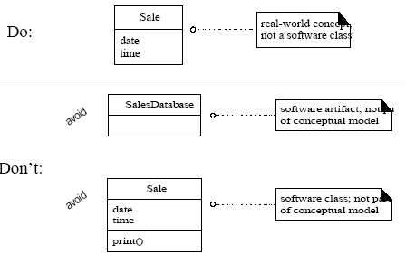
Do’s and Don’ts in Conc. Model

Slide 47
Specification Concepts/Conceptual Classes
When are they needed?
Add a specification concept when:
deleting instances of things they describe (for example, Item) results in a loss of information that needs to be maintained.
it reduces redundant or duplicated information

Slide 48
Specification Example
Assume that
an item instance represents a physical item in the store; it has a serial number
an item has a description, price and itemID which are not recorded anywhere else.
every time a real physical item is sold, a corresponding software instance of item is deleted from the database
With these assumptions, what happens when the store sells out of a specific item like “burgers”? How does one find out how much does the “burger” cost ?
Notice that the price is stored with the inventoried instances

Slide 49
Specification Example – Contd.
Also notice the data is duplicated many times with each instance of the item.
This example illustrates the need for a concept of objects that are specifications or descriptions of other things (often called a Proxy or Surrogate)
Description or specification objects are strongly related to the things they describe.

Slide 50
Specification - Example
ProductDesciption
description
describes
Item
price
Serial Number
UPC
1
1
*
*
Which of these two
is a better choice of concepts?
XSpecification describes X
Item
Serial Number
description
Price
itemID

Slide 51
Conceptual Models - Association
Objective
Identify associations within a conceptual model
distinguish between need-to-know associations from comprehension-only associations

Slide 52
Associations
Associations imply knowledge of a relationship that needs to be preserved over time
– could be milliseconds or years!
– such associations are need-to-know assocs.
Associations derived from the Common Associations List (Pg 155-156, Larman).
Represented as a solid line between objects
– the association is inherently bi-directional
– may contain a cardinality or multiplicity value
– optionally contains an arrow for easy reading

Slide 53
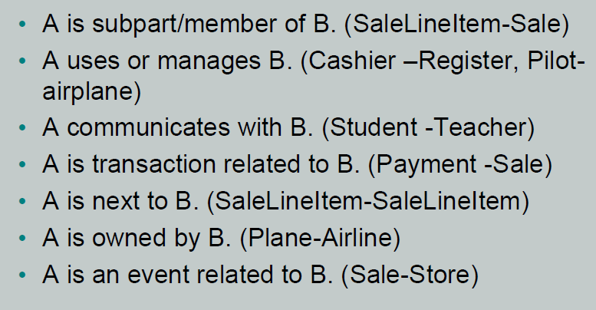
Common Associations

Slide 54
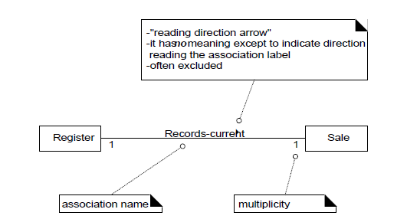
Associations
Association - a relationship between concepts that indicates some meaningful and interesting connection
For example, do we need to remember what SalenLineItem instances are associated with a Sale instance? Definitely, otherwise it would not
be possible to reconstruct a sale, print a receipt, or calculate a sale total.

Slide 55
Associations
Do we need to have memory of a relationship between a current Sale and a Manager?
No, the requirements do not suggest that any such relationship is needed. It is not wrong to show a relationship between a Sale and Manager, but it is not compelling or useful in the context of our requirements.

Slide 56
Finding Associations
High priority associations
A is a physical or logical part of B
A is physically or logically contained in/on B
A is recorded in B
Other associations
A uses or manages or controls B (Pilot -airplane)
A owns B (Airline -airplane) or (Register-Store)
A is event related to B (Customer-Sale)

Slide 57
Association Guidelines
Focus on those associations for which knowledge of the relationship needs to be preserved for some duration (need-to-know associations)
More important to identify concepts than associations
Too many associations tend to confuse the conceptual model
Avoid showing redundant or derivable associations

Slide 58
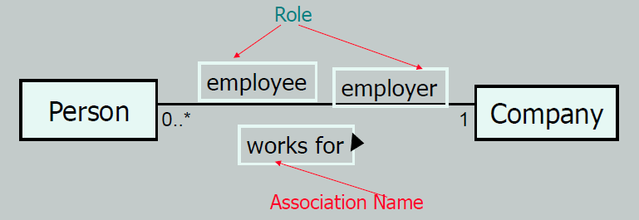
Roles in Associations
Each of the two ends of an association is called a role. Roles have
name
multiplicity expression
navigability

Slide 59
Naming Associations
Association names should start with a capital letter (same as concepts, objects)
Noun phrases help identify objects/concepts
Verb phrases help identify associations
Use hyphens to separate words when a phrase is used to name something. Name should enhance meaning also. Like Sales uses Cashpayment instead of sale Paid -by Cashpayment
Legal Format are:
Records-current or RecordCurrent

Slide 60
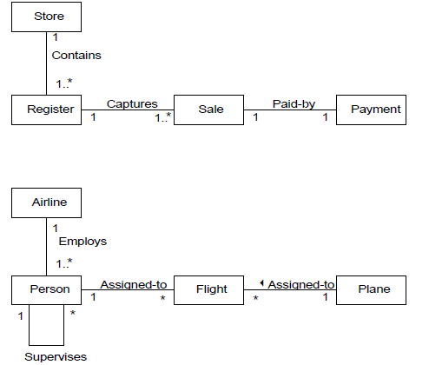
Naming Associations

Slide 61
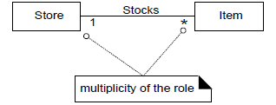
Multiplicity
Multiplicity defines how many instances of type A can be associated with one instance of type B at a particular moment in time
Multiplicity of the role

Slide 62
Association - Multiplicity
Multiplicity: indicates the number of objects of one class that may be related to a single object of an associated class.
Can be one of the following types
1 to 1, 1 to 0..*, 1 to 1..*, 1 to n, 1 to 1..n
The multiplicity value communicates how many instances can be validly associated with another, at a particular moment, rather than over a span of time. For example, it is possible that a used car could be repeatedly sold back to used car dealers over time. But at any particular moment, the car is only Stocked-by one dealer. The car is not Stocked-by many dealers at any particular moment.

Slide 63
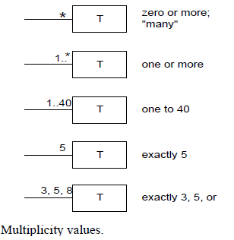
Association - Multiplicity

Slide 64
Associations - Contd.
Associations are generally read left to right, top to bottom

Slide 65
Associations - Contd.
Multiple associations between two types
During analysis phase, an association is not a statement
about data flows, instance variables, or object connections
in the software solution, it is a statement that a relationship
is meaningful in a purely conceptual sense.

Slide 66
Regarding Associations
Associations are real-world relationships, which may or may not be implemented in the final system.
Conversely, we may discover associations that need to be implemented but were missed in analysis. The conceptual model should be updated!
Usually, associations are implemented by placing an instance variable which “points to” (references) an instance of the associated class.
Only add associations (or concepts) to the model that aid in the comprehension(understanding) of the system by others.
Remember, conceptual models are communication tools, used to express concepts in the problem domain.

Slide 67
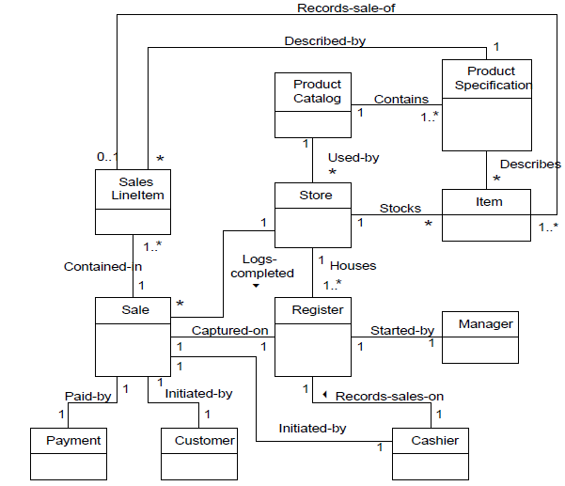
Partial Domain Model of POST

Slide 68
Conceptual Model - Attributes
Objectives
identify attributes in a conceptual model
distinguish between correct and incorrect attributes
It is useful to identify those attributes of conceptual classes that are needed to satisfy the information requirements of the current scenarios under development.

Slide 69
Attributes [1]
Attribute - is a logical data value of an object.
It is a named property of a class describing values held by each object of the class
Attribute Type: A specification of the external behavior and/or the implementation of the attribute
Include the following attributes in a domain model
those for which the requirements suggest or imply a need to remember information
For example, a sale receipt normally includes a date and time attribute
Attribute Name:attribute Type

Slide 70

UML Attribute Notation
Attributes reside in the 2nd compartment of
a concept box
Format is name: type
Attributes should be pure data values

Slide 71
Attributes [2]
Attributes in a conceptual model should preferably be simple attributes or pure data values
Common simple attribute types include
boolean, date, number, string, time

Slide 72
Attributes: Examples
not a
worse
Cashier
"simple” attribute
name
currentPost
better
Cashier
uses
POST
name
1
number
1
1
Relate two items with associations, not attributes, in conceptual model. Avoid representing complex domain concepts as attributes; use associations.

Slide 73
Complex Attributes
Pure data values - expressed as attributes; they do not illustrate specific behaviors;
Example - Phone number
A Person can have many Phone numbers
Non-primitive attribute types
represent attributes as non-primitive types (concepts or objects) if
it is composed of separate sections (name of a person)
there are operations associated with it such as validation
it is a quantity with a unit (payment has a unit of currency)

Slide 74
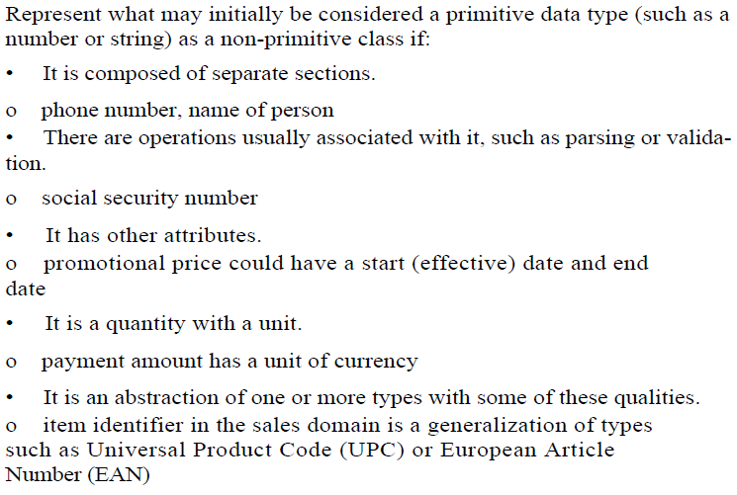
Non-primitive Data Type Classes

Slide 75
Non-primitive Data Type Classes
The type of an attribute may be expressed as a non-primitive class in its own right in a domain model.
Example: The item identifier in POST is an abstraction of various common coding schemes, including UPC-A, UPC-E, and the family of EAN schemes. These numeric coding schemes have subparts identifying the manufacturer, product, country (for EAN), and a check-sum digit for validation. Therefore, there should be a non-primitive ItemID class

Slide 76
Where to Illustrate Data Type Classes?
Should the ItemID class be shown as a separate conceptual class in a domain model?
It depends on what you want to emphasize in the diagram. Since ItemID is a data type (unique identity of instances is not important), it may be shown in the attribute compartment of the class box. But since it is a non-primitive class, with its own attributes an associations, it may be interesting to show it as a conceptual class in its own box. There is no correct answer; it depends on how the domain model is being used as a tool of communication, and the significance of the concept in the domain.

Slide 77
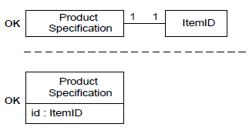
Example

Slide 78
Non-primitive Data Type Classes
The price and amount attributes should be non-primitive Quantity or Money classes because they are quantities in a unit of currency.
The address attribute should be a non-primitive Address class because it has separate sections.
The classes ItemID, Address, and Quantity are data types (unique identity of instances is not meaningful) but they are worth considering as separate classes because of their qualities.

Slide 79
Example
It is desirable to show non-primitive attributes as concepts in a conceptual model
Destination a
Flight
Complex concept
destination
Flies-to
Airport
Flight
1
1

Slide 80
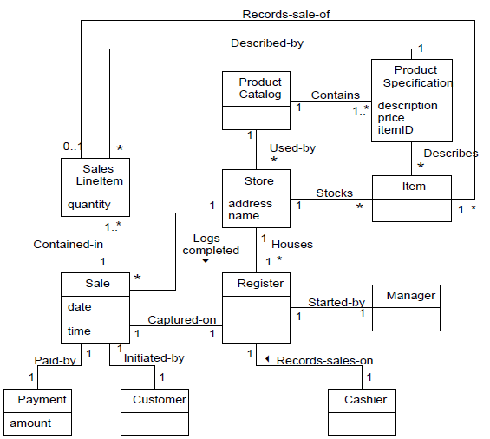
Partial Domain Model

Slide 81
Recording terms in Glossary
Define all terms that need clarification in a glossary or model dictionary.

Slide 82
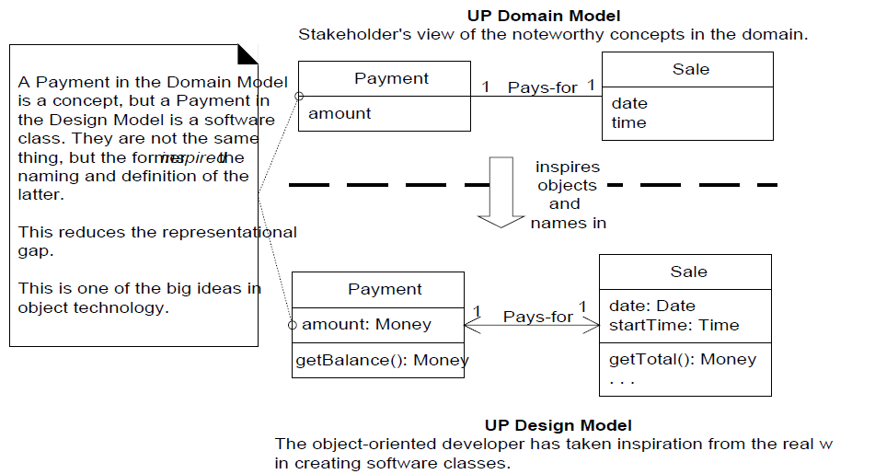
Domain Model v/s Design Model

