Slide 1
Object Oriented Analysis & Design Module-6 (RL 6.2.4)
Harvinder S Jabbal

Slide 2
Application of Information Expert in PoS System

Slide 3
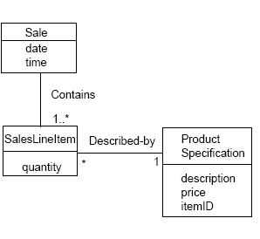
Information Expert (or Expert)
It is necessary to know about all the
SalesLineItem instances of a sale and
the sum of the subtotals.
A Sale instance contains these, i.e. it is
an information expert for this responsibility.

Slide 4
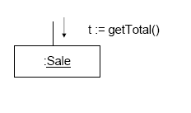
Information Expert (or Expert)
This is a partial interaction diagram.

Slide 5
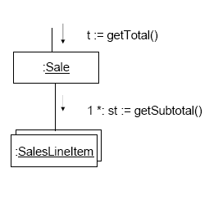
Information Expert (or Expert)
What information is needed to determine the line item subtotal?
quantity and price.
SalesLineItem should determine the subtotal.
This means that Sale needs to send getSubtotal() messages to each of the
SalesLineItems and sum the results.

Slide 6
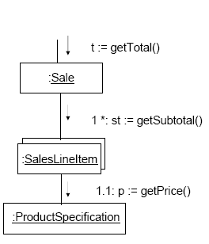
Information Expert (or Expert)
To fulfil the responsibility of knowing and answering its subtotal, a SalesLineItem needs to know the product price.
The ProductSpecification is the information expert on answering its
price.

Slide 7
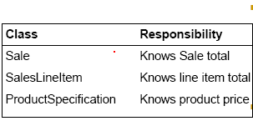
Information Expert (or Expert)
To fulfil the responsibility of knowing and answering the
sale’s total, three responsibilities were assigned to three design classes
The fulfillment of a responsibility often requires information that is spread across different classes of objects. This implies that there are many “partial experts” who will collaborate in the task.

Slide 8
Acknowledgement
Slides are based on Course Text Books:
Applying UMP and Patterns (An Introduction to Object-Oriented Analysis and Design and Iterative Development) : Craig Larman
UMP Distilled (A Brief Guide to the Standard Object Modeling Langauge) : Martin Fowler
Design Patterns (Elements of Reusable Object-Oriented Software) : Erich Gama | Richard Helm | Rapph Johnson | John Vlissides alias GoF.

