Slide 1
Object Oriented Analysis & Design Module-6 (RL 6.2.8)
Harvinder S Jabbal

Slide 2
Application of Creator Pattern in PoS System

Slide 3
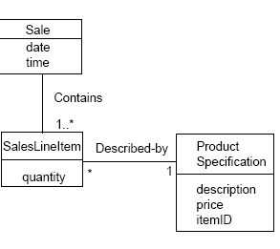
Creator
In the POS application, who should be
responsible for creating a SalesLineItem
instance?
Since a Sale contains many SalesLineItem
objects, the Creator pattern suggests that
Sale is a good candidate.

Slide 4
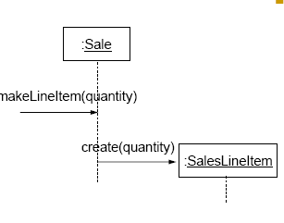
Creator
This assignment of responsibilities requires that a makeLineItem method be defined in Sale.

Slide 5
Acknowledgement
Slides are based on Course Text Books:
Applying UMP and Patterns (An Introduction to Object-Oriented Analysis and Design and Iterative Development) : Craig Larman
UMP Distilled (A Brief Guide to the Standard Object Modeling Langauge) : Martin Fowler
Design Patterns (Elements of Reusable Object-Oriented Software) : Erich Gama | Richard Helm | Rapph Johnson | John Vlissides alias GoF.

