Slide 1
Object Oriented Analysis & Design Module-6 (RL 6.3.2)
Harvinder S Jabbal

Slide 2
Application of Low Coupling to optimize the design

Slide 3
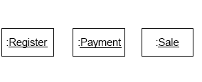
Low Coupling
Assume we need to create a Payment
instance and associate it with the Sale.
What class should be responsible for this?
By Creator, Register is a candidate.

Slide 4
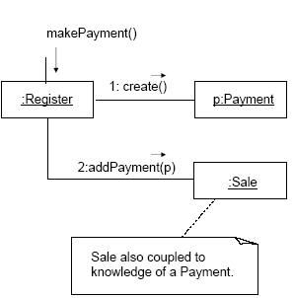
Low Coupling
Register could then send an addPayment
message to Sale, passing along the new
Payment as a parameter.
The assignment of responsibilities couples
the Register class to knowledge of the
Payment class.

Slide 5
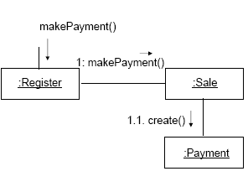
Low Coupling
An alternative solution is to create Payment and associate it with
the Sale.
No coupling between Register and Payment.

Slide 6
Low Coupling
Some of the places where coupling occurs:
Attributes: X has an attribute that refers to a Y instance.
Methods: e.g. a parameter or a local variable of type Y is
found in a method of X.
Subclasses: X is a subclass of Y.
Types: X implements interface Y.
There is no specific measurement for coupling, but
in general, classes that are generic and simple to
reuse have low coupling.
There will always be some coupling among objects,
otherwise, there would be no collaboration.

Slide 7
Acknowledgement
Slides are based on Course Text Books:
Applying UMP and Patterns (An Introduction to Object-Oriented Analysis and Design and Iterative Development) : Craig Larman
UMP Distilled (A Brief Guide to the Standard Object Modeling Langauge) : Martin Fowler
Design Patterns (Elements of Reusable Object-Oriented Software) : Erich Gama | Richard Helm | Rapph Johnson | John Vlissides alias GoF.

