Slide 1
Object Oriented Analysis & Design Module-6 (RL 6.3.4)
Harvinder S Jabbal

Slide 2
Application of High Cohesion Pattern to optimize the design

Slide 3
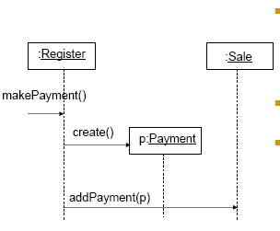
High Cohesion
Assume we need to create a Payment instance and associate it with Sale. What class should be responsible for this?
By Creator, Register is a candidate.
Register may become bloated if it is assigned more and more system
operations.

Slide 4
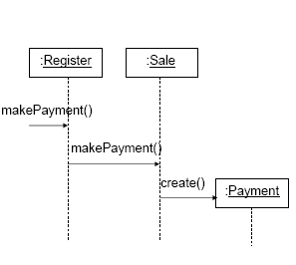
High Cohesion
An alternative design delegates the Payment creation responsibility to the Sale, which supports higher cohesion in the Register.
This design supports high cohesion and low coupling.

Slide 5
Acknowledgement
Slides are based on Course Text Books:
Applying UMP and Patterns (An Introduction to Object-Oriented Analysis and Design and Iterative Development) : Craig Larman
UMP Distilled (A Brief Guide to the Standard Object Modeling Langauge) : Martin Fowler
Design Patterns (Elements of Reusable Object-Oriented Software) : Erich Gama | Richard Helm | Rapph Johnson | John Vlissides alias GoF.

