Slide 1
Object Oriented Analysis & Design Module-6 (RL 6.4.9)
Harvinder S Jabbal

Slide 2
Application of Protected Variation Pattern to optimize the design

Slide 3
Protected Variation
This pattern is in line with the pure fabrication and Indirections in a sense that it addresses similar concerns.
The principles are same like low coupling high cohesion, reuse but the focus is on protecting the existing objects from variations. i.e. creating a stable interface so to protect from variations in coupled objects.
Approach: “Find what varies and encapsulate it.”
Step I: Closely look for elements with direct coupling and also relatively prone to change.
Step II: Identify for the objects or points of predicted variation
Step III: Assign these responsibilities in such a way to create a stable interface around them.

Slide 4
Protected Variation
According to Larman, PV (Protected Variations) is a very important and root principle motivating most of the mechanism and patterns in programming and design to provide flexibility and protection from variation, almost every design trick in his book is a specialization of the Protected Variations pattern.
POS.
Consider Classes: Sale, Payment, and SaleLineItem etc.
Every sale amount has taxes applied to arrive at the total.
There are different tax rules at different places and tax rates are different also.
On top of this the rates and rules are bound to changes which makes the design of such systems tricky.

Slide 5
Protected Variation
The best approach is design the tax calculation as separate system.
There could be different tax calculator systems (third party) available or there could be web service providing the tax calculation services.
There might be reason for having multiple systems or move to different system.
As mentioned above, the rules, rates are the moving target and as these changes the tax calculation systems have to follow.
This is the point of variation or stability. In such scenario, the changes would require the consumers or users of such systems, to change also.

Slide 6
Protected Variation
These changes or variations would cause the changes in POS system or it may require revision.
This is where the “protected Variations” pattern helps to design in such a way that the changes in the tax calculation system would not cause major problems. This is accomplished through implementation of polymorphism and indirection as depicted in the following diagram.

Slide 7
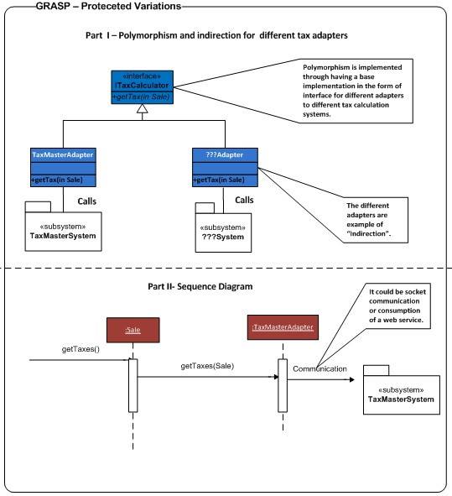
Protected Variation

Slide 8
Protected Variation
Class | Responsibility and method | Remarks
ITaxCalculator | Facilitator for different adapters to different systems | Provides polymorphic behaviour and handles the variations based on the type.
….Adapter | Facilitator for particular Tax System | These classes provide indirection i.e. facilitates low coupling and reuse.

Slide 9
Acknowledgement
Slides are based on Course Text Books:
Applying UMP and Patterns (An Introduction to Object-Oriented Analysis and Design and Iterative Development) : Craig Larman
UMP Distilled (A Brief Guide to the Standard Object Modeling Langauge) : Martin Fowler
Design Patterns (Elements of Reusable Object-Oriented Software) : :GoF
Erich Gama | Richard Helm |
Ralph Johnson | John Vlissides.

