Slide 1
Object Oriented Analysis & Design Module-6 (RL 6.5.3)
Harvinder S Jabbal

Slide 2
Open-Closed Principle (OCP)

Slide 3
Open-Closed Principle (OCP)
you should be able to extend a class's behavior, without modifying it.
Software entities (classes, modules, functions, etc.) should be open for extension but closed for modification.
Open Heart Surgery is not necessary when putting on a coat

Slide 4
OCP
Open for extension
Behavior of the module can be extended
We are able to change what the module does
Closed for modification
Extending behavior does not result in changes to source, binary, or code of the module

Slide 5
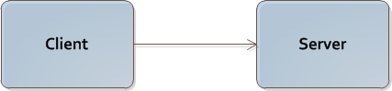
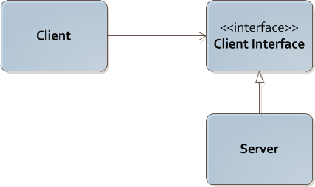
Implementing OCP
Note this situation
Rely on abstractions
Interfaces
Abstract classes
Strategy Pattern below

Slide 6
Acknowledgement
Slides are based on Course Text Books:
Applying UMP and Patterns (An Introduction to Object-Oriented Analysis and Design and Iterative Development) : Craig Larman
UMP Distilled (A Brief Guide to the Standard Object Modeling Langauge) : Martin Fowler
Design Patterns (Elements of Reusable Object-Oriented Software) : Erich Gama | Richard Helm | Rapph Johnson | John Vlissides alias GoF.

