Slide 1
BITS Pilani presentation
Dr. Yashvardhan Sharma
Computer Science and Information Systems

Slide 2
SS ZG514/SE Z512
Object Oriented Analysis and Design
Lecture No.2

Slide 3
Defining Models and Artifacts
Objectives
analysis and design models
familiarize UML notations and diagrams
Real world software systems are inherently complex
Models provide a mechanism for decomposition and expressing specifications

Slide 4
Analysis and Design models
Analysis model - models related to an investigation of the domain and problem space (Use case model qualifies as an example)
Design model - models related to the solution (class diagrams qualifies as an example)

Slide 5
Unified Modeling Language
“A language for specifying, visualizing and constructing the artifacts of software system” [Booch, Jacobson, Rumbaugh]
It is a notational system aimed at modeling systems using OO concepts
… not a methodology
… not a process

Slide 6
Software Development Process
Steps correspond to one or more tasks related to software development.
Tasks:
Requirements gathering
Integration
Requirements analysis
Test
Design
Delivery
Coding
Maintenance
Training
Software life cycle: Software Life Cycle consists of all phases from its inception until its retirement. These are (for Unified Process): Inception, elaboration, construction, transition.

Slide 7
The software process
Software process: organizing a structured set of activities to develop software systems.
Many different software processes but all involve the following activities:
Specification – defining what the system should do;
Design and implementation – defining the organization of the system and implementing the system;
Validation – checking that it does what the customer wants;
Evolution – changing the system in response to changing customer needs.

Slide 8
Software Process Model descriptions
A software process model is an abstract representation of a process. It presents a description of a process.
Process descriptions may also include:
Products, which are the outcomes of a process activity;
Roles, which reflect the responsibilities of the people involved in the process;
Pre- and post-conditions, which are statements that are true before and after a process activity has been enacted or a product produced.
Notation: activities, products

Slide 9
The Software Development Process
Why a Process?
Software projects are large, complex, sophisticated
time to market is key
many facets involved in getting to the end
Common process should
integrate the many facets
provide guidance to the order of activities
specify what artifacts need to be developed
offer criteria for monitoring and measuring a project

Slide 10
Software Development Process
"It is better not to proceed at all, than to proceed
without method." --Descartes
The Software Development Process:
– The framework for the set of tasks that are
required to develop a software system.
– Process defines how a software product is
developed and maintained.
– A well-defined and rigorously enforced process
forms the basis for high-quality software
development.
A good software process is repeatable, predictable, learnable, measurable and improvable.

Slide 11
A software life cycle is a process
A process involves activities, constraints and resources that produce an intended output.
Each process activity, e.g., design, must have entry and exit criteria—why?
A process uses resources, subject to constraints (e.g., a schedule or a budget)
A process is organized in some order or sequence, structuring activities as a whole
A process has a set of guiding principles or criteria that explain the goals of each activity

Slide 12
Software Life Cycle
Having a defined process is essential
life cycle is the series of steps that software undergoes from concept exploration through retirement
Maturity of the process is some gauge of success of organization

Slide 13
Software Life Cycle Model
Definition
Describes an abstract collection of software processes that share common characteristics such as timing between phases, entry and exit criteria for phases.
The models specifies
the various phases of the process
e.g., requirements, specification, design…
the order in which they are carried out

Slide 14
Importance of Lifecycle Models
Provide guidance for project management
what major tasks should be tackled next? milestones!
what kind of progress has been made?
The necessity of lifecycle models
character of software development has changed
early days: programmers were the primary users
modest designs; potential of software unknown
more complex systems attempted
more features, more sophistication → greater complexity, more chances for error
heterogeneous users

Slide 15
Life Cycle Models: Summary [1]
Build and fix: Acceptable for short programs that do not require maintenance.
Waterfall: Disciplined approach, document driven; delivered product may not meet client needs.
Rapid prototyping: Ensures that delivered product meets client needs; might become a build-and-fix model.
Incremental: Maximizes early return on investment; requires open architecture; may degenerate into build-and-fix.

Slide 16
Life Cycle Models: Summary [2]
Spiral: Risk driven, incorporates features of the above models; useful for very large projects
UDP: Iterative, supports OO analysis and design; may degenerate into code-a-bit-test-a-bit.

Slide 17
Object-Oriented Life-Cycle Models
Need for iteration within and between phases
Fountain model
Recursive/parallel life cycle
Unified software development process
All incorporate some form of
Iteration
Parallelism
Incremental development
Danger
CABTAB

Slide 18
Lifecycle Models
Build-and-fix
develop system
without specs or design
modify until customer is satisfied
Why doesn’t build-and-fix scale?
changes during maintenance
most expensive!

Slide 19
Build and fix model [1]
Idea or client request
Build first version
Modify until client satisfied
Operations mode
Development
Retirement
Maintenance

Slide 20
Build and fix model [2]
Product is constructed without specifications.
There is no explicit design. However, a design will likely evolve in the mind of the developer.
Modify until customer is satisfied.
The approach might work for small programming projects [TA 162/252].

Slide 21
Build and fix model [3]
Cost of fixing an error increases as one moves away from the phase in which the error was injected.
There is a good chance that many errors will be found in the operations phase thereby leading to high cost of maintenance.
Rarely used in commercial projects.

Slide 22
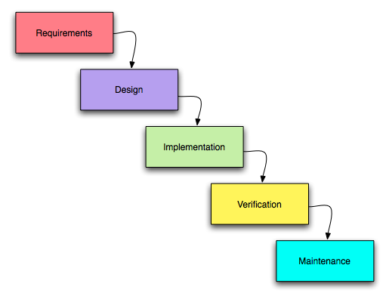
Waterfall Model

Slide 23
Waterfall model [1]
Requirements phase
Specification phase
Design phase
Verification done at the end of each phase.
Retirement
Implementation phase
Flaw?
Integration phase
original model didn’t
let you go back!
Operations mode

Slide 24
Waterfall model [2]
Popular in the 70’s.
Requirements are determined and verified with the client and members of the SQA group.
Project management plan is drawn, cost and duration estimated, and checked with the client and the SQA group
Then the design (i.e. “How is the product going to do what it is supposed to do.”) begins and the project proceeds as in the figure.

Slide 25
Waterfall model [3]
Each phase terminates only when the documents are complete and approved by the SQA group.
Testing is inherent in every phase
Maintenance begins when the client reports an error after having accepted the product. It could also begin due to a change in requirements after the client has accepted the product.

Slide 26
Waterfall model: Advantages
Disciplined approach
Careful checking by the Software Quality Assurance Group at the end of each phase.
Testing in each phase.
Documentation available at the end of each phase.
Concrete evidence of progress.
Works best when you know what you’re doing
when requirements are stable & problem is well-known

Slide 27
Waterfall model: Disadvantages
Documents do not always convey the entire picture. Customers cannot understand these
imagine an architect just showing you a textual spec!
first time client sees a working product is after it has been coded. Problem here?
leads to products that don’t meet customers needs
Assumes feasibility before implementation
re-design is problematic
Feedback from one phase to another might be too late and hence expensive.
Linear nature leads to ‘blocking states’
Difficult to estimate time and cost for each stage of the development process.

Slide 28
Unified Development Process [2]
Architecture is built during early iterations.
Early iterations seek feedback from the customer. Risk and value to customer is managed through early feedback.
Customer is engaged continuously in evaluation and requirements gathering.

Slide 29
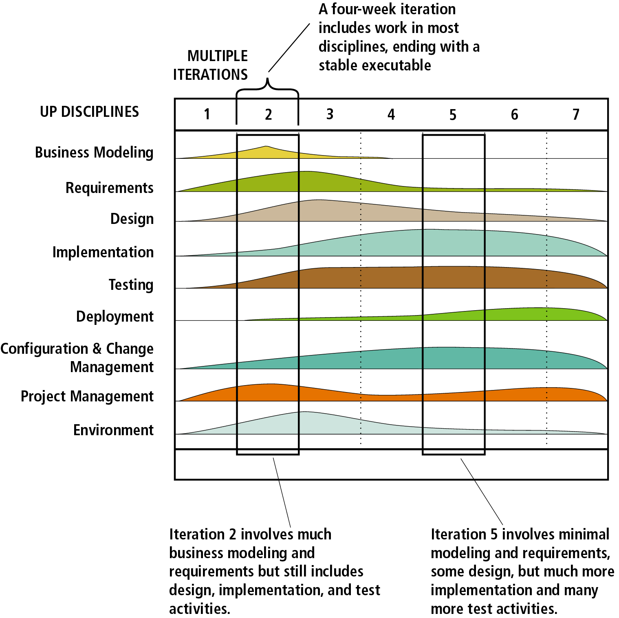
Unified Development Process [3]

Slide 30
The Unified Process
Component based - meaning the software system is built as a set of software components interconnected via interfaces
Uses the Unified Modeling Language (UML)
Use case driven
Architecture-centric
Iterative and incremental
This is what makes
the Unified process
Unique
Component: A physical and replaceable part of a system that conforms to and provides realization of a set of interfaces.
Interface: A collection of operations that are used to specify a service of a class or a component

Slide 31
The Unified Process
User’s
requirements
Software
Development
Process
Software
System
Based around the 4Ps - People, Project, Product, Process

Slide 32
The Unified Process
Use Case driven
A use case is a piece of functionality in the system that gives a user a result of value.
Use cases capture functional requirements
Use case answers the question: What is the system supposed to do for the user?

Slide 33
The Unified Process
Architecture centric
similar to architecture for building a house
Embodies the most significant static and dynamic aspects of the system
Influenced by platform, OS, DBMS etc.
Related as function (use case) and form (architecture)
Primarily serves the realization of use cases
The form must allow the system to evolve from initial development through future requirements (i.e. the design needs to be flexible)

Slide 34
The Unified Process
Iterative and Incremental
commercial projects continue many months and years
to be most effective - break the project into iterations
Every iteration - identify use cases, create a design, implement the design
Every iteration is a complete development process

Slide 35
An iterative and incremental process
Initial
Planning
Requirements
Planning
Analysis & Design
Management
Environment
Implementation
Evaluate
Deployment
Each iteration
results in executable
release
Test
(Kruchten, 1999)

Slide 36
Iterations
Iterations must be selected & developed in a planned way i.e. in a logical order - early iterations must offer utility to the users
iteration based on a group of use cases extending the usability of the system developed so far
iterations deal with the most important risks first
not all iterations are additive - some replace earlier “superficial” developments with a more sophisticated and detailed one.

Slide 37
Benefits of an iterative approach
Risks are mitigated earlier
Change is more manageable
Higher level of reuse
Project team can learn along the way
Better overall quality

Slide 38
Unified Software Development Process (UP)
Selects from best practices to
Provide a generic process framework
instantiate/specialize for specific application areas, organizations, project sizes, etc.
Define a set of activities (workflows)
transforms users’ requirements into a software system
Define a set of models
from abstract (user-level) to concrete (code)
Allow component-based development
software components interconnected via well-defined interfaces
use-case (UML) and risk driven
architecture-centric
iterative and incremental

Slide 39
Unified Process - Milestones
Milestone: a management decision point in a project that determines whether to authorize movement to the next iteration/phase
Inception phase - agreement among customers/developers on the system’s life cycle objectives
Elaboration phase - agreement on the viability of the life cycle architecture, business case and project plan
Construction phase - agreement on the acceptability of the software product both operationally and in terms of cost
Transition phase - final agreement on the acceptability of the software product

Slide 40
Lifecycle Phases
Inception – “Daydream”
Elaboration – “Design/Details”
Construction – “Do it”
Transition – “Deploy it”
Phases are not the classical requirements/ design/coding/implementation processes
Phases iterate over many cycles

Slide 41
Timeboxing
Management of a UP project.
Iterations are “timeboxed” or fixed in length.
Iteration lengths of between two to six weeks are recommended.
Each iteration period has its own development plan.
If all the planned activities cannot be completed during an iteration cycle, the completion date should not be extended, but rather tasks or requirements from the iteration should be removed and added to the next iteration cycle.

Slide 42
The Unified Process
The Unified Software Development Process is a definition of a complete set of activities to transform users’ requirements through a consistent set of artifacts into a software product
Look at the whole process
Life cycle
Artifacts
Workflows
Phases
Iterations
A process is described in terms of workflows where a workflow is a set of activities with identified artifacts that will be created by those activities

Slide 43
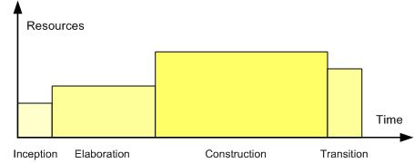
Phases in Unified Process
Profile of a typical project showing the relative sizes of the four phases of the Unified Process.

Slide 44
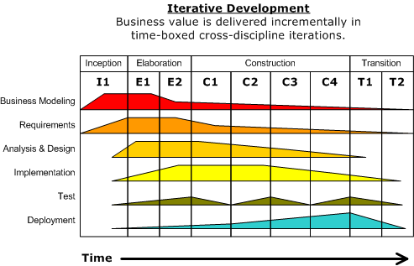
Diagram illustrating how the relative emphasis of different disciplines changes over the course of the project

Slide 45
UP phases are iterative & incremental
Inception
Feasibility phase and approximate vision
Elaboration
Core architecture implementation, high risk resolution
Construction
Implementation of remaining elements
Transition
Beta tests, deployment
Development cycle

Slide 46
Inception ➔ Elaboration ➔ …
During inception, establish business rationale and scope for project
Business case: how much it will cost and how much it will bring in?
Scope: try to get sense of size of the project and whether it’s doable
Creates a vision and scope document at a high level of abstraction
In elaboration, collect more detailed requirements and do high-level analysis and design
Inception gives you the go-ahead to start a project, elaboration determines the risks
Requirement risks: big danger is that you may build the wrong system
Technological risks: can the technology actually do the job? will the pieces fit together?
Skills risks: can you get the staff and expertise you need?
Political risks: can political forces get in the way?
Develop use cases, non-functional requirements & domain model

Slide 47
… ➔ Construction ➔ Transition
Construction builds production-quality software in many increments, tested and integrated, each satisfying a subset of the requirements of the project
Delivery may be to external, early users, or purely internal
Each iteration contains usual life-cycle phases of analysis, design, implementation and testing
Planning is crucial: use cases and other UML documents
Transition activities include beta testing, performance tuning (optimization) and user training
No new functionality unless it’s small and essential
Bug fixes are OK

Slide 48
UP artifacts
The UP describes work activities, which result in work products called artifacts
Examples of artifacts:
Vision, scope and business case descriptions
Use cases (describe scenarios for user-system interactions)
UML diagrams for domain modeling, system modeling
Source code (and source code documentation)
Web graphics
Database schema

Slide 49
Milestone for first Elaboration
At start of elaboration, identify part of the project to design & implement
A typical and crucial scenario (from a use case)
After first elaboration, project is, say, 1/5th done
Can then provide estimates for rest of project
Significant risks are identified and understood
How is such a milestone different from a stage in the waterfall model?

Slide 50
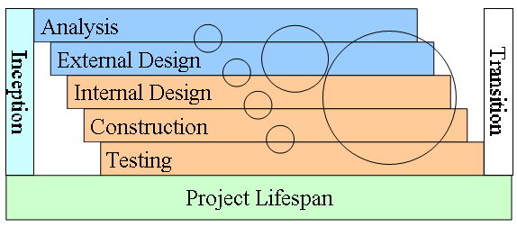
What does diagram imply about UP?
How can iterations reduce risk or reveal problems?

Slide 51
Inception Phase
Purpose
To establish the business case for a new system or for a major update of an existing system
To specify the project scope
Outcome
A general vision of the project’s requirements, i.e., the core requirements
– Initial use-case model and domain model (10-20% complete)
An initial business case, including:
– Success criteria (e.g., revenue projection)
– An initial risk assessment
– An estimate of resources required
Milestone: Lifecycle Objectives

Slide 52
Elaboration Phase
Purpose
To analyze the problem domain
To establish a sound architectural foundation
To address the highest risk elements of the project
To develop a comprehensive plan showing how the project will be completed
Outcome
Use-case and domain model 80% complete
An executable architecture and accompanying documentation
A revised business case, incl. revised risk assessment
A development plan for the overall project
Milestone: Lifecycle Architecture

Slide 53
Construction Phase
Purpose
To incrementally develop a complete software product which is ready to transition into the user community
Products
A complete use-case and design model
Executable releases of increasing functionality
User documentation
Deployment documentation
Evaluation criteria for each iteration
Release descriptions, including quality assurance results
Updated development plan
Milestone: Initial Operational Capability

Slide 54
Transition Phase
Purpose
To transition the software product into the user community
Products
Executable releases
Updated system models
Evaluation criteria for each iteration
Release descriptions, including quality assurance results
Updated user manuals
Updated deployment documentation
“Post-mortem” analysis of project performance
Milestone: Product Release

Slide 55
Best Practices and Key Concepts
Tackle high-risk and high-value issues in early iterations.
Continuously engage users for evaluation, feedback and requirements
Build a cohesive, core architecture in early iterations
Continuously verify quality; test early, often and realistically
Apply use cases where appropriate
Do some visual modeling (with the UML)
Carefully manage requirements
Practice change request and configuration management.

Slide 56
Questions
What are the four lifecycle phases of UP?
What happens in each?
What are the process disciplines?
What are some major differences between distinguishes UP and the waterfall model?

