Slide 1
Capstone Project-1 EDA
Play Store App Review Analysis
AMIT KUMAR SAHU

Slide 2






Project Recap
EDA
Problem
Process
Insights

Slide 3


Project Recap
The Google Play Store is a digital distribution service operated and developed by Google. It serves as the official app store for certified devices running on the Android operating system and its derivatives as well as ChromeOS.
The Play Store apps data has enormous potential to drive app-making businesses to success.

Slide 4

Problem
The Play Store app data has enormous potential to drive app-making businesses to success.
Actionable insights can be drawn for developers to work on and capture the Android market. Each app (row) has values for category, rating, size, and more.
Another dataset contains customer reviews of the android apps along with the sentiment analysis. We have to explore and analyze the data to discover key factors responsible for app engagement and success.

Slide 5

Process
Data Understanding
Data Cleaning
Missing Null/Value Treatment
Correcting Data Type
Visualization

Slide 6
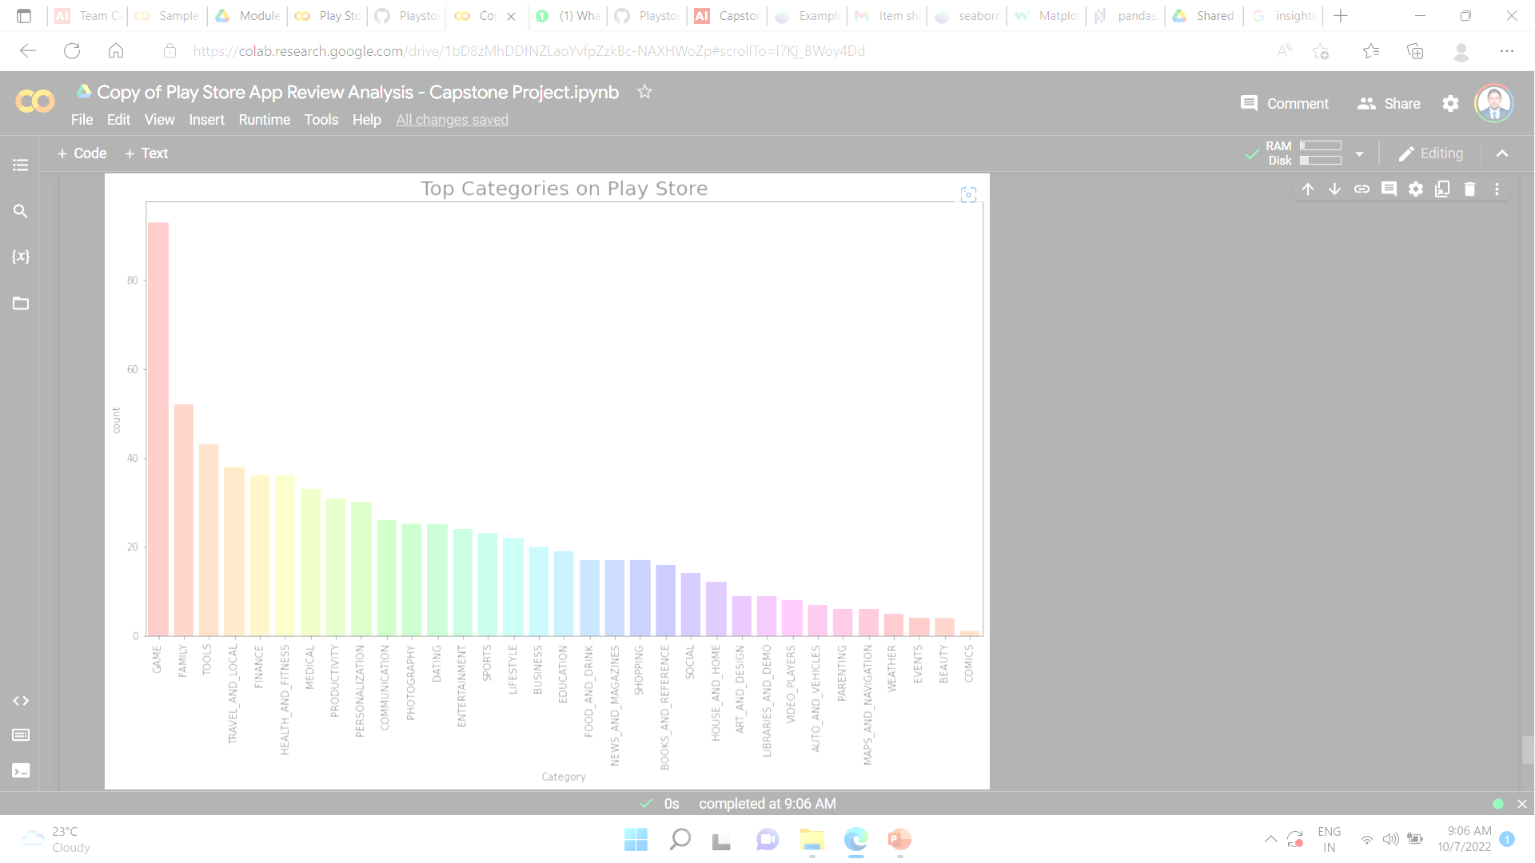
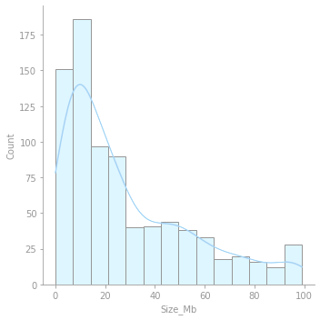
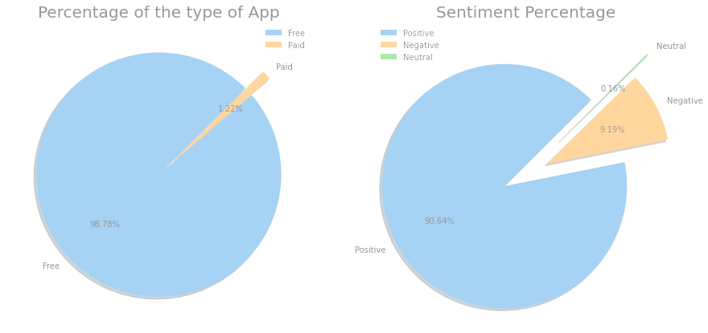
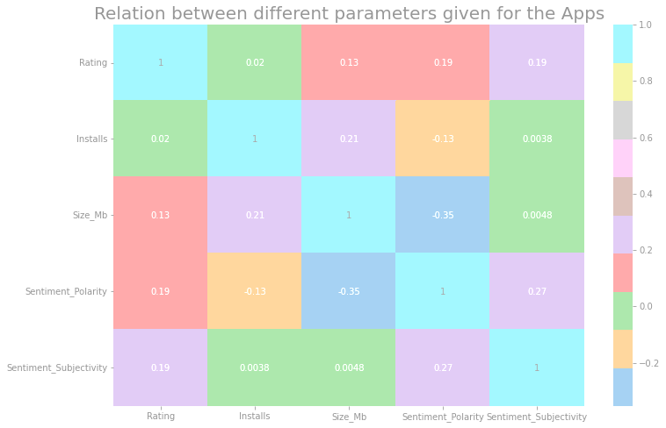
Insights

Slide 7
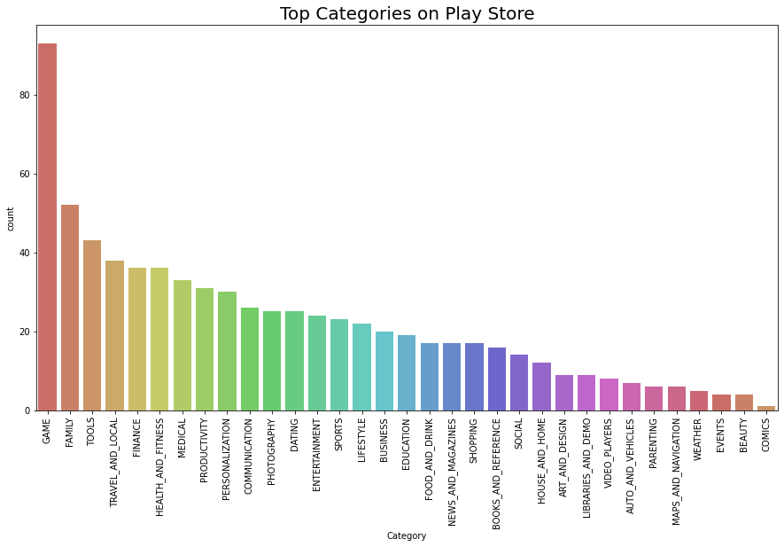
Observation 1:The Top Apps

Slide 8
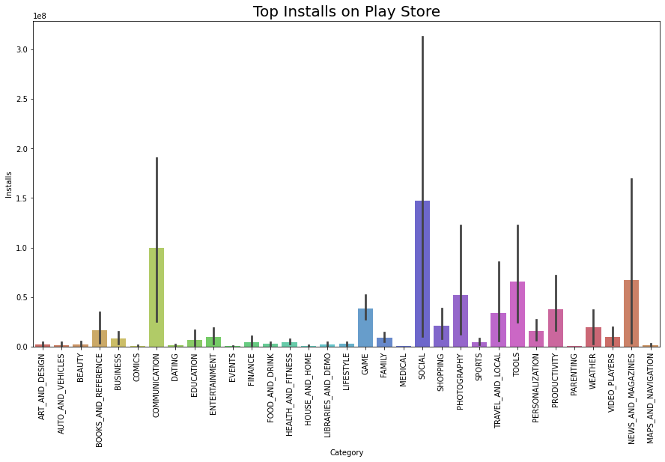
Observation 1(Cont.)

Slide 9
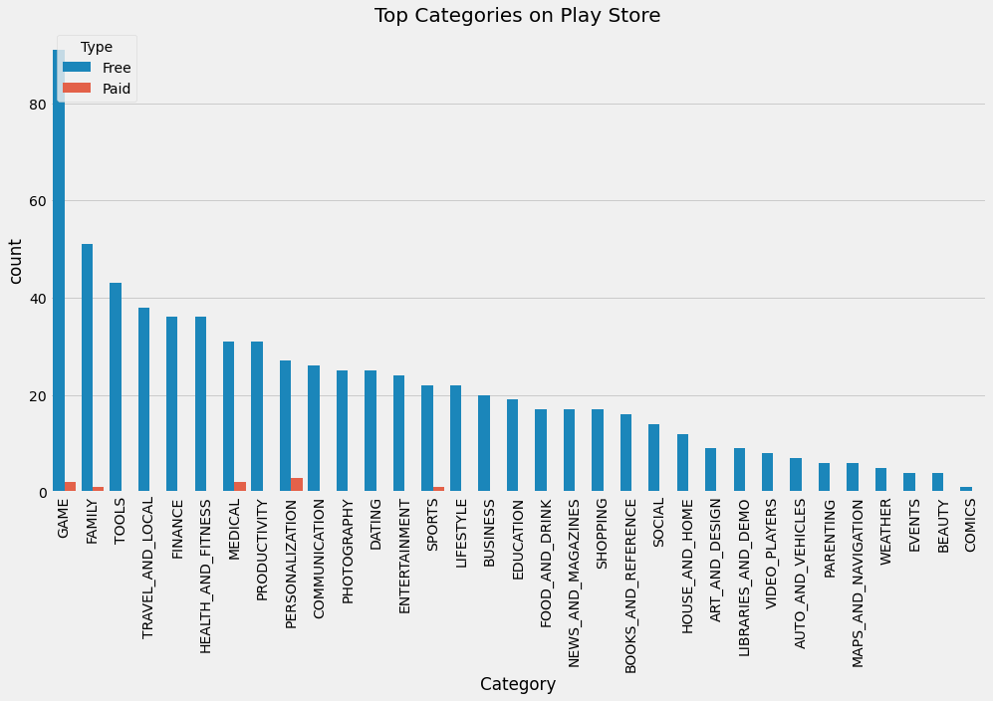
Observation 1(Cont.)

Slide 10
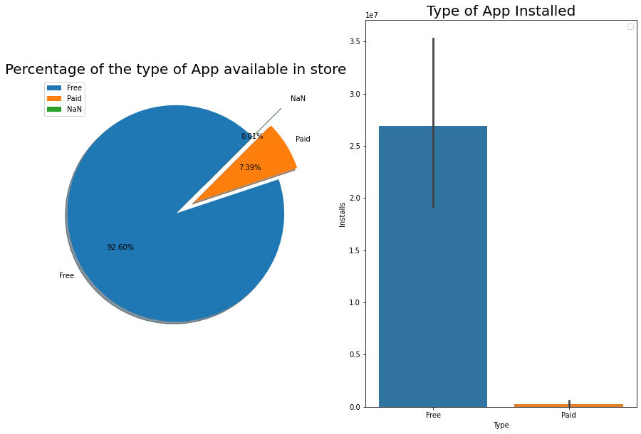
Observation 1 (Cont.)

Slide 11
Observation 1
Well, we have got some surprising results
Social category app are downloaded the most but they don't even contribute by a fourth to the overall apps present in the play store.
Communication and news/magazine closely follow the suit and are not very far behind it.
The amount of apps present in the store not necessarily means that they are downloaded.
There are around 8% paid apps available in app store but the users give free apps more preference.
There are loads of free apps on play store, but within it there are apps which have in app purchase feature which is not mentioned in our data is. So, there can be a sizeable amount which may fall under free category but may charge for unlocking more features.

Slide 12
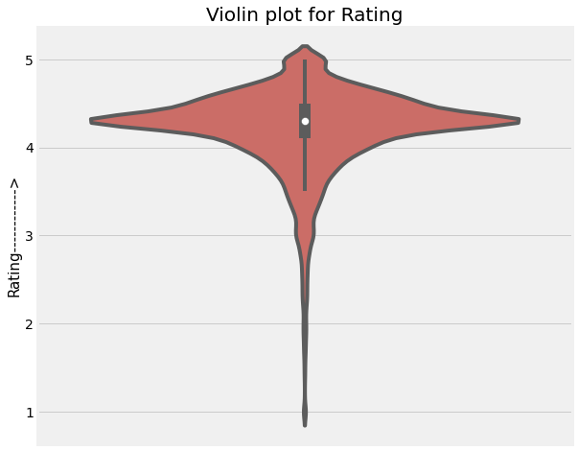
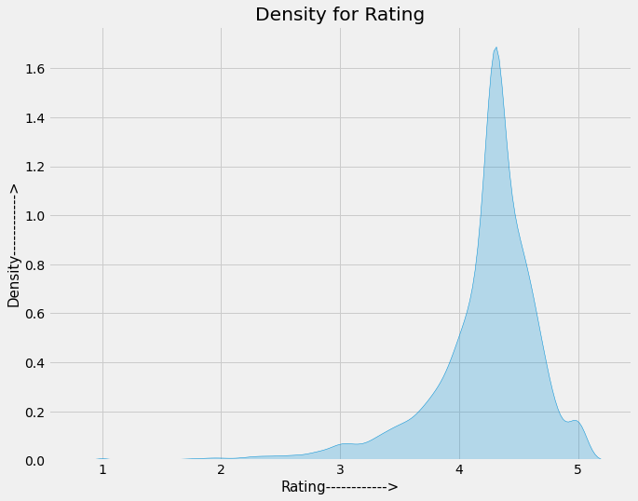
Observation 2: The User Rating

Slide 13
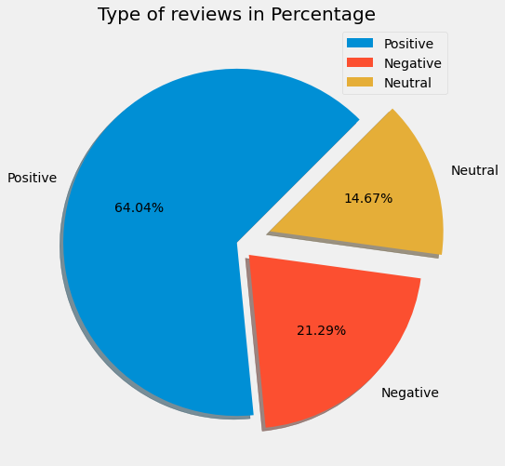
Observation 2(Cont.)

Slide 14
Observation 2(Cont.)
From our observation, we found that the average volume of ratings across all app categories is between 4-4.5.
Even though, almost 40% people have negative and neutral outlook in reviews, people generally rate the apps as good and very good.
The histogram plot is skewed to the left indicating that the majority of the apps are highly rated with only a few exceptions in the low-rated apps.

Slide 15
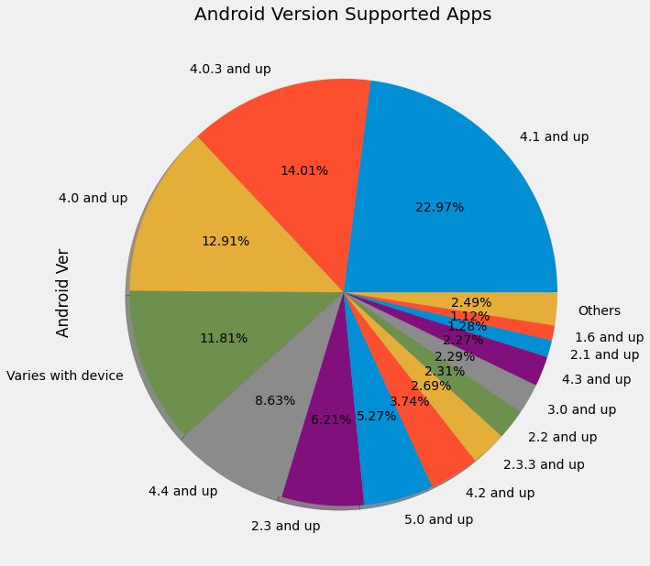
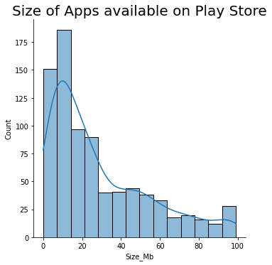
Observation 3: Type of Apps

Slide 16
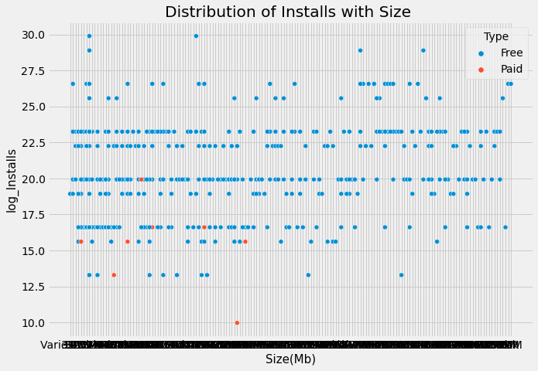
Observation 3(Cont.)

Slide 17
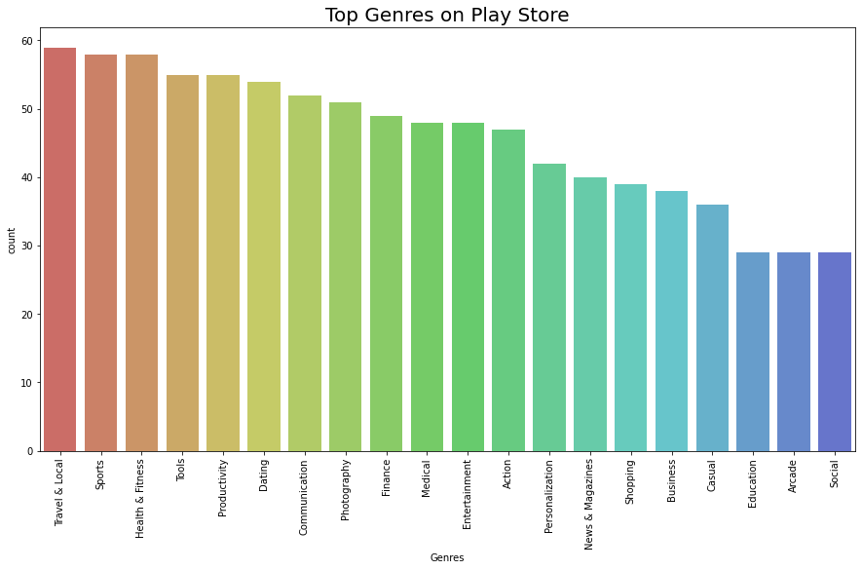
Observation 3(Cont.)

Slide 18
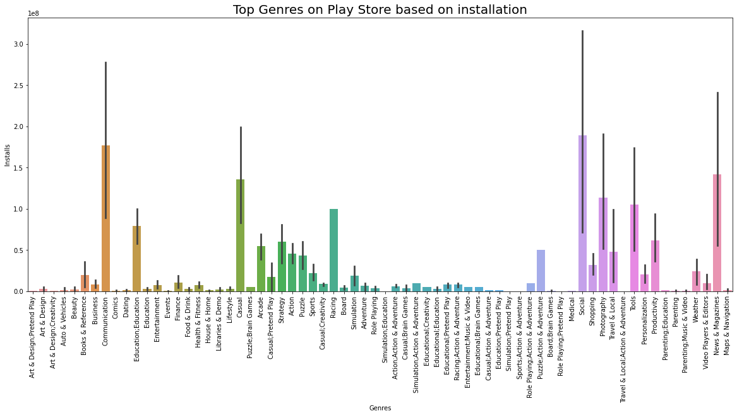
Observation 3(Cont.)

Slide 19
Observation 3(Cont.)
The app store contains almost 60-70% apps which still have support for the older devices which means there are still older version android devices in the market.
Maximum apps available in the market are generally small in size.
The apps falling under the genre "Tools" are the most closely followed by "Travel and Local" and 'Health & Fitness“
Though the “Tools” genre have the largest chunk in the marketplace, the “Social” genre rules the marketplace in terms of downloads.
The size may impact the number of installations, bulkier applications are less likely to be installed by the user.

Slide 20
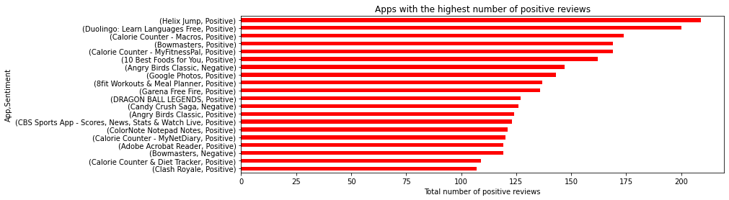
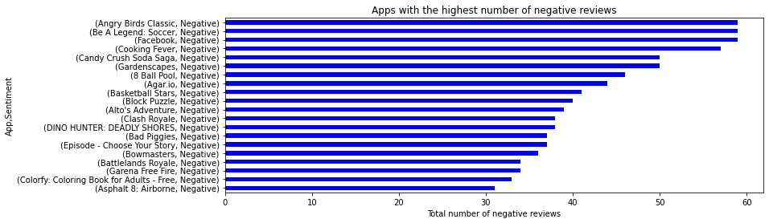
Observation 4: The User Experience-I

Slide 21
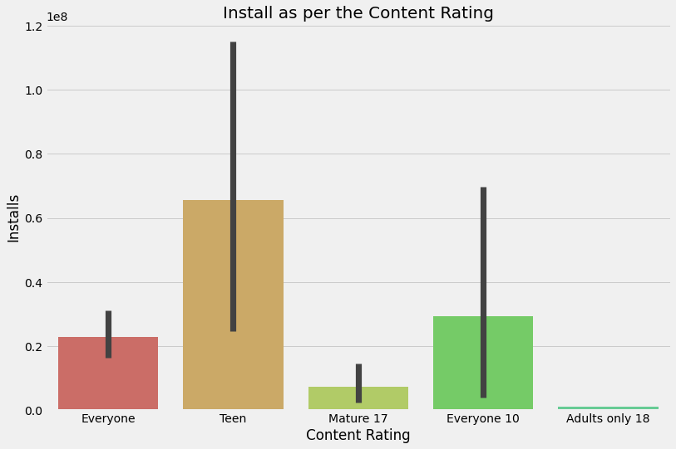
Observation 4(Cont.)

Slide 22
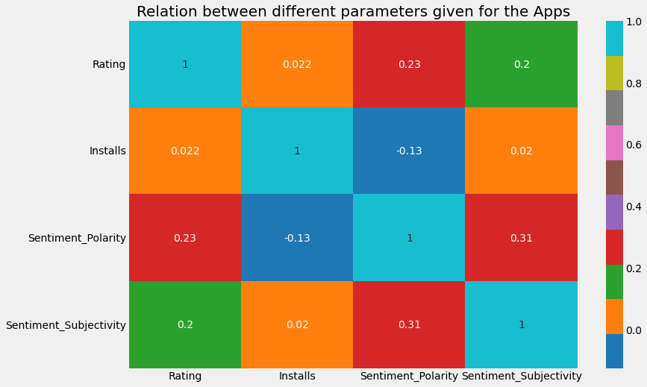
Observation 4(Cont.)

Slide 23
Observation 4(Cont.)
We observed that there is a direct relation between the sentiment polarity, rating, sentiment subjectivity and installs.
If the sentiments are negative then then there can be decrease in the number of installs by users.
The maximum installs is for apps which are available for 12 and above group, which constitutes to the maximum phone users.
The adult category has the least installs as it specifically caters the content to the age group.

Slide 24
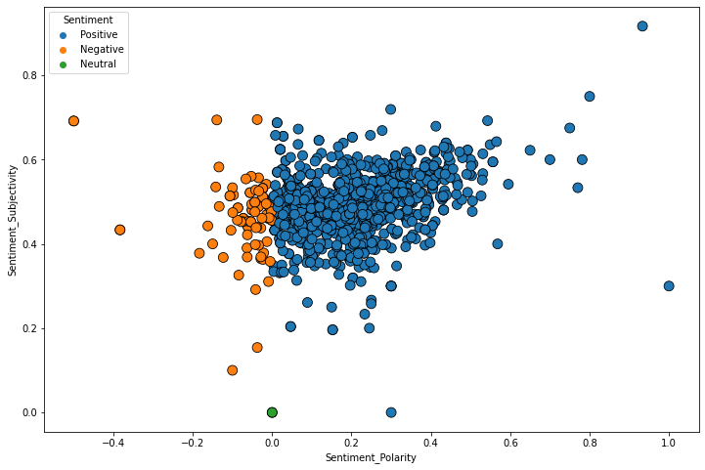
Observation 5:The User Experience-II (Sentiments)

Slide 25
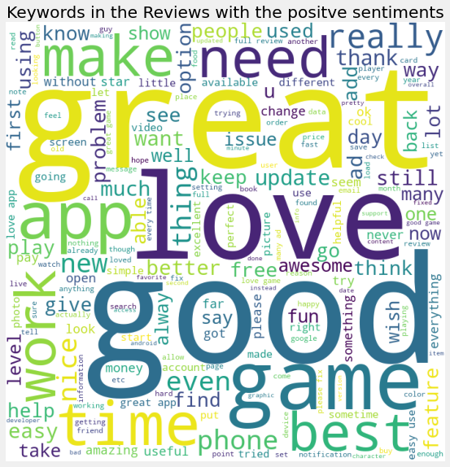
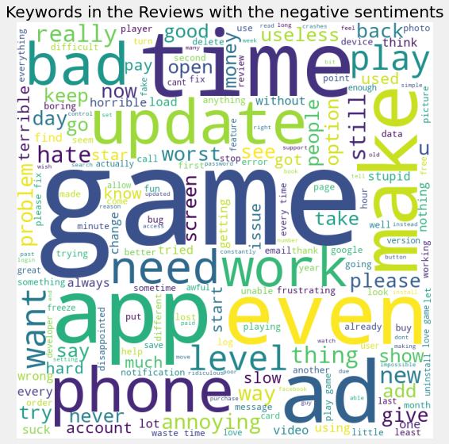
Observation 5(Cont.)

Slide 26
Observation 5(Cont.)
We observed the sentiment subjectivity is not always proportional to sentiment polarity but in maximum number of case, shows a proportional behavior.
Using the sentiment data we observed that reviews play a major role in app development process. It not only help the developer to know the shortcoming in the app so that the developer can provide a great user experience.

Slide 27

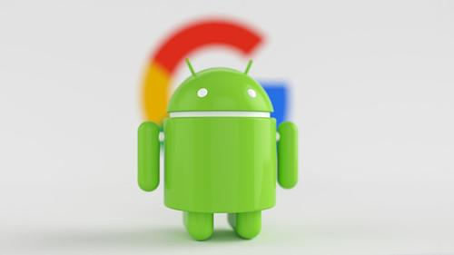

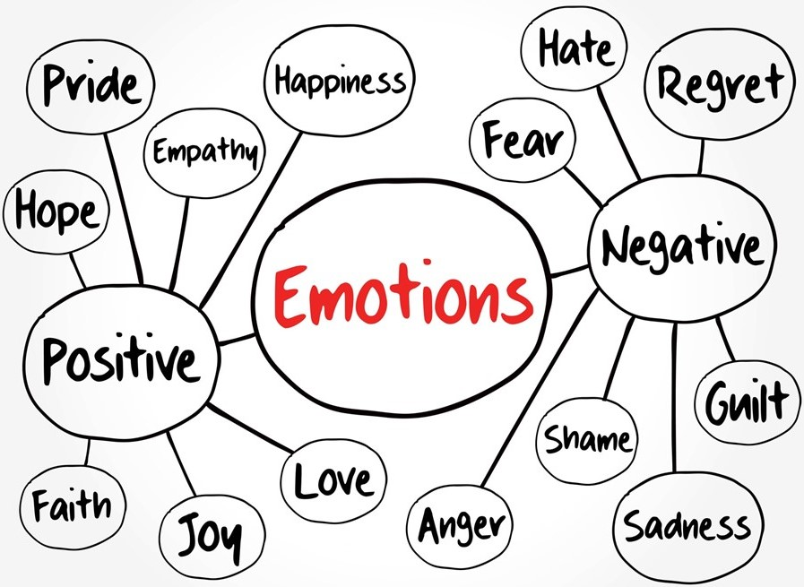
Conclusion
Size & Type
The smaller apps which are free have more audience in the Play store.
User OS
Better to have support for devices with older versions as well
User Rating & Category
Making an app which is 12+ rated is better. The social, communication and tools category find the maximum number of installs on the android devices.
User Sentiments
The negative sentiments directly affect the installs by the users, developer needs to keep an eye on the reviews and feedbacks.

Slide 28
