Slide 1

Supplement Sales Dashboard Summary
Task 3: Data Analyst Internship – Amit Vyas

Slide 2
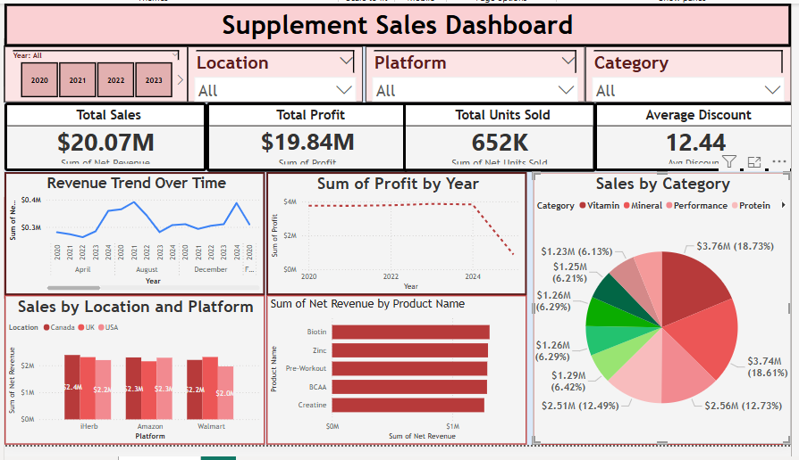
Dashboard Insights
Total Sales: $20.07M, Total Profit: $19.84M.
Units Sold: 652K, Average Discount: 12.44%.
Top Category: Protein ($12.51M, 62.49% of sales).
Top Product: Biotin ($4.26M in revenue).
Highest Profit Year: 2021 (~$4.5M).
Top Location/Platform: Canada on eHerbs ($4.04M).

Slide 3
Performance Trends by Year and Platform
📈 2021 was the highest profit year (~$4.5M), showing strong growth in supplement sales. 📊 eHerb in Canada led all platforms with $4.04M revenue. 📉 2024 shows a declining trend in profit – indicating possible market saturation or rising costs.

Slide 4
Top Products and Category Contribution
🏆 Protein is the leading supplement category, contributing over 62% of total sales. 🔬 Biotin tops the product list with $4.26M in net revenue. 💡 Balanced product mix across categories (Vitamins, Minerals, Performance) ensures diversified revenue streams.

Slide 5
Supplement Sales Overview
📌 Sales Summary: $20.07M in total sales and $19.84M in profit across 652K units. 🏅 Category Spotlight: Protein led with $12.51M in revenue. 📈 Best Performing Year: 2021 had the highest profitability. 🌍 Top Market: Canada on eHerbs generated the most revenue ($4.04M).

