Slide 1




R A I L W A Y · I N D U S T R I A L · C I V I L · S U S T A I N A B I L I T Y
COMPANY PROFILE & CAPABILITIES
2026 EDITION
DPIIT Recognised
MSME Registered
Make in India

Slide 2
ABOUT THE COMPANY
NAVGROW
Building a Sustainable Tomorrow
ENGINEERING SERVICE PVT. LTD.
Navgrow Engineering Service Pvt. Ltd. is a Siliguri-based, DPIIT-recognised engineering & sustainability company incorporated in 2022. We combine engineering excellence with modern technology to deliver reliable, quality-first solutions for railway, industrial and civil projects — alongside solar, water and green-building systems.
WHO WE ARE
OUR VISION
OUR MISSION
A team of engineers, planners and innovators delivering high-quality engineering, infrastructure and sustainable-energy solutions across India.
To be India's most trusted engineering company, recognised for innovation, quality and sustainable impact.
To provide cost-effective, reliable and eco-friendly engineering solutions that empower clients and contribute to a better planet.
WHAT WE VALUE
Integrity & Transparency
Safety & Quality
Innovation & Excellence
Sustainability
Customer Commitment
Serving Indian Railways, industrial plants, government departments and private developers across North Bengal and beyond.
NAVGROW ENGINEERING SERVICE PVT. LTD.
COMPANY PROFILE
02

Slide 3
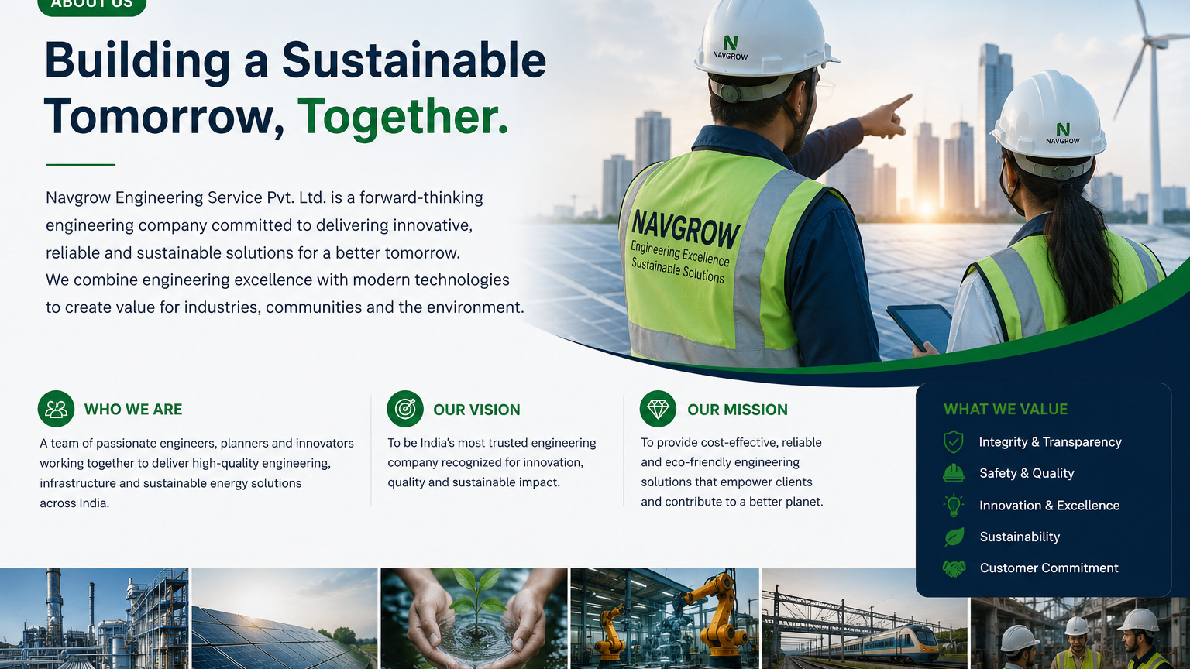
Engineering excellence across energy, water, industry and infrastructure.
NAVGROW ENGINEERING SERVICE PVT. LTD.
COMPANY OVERVIEW
03

Slide 4










CAPABILITY OVERVIEW
NAVGROW
Ten Service Lines. One Standard.
ENGINEERING SERVICE PVT. LTD.
Railway Infrastructure
Industrial Engineering
Track, ROB, electrification, signalling & shed works to RDSO standards.
Fabrication, plant engineering and installations for manufacturers.
Civil & Construction
Government Contracts
Buildings, bridges, roads and structural works — built to last.
Tender-based execution via GeM & IREPS with full documentation.
Maintenance & AMC
Rainwater Harvesting
Preventive and corrective upkeep that maximises asset uptime.
Catchment, recharge and storage systems for water security.
Solar Energy Solutions
Wastewater Treatment & Recycling
Rooftop and ground-mount solar for cleaner, cheaper power.
STP/ETP, reuse and zero-liquid-discharge systems.
Energy Efficiency & Audits
Green Building & Sustainability
Audits and retrofits that cut energy cost and carbon.
Consulting for efficient, certified, low-impact buildings.
NAVGROW ENGINEERING SERVICE PVT. LTD.
SERVICES
04

Slide 5
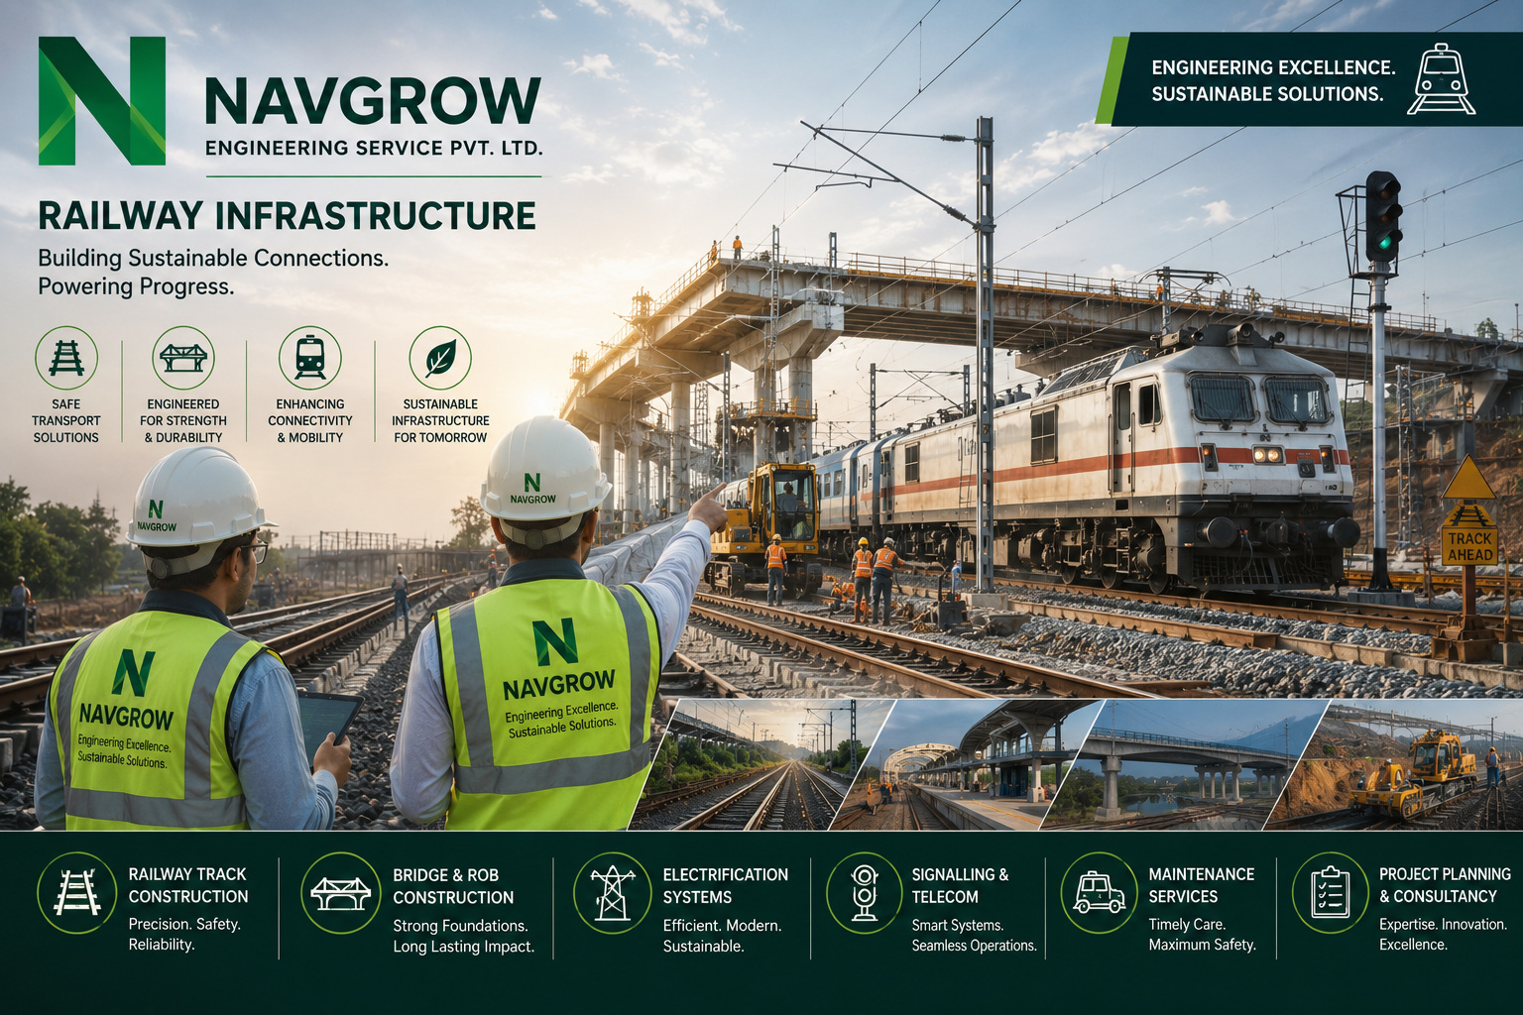
NAVGROW ENGINEERING SERVICE PVT. LTD.
SERVICE LINE · RAILWAY INFRASTRUCTURE
05

Slide 6

NAVGROW ENGINEERING SERVICE PVT. LTD.
SERVICE LINE · CIVIL & CONSTRUCTION
06

Slide 7
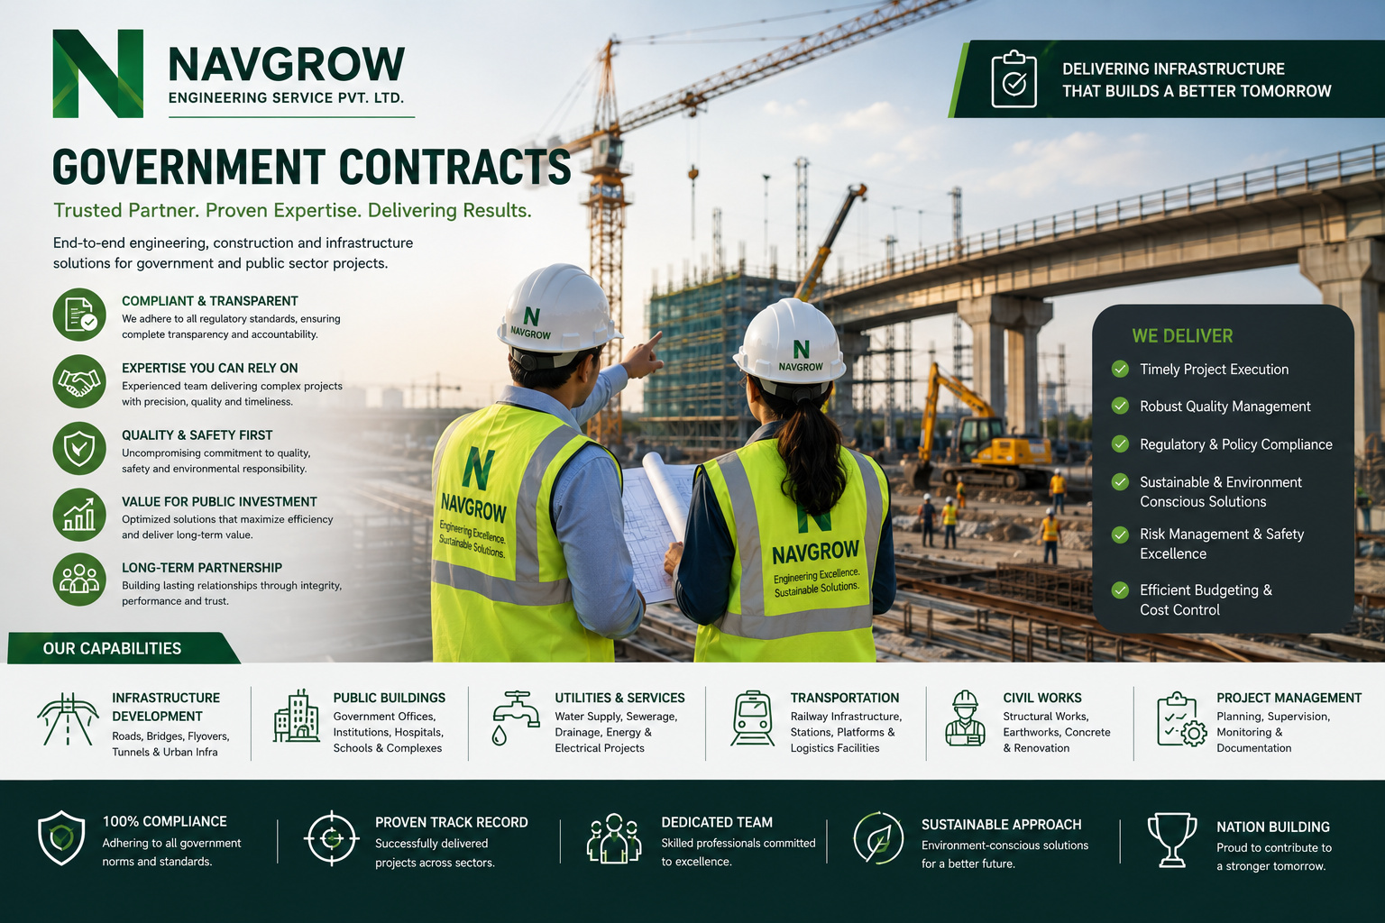
NAVGROW ENGINEERING SERVICE PVT. LTD.
SERVICE LINE · GOVERNMENT CONTRACTS
07

Slide 8
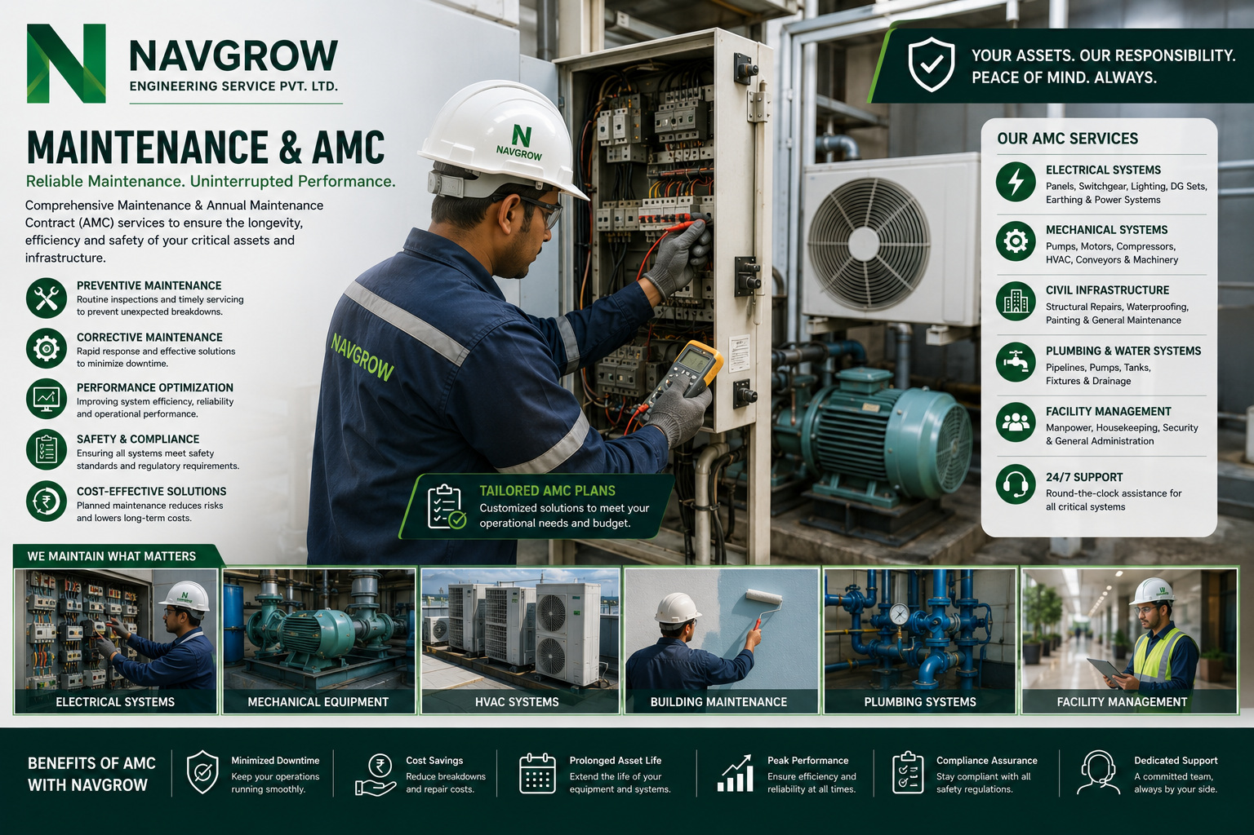
NAVGROW ENGINEERING SERVICE PVT. LTD.
SERVICE LINE · MAINTENANCE & AMC
08

Slide 9
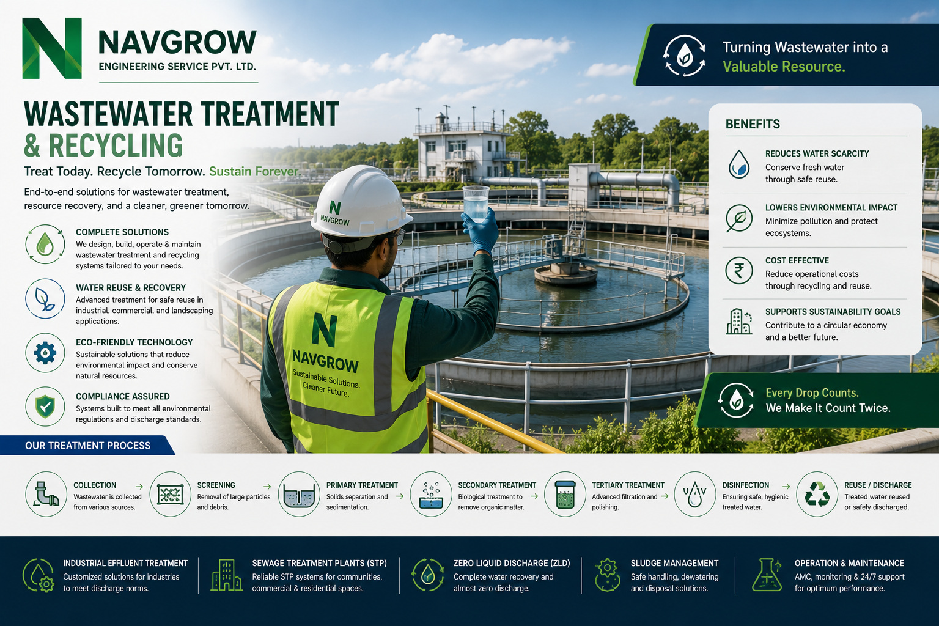
NAVGROW ENGINEERING SERVICE PVT. LTD.
SERVICE LINE · WASTEWATER TREATMENT & RECYCLING
09

Slide 10
HOW WE WORK
NAVGROW
A Process Built for Approval
ENGINEERING SERVICE PVT. LTD.
01
Scope & Specification Study
The Navgrow Assurance
Drawings, specifications and site constraints studied before work begins.
Approved-Vendor Assurance
Working to Indian Railways and departmental vendor norms — documentation audit-ready.
02
Method & Safety Approval
Method statements, safety plans and material certificates submitted for approval.
Zero-Surprise Compliance
Statutory, safety and quality requirements engineered in from the start.
03
Execution Under Supervision
Qualified supervisors on site daily; hold points respected, deviations escalated.
Live-Environment Discipline
Trained for block-working and operating-plant conditions where downtime is not an option.
04
Testing & Handover Dossier
Stage tests, final inspection and a full handover dossier with warranty.
Audit-Ready Records
Every stage documented — measurement books, certificates, photos and approvals.
NAVGROW ENGINEERING SERVICE PVT. LTD.
DELIVERY PROCESS
10

Slide 11
OUR COMMITMENT
NAVGROW
Quality, Safety & Compliance
ENGINEERING SERVICE PVT. LTD.
Every Navgrow project is governed by three non-negotiables — the quality of what we build, the safety of how we build it, and full compliance with the standards our clients answer to. Engineered into our workflow, not inspected in at the end.
QUALITY
SAFETY
COMPLIANCE
Built to Standard
Zero-Harm Mindset
Audit-Ready Always
ISI-marked materials & tested components
Method statements & job safety analysis
Indian Railways / departmental vendor norms
Material test certificates on every batch
Trained crews for block & live-plant work
Statutory & regulatory conformance
Stage inspections with defined hold points
PPE compliance and site safety supervision
GST-compliant billing & documentation
Handover dossier: drawings, MTCs & reports
Incident reporting and corrective action
Traceable measurement books & approvals
OUR COMMITMENT
“We deliver work that is safe to build, built to last, and ready for audit — on every single project.”
NAVGROW ENGINEERING SERVICE PVT. LTD.
QUALITY & SAFETY
11

Slide 12
WHY NAVGROW
NAVGROW
Built on Trust. Proven by Delivery.
ENGINEERING SERVICE PVT. LTD.
What Sets Us Apart
BY THE NUMBERS
✓
Quality-First, Every Time
ISI-marked materials, tested components and documentation ready for audit on every job.
2022
Incorporated in Siliguri
✓
Approved-Vendor Discipline
Working to Indian Railways and departmental norms — trained for block-working and live-plant conditions.
10
One Accountable Partner
Engineering service lines
✓
Design, supply, execution and maintenance under a single, named point of responsibility.
100%
✓
On-Time, On-Budget
On-time project delivery
Method-approved planning and financial discipline that keep projects predictable end to end.
3
✓
Sustainability Built In
Government recognitions
Solar, water-recycling and energy-efficiency expertise woven through our engineering.
24 hrs
NAVGROW ENGINEERING SERVICE PVT. LTD.
WHY NAVGROW
Typical quotation turnaround
12

Slide 13

WORKING WITH US
NAVGROW
From Enquiry to Handover
ENGINEERING SERVICE PVT. LTD.
1
Share Your Requirement
Send drawings, BOQs or a simple description — by email, phone or the online quote calculator at navgrow.org.
2
Receive a Formal Quotation
Detailed, GST-compliant quotation with scope, timeline and terms — typically within 24 hours.
3
Execution & Updates
A named supervisor, agreed milestones and photographic progress records throughout the job.
4
Handover, Invoice & Support
Complete dossier, GST invoice and post-handover support — with AMC options where relevant.
ALSO ON NAVGROW.ORG
Instant quote calculator · Live tender listings (GeM / IREPS) · Online product store
Project gallery · Careers · News & case studies
NAVGROW ENGINEERING SERVICE PVT. LTD.
ENGAGEMENT
13

Slide 14


Let's Build What Lasts.
One accountable partner for engineering, construction and sustainability.
GET IN TOUCH
START A PROJECT
REGISTERED OFFICE
1
Send drawings, a BOQ or a brief.
Ward No-47, Old Matigara Road, Pati Colony, Siliguri, WB – 734001
PHONE
2
Get a GST-compliant quote in 24 hrs.
+91 89270 70972
We execute under supervision.
3
EMAIL
info@navgrow.org
4
Handover with a full dossier.
WEBSITE
www.navgrow.org
REQUEST A QUOTE
WHATSAPP
+91 89270 70972
SCAN TO VISIT
Startup India (DPIIT) · Udyam MSME · Make in India · CIN: U74999WB2022PTC256012
© 2026 Navgrow Engineering Service Pvt. Ltd. All rights reserved. · Engineering Excellence. Sustainable Solutions.

