Slide 1



Noida Institute of Engineering and Technology, Greater Noida
Notion and Concepts
Unit: 1
Subject:
Compiler Design
Vivek Kumar Sharma
Assistant Professor
CSE Department
Course Details B Tech CSE 5th Sem

Slide 2
Brief Introduction of Faculty
Vivek Kumar Sharma
Designation: Assistant Professor CSE Department
NIET Grater Noida
Qualifications:
B.Tech (CSE) in 2010
M.Tech (CSE) in 2013
Teaching Experinces: 10 year +
Research Publications:
Particulars | Journals | Conference
International | 04 | 01
National | 00 | 00

Slide 3
Evaluation Scheme

Slide 4
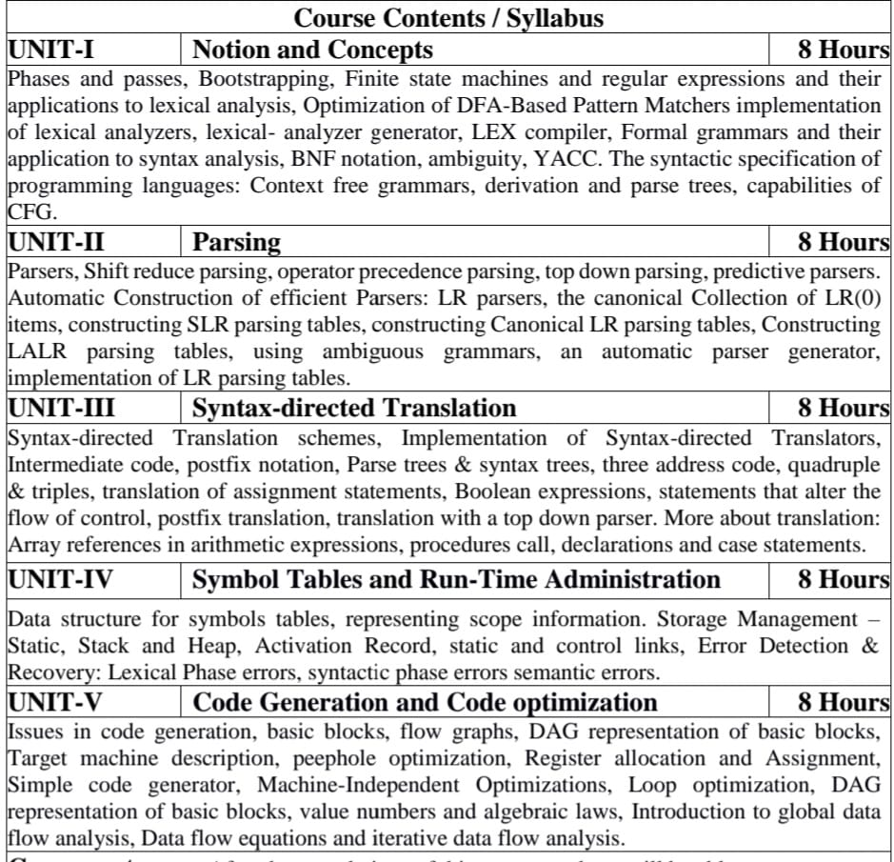
Syllabus

Slide 5
Branch wise Applications
Computer Science Compiler technology can be used to translate the binary code for one machine to that of another, allowing a machine to run programs originally compiled for another instruction set. Binary translation technology has been used by various computer companies to increase the availability of software for their machines
Implementations of High Level Programming
Optimization of Computer Architecture
Design of New Computer Architecture
Program Translation
Software Productive tools

Slide 6
Course Objectives
Introduce students to the concepts underlying the design and implementation of language processors. More specifically, by the end of the course, students will be able to answer these questions:
What language processors are, and what functionality do they provide to their users?
What core mechanisms are used for providing such functionality?
How are these mechanisms implemented?
Apart from providing a theoretical background, the course places a special emphasis in practical issues in designing language processors.

Slide 7
Course Outcomes
CO1: To have the knowledge of patterns, tokens, regular expressions and finite automata to develop a scanner or lexical analyzer.
CO2: To design and develop various parser by parsing LL parser and LR parser
CO3: To apply various design & conduct experiments for Intermediate Code Generation in compiler.
CO4: To design and develop various Data structure for symbols tables and Error Detection & Recovery at every phases
CO5: To apply various new code optimization techniques to improve the performance of a program in terms of speed & space.

Slide 8
Program Outcomes (PO)
PO1: Engineering Knowledge
PO2: Problem Analysis
PO3: Design/Development of solutions
PO4: Conduct Investigations of complex problems
PO5: Modern tool usage
PO6: The engineer and society
PO7: Environment and sustainability
PO8: Ethics
PO9: Individual and team work
PO10: Communication
PO11: Project management and finance
PO12: Life-long learning

Slide 9
CO-PO Mapping
 | PO1 | PO2 | PO3 | PO4 | PO5 | PO6 | PO7 | PO8 | PO9 | PO10 | PO11 | PO12
.1 | 3 | 3 | 3 | 3 | 3 | 1 | 1 | 1 | 3 | 1 | 2 | 2
.2 | 3 | 3 | 3 | 3 | 3 | 1 | 1 | 1 | 3 | 1 | 2 | 2
.3 | 3 | 3 | 3 | 3 | 3 | 1 | 1 | 1 | 3 | 1 | 2 | 2
.4 | 3 | 2 | 3 | 3 | 3 | 1 | 1 | 1 | 3 | 1 | 2 | 2
.5 | 3 | 2 | 3 | 3 | 3 | 1 | 1 | 1 | 3 | 1 | 2 | 2
AVG | 3 | 2.6 | 3 | 3 | 3 | 1 | 1 | 1 | 3 | 1 | 2 | 2

Slide 10
Program Specific Outcomes (PSO)
PSO1: Work as a software developer, database administrator, tester or networking engineer for providing solutions to the real world and industrial problems
PSO2:Apply core subjects of information technology related to data structure and algorithm, software engineering, web technology, operating system, database and networking to solve complex IT problems.
PSO 3:Practice multi-disciplinary and modern computing techniques by lifelong learning to establish innovative career.
PSO 4:Work in a team or individual to manage projects with ethical concern to be a successful employee or employer in IT industry

Slide 11
CO-PSO Mapping
 | PSO1 | PSO2 | PSO3 | PSO4
.1 | 3 | 3 | 3 | 1
.2 | 3 | 3 | 3 | 1
.3 | 3 | 3 | 3 | 1
.4 | 3 | 3 | 3 | 1
.5 | 3 | 3 | 3 | 1
AVG | 3 | 3 | 3 | 1

Slide 12
Program Educational Objectives
PEO1: To have an excellent scientific and engineering breadth so as to
comprehend, analyze, design and provide sustainable solutions for
real-life problems using state-of-the-art technologies.
PEO2:To have a successful career in industries, to pursue higher studies or
to support entrepreneurial endeavors and to face global challenges.
PEO3:To have an effective communication skills, professional attitude,
ethical values and a desire to learn specific knowledge in emerging
trends, technologies for research, innovation and product
development and contribution to society.
PEO4: To have life-long learning for up-skilling and re-skilling for
successful professional career as engineer, scientist, enterpreneur
and bureaucrat for betterment of society

Slide 13
Result Analysis

Slide 14
End Semester Question Paper Template
B TECH
(SEM-V) THEORY EXAMINATION 20__-20__
COMPILER DESIGN
Time: 3 Hours Total Marks: 100
Note: 1. Attempt all Sections. If require any missing data; then choose suitably.
SECTION A
Attempt all questions in brief. 2 x 10 = 20
Q.No. | Question | Marks | CO
1 |  | 2
2 |  | 2
. |  | .
10 |  | 2

Slide 15
End Semester Question Paper Templates
SECTION B
2. Attempt any three of the following: 3 x 10 = 30
SECTION C
3. Attempt any one part of the following: 1 x 10 = 10
Q.No. | Question | Marks | CO
1 |  | 10
2 |  | 10
. |  | .
5 |  | 10
Q.No. | Question | Marks | CO
1 |  | 10
2 |  | 10

Slide 16
End Semester Question Paper Templates
4. Attempt any one part of the following: 1 x 10 = 10
5. Attempt any one part of the following: 1 x 10 = 10
6. Attempt any one part of the following: 1 x 10 = 10
Q.No. | Question | Marks | CO
1 |  | 10
2 |  | 10
Q.No. | Question | Marks | CO
1 |  | 10
2 |  | 10
Q.No. | Question | Marks | CO
1 |  | 10
2 |  | 10

Slide 17
End Semester Question Paper Templates
7. Attempt any one part of the following: 1 x 10 = 10
Q.No. | Question | Marks | CO
1 |  | 10
2 |  | 10

Slide 18
Prerequisite
Theory of Automata
Algorithms
Languages and machines
Operating systems
Computer architectures

Slide 19
Recap
Language processing system
Finite Automata
Production rules
Chomsky hierarchy of grammar

Slide 20
Unit Content
Introduction
Translator
Compiler
Simple structure of compiler
Phases of Compiler
The structure of compiler
Analogy
An example
Language Processing System
Pass of Compiler
Front end and back end of compiler
Bootstrapping and Cross Compiler
Finite Automata
Regular Expression
Thompson’s Method
Subset Construction Method
Lexical Analysis
Context Free Grammar

Slide 21
Unit Objective(CO1)
Introduce students to the concepts of simple structure of Compiler .
Introduce students to the concepts of Token through finite automata
Introduce students to the concepts of scanner.

Slide 22
Topic Objective(CO1)
Introduce students to the concepts of simple structure of Compiler .

Slide 23
Introduction(CO1)
Target program is a running process on any computer which accepts some input and in response generates desired output.
Input
Target Program
Output

Slide 24
Introduction(CO1)
Compiler:
A program that translates a source program written in high level language into target/executable program written in low level language is called compiler.
High Level Language:
Which closer to human understanding. Ex- C, C++, Java, Pascal etc
Low Level Language:
Which is closer to computer understanding. Ex- Machine Language and assembly language.
“It also report errors present in source program.”
High level language
Compiler
warnings
errors
Low level language

Slide 25
Simple Structure of a Compiler(CO1)
Process of compilation involves two major phases.
Analysis Phase:
It breaks up the source code / program into small parts and creates an Intermediate representation of Source Code.
Where Source program is analyzed for errors.
Synthesis Phase:
It takes intermediate representation of source code / program as Input and creates the desired target code.
Where source is converted into target program.
Source program
Source program
Analysis
Compiler
Synthesis
Target program
Target program

Slide 26
Need of Compiler(CO1)
A Compiler is a special type of computer program that translates a human readable text file into a form that the computer can more easily understand.
Bridge the gap between human readable text and machine understandable language 0 & 1.

Slide 27
Interpreter (CO1)
It is also a program that scans the pure High Level Code line by line and Convert it into executable code line by line.
Interpreted Program are usually slower with respect to compiled ones.

Slide 28
Compiler vs Interpreter(CO1)
Compiler | Interpreter
Takes entire program at once | Takes single line of code at a time.
Speed : High | Speed : Low
Generates intermediate object code. So memory requirement is more. | Memory requirement is less because no intermediate code created.
Errors : All errors are displayed together | Errors : Continues translating the program until the first error is meet, in which case it stops.
Compilers are larger in size. | Smaller in Size.
Error detection is difficult | Error detection is easy.

Slide 29
Phases of Compiler: Structure of a Compiler(CO1)
Source Program
(Pure HLL)
Front End
Lexical Analysis
Token
Syntax Analysis
CFG
Parse Tree
Symbol Table management
Semantic Analysis
Error Handler
Parse Tree verified Semantically
Intermediate Code Generation
Three Address Code
Code Optimization
Optimized Code
Back End
Target Code Generation
Target Program
(Assembly Code)

Slide 30
Phases of Compiler (CO1)
Lexical Analyzer:
Reads the program (Source Code) and convert it into tokens.
Tokens are defined by regular expression which are understood by the lexical analyzer.
Removes white spaces, comments, tabs etc.
Syntax Analysis (Parser):
Construct the parse Tree.
Takes the tokens one by one and uses CFG to construct the Parse Tree.
If it is not possible to construct the parse tree then input is syntactically incorrect & error message shown / displayed.

Slide 31
Phases of Compiler (CO1)
Semantic Analyzer:
Verify the parse tree, whether its meaningful or not?
It uses the parse tree & information in the symbol table to check the source program for semantic consistency with the language definition.
Intermediate Code Generation:
Generates the intermediate code. (Eg Three Address Code)
Three Address Code (at most three operands , at most one operator in addition to the assignment)
E.g. X := Y op. Z
(Type checking , definition of variable , Label Checking , Flow Control Checking etc)

Slide 32
Phases of Compiler (CO1)
Code Optimization:
We get optimized code (our number of lines are reduced).
Code optimization phase attempts to improve the intermediate code so that it runs faster & consumes less resources.
Target Code Generator:
Final Phase of compiler which generates the target code / assembly code.
Code generator produces the target code by assigning registers and memory locations to store variables defined in the program.

Slide 33

Phases of Compiler: An Example(CO1)
Statement: P = I + R * 40
Intermediate Code Generation
Lexical Analysis
t1 = inttofloat (40)
t2 = id3 * t1
t3 = id2+t2
id1 = t3
Id1 = id2 + id3 * 40
Syntax Analysis
=
Code Optimization
id1
+
t1 = id3 * 40.0
id1 = id2 + t1
id2
*
id3
40
Target Code Generation
Semantic Analysis
=
LDF R2, id3
MULF R2, #40.0
LDF R1, id2
ADDF R1, R2
STF id1, R1
id1
+
id2
*
id3
int to float
40

Slide 34
Phases of Compiler: An Example(CO1)
Statement: P = I + R * 40
Intermediate Code Generation
Lexical Analysis
t1 = inttofloat (40)
t2 = id3 * t1
t3 = id2+t2
id1 = t3
Id1 = id2 + id3 * 40
Syntax Analysis
=
Code Optimization
id1
+
t1 = id3 * 40.0
id1 = id2 + t1
id2
*
id3
40
Target Code Generation
Semantic Analysis
=
LDF R2, id3
MULF R2, #40.0
LDF R1, id2
ADDF R1, R2
STF id1, R1
id1
+
id2
*
id3
int to float
40

Slide 35
Recap
Compiler is a translator that converts the high level language to low level language
Simple Structure of Compiler
Phases of complier

Slide 36
Topic Objective(CO1)
Introduce students to the concepts of language processing system how a program is going to interact with different program in a system

Slide 37
Language Processing System(CO1)
Source Program
( HLL )
Pre-Processor
Pre-Processed Code (Pure HLL)
Compiler
Assembly Language
Assembler
Re-locatable machine Code {Code can be loaded anywhere in memory}
Linker / Loader
Executable Machine Code {Load to work at one specific position}

Slide 38
Language Processing System(CO1)
Pre-Processor:
In Pre-Processing, HLL converted to pure HLL.
Preprocessor removes the preprocessor directives.
(#include<stdio.h>)
And will add the respective files. (i.e. File Inclusion)
It will do macro expansion, operator conversion.
(e.g. a-- a = a-1)
2. Compiler :
During compilation converts pure HLL into Assembly Language.
Also gives errors and warning.

Slide 39
Language Processing System(CO1)
Assembly Language :
Is a low level programming language.
It is not in binary form.
3. Assemblers:
For every platform (H/W+O.S.) , we have a assembler.
A assembler for one platform will not work for another platform.
4. Loader and Linker:
Convert relocatable code into Absolute machine code.
A Linker links different files into a single file / executable file.
Loader loads that executable file in the memory and executes it

Slide 40
Topic Objective(CO1)
Introduce students to the concepts of the different pass and categories of compiler

Slide 41
Pass of Compiler(CO1)
Pass: A Compiler Pass refers to the traversal of a compiler through the entire program.
Pass also refers to the grouping of phases in different module.
Compiler pass are of two types:
Single Pass Compiler
Two Pass Compiler or Multi Pass Compiler
Single Pass: If we combine or group all the phases of compiler design in a single module known as single pass compiler.
Multi Pass: A Two pass/multi-pass Compiler is a type of compiler that processes the source code or abstract syntax tree of a program multiple times. In multi pass Compiler we divide phases in two or more Module.

Slide 42
Single Pass Compiler
Lexical Analysis
Syntax Analysis
Single Pass: All the units are in one module
Semantic Analysis
Intermediate Code Generation
Code Optimization
Target Code Generation

Slide 43
Two Pass or Multi-Pass Compiler
Lexical Analysis
Syntax Analysis
First Pass: Front End
Semantic Analysis
Intermediate Code Generation
Code Optimization
Second Pass: Back End
Target Code Generation

Slide 44
Front-End & Back- End of Compiler(CO1)
Lexical Analysis
Syntax Analysis
Front End ,Related to Source Language (Machine Independent)
Semantic Analysis
Intermediate Code Generation
Code Optimization
Back End, Related to Target Language ( Machine Dependent)
Target Code Generation

Slide 45
Two basic problems (Solvable by Two Pass Compilers) (CO1)
If you want to design compiler for different programming languages for same machine.
If you want to design compiler of same programming language for different machines.
PL1
PL2
PL3
FE1
FE2
FE3
BE M1
M1
PL
FE
BE M1
BE M2
BE M3
M1
M2
M3

Slide 46
Recap
Passes of Compiler
One Pass
Two Pass
Three Pass
Front and Back end Compiler

Slide 47
Topic Objective(CO1)
Introduce students to the concepts of handling the complicated language to understand the more complicated language

Slide 48
Bootstrapping(CO1)
Bootstrapping is a process of writing compiler in the source programming language that it intends to compile. This technique leads to hosting compiler.
Bootstrapping is a process to create new compiler.
It is used to create cross compiler.

Slide 49
Bootstrapping…
Language Associated with a Compiler:
Source Language(S): Language for which compiler is designed.
Target Language(T): Language in which compiler generates final code.
Implementation Language(I): Language in which compiler itself is written.

Slide 50
Bootstrapping…
T Diagram Representation of Compiler:
Source Language: S
Target Language: T
Implementation Language: I
S
T
I
I
(S)
(T)

Slide 51
Cross Compiler(CO1)
A Compiler which runs on one machine and generates target code for Another machine is called Cross Compiler.
Ex: A Compiler that run on windows and produce code that run on Android.
Note : Each System (In Starting, Computer will understand the Assembly Language.) has their own Assembler which understand Assembly Language as input.
Each System understand Assembly Language and convert it into machine language.
S
N
M
Cross Compiler

Slide 52
Cross Compiler(CO1)
Compiler for First Language is made up in machine Code (Machine Language).
Source Language ( C )
M (Machine Code)
( Target Language ) for Machine M
Ex : windows
Compiler
C
M
M

Slide 53
Cross Compiler(CO1)
Now, for Source Language C++, we already have a C Language as a Machine Code for developing compiler.
Source Language ( C++ )
C (Machine Code)
( Target Language ) for Machine N
Ex: Android
Compiler
C++
N
C

Slide 54
Cross Compiler(CO1)
Now to run C++ on Machine M and convert into Target Code N :
Compiling the Compiler
Source Language ( C++ )
M (Machine Code)
( Target Language ) for Machine N
Ex: Android
Compiler
C++
N
C++
N
C
C
M
M
M

Slide 55
Cross Compiler(CO1)
Not Possible Cross Compilation
C++
N
C++
N
X
C
M
M
M

Slide 56
Cross Compiler(CO1)
To Create Compiler for Language L for Machine A.
1. Create C a compiler for subset of L.
2. Create C a compiler for L.
S
A
A
L
A
S
A
L
A
3. Compiler C using C to obtain C
S
A
S
A
A
A
L
A
L
A
L
A
S
S
A
A
S
L
A
A
S

Slide 57
Recap
Bootstrapping is a process in which simple language is used to translate more complicated program
A Compiler which runs on one machine and generates target code for Another machine is called Cross Compiler

Slide 58
Topic Objective(CO1)
Introduce students to the concepts of tokens how the automata is useful in finding tokens

Slide 59
Finite Automata(CO1)
A finite automaton is a machine used to recognize patterns within input taken from some character set (or alphabet) .
The job of an FA is to accept or reject an input depending on whether the pattern defined by the FA occurs in the input.
Finite Automata (M) is defined by 5-tuples.
M = (Q, ∑, q0 , δ ,F)
Q: Finite set of non empty states.
∑: Finite set of input characters or alphabets.
q0: Initial state.
δ: State transition function.
F: Non empty set of final states.

Slide 60
Types of Finite Automata
There are two types of finite automata.
Deterministic Finite Automata (DFA)
One transition per input per state
No ε-moves (null moves)
Nondeterministic Finite Automata (NFA)
Can have multiple transitions for one input in a given state
Can have ε-moves

Slide 61
Deterministic Finite Automata (DFA)
State transition function of DFA is:
δ: Q X ∑ → Q
Example: Let Q = {q0, q1}, ∑= {a, b} then
Q X ∑ = { (q0,a), (q0, b), (q1, a), (q1, b) }
δ: Q X ∑ → Q
Q X ∑
Q
(q0,a)
(q0, b)
(q1, a)
(q1, b)
q0
q1
One transition per input
per state and no ε-moves

Slide 62
Examples of DFA
Construct a DFA that accepts all strings over ∑={0,1} ending with 1.
1
0
1
q0
q1
0

Slide 63
Examples of DFA
Construct a DFA for L={w=(0,1)*| |w|=3n , n=0,1,2,...}
0, 1
0, 1
q0
q1
q2
0, 1

Slide 64
Examples of DFA
Construct a DFA for L= { all binary strings containing substring 001 }
0, 1
1
0
q0
0
q1
0
q2
1
q3
1

Slide 65
Examples of DFA
Construct a DFA for L= { all binary strings not containing substring 001 }
0, 1
1
0
q0
0
q1
0
q2
1
q3
1

Slide 66
Nondeterministic Finite Automata (NFA)
State transition function of NFA is:
δ: Q X ∑ → 2
Example: Let Q = {q0, q1}, ∑= {a, b} then
Q X ∑ = { (q0,a), (q0, b), (q1, a), (q1, b) }
Q
Q
δ: Q X ∑ → 2
Q
Q X ∑
2
(q0,a)
(q0, b)
(q1, a)
(q1, b)
{q0} {q1}
Multiple transitions for
one input in a given state

Slide 67
Representation of Finite Automata
State Transition Diagram
States are represented by:
Inputs are represented by:
Initial state:
Final States:
DFA of string ending with 0 over input set {0, 1}:
q
q
q
1
0
q0
0
q1
1

Slide 68
Representation of Finite Automata
State Transition Table: A 2-D Array is used
Rows are represented by states (Q)
Columns are represented by input characters (∑)
DFA of string ending with 0 over input set {0, 1}:
Q
∑
0
1
1
0
q0
0
q1
q0
q1
q0
1
q1
q1
q0

Slide 69
Conversion of NFA to DFA
Convert following NFA to DFA
0
1
0,1
 | 0 | 1
q0 | q0 | q1
q1 | q1 | {q0,q1}
q0
q1
1
0
0
0,1
 | 0 | 1
q0 | q0 | q1
q1 | q1 | [q0,q1]
[q0,q1] | [q0,q1] | [q0,q1]
[q0,q1]
q0
1
q1
1

Slide 70
NFA with Ɛ- Transition
0
1
q0
ε
q1
We extend the class of an NFA by allowing ε transitions:
The automaton may be allowed to change its state without reading the input symbol.
Such transitions are depicted by labeling the appropriate arcs with ε.
‘ε’ does not belong to any alphabet (∑).

Slide 71
Why Ɛ- NFA ?/
ε -NFAs add a convenient feature.
Through ε –NFAs we can implement some complex languages easily.
They do not extend the power of an NFA.
Both NFAs and ε-NFAs have same power.

Slide 72
Formal definition of an Ɛ- NFA
An NFA is represented as a 5 tuples,
M={Q, ∑, δ, q₀, F}
Q= Non empty finite set of states
∑= Input alphabet
δ= Transition Function, δ: Q X (∑∪Ɛ) → 2^{Q}
q₀= Initial State
F= Set of final states (F⊆ Q)

Slide 73
Regular Expression
A regular expression is a mathematical representation of a pattern which is used to formulate tokens of any high level programming language.
Regular Expressions can be:
ε is a regular Expression (null move)
Every ‘a’ belonging to ∑ is a regular expression
Let R is a regular expression then
R* (Kleen’s Closure): Zero or more occurrence of R is a regular expression.
R⁺ : one or more occurrence of R is a regular expression.
Let R and S are regular expressions then
R/S or R+S: R or S is a regular expression.
R.S: concatenation is a regular expression.

Slide 74
Regular Expression to NFA Conversion(CO1)
Thompson’s Method:
ε is a regular Expression (null move)
Every ‘a’ belonging to ∑ is a regular expression
R.S is a regular expression
R+S is a regular expression
R* is a regular expression
ε
a
ε
R
S
ε
ε
R
ε
S
ε
ε
ε
ε
R
ε

Slide 75
Example of Regular Expression to NFA
Consider the regular expression (1 + 0)*.1 and construct equivalent NFA.
By precedence:
(1+0)
(1+0)*
1
(1+0)*.1
ε
1
ε
ε
ε
ε
1
ε
0
ε
ε
ε

Slide 76
NFA With Null Moves to DFA Conversion
Some definition used in the method
ε-Closure (S): Set of states reachable from state S via epsilon.
ε-Closure (T): Set of states reachable from any state in set T via epsilon.
move (T, a): Set of states to which there is an NFA transition from states in T on a symbol a.
D_states: Set of states in equivalent DFA.
D_Tran: Transition table of equivalent DFA.

Slide 77
NFA With Null Moves to DFA Conversion
^
Let N = (Q,∑, δ, q0, F) is a NFA with ε-moves then there exists N’ = (Q, ∑, δ, q0, F’) without ε-moves.
First Find ε-closure of all states in the design.
Calculate extended transition function using following conversion formulae.
(i) δ (q, x) = ε-closure (δ(δ(q, ε), x))
(ii) δ (q, ε) = ε-closure (q)
3. F’ is a set of all states whose ε-closure contains a final state in F.
^
^
^

Slide 78
ε –Closure of a state
The ε-closure of the state q, denoted as ε-Closure(q), is the set that contains q, together with all states that can be reached starting at q by following only ε-transitions.
a
b
c
q0
ε
q1
ε
q2
ε-Closure(q0) = {q0, q1, q2}
ε-Closure(q1) = {q1, q2}
ε-Closure(q2) = {q2}

Slide 79
ε –Closure of a state
δ’({q0, q1,q2} ,a) = ε-Closure (δ (q0,q1,q2), a)
= ε-Closure (δ(q0,a) U δ (q1,a) U δ (q2,a))
= ε-Closure (q0 U φ U φ)
= ε-Closure (q0)
= {q0,q1,q2}
Similarly
δ’({q0, q1,q2} ,b) = ε-Closure (δ (q0,q1,q2), b)
= ε-Closure (δ(q0,b) U δ (q1,b) U δ (q2,b))
= ε-Closure (φ U q1 U φ)
= ε-Closure (q1)
= {q1,q2}

Slide 80
Conversion of ε –NFA to NFA
a
b
c
q0
ε
q1
ε
q2
States | ε-Closure
q0 | {q0, q1, q2}
q1 | {q1, q2}
q2 | {q2}
 | a | b | c
A={q0, q1,q2} | {q0, q1, q2} | {q1, q2} | {q2}
B={q1,q2} | φ | {q1, q2} | {q2}
C={q2} | φ | φ | {q2}
a
b
c
A
b
B
c
C
c

Slide 81
Minimization of DFA
Minimization of a DFA refers to the removal of those states of a DFA, whose presence or absence in a DFA does not affect the language accepted by the automata.
The states that can be eliminated from automata are:
Unreachable or inaccessible states: All those states which can never be reached from the initial state called unreachable states.
Dead states: All those non final states which transition to itself for all input
Non-distinguishable or indistinguishable state or equivalent states: Two states q1 and q2 are indistinguishable if
δ (q1,w) ε F δ (q2,w) ε F
δ (q1,w) ε F δ (q2,w) ε F
^
^
^
^

Slide 82
Minimization of DFA
Minimize the following DFA:
0
0
Transition Table
B
D
 | 0 | 1
→A | B | C
B | B | D
C | B | C
D | B | E
*E | B | C
1
0
A
0
1
0
1
C
E
1
1

Slide 83
Minimization of DFA
Eqivalent State
Two states qi and qj are equivalent or indistinguishable (for the future), if, when started in these states, every string causes the machine to either end up in an accepting state for both or end up in a non-accepting state for both.
qi
qm
a
qj
qn
a
If qm and qn are distinguishable, then so are qi and qj

Slide 84
Minimization of DFA
Suppose there is a DFA D < Q, Σ, q0, δ, F > which recognizes a language L. Then the minimized DFA D < Q’, Σ, q0, δ’, F’ > can be constructed for language L as:
Step 1: We will divide Q (set of states) into two sets. One set will contain all final states and other set will contain non-final states. This partition is called Π₀.
Step 2: Initialize k = 1
Step 3: Find Πk by partitioning the different sets of Πk-1. In each set of Πk-1, we will take all possible pair of states. If two states of a set are distinguishable, we will split the sets into different sets in Πk.
Step 4: Stop when Πk = Πk-1 (No change in partition)
Step 5: All states of one set are merged into one. No. of states in minimized DFA will be equal to no. of sets in Πk.

Slide 85
Minimization of DFA
Find Equivalence classes
Π₀= {A,B,C,D} {E}
Π₁= {A,B,C} {D} {E}
Π₂= {A,C} {B} {D} {E}
Π₃= {A,C} {B} {D} {E}
Π₂= Π₃ ,so stop here.
Transition Table
 | 0 | 1
→A | B | C
B | B | D
C | B | C
D | B | E
*E | B | C

Slide 86
Minimization of DFA
{A,C} {B} {D} {E}
Transition Table
0
 | 0 | 1
→A | B | C
B | B | D
C | B | C
D | B | E
*E | B | C
0
B
1
D
0
AC
0
1
0
1
E

Slide 87
Regular Expressions to Finite Automata
NFA
DFA
Regular
expressions
Table-driven
Implementation of DFA
Lexical
Specification

Slide 88
Recap
There are two types of finite automata.
Deterministic Finite Automata (DFA)
One transition per input per state
No ε-moves (null moves)
Nondeterministic Finite Automata (NFA)
Can have multiple transitions for one input in a given state
Can have ε-moves
A regular expression is a mathematical representation of a pattern
Thompson’s method
Subset Construction Method: (ε-Closure Method)

Slide 89
Topic Objective(CO1)
Introduce students to the concepts of scanner how a lexical analyzer work in compiler designing

Slide 90
Lexical Analysis(CO1)
Interface diagram of Lexical Analysis
token
Source
program
Lexical Analyzer
Syntax Analysis
To semantic
analysis
Get Next Token
Symbol
table

Slide 91
Functions of Lexical Analyzer(CO1)
Reads the input program character by character & produce a stream of token.
Removing white spaces / tabs.
Remove comments from source program.
Lexical Analyzer generates errors and gives the line number of the error.

Slide 92
Tokens, Patterns and Lexemes(CO1)
Tokens- Sequence of characters that have a collective meaning and treated as a single logical entity.
Tokens are symbolic names for the entities that make up the text of the program.
Typical Tokens are:
{ Keywords , Identifiers, Operators , Separators etc }
(for, if, while) (variable name, ( +, - , * , ++ ) ( , ; etc )
function name)
Patterns- Rule that check Lexeme is valid token or not.
Lexeme- A sequence of characters in the source program that is matched by the pattern for a token.

Slide 93
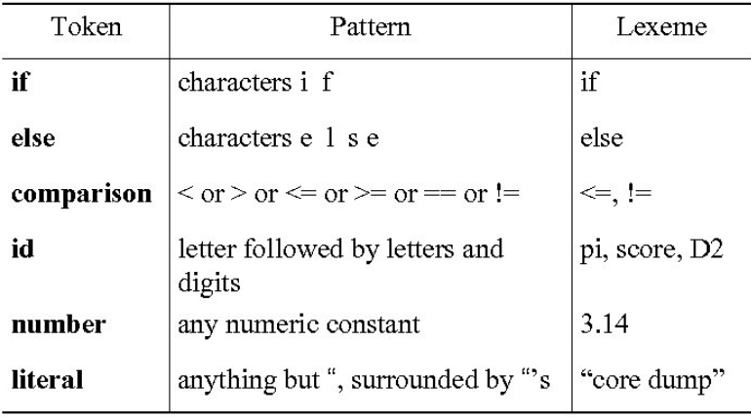
Example of Tokens, Patterns and Lexemes
Keyword
Keyword
Operator
Identifier
Constant
Constant

Slide 94
Recap
Tokens, Patterns and Lexemes with example
Designing of Lexical Analyzer
Lexical analysis turns input characters into tokens.
Lexical syntax is described by regular expressions.

Slide 95
Topic Objective(CO1)
Introduce students to the concepts of language used to design the compiler.

Slide 96
Grammar
A grammar G can be formally written as a 4-tuple (N, T, S, P) where −
N or V_{N} is a set of variables or non-terminal symbols.
T or ∑ is a set of Terminal symbols.
S is a special variable called the Start symbol, S ∈ N
P is Production rules for Terminals and Non-terminals. A production rule has the form α → β, where α and β are strings on V_{N} ∪ ∑ and least one symbol of α belongs to V_{N}.

Slide 97
Example
Grammar G1 − ({S, A, B}, {a, b}, S, {S → AB, A → a, B → b})
Here,
S, A, and B are Non-terminal symbols;
a and b are Terminal symbols
S is the Start symbol, S ∈ N
Productions, P : S → AB, A → a, B → b
Grammar G2 −(({S, A}, {a, b}, S,{S → aAb, aA → aaAb, A → ε } )
Here,
S and A are Non-terminal symbols.
a and b are Terminal symbols.
ε is an empty string.
S is the Start symbol, S ∈ N
Production P : S → aAb, aA → aaAb, A → ε

Slide 98
Derivations from a Grammar
Strings may be derived from other strings using the productions in a grammar.
If a grammar G has a production α → β, we can say that x α y derives x β y in G.
This derivation is written as
x α y ⇒ x β y
G

Slide 99
Example
Let us consider the grammar −
G2 = ({S, A}, {a, b}, S, {S → aAb, aA → aaAb, A → ε } )
Some of the strings that can be derived are −
S ⇒ aAb using production S → aAb
⇒ aaAbb using production aA → aaAb
⇒ aaaAbbb using production aA → aaAb
⇒ aaabbb using production A → ε

Slide 100
Language Generated by a Grammar
The set of all strings that can be derived from a grammar is said to be the language generated from that grammar.
A language generated by a grammar G is a subset formally defined by
L(G)={W|W ∈ ∑*, S ⇒G W}
If L(G1) = L(G2), the Grammar G1 is equivalent to the Grammar G2.

Slide 101
Example
1. If there is a grammar
G: N = {S, A, B} T = {a, b} P = {S → AB, A → a, B → b}
Here S produces AB, and we can replace A by a, and B by b. Here, the only accepted string is ab, i.e.,
L(G) = {ab}
2. Suppose we have the following grammar −
G: N = {S, A, B} T = {a, b} P = {S → AB, A → aA|a, B → bB|b}
The language generated by this grammar −
L(G) = {ab, a²b, ab², a²b², ………}
= {a^{m} b^{n} | m ≥ 1 and n ≥ 1}

Slide 102
Chomsky Classification of Grammars
According to Noam Chomosky, there are four types of grammars − Type 0, Type 1, Type 2, and Type 3. The following table shows how they differ from each other
Grammar Type | Grammar Accepted | Language Accepted | Automaton
Type 0 | Unrestricted grammar | Recursively enumerable language | Turing Machine
Type 1 | Context-sensitive grammar | Context-sensitive language | Linear-bounded automaton
Type 2 | Context-free grammar | Context-free language | Pushdown automaton
Type 3 | Regular grammar | Regular language | Finite state automaton

Slide 103
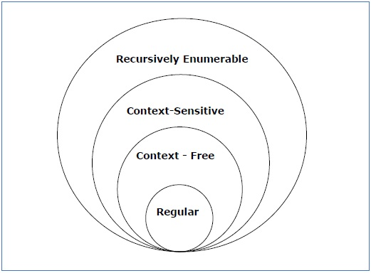
Chomsky Classification of Grammars
It shows the scope of each type of grammar −

Slide 104
Type - 3 Grammar
Type-3 grammars generate regular languages.
Type-3 grammars must have a single non-terminal on the left-hand side .
a right-hand side consisting of a single terminal or single terminal followed by a single non-terminal.
The productions must be in the form
X → a or X → aY ---------- (right linear)
X → a or X → Ya -----------(left linear)
where X, Y ∈ N (Non terminal)
a ∈ T (Terminal)
Note: The rule S → ε is allowed if S does not appear on the right side of any rule.

Slide 105
Type - 3 Grammar Example
Example1 :
X → ε
X → a | aY
Y → b
Example 2:
The language 0(10)* is generated by
the right linear grammar: S → 0A
A → 10 A / ε
The left linear grammar : S → S10 / 0

Slide 106
Type - 2 Grammar
Type-2 grammars generate context-free languages.
The productions must be in the form A → γ
where A ∈ N (Non terminal)
γ ∈ (T ∪ N)* (String of terminals and non-terminals).
These languages generated by these grammars are be recognized by a non-deterministic pushdown automaton.
Example:
S → X a
X → a
X → aX
X → abc
X → ε

Slide 107
Type - 1 Grammar
Type-1 grammars generate context-sensitive languages.
The productions must be in the form
α A β → α γ β
where A ∈ N (Non-terminal)
α, β, γ ∈ (T ∪ N)* (Strings of terminals and non-terminals)
The strings α and β may be empty, but γ must be non-empty.
The rule S → ε is allowed if S does not appear on the right side of any rule. The languages generated by these grammars are recognized by a linear bounded automaton.
Right hand side string be at least as long as or longer than Left hand side string.

Slide 108
Type - 1 Grammar Example
AB → AbBc
A → bcA
B → b

Slide 109
Type - 0 Grammar
Type-0 grammars generate recursively enumerable languages. The productions have no restrictions.
They are any phase structure grammar including all formal grammars.
They generate the languages that are recognized by a Turing machine.
The productions can be in the form of α → β
where α is a string of terminals and nonterminals with at least one non-terminal and α cannot be null. β is a string of terminals and non-terminals.

Slide 110
Type - 0 Grammar Example
S → ACaB
Bc → acB
CB → DB
aD → Db

Slide 111
Context free grammars(CO1)
Terminals
Non terminals
Start symbol
productions
expression -> expression + term
expression -> expression – term
expression -> term
term -> term * factor
term -> term / factor
term -> factor
factor -> (expression)
factor -> id

Slide 112
Derivation(CO1)
Productions are treated as rewriting rules to generate a string
Rightmost and leftmost derivations
E -> E + E | E * E | -E | (E) | id
Derivations for –(id+id)
E => -E => -(E) => -(E+E) => -(id+E)=>-(id+id)

Slide 113
Left Most ad Right Most derivations
A string can be derived in many ways . But we restrict ourselves to :
1. Rightmost Derivations
2. Leftmost Derivations
In leftmost derivations the left most variable of β from (α→β) , is picked for expansion.
In rightmost derivations the right most variable of β from (α→β) , is picked for expansion.

Slide 114
Left Most ad Right Most derivations [Example]
For the grammar given below :
S →A1B
A →0A|ɛ
B →0B|1B|ɛ
Give Leftmost derivation and rightmost derivation of string 1001.
Solution
Leftmost derivation of 1001:
S →A1B
S →1B [A →ɛ]
→10B [B →0B]
→100B [B →0B]
→1001B [B →1B]
→1001 [B →ɛ]

Slide 115
Left Most ad Right Most derivations [Example] (Continued)
Rightmost derivation of 1001:
S →A1B
S →A10B [B →0B]
→A100B [B →0B]
→A1001B [B →1B]
→A1001 [A →ɛ]
→1001 [B →ɛ]

Slide 116
Parse Tree (CO1)
Objective: To understand the design of parse tree
A set of derivations applied to generate a word can be represented using a tree. Such a tree is known as a parse tree. A parse tree representation gives us a better understanding of:
Recursion
Grouping of symbols
A parse tree is constructed with the following conditions:
Root of the tree is represented by start symbol.
Each interior mode is represented by a variable belonging to V.
Each leaf mode is represented by a terminal or ɛ.

Slide 117
Parse Tree [Example]
For a grammar given below S →0S1|01
Give Parse tree derivation of 000111
Derivation using parse tree:
S
S →0S1
0
S
1
S →0S1
0
1
S →01
S
0
1

Slide 118
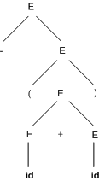
Parse trees(CO1)
-(id+id)
E => -E => -(E) => -(E+E) => -(id+E)=>-(id+id)

Slide 119
Ambiguous grammar:
A CFG is said to ambiguous if there exists more than one derivation tree for the given input string i.e., more than one Left Most Derivation Tree (LMDT) or Right Most Derivation Tree (RMDT). Definition:
G = (V,T,P,S) is a CFG is said to be ambiguous if and only if there exist a string in T* that has more than on parse tree.
where V is a finite set of variables. T is a finite set of terminals. P is a finite set of productions of the form, A -> α, where A is a variable and α ∈ (V ∪ T)* S is a designated variable called the start symbol.

Slide 120
Ambiguous grammar Example:
S →SS|a|b is ambiguous or not?
Two parse trees can be generated for the string ‘aab’
S
S
S
S
S
S
S
S
b
a
S
S
a
a
b
a

Slide 121
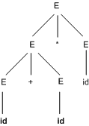
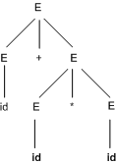
Ambiguity(CO1)
For some strings there exist more than one parse tree
Or more than one leftmost derivation
Or more than one rightmost derivation
Example: id+id*id

Slide 122
Recap
Context Free grammar
Parse Tree
Ambiguity

Slide 123
Lex
Lex is a tool which generates Lexical Analyzer .
It is also used with YACC parser generator.
Lex written by Mike Lesk and Eric Schridt and described in 1975.

Slide 124
Block diagram of Lex
Lex Source Program
(File.l)
Lex Compiler
Lex.yy.c
(C program)
Lex.yy.c
C Compiler
a.Out
(Lexical Analyzer)
Input stream or HLL
a.out
stream of tokens

Slide 125
Lex
Source Code is in Lex language with file name .l extension.
It is given to Lex Compiler which is the Lex tool and produce lex.yy.c
C compiler runs this C Code ie lex.yy.c program and produce an output a.out .
a.out transforms an input stream into a sequence of tokens.

Slide 126
Structure of LEX
{declaration}
%%
{ Translation Rules}
%%
{ Auxiliary functions}

Slide 127
YACC
It stands for Yet Another Compiler Compiler .
It is a tool for generating a parser.

Slide 128
Block diagram of YACC
YACC specification
(File.y)
YACC Compiler
y.tab.c
y.tab.c
C Compiler
a.out
Input (Tokens from Lexical Analyzer)
a.out
output

Slide 129
Structure of YACC
{declaration}
% tokens
%%
{ Translation Rules}
%%
{ Auxiliary Routines}

Slide 130
Faculty Video Links, Youtube & NPTEL Video Links and Online Courses Details
Youtube/other Video Links
https://www.youtube.com/watch?v=WccZQSERfCM
https://www.youtube.com/watch?v=e-WJJl1Wzc4
https://www.youtube.com/watch?v=ZMgiwh_Aimw
https://www.youtube.com/watch?v=jN8zvENdjBg
NPTEL
https://youtu.be/trocRZqxZFM
https://youtu.be/-Ut1b1xEbCo
https://youtu.be/UMnllso8znw

Slide 131
Daily Quiz
What is the output of lexical analyzer?
a. A list of tokens
b. A parse tree
c. Intermediate code
d. Machine code
which is the permanent data base in the general model of Compiler ?
a. identifier table
b. literal table
c. terminal table
d. source code
A _________ is a software utility that translates code written in higher language into a low level language.
a. Text editor
b. Compiler
c. Converter
d. Code optimizer

Slide 132
Daily Quiz
Compiler can check ________ error.
a. Syntax
b. Content
c. Logical
d. Both A and B
Compiler translates the source code to
a. Machine code
b. Binary code
c. Executable code
d. Both 1 and 2

Slide 133
Weekly Assignment
What is compiler? Explain the various phases of compiler with suitable example. [CO1]
Describe various compiler writing tools. [CO1]
How the boot strapping is done on more than one machine? [CO1]
Construct minimum state DFA for the regular expression (a|b)*a(a|b). [CO1]
Discuss the algorithm for subset construction and computation of ε-closure. [CO1]
Construct NFA For regular expression (a.b)*a. [CO1]
Design FA from given regular expression 10 + (0+11)0*1. [CO1]
Construct NFA equivalent to r = a*b. [CO1]
Construct NFA equivalent to r = (a+b)*b. [CO1]

Slide 134
MCQ s
In a compiler, keywords of a language are recognized during -
a. the code generation
b. parsing of the program
c. the lexical analysis of the program
d. dataflow analysis
Which of the following is used for grouping of characters into tokens?
a. Parser
b. Code generator
c. Lexical analyser
d. Code generator
Given the language L = {ab, aa, baa}, which of the following strings are in L*?
1)abaabaaabaa 2) aaaabaaaa 3) baaaaabaaaab 4) baaaaabaa
a. 1,2,3
b. 2,3,4
c. 1,2,4
d. 1,3,4

Slide 135
MCQ s
Which one of the following is FALSE?
a. Every NFA can be converted to DFA
b. Every subset of a recursively enumerable set is recursive
c. NFA is a machine.
d. DFA is also a type of NFA.
e. All of the mentioned
f. None of the mentioned
Number of states of FSM required simulating behaviour of a computer with a memory capable of storing “m” words, each of length ‘n’
a. m x 2n
b. 2mn
c. 2(m+n)
d. All of the mentioned

Slide 136
Glossary Questions
Construct minimum state DFA for the regular expression (a|b)*a(a|b).
Discuss the algorithm for subset construction and computation of ε-closure.
3. What is LEX compiler? Explain the working and advantage of LEX compiler.
4. Write short note on the following.
(i) Formal Grammar (ii) Left Recursion (iii) Left factoring

Slide 137
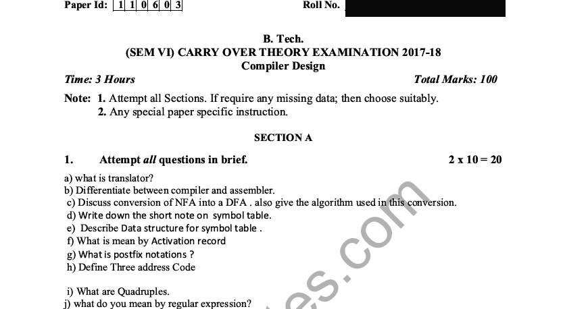
Old Question Papers

Slide 138
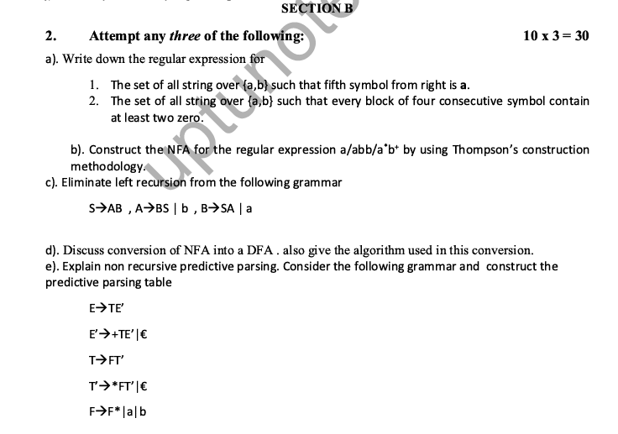
Old Question Papers

Slide 139
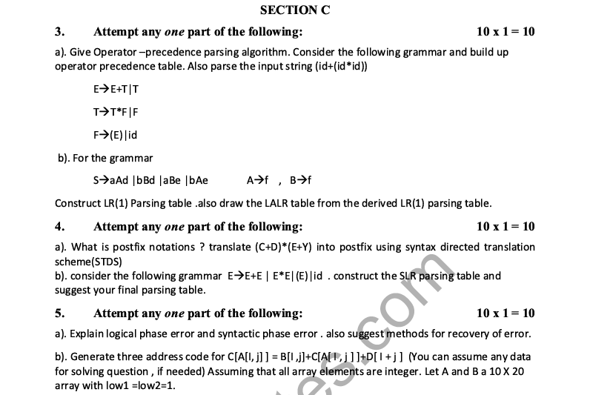
Old Question Papers

Slide 140
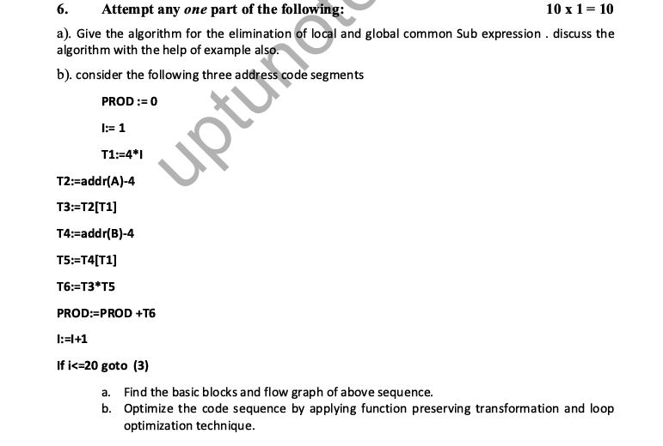
Old Question Papers

Slide 141
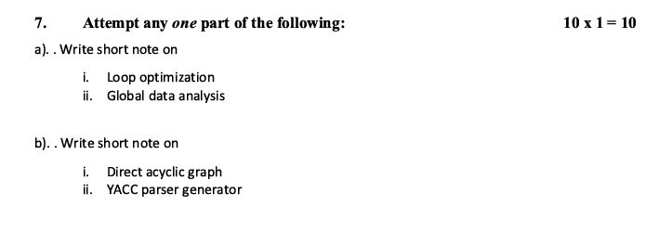
Old Question Papers

Slide 142
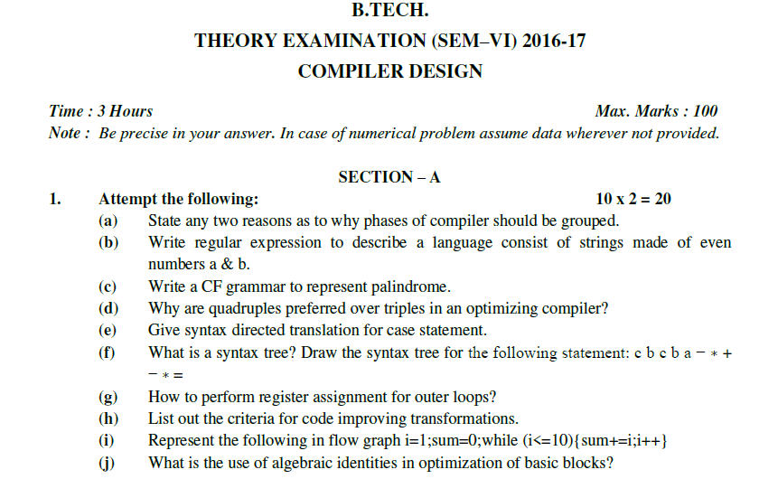
Old Question Papers

Slide 143
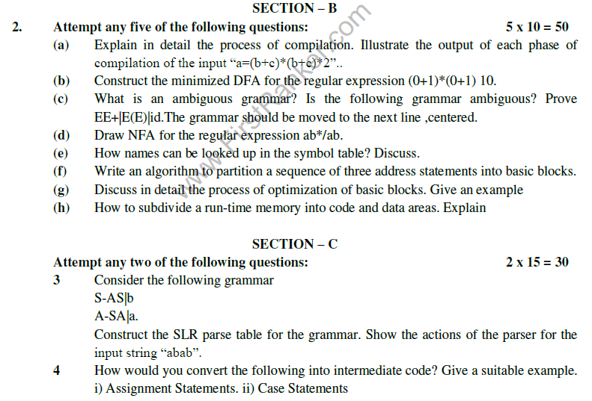
Old Question Papers

Slide 144
Old Question Papers

Slide 145
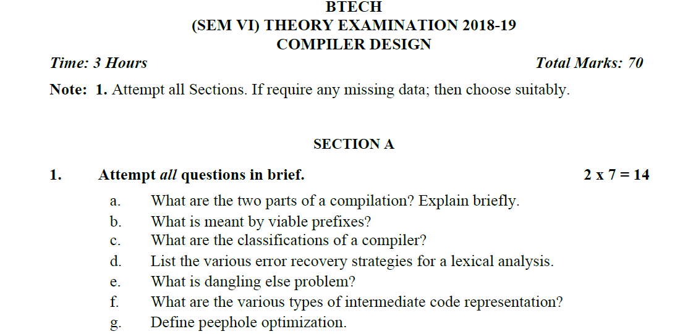
Old Question Papers

Slide 146
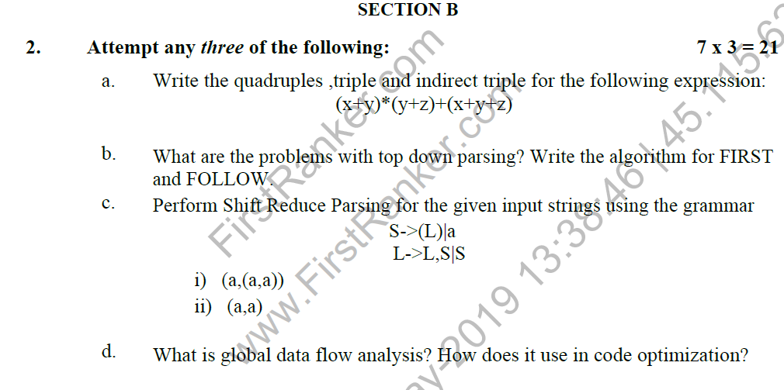
Old Question Papers

Slide 147
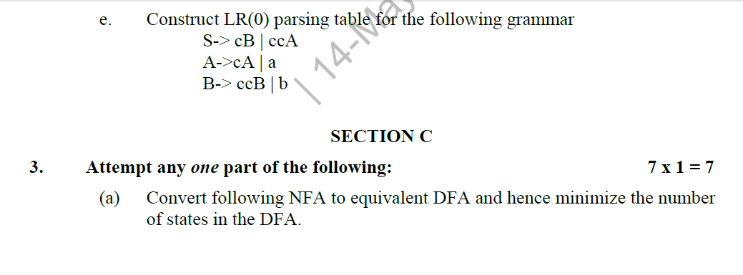
Old Question Papers

Slide 148
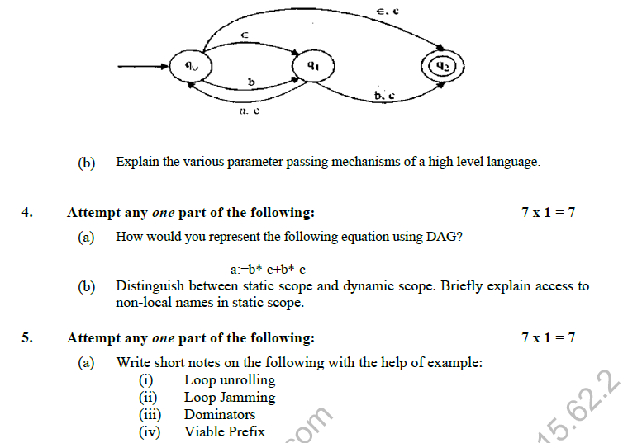
Old Question Papers

Slide 149
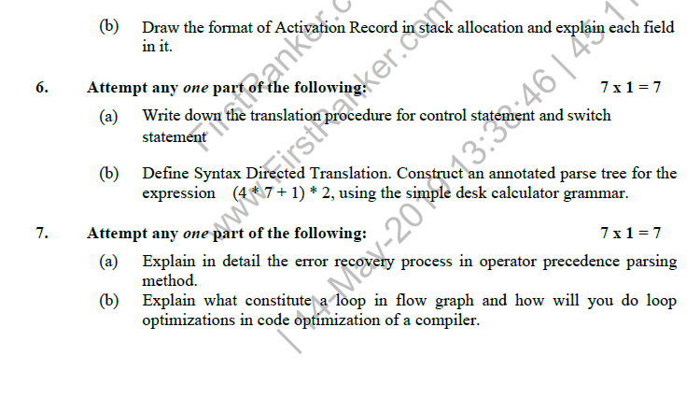
Old Question Papers

Slide 150
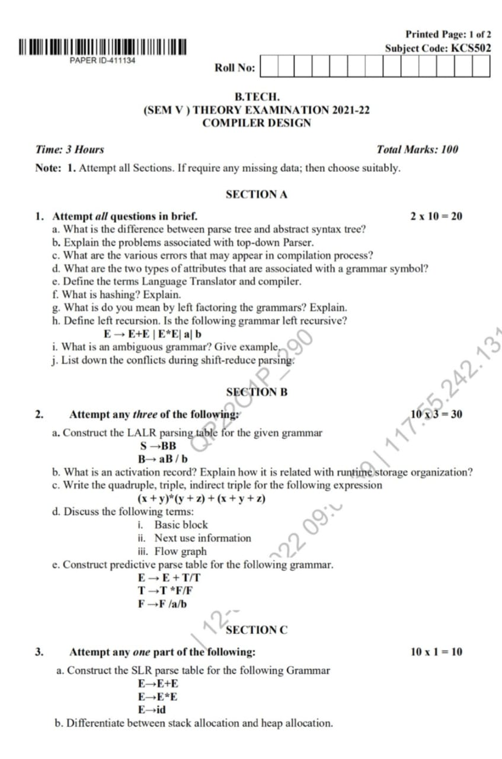
Old Question Papers

Slide 151
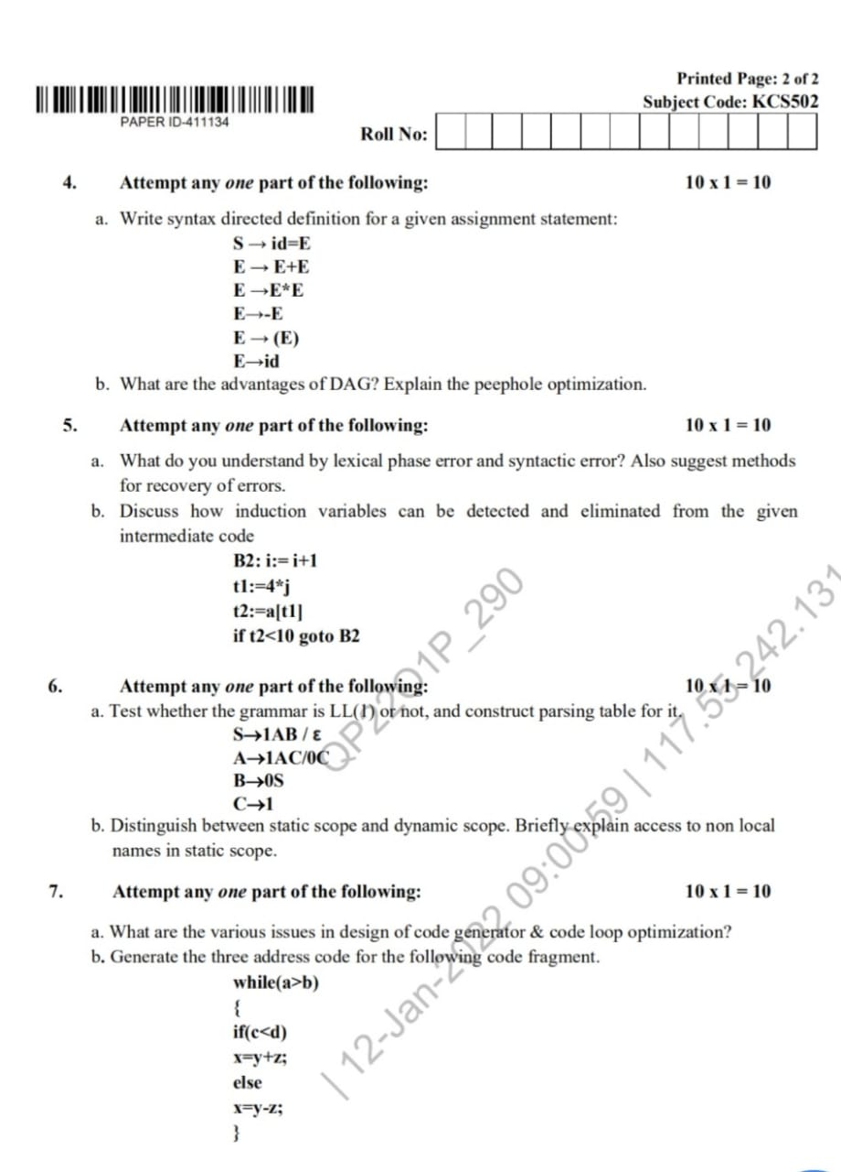
Old Question Papers

Slide 152
Expected Questions for University Exam
Create a new compiler for machine B which accepts a language L by using an existing compiler on machine A for language other than L.
Convert regular expression (a,b)*aba in a NFA by using Thomson rule and reduce it in equivalent DFA using ε-closure function.
Explain the implementation of lexical analyzer by taking the example of identifier.
What do you mean by translators? Discuss the structure of a compiler.
What is LEX compiler? Explain the working and advantage of LEX compiler.
Write short note on the following.
(i) Formal Grammar (ii) Left Recursion (iii) Left factoring

Slide 153
Recap of Unit
Lexical analysis turns input characters into tokens.
Lexical syntax is described by regular expressions.
Lexical analysis is the very first phase in the compiler designing
A lexeme is a sequence of characters that are included in the source program according to the matching pattern of a token
Lexical analyzer is implemented to scan the entire source code of the program
Lexical analyzer helps to identify token into the symbol table
A character sequence which is not possible to scan into any valid token is a lexical error
Removes one character from the remaining input is useful Error recovery method
Lexical Analyzer scan the input program.
It eases the process of lexical analysis and the syntax analysis by eliminating unwanted tokens

Slide 154
References
Principles of Compiler Design Textbook by Alfred Aho and Jeffrey Ullman
Principle of Compiler Design, A.V.Aho, Rabi Sethi, J.D.Ullman.
Compilers: Principles, Techniques and Tools A.V.Aho, Monica S. Lam, Rabi Sethi, J.D.Ullman
https://www.geeksforgeeks.org/compiler-design-tutorials/
https://www.javatpoint.com/compiler-tutorial
https://www.tutorialspoint.com/compiler_design/index.htm
https://nptel.ac.in/courses/106105190/

Slide 155
Noida Institute of Engineering and Technology, Greater Noida
Thank You

