Slide 1



Noida Institute of Engineering and Technology, Greater Noida
Parsing
Unit: 2
Compiler Design
Vivek Kumar Sharma
Assistant Professor
CSE
Course Details (B Tech 5th Sem)

Slide 2
Brief Introduction of Faculty
Vivek Kumar Sharma
Designation: Assistant Professor CSE Department
NIET Grater Noida
Qualifications:
B.Tech (CSE) in 2010
M.Tech (CSE) in 2013
Teaching Experinces: 10 year +
Research Publications:
Particulars | Journals | Conference
International | 04 | 01
National | 00 | 00

Slide 3
Evaluation Scheme

Slide 4
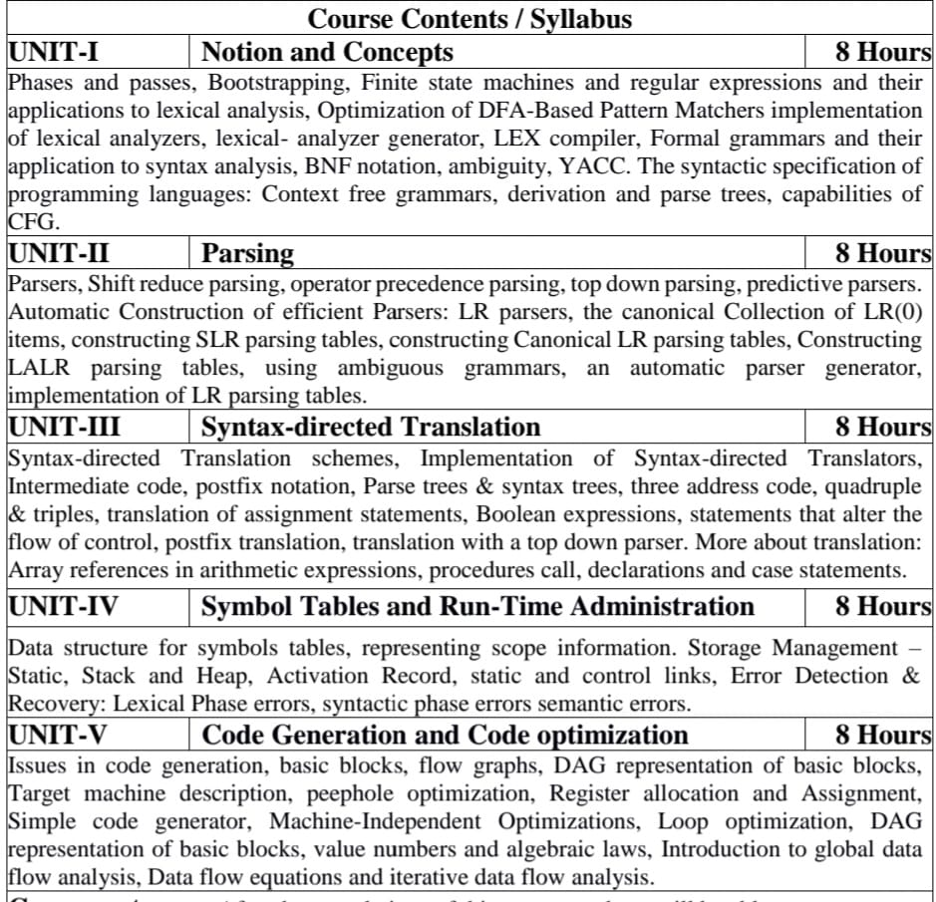
Syllabus

Slide 5
Branch wise Applications
Computer Science
Compiler technology can be used to translate the binary code for one machine to that of another, allowing a machine to run programs originally compiled for another instruction set. Binary translation technology has been used by various computer companies to increase the availability of software for their machines
Implementations of High Level Programming
Optimization of Computer Architecture
Design of New Computer Architecture
Program Translation
Software Productive tools

Slide 6
Course Objective
To learn the process of translating a modern high-level language to executable code.
To provide a student with an understanding of the fundamental principles in compiler design and to provide the skills needed for building compilers for various situations that one may encounter in a career in Computer Science.
To understand the machine dependent code
To draw the flow graph for the intermediate codes.
To apply the code generation algorithms to get the machine code for the optimized code
To apply the optimization techniques to have a better code for code generation

Slide 7
Course Outcome
CO-1 Acquire knowledge of different phases and passes of the compiler and also able to use the compiler tools like LEX, YACC, etc. Students will also be able to design different types of compiler tools to meet the requirements of the realistic constraints of compilers.
CO-2 Understand the parser and its types i.e. Top-Down and Bottom-up parsers and construction of LL, SLR, CLR, and LALR parsing table.
CO-3 Implement the compiler using syntax-directed translation method and get knowledge about the synthesized and inherited attributes.
CO-4 Acquire knowledge about run time data structure like symbol table organization and different techniques used in that.
CO-5 Understand the target machine’s run time environment, its instruction set for code generation and techniques used for code optimization.

Slide 8
CO-PO Mapping
 | PO1 | PO2 | PO3 | PO4 | PO5 | PO6 | PO7 | PO8 | PO9 | PO10 | PO11 | PO12
1 | 3 | 3 | 3 | 3 | 3 | 1 | 1 | 1 | 3 | 1 | 2 | 2
2 | 2 | 3 | 3 | 3 | 3 | 1 | 1 | 1 | 3 | 1 | 2 | 2
.3 | 3 | 3 | 3 | 3 | 2 | 1 | 1 | 1 | 3 | 1 | 2 | 2
4 | 3 | 2 | 3 | 3 | 3 | 1 | 1 | 1 | 3 | 1 | 2 | 2
.5 | 3 | 2 | 1 | 3 | 3 | 1 | 1 | 1 | 3 | 1 | 2 | 2
AVG | 3 | 2.6 | 3 | 3 | 3 | 1 | 1 | 1 | 3 | 1 | 2 | 2

Slide 9
Program Specific Outcomes (PSO)
PSO1: Work as a software developer, database administrator, tester or networking engineer for providing solutions to the real world and industrial problems
PSO2:Apply core subjects of information technology related to data structure and algorithm, software engineering, web technology, operating system, database and networking to solve complex IT problems.
PSO 3:Practice multi-disciplinary and modern computing techniques by lifelong learning to establish innovative career.
PSO 4:Work in a team or individual to manage projects with ethical concern to be a successful employee or employer in IT industry

Slide 10
CO and PSO Mapping
 | PSO1 | PSO2 | PSO3 | PSO4
1 | 3 | 3 | 3 | 1
2 | 3 | 3 | 3 | 1
.3 | 3 | 3 | 3 | 1
.4 | 3 | 3 | 3 | 1
.5 | 3 | 3 | 3 | 1
AVG | 3 | 3 | 3 | 1

Slide 11
Program Educational Objectives
PEO1: To have an excellent scientific and engineering breadth so as to
comprehend, analyze, design and provide sustainable solutions for
real-life problems using state-of-the-art technologies.
PEO2:To have a successful career in industries, to pursue higher studies or
to support enterpreneurial endeavors and to face global challenges.
PEO3:To have an effective communication skills, professional attitude,
ethical values and a desire to learn specific knowledge in emerging
trends, technologies for research, innovation and product
development and contribution to society.
PEO4: To have life-long learning for up-skilling and re-skilling for
successful professional career as engineer, scientist, enterpreneur
and bureaucrat for betterment of society

Slide 12
Result Analysis

Slide 13
End Semester Question Paper Template
B TECH
(SEM-V) THEORY EXAMINATION 20__-20__
COMPILER DESIGN
Time: 3 Hours Total Marks: 100
Note: 1. Attempt all Sections. If require any missing data; then choose suitably.
SECTION A
Attempt all questions in brief. 2 x 10 = 20
Q.No. | Question | Marks | CO
1 |  | 2
2 |  | 2
. |  | .
10 |  | 2

Slide 14
End Semester Question Paper Templates
SECTION B
2. Attempt any three of the following: 3 x 10 = 30
SECTION C
3. Attempt any one part of the following: 1 x 10 = 10
Q.No. | Question | Marks | CO
1 |  | 10
2 |  | 10
. |  | .
5 |  | 10
Q.No. | Question | Marks | CO
1 |  | 10
2 |  | 10

Slide 15
End Semester Question Paper Templates
4. Attempt any one part of the following: 1 x 10 = 10
5. Attempt any one part of the following: 1 x 10 = 10
6. Attempt any one part of the following: 1 x 10 = 10
Q.No. | Question | Marks | CO
1 |  | 10
2 |  | 10
Q.No. | Question | Marks | CO
1 |  | 10
2 |  | 10
Q.No. | Question | Marks | CO
1 |  | 10
2 |  | 10

Slide 16
End Semester Question Paper Templates
7. Attempt any one part of the following: 1 x 10 = 10
Q.No. | Question | Marks | CO
1 |  | 10
2 |  | 10

Slide 17
Prerequisite
.
Automata Theory
Context Free Languages
Data Structure
Logic or Algebra
Simple Graph Algorithms
Computer Architecture

Slide 18
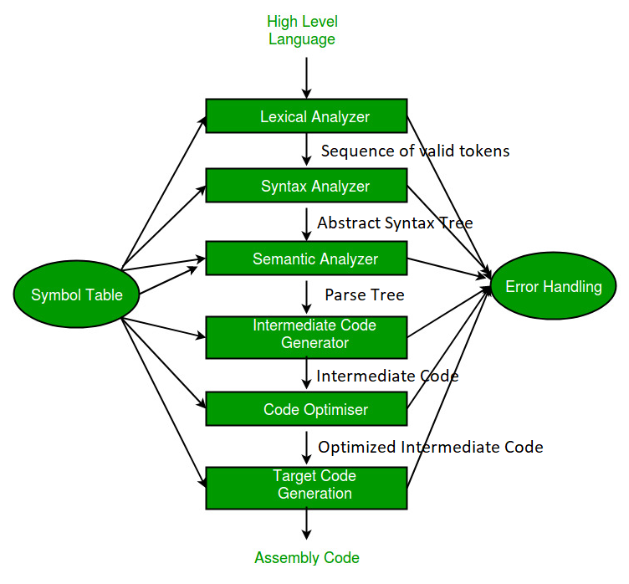
RECAP
Analysis
(Frontend)
Synthesis
(Backend)

Slide 19
Unit Content
Course Objective
Course Outcome
CO-PO and PSO Mapping
Prerequisite and Recap
Objective of Topics
Basic Parsing Techniques: Parsers
Shift reduce parsing
Operator precedence parsing
Top down parsing,
Predictive parsers Automatic Construction of efficient Parsers: LR parsers
The canonical Collection of LR(0) items,

Slide 20
Unit Content
Constructing SLR parsing tables
Constructing Canonical LR parsing tables
Constructing LALR parsing tables
Using ambiguous grammars
An automatic parser generator
Implementation of LR parsing tables.
Faculty Video Links, Youtube & NPTEL Video Links and Online Courses Details
Daily Quiz
Weekly Assignments
MCQ
Expected Question for University Exam/old question paper
References

Slide 21
Unit Objective
Topic | Objective
Basic Parsing Techniques | To learn about different parsing techniques.
Top Down Parsing | Understand the logic behind top down parsing technique i.e. Predictive parsing technique.
Bottom Up Parsing | To know about different bottom-up parsing techniques i.e. shift-reduce parsing techniques, operator precedence parsing etc.
LR Parsing | To understand the four different types of LR parsing techniques

Slide 22
Topic Objective(CO1)
Introduce students to the concepts of Top Down and Bottom Up Parser .

Slide 23
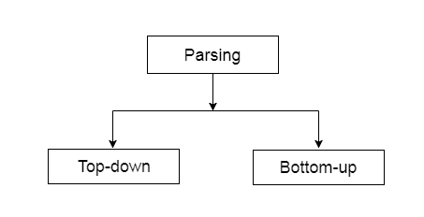
Basic Parsing Techniques(CO2)
Parsing (also known as syntax analysis) can be defined as a process of analyzing a text which contains a sequence of tokens, to determine its grammatical structure with respect to a given grammar.
Depending upon how the parse tree is built, parsing techniques are classified into two general categories

Slide 24
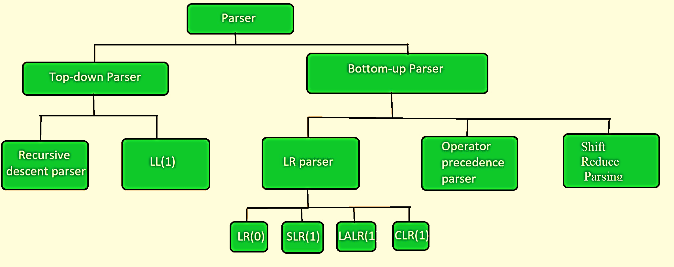
Basic Parsing Techniques(CO2)

Slide 25
Basic Parsing Techniques
Since a parse tree is the graphical representation derivation.
Top-Down parsing is equivalent to left-most derivation
Bottom-Up parsing is equivalent to reverse of right most derivation

Slide 26
Top-Down Parse(CO2)
It is the parser which generate parser for the given input string with the help of grammar production by expanding the non-terminals i.e. it starts from the start symbol and ends on the terminals.
Top Down parser uses left most derivation.
Top down parser can be constructed for the grammar if it is free from ambiguity and left recursion.

Slide 27
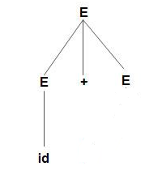
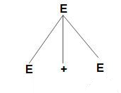
Top-Down Parse Example
Construct parse tree for
E –> E + E | E * E | id
using Top Down Parsing Technique

Slide 28
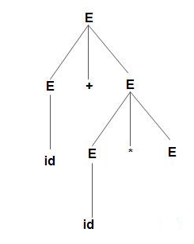
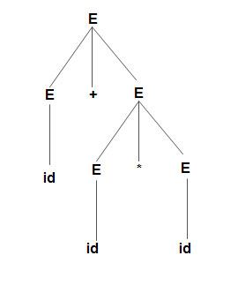
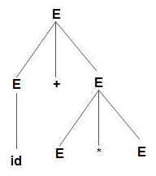
Top-Down Parse Example
Parse tree for word
id+id*id

Slide 29
Bottom-Up Parse(CO2)
Bottom-up parsing starts from the leaf nodes of a tree and works in upward direction till it reaches the root node.
Here, we start from a sentence and then apply production rules in reverse manner in order to reach the start symbol.
Bottom up parser can be constructed for the grammar if it is free from ambiguity.

Slide 30
Bottom-Up Parse Example
Example: Input string is id+id*id and production rules are as given below:
S → E
E → E + T
E → E * T
E → T
T → id
Perform bottom-up parsing technique.
Solution: Starting with input string id+id*id
id + id * id
T + id * id
E + id * id
E + T * id
E * id
E * T
E
S

Slide 31
Bottom-Up Parse Example
Bottom-up parse of n + n * n using the following grammar
E | → | T
E | → | E + T
T | → | F
T | → | T * F
F | → | n
F | → | ( E )

Slide 32
Bottom-Up Parse Example
E
|
T
|
F
|
n
E
|
T
|
F
|
n +
E
|
T T
| |
F F
| |
n + n
T
|
F
|
n
F
|
n
n

Slide 33
Bottom-Up Parse Example
E
/ | \
/ + \
/ \
E T
| / | \
T T * F
| | |
F F n
| |
n n
E
|
T T
| |
F F F
| | |
n + n * n
E T | / | \ T T * F | | | F F n | | n + n

Slide 34
Top-Down Parse(CO2)
Further Top-down parser is classified into 2 types: Recursive descent parser, and Non-recursive descent parser.
TDP with Backtraking
It is also known as Brute force parser or backtracking parser. It basically generates the parse tree by using brute force and backtracking
TDP without Backtracking Predictive Parser
It is also known as predictive parser or without backtracking parser or dynamic parser. 1. Recursively Descent 2. LL(1) Parser

Slide 35
Recursive Descent Parsing(CO2)
Recursive descent is a top-down parsing technique that constructs the parse tree from the top and the input is read from left to right.
It uses procedures for every terminal and non-terminal entity.
This parsing technique recursively parses the input to make a parse tree, which may or may not require back-tracking.
A form of recursive-descent parsing that does not require any back-tracking is known as predictive parsing.
This parsing technique is regarded recursive as it uses context-free grammar which is recursive in nature.

Slide 36
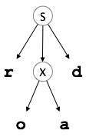
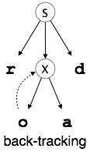
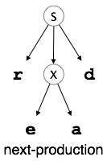
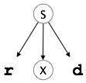
Back Tracking(CO2)
It means, if one derivation of a production fails, the syntax analyzer restarts the process using different rules of same production. This technique may process the input string more than once to determine the right production.
Example:-S → rXd | rZd X → oa | ea Z → ai
For an input string: read, a top-down parser, will behave like this

Slide 37
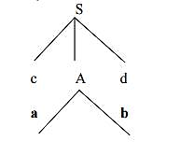
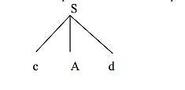
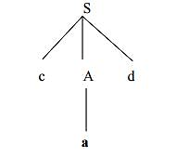
Example of Backtracking
Example:
Consider the grammar G : S → cAd
A→ab|a
and the input string w=cad.
Solution:
The parse tree can be constructed using the following top-down approach :

Slide 38
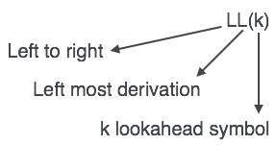
LL (1) Parsing(CO2)
An LL Parser accepts LL grammar.
LL grammar can be implemented by means of both algorithms namely, recursive-descent or table-driven

Slide 39
Predictive parsing(CO2)
It is a type of parser which has the capability to predict which production is to be used to replace the input string.
To fulfil this tasks, the predictive parser uses a lookahead pointer, which points to the next symbols.
To make the parser back-tracking free, the predictive parser puts some constraints on the grammar and accepts only a class of grammar known as LL(K) grammar.

Slide 40
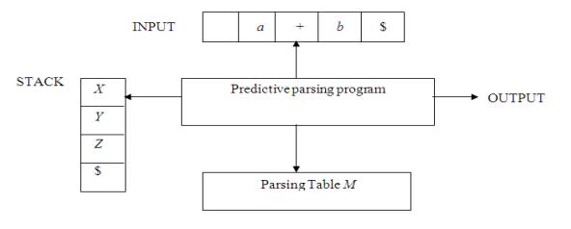
LL(1) Parser / Predictive parsing
It uses a stack and a parsing table to parse the input and generates a parse tree. Both the stack and the input contains an end symbol $ to denote that the stack is empty and the input is consumed.
The parser refers to the parsing table to take any decision on the input and stack element combination.

Slide 41
Predictive parsing
The input buffer contains the string to be parsed, followed by $, a symbol used as a right end marker to indicate the end of the input string.
The stack contains a sequence of grammar symbols with $ on the bottom, indicating the bottom of the stack. Initially, the stack contains the start symbol of the grammar on top of $.
The parsing table is a two dimensional array M[A,a] where A is a nonterminal, and a is a terminal or the symbol $.

Slide 42
Predictive parsing
A(X)\a | + | * | id | num | $
E
T
T’
F
F’
General Structure of paring Table

Slide 43
Predictive parsing
The program considers X-the symbol on the top of the stack, and a-the current input symbol. These two symbols determine the action of the parser.
There are three possibilities:-
If X= a=$, the parser halts and announces successful completion of parsing.
If X=a!=$, the parser pops X off the stack and advances the input pointer to the next input symbol.
If X is a nonterminal, the program consults entry M[X,a] of the parsing table M.
This entry will be either an X-production of the grammar or an error entry.
If, for example, M[X,a]={X- >UVW}, the parser replaces X on top of the stack by WVU( with U on top).
If M[X,a]=error, the parser calls an error recovery routine.

Slide 44
Predictive parsing table construction
The predictive parser is aided by two functions
FIRST
FOLLOW

Slide 45
Predictive parsing
First (X):-
It is used for finding the set of all terminals that begins the strings derive from the given grammar symbol.
Follow (X):-
Set of Terminals that appear immediately to the right of X

Slide 46
First Function
To complete first(x) for all grammar symbols X apply the following rules until no more terminal or ε be added to any first set.
Rules for first(X ):
1. If X is terminal, then
2. If X → ε is a production, then
3. If X is non-terminal and X → aα is a production then
4. If X is non-terminal and X → Y1 Y2…Yk is a production, then
If ε is in FIRST(Y1) then
FIRST(X) = {X}.
FIRST(X) = {ε}.
FIRST(X) = {a}.
FIRST(X) = {FIRST(Y1)}.
FIRST(X) = {FIRST(Y2)}.

Slide 47
Example on First Function
Example:- Calculate the first function of production rules:
S->ABCD
A->a | ε
B->CD | b
C->c | ε
D->Aa | d | ε
Solution:-
Symbols | First()
S | {a,b,c,d, ε}
A | {a, ε}
B | {c,a,d,b,ε}
C | {c, ε}
D | {a,d, ε}

Slide 48
Example on First Function
Example:- Calculate the first function of production rules:
S → aBDh
B → cC
C → bC / ∈
D → EF
E → g / ∈
F → f /∈
Solution:-
Symbols | First()
S | {a}
B | {c}
C | {b, ε}
D | {g,f ε}
E | {g, ε}
F | {f, ε}

Slide 49
Follow Function
To compute follows of A for all non-terminal A apply the following rules:-
1. If S is a start symbol,
2. If there is a production A → αBβ,
3. If there is a production A → αB, or a production A → αBβ where FIRST(β) contains ε, then everything in FOLLOW(A) is in FOLLOW(B).
FOLLOW(S)={$}
FOLLOW(B)=FIRST(β) except ε
FOLLOW(B)=FOLLOW(A)

Slide 50
Example on Follow Function
Example:- Calculate the follow function of production rules:
S->ABCD
A->a | ε
B->CD | b
C->c | ε
D->Aa | d | ε
Solution:-
Symbols | First()
S
A
B
C
D
Symbols | Follow()
S
A
B
C
D
{a,b,c,d, ε}
{$}
{a, ε}
{a,b,c,d,$}
{c,a,d,b,ε}
{c,a,d,$}
{c, ε}
{a,d,c,$}
{a,d, ε}
{c,a,d,$}

Slide 51
Example on Follow Function
Example:- Calculate the follow function of production rules:
S → aBDh
B → cC
C → bC / ∈
D → EF
E → g / ∈
F → f /∈
Solution:-
Symbols | First()
S
B
C
D
E
F
Symbols | Follow()
S
B
C
D
E
F
{a}
{$}
{c}
{g, f, h}
{b, ε}
{g, f, h}
{g, f, ε}
{h}
{g, ε}
{f, h}
{f, ε}
{h}

Slide 52
Recursion
Left Recursion:-
A production of grammar is said to have left recursion if the leftmost variable of its RHS is same as variable of its LHS.
Right Recursion-
A production of grammar is said to have right recursion if the rightmost variable of its RHS is same as variable of its LHS
Example: A->Aα|β
Example: A->αA|β

Slide 53
Left Recursion
Left recursion is eliminated by converting the grammar into a right recursive grammar.
If we have the left-recursive pair of productions:-
where β does not begin with an A.
Then, we can eliminate left recursion by replacing the pair of productions with-
This right recursive grammar functions same as left recursive grammar.
A → Aα / β
A → βA’
A’ → αA’ / ∈

Slide 54
Example: Left Recursion
Example1:- Consider the following grammar and eliminate left recursion-
A → ABd / Aa / a
B → Be / b
Solution:-
Firstly break the production according to the format-
A → ABd / a
A → Aa / a
B → Be / b
Than apply the rule
A → Aα / β => A → βA’
A’ → αA’ / ∈

Slide 55
Example: Left Recursion
The grammar after eliminating left recursion is-
A → aA’
A’ → BdA’ / aA’ / ∈
B → bB’
B’ → eB’ / ∈
A → ABd / a
A → Aa / a
B → Be / b

Slide 56
Left Recursion
Example 2:- Consider the following grammar and eliminate left recursion-
E → E + T / T
T → T x F / F
F → id
Solution:-The grammar after eliminating left recursion is
E → TE’
E’ → +TE’ / ∈
T → FT’
T’ → xFT’ / ∈
F → id

Slide 57
Example of first and follow function with left recursion
Example:- Calculate the first and follow function of production rules:
S → A
A → aB / Ad
B → b
C → g
Solution:-
Given grammar is left recursive.
So, first remove left recursion from the given grammar.

Slide 58
Example of first and follow function with left recursion
After eliminating left recursion, we get the following grammar
S → A
A → aBA’
A’ → dA’ / ∈
B → b
C → g
First Function
Symbols | First()
S | {a}
A | {a}
A’ | {d, ε}
B | {b}
C | {g}

Slide 59
Example of first and follow function with left recursion
Follow Function:-
Symbols | Follow()
S | {$}
A | {$}
A’ | {$}
B | {d,$}
C | {NA}

Slide 60
Left Factoring
Left factoring is a process by which the grammar with common prefixes is transformed.
To make it useful for Top down parsers.
Example- A → αβ₁ / αβ₂ / αβ₃
Top down parsers can not decide which production must be chosen to parse the string in hand.
To remove this confusion, we use left factoring.

Slide 61
Left Factoring
In left factoring,
We make one production for each common prefixes.
The common prefix may be a terminal or a non-terminal or a combination of both.
Rest of the derivation is added by new productions.
A → αβ₁ / αβ₂ / αβ₃
A → αA’
A’ → β₁ / β₂ / β₃

Slide 62
Example of Left Factoring
Example: Do left factoring in the following grammar-
S → iEtS / iEtSeS / a
E → b
Solution-
The left factored grammar is-
S → iEtSS’ / a
S’ → eS / ∈
E → b

Slide 63
Example of Left Factoring
Example: Do left factoring in the following grammar-
A → aAB / aBc / aAc
Solution-
Step-01:
A → aA’
A’ → AB / Bc / Ac
Again, this is a grammar with common prefixes.
Step-02:
A → aA’
A’ → AD / Bc
D → B / c
This is a left factored grammar.

Slide 64
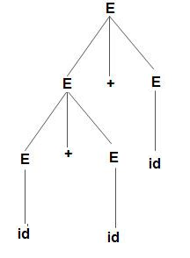
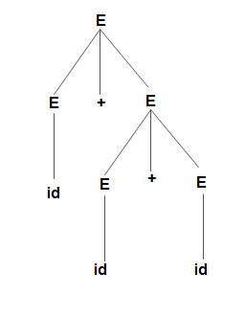
Ambiguity
Example: Production rule-
E –> E + E
E –> E * E
E –> id
Input string:-id+id+id
Correct
Incorrect
Bcoz the rule of associativity is failed

Slide 65
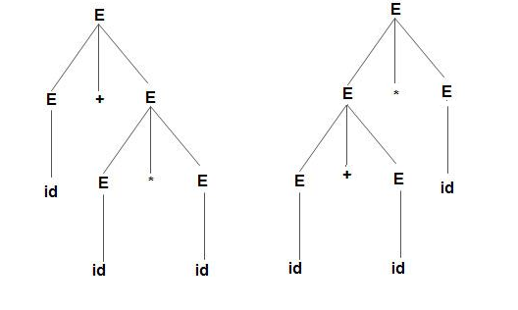
Ambiguity
Example: Production rule-
E –> E + E
E –> E * E
E –> id
Input string:-id+id*id
Incorrect
Because precedence is not taken care of
Correct

Slide 66
Ambiguity
Left Recursion, Common Prefixes makes the grammar Ambiguous
An ambiguous grammar may be converted into an unambiguous grammar by implementing
Precedence Constraints:-
Associativity Constraints

Slide 67
Ambiguity
Associativity Rule:
If the operator is left associative, induce left recursion in its production.
If the operator is right associative, induce right recursion in its production.

Slide 68
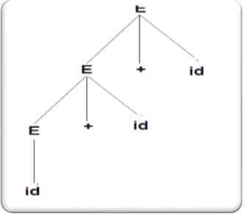
Ambiguity
According to the associativity rule:- Left associativity is obtain by converting the grammar into left recursion.
Production rule: E –> E + E
E –> E + E
E –> id
E –> E + id
E –> id

Slide 69
Ambiguity
Precedence Rule:
The level at which the production is present defines the priority of the operator contained in it.
The higher the level of the production, the lower the priority of operator.
The lower the level of the production, the higher the priority of operator.

Slide 70
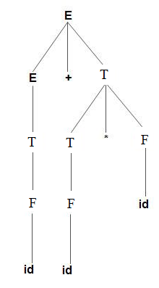
Ambiguity
According to the Precedence rule:- Highest precedence operator should be at the least level.
Production rule: E –> E + E
E –> E * E
E –> id
E –> E +T|T
T –> T * F|F
F->id

Slide 71
Ambiguity
Precedence and Associativity of Operators
.
Precedence | Operator | Associativity
1 | (), [] | non-associative
2 | new | non-associative
3 | . | left-associative
4 | ++, - - | non-associative
5 | - (unary), + (unary), !, ~, ++, - -, (type) | right-associative
6 | *, /, % | left-associative
7 | +, - | left-associative
8 | <<, >>, >>> | left-associative
9 | <, >, <=, >=, instanceof | non-associative
10 | ==, != | left-associative
11 | & | left-associative
12 | ^ | left-associative
13 | | | left-associative
14 | && | left-associative
15 | || | left-associative
16 | ?: | right-associative
17 | =, *=, /=, %=, -=, <<=, >>=, >>>=, &=, ^=, |= | right-associative

Slide 72
Example
Example: Consider the following grammar :
E→E+E
E→E*E
F→(E)|id
Check whether this input string id+id*id is accepted using LL(1) parsing technique
Solution:
Step 1: Check whether a given grammar is ambiguous or not.
If ambiguous remove ambiguity:
E→E+T |T
T→T*F |F
F→(E) |id

Slide 73
Example
Step 2:
Check and Remove Left –Recursion
After eliminating left-recursion the grammar is
E →TE’
E’ → +TE’ | ε
T →FT’
T’ → *FT’ | ε
F → (E)|id
A → Aα / β => A → βA’
A’ → αA’ / ∈

Slide 74
Example
Step 3:
Check and Remove Left –Factoring
There is no left factoring.
A → αβ₁ / αβ₂ / αβ₃
A → αA’
A’ → β₁ / β₂ / β₃

Slide 75
Example
Step 4:Construct predictive parse table.
Calculate first and follow function
First function
FIRST(E) = { ( , id}
FIRST(E’) ={+ , ε }
FIRST(T) = { ( , id}
FIRST(T’) = {*, ε }
FIRST(F) = { ( , id }

Slide 76
Example
Follow function
FOLLOW(E) = { $, ) }
FOLLOW(E’) = { $, ) }
FOLLOW(T) = { +, $, ) }
FOLLOW(T’) = { +, $, ) }
FOLLOW(F) = {+, * , $ , ) }

Slide 77
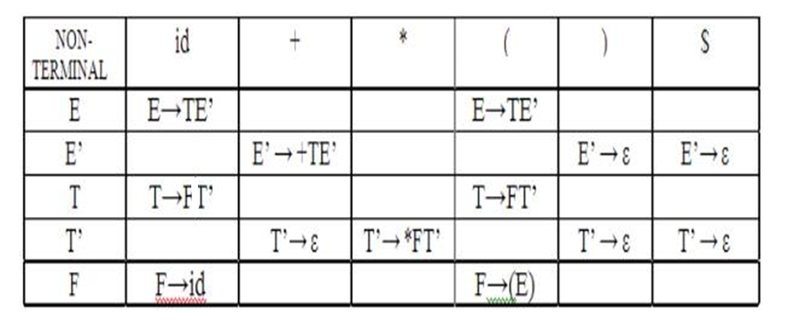
Example
Predictive Parse Table

Slide 78
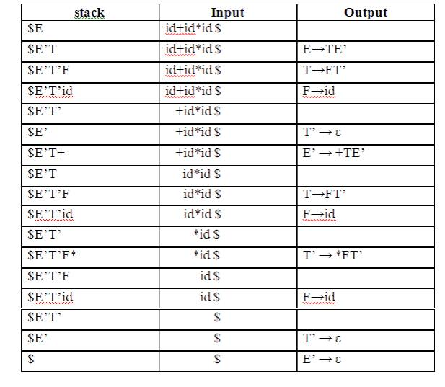
Example
Stack Implementation:

Slide 79
Example
Implementation of predictive parser:
1. Elimination of left recursion, left factoring and ambiguous grammar.
2. Construct FIRST() and FOLLOW() for all non-terminals.
3. Construct predictive parsing table.
4. Parse the given input string using stack and parsing table

Slide 80
Bottom-up Parsing(CO2)
Bottom-up parsing starts from the leaf nodes of a tree and works in upward direction till it reaches the root node.
Here, we start from a sentence and then apply production rules in reverse manner in order to reach the start symbol
E
/ | \
/ + \
/ \
E T
| / | \
T T * F
| | |
F F n
| |
n n

Slide 81
Shift-Reduce Parsing(CO2)
Shift-Reduce Parsing uses two unique steps for bottom-up parsing. These steps are known as shift-step and reduce-step.
Shift step:
The shift step refers to the advancement of the input pointer to the next input symbol, which is called the shifted symbol.
This symbol is pushed onto the stack.
The shifted symbol is treated as a single node of the parse tree.
Reduce step :
When the parser finds a complete grammar rule (RHS) and replaces it to (LHS), it is known as reduce-step.
This occurs when the top of the stack contains a handle.
To reduce, a POP function is performed on the stack which pops off the handle and replaces it with LHS non-terminal symbol.

Slide 82

Shift-Reduce Parsing
Shift Action, the current symbol in the input string pushed into a stack.
At each reduction, the symbol will replaced by the non-terminals.

Slide 83
Example of Shift-Reduce Parsing
Example:
Grammar: S → S+S
S → S-S
S → (S)
S → a
Input String: a1-(a2+a3)
Perform Shift –Reduce Parsing on above grammar.

Slide 84
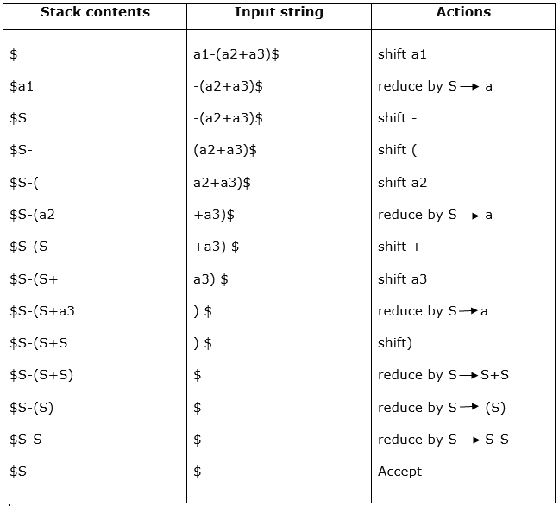
Example of Shift-Reduce Parsing

Slide 85
Example of Shift-Reduce Parsing
Example:
Grammar: E –> 2E2 E –> 3E3 E –> 4
Input String: 32423
Perform Shift –Reduce Parsing on above grammar.

Slide 86
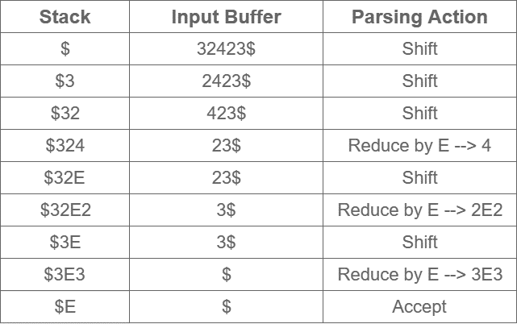
Example of Shift-Reduce Parsing

Slide 87
Operator Precedence Parser(CO2)
Operator precedence grammar is kinds of shift reduce parsing method. It is applied to a small class of operator grammars.
A grammar is said to be operator precedence grammar if it has two properties:
No R.H.S. of any production has a ∈.
No two non-terminals are adjacent.
Example:-
E->E+E|E*E|id
E->EAE|id => E->E+E|E*E|id
A->+|* A->+|*
S->AB
Operator Grammar
Partial Operator Grammar
Not an Operator Grammar

Slide 88
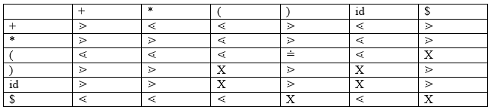
Operator Precedence Parser
There are the three operator precedence relations:
a ⋗ b means that terminal "a" has the higher precedence than terminal "b".
a ⋖ b means that terminal "a" has the lower precedence than terminal "b".
a ≐ b means that the terminal "a" and "b" both have same precedence.

Slide 89
Operator Precedence Parser
Parsing Action
Both end of the given input string, add the $ symbol.
Now scan the input string from left right until the ⋗ is encountered.
Scan towards left over all the equal precedence until the first left most ⋖ is encountered.
Everything between left most ⋖ and right most ⋗ is a handle.
$ on $ means parsing is successful.

Slide 90
Example: Operator Precedence Parser
Example: Parse the input string id+id*id using Operator Precedence Parser
Production rule: T → T+T
T → T*T
T → id
Solution:
Step 1: Check Operator Precedence Grammar or Not
Yes grammar is operator precedence grammar
Step 2: Operator Precedence Relation Table
 | + | * | id | $
+ | > | < | < | >
* | > | > | < | >
id | > | > | - | >
$ | < | < | < | Accepted

Slide 91
Example: Operator Precedence Parser
Step 3: Parse the given string
Stack | Relation | Input | Comment
$ | < | Id+id*id$ | Shift id
$id | > | +id*id$ | Reduce T->id
$T | < | +id*id$ | Shift +
$T+ | < | id*id$ | Shift id
$T+id | > | *id$ | Reduce T->id
$T+T | < | *id$ | Shift *
$T+T* | < | id$ | Shift id
$T+T*id | > | $ | Reduce T->id
$T+T*T | > | $ | Reduce T->T*T
$T+T | > | $ | Reduce T->T+T
$T | Accepted | $ | Hence Parse

Slide 92
Example: Operator Precedence Parser
Step 4: Generate Parse Tree
T
/ | \
T + T
| / | \
id T * T
| |
id id

Slide 93
Example: Operator Precedence Parser
Example: Parse the input string id+id*id using Operator Precedence Parser
Production rule: E → E+T/T
T → T*F/F
F → id
Solution:
Step 1: Check Operator Precedence Grammar or Not
Yes grammar is operator precedence grammar

Slide 94
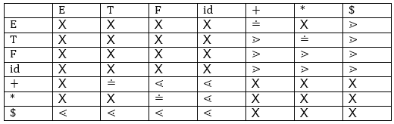
Example: Operator Precedence Parser
Step 2: Operator Precedence Relation Table

Slide 95
Example: Operator Precedence Parser
Step 3: Parse the given string
Stack | Relation | Input | Comment
$ | < | id+id*id$ | Shift id
$id | > | +id*id$ | Reduce F->id
$F | > | +id*id$ | Reduce T->F
$T | > | +id*id$ | Reduce E->T
$E | = | +id*id$ | Shift +
$E+ | < | id*id$ | Shift id
$E+id | > | *id$ | Reduce F->id
$E+F | > | *id$ | Reduce T->F
$E+T | = | *id$ | Shift *
$E+T* | < | id$ | Shift id
$E+T*id | > | $ | Reduce F->id
$E+T*F | > | $ | Reduce T->T*F
$E+T | > | $ | Reduce E->E+T
$E | Accepted | $ | Hence Parse

Slide 96
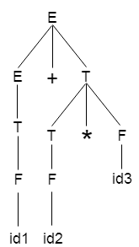
Example: Operator Precedence Parser
Step 4: Generate Parse Tree

Slide 97
Example: Operator Precedence Parser
Example 3-Consider the following grammar-
E → E + E | E x E | id
Construct Operator Precedence Parser.
Find the Operator Precedence Functions.
Solution-
g →
f ↓ |  | id | + | x | $
 | id |  | > | > | >
 | + | < | > | < | >
 | x | < | > | > | >
 | $ | < | < | <

Slide 98
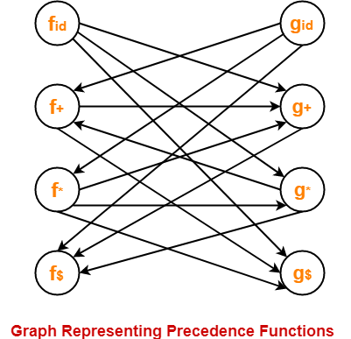
Example: Operator Precedence Parser
The graph representing the precedence functions is-
g →
f ↓ |  | id | + | x | $
 | id |  | > | > | >
 | + | < | > | < | >
 | x | < | > | > | >
 | $ | < | < | <

Slide 99
Example: Operator Precedence Parser
Here, the longest paths are-
f_{id} → g_{x} → f₊ → g₊ → f$
g_{id} → f_{x} → g_{x} → f₊ → g₊ → f$
The resulting precedence functions are-
 | + | x | id | $
f | 2 | 4 | 4 | 0
g | 1 | 3 | 5 | 0

Slide 100
LR Parsing(CO2)
The LR(k) parsing technique
L is for Left-to-right scanning of input
R corresponds to a Rightmost derivation done in reverse
k is the number of lookahead symbols used to make parsing decisions

Slide 101
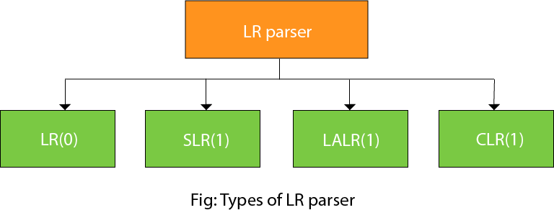
Types of LR Parser(CO2)
Four LR parsing techniques will be considered

Slide 102
Types of LR Parser
LR(0)-LR parsing with no lookahead token to make parsing decisions
SLR(1)-Simple LR, with one token of lookahead
CLR(1)- Canonical LR, with one token of lookahead
LALR(1) : Lookahead LR, with one token of lookahead
LALR(1) is the preferable technique used by parser generators

Slide 103
Structure of LR Parser
Scanner
next token
LR Parser
Driver
Output
sm
Parsing Table
Parsing Stack
s
action
goto
1
s₀

Slide 104
Structure of LR Parser
An LR parser consists of …
Driver program
Same driver is used for all LR parsers
Parsing stack
Contains state information, where s_{i} is state i
States are obtained from grammar analysis
Parsing table, which has two parts
Action section: specifies the parser actions
Goto section: specifies the successor states

Slide 105
Various steps involved in the LR (0) Parsing
For the given input string write a context free grammar
Check the ambiguity of the grammar
Add Augment production in the given grammar
Create Canonical collection of LR (0) items
Draw a data flow diagram (DFD)
Construct a LR (0) parsing table

Slide 106
Example:
Question:
S → AA
A → aA | b
Solution:
The Augment grammar G` is represented by
S`→ S
S → AA
A → aA | b

Slide 107
Canonical Collection of LR(0) items
An LR (0) item is a production G with dot at some position on the right side of the production.
LR(0) items is useful to indicate that how much of the input has been scanned up to a given point in the process of parsing.
In the LR (0), we place the reduce node in the entire row.

Slide 108
EXAMPLE
Example:-
S → AA & A → aA | b
Solution:
Add Augment Production and insert '•' symbol at the first position for S` → •S production.
S` → •S
S → •AA
A → •aA
A → •b

Slide 109
Create Canonical Collection of LR(0) items
I0 State:
Add Augment production to the I0 State and Compute the Closure
I0 = Closure (S` → •S)
Add all productions starting with S in to I0 State because "•" is followed by the non-terminal. So, the I0 State becomes
I0 = S` → •S S → •AA
Add all productions starting with "A" in modified I0 State because "•" is followed by the non-terminal. So, the I0 State becomes.

Slide 110
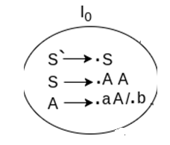
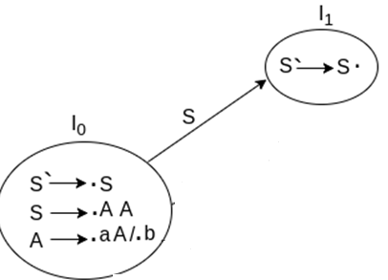
Create Canonical Collection of LR(0) items
I0= S` → •S S → •AA A → •aA A → •b
I1= Go to (I0, S) = closure (S` → S•) = S` → S•
Here, the Production is reduced so close the State.
I1= S` → S•

Slide 111
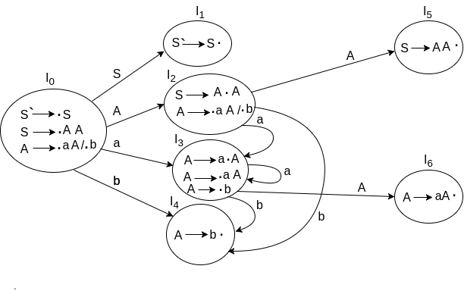
DRAWING DFD

Slide 112
Canonical Collection of LR(0) items
For I2, consider 2nd production in I0 S → •AA
Go to (I0, A) = closure (S → A•A)
Add all productions starting with A in to I2 State because "•" is followed by the non-terminal. So, the I2 State becomes
I2 =S→A•A A → •aA A → •b
Go to (I2,a) = Closure (A → a•A) = (same as I3)
Go to (I2, b) = Closure (A → b•) = (same as I4)

Slide 113
Canonical Collection of LR(0) items
I3= Go to (I0,a) = Closure (A → a•A)
Add productions starting with A in I3.
A → a•A A → •aA A → •b
Go to (I3, a) = Closure (A → a•A) = (same as I3) Go to (I3, b) = Closure (A → b•) = (same as I4)

Slide 114
Canonical Collection of LR(0) items
I4= Go to (I0, b) = closure (A → b•) = A → b•
I5= Go to (I2, A) = Closure (S → AA•) = SA → A•
I6= Go to (I3, A) = Closure (A → aA•) = A → aA•

Slide 115
LR(0) Table
If a state is going to some other state on a terminal then it correspond to a shift move.
If a state is going to some other state on a variable then it correspond to go to move.
If a state contain the final item in the particular row then write the reduce node completely

Slide 116
Drawing DFD
Reduce Completed
Reduce Completed
goto
goto
goto
Shift
Shift
Reduce Completed
Shift
goto
Shift
Shift
Shift
Reduce Completed

Slide 117
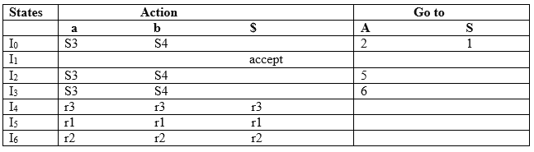
LR(0) Table

Slide 118
LR(0) Table
Productions are numbered as follows:
S → AA ... (1)
A → aA ... (2)
A → b ... (3)

Slide 119
LR(0) Table- Explanation
I1 contains the final item which drives(S` → S•), so action {I1, $} = Accept.
I4 contains the final item which drives A → b• and that production corresponds to the production number 3 so write it as r3 in the entire row.
I5 contains the final item which drives S → AA• and that production corresponds to the production number 1 so write it as r1 in the entire row.
I6 contains the final item which drives A → aA• and that production corresponds to the production number 2 so write it as r2 in the entire row.

Slide 120
LR(0) Table-Explanation:
I0 on S is going to I1 so write it as 1.
I0 on A is going to I2 so write it as 2.
I2 on A is going to I5 so write it as 5.
I3 on A is going to I6 so write it as 6.
I0, I2and I3on a are going to I3 so write it as S3 which means that shift 3.
I0, I2 and I3 on b are going to I4 so write it as S4 which means that shift 4.
I4, I5 and I6 all states contains the final item because they contain • in the right most end. So rate the production as production number.

Slide 121
SLR Parser(CO2)
SLR (1) refers to simple LR Parsing.
It is same as LR(0) parsing.
The only difference is in the parsing table.
To construct SLR (1) parsing table, we use canonical collection of LR (0) item.
In the SLR (1) parsing, we place the reduce move only in the follow of left hand side

Slide 122
Various steps involved in the SLR (1) Parsing
For the given input string write a context free grammar
Check the ambiguity of the grammar
Add Augment production in the given grammar
Create Canonical collection of LR (0) items
Draw a data flow diagram (DFD)
Construct a SLR (1) parsing table

Slide 123
SLR (1) Table Construction
The steps which use to construct SLR (1) Table is given below:
If a state (I_{i}) is going to some other state (I_{j}) on a terminal then it corresponds to a shift move in the action part
If a state (I_{i}) is going to some other state (I_{j}) on a variable then it correspond to go to move in the Go to part.
If a state (I_{i}) contains the final item, which has no transitions to the next state then the production is known as reduce production. For all terminals X in FOLLOW (A), write the reduce entry along with their production numbers

Slide 124
Example-SLR(1)
Example 1:-
S → E E → E + T | T T → T * F | F F → id
Solution:-
Step 1:- Add Augment Production and insert '•' symbol at the first position of Augment Production
S → E S` → •E

Slide 125
Example-SLR(1)
Step 2: Compute Canonical Collection
I0 State:
I0 = Closure (S` → •E)
S` → •E
S` → •E E → •E + T E → •T T → •T * F T → •F F → •id
S` → •E E → •E + T E → •T

Slide 126
Example-SLR(1)
I1= Go to (I0, E)
I2= Go to (I0, T)
I3= Go to (I0, F)
I4= Go to (I0, id)
S` → E•
E → E• + T
E → T•
T→T• * F
T → F•
F → id•

Slide 127
Example-SLR(1)
I5= Go to (I1, +)
Go to (I5, F) = Closure (T → F•) = (same as I3)
Go to (I5, id) = Closure (F → id•) = (same as I4)
I6= Go to (I2, *) = Closure ()
E → E +•T T → •T * F T → •F
E → E +•T T → •T * F T → •F
F → •id
E → E +•T
T → F•
F → id•
T → T * •F F → •id
T → T * •F

Slide 128
Example-SLR(1)
I6 = Go to (I6, id) = Closure (F → id•) = (same as I4)
I7= Go to (I5, T)
I8= Go to (I6, F)
F → id•
E → E + T•
E → E + T•
T → T• * F
T → T * F•

Slide 129
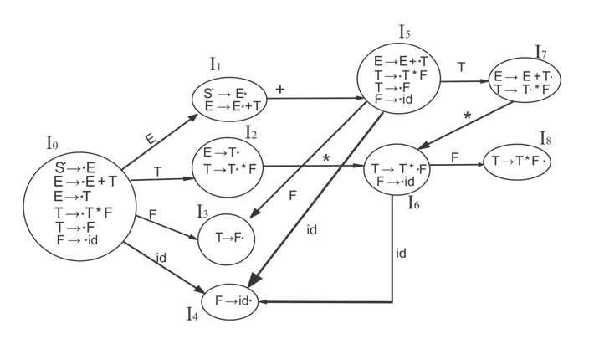
Example-SLR(1)
Step-3 Drawing DFD:
1
ACCEPTED STATE
2
3
4
5

Slide 130
Example-SLR(1)
Productions are numbered as follows:
E->E+T. ………………(1)
E->T. …………………(2)
T->T*F. ………………(3)
T->F. ………………….(4)
F->id. ………………….(5)

Slide 131
Example-SLR(1)
First and Follow Function
First (E) = First (E ) ∪ First (T) First (T) = First (T ) ∪ First (F) First (F) = {id} First (T) = {id} First (E) = {id}
Follow (E) = First (+T) ∪ {$} = {+, $} Follow (T) = First (*F) ∪ First (F)U Follow (E) = {*, +, $} Follow (F) = {*, +, $}

Slide 132
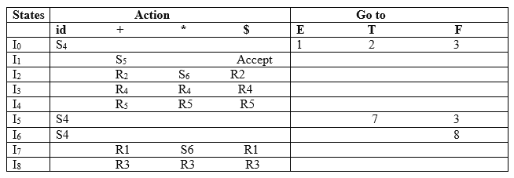
Example-SLR(1)
Step-4 SLR (1) Table

Slide 133
Example-SLR(1)
I1 contains the final item which drives S → E• and follow (S) = {$}, so action {I1, $} = Accept
I2 contains the final item which drives E → T• and follow (E) = {+, $}, so action {I2, +} = R2, action {I2, $} = R2
I3 contains the final item which drives T → F• and follow (T) = {+, *, $}, so action {I3, +} = R4, action {I3, *} = R4, action {I3, $} = R4
I4 contains the final item which drives F → id• and follow (F) = {+, *, $}, so action {I4, +} = R5, action {I4, *} = R5, action {I4, $} = R5
I7 contains the final item which drives E → E + T• and follow (E) = {+, $}, so action {I7, +} = R1, action {I7, $} = R1
I8 contains the final item which drives T → T * F• and follow (T) = {+, *, $}, so action {I8, +} = R3, action {I8, *} = R3, action {I8, $} = R3.

Slide 134
Example
Question:
A →(A)/a
Solution:
Step 1:- Augmented Grammar
A’ →.A
A’ →A A →.(A)
A →.a
Step 2:- Create Canonical Collection of LR(0) items
Find out the canonical collection of each production.

Slide 135
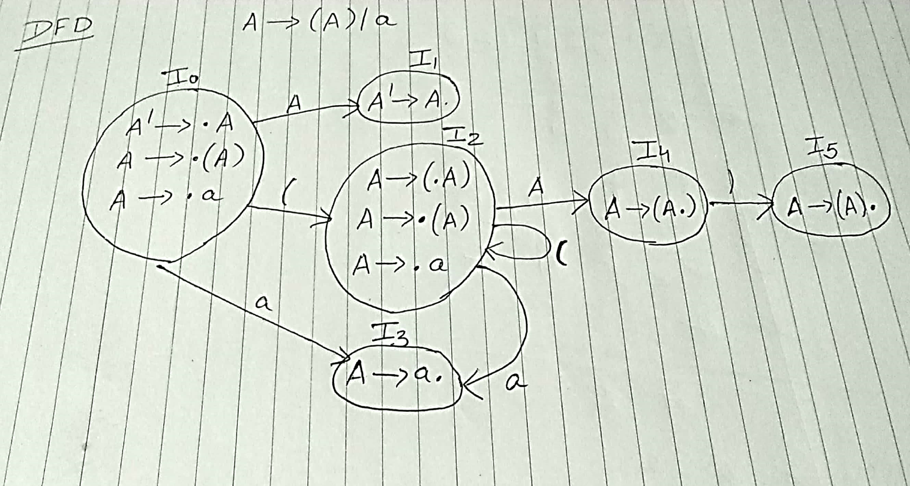
Drawing DFD:
Step:-3 Drawing DFD:

Slide 136
Example-SLR (1)
Productions are numbered as follows:
A → (A). ....(1)
A → a. ….(2)
Calculate the follow function:
Follow of A will be { ), $ }
So, just place production number on the follow of A.

Slide 137
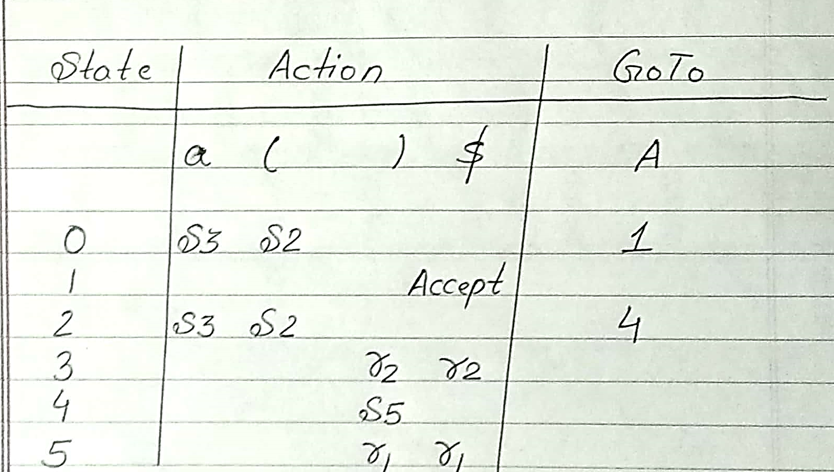
SLR (1) Table

Slide 138
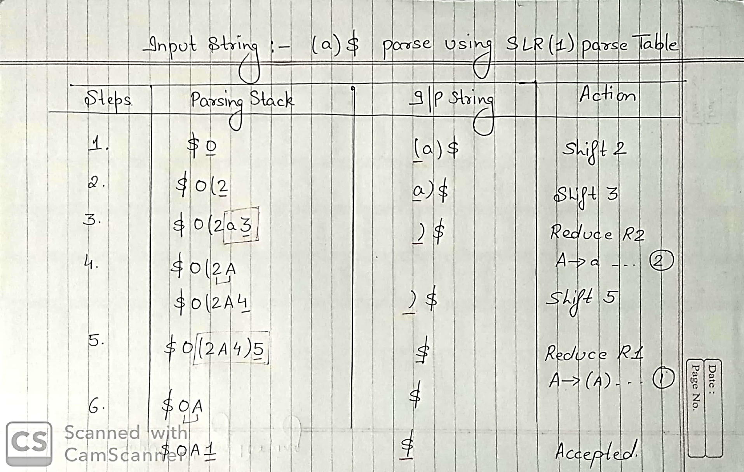
Parsing Input String

Slide 139
CLR (1) Parsing(CO2)
CLR refers to canonical lookahead.
CLR parsing use the canonical collection of LR (1) items to build the CLR (1) parsing table.
CLR (1) parsing table produces the more number of states as compare to the SLR (1) parsing.
In the CLR (1), we place the reduce node only in the lookahead symbols.

Slide 140
Various steps involved in the CLR (1) Parsing
For the given input string write a context free grammar
Check the ambiguity of the grammar
Add Augment production in the given grammar
Create Canonical collection of LR (1) items
Draw a data flow diagram (DFD)
Construct a CLR (1) parsing table

Slide 141
CLR (1) Parsing
LR (1) item
LR (1) item is a collection of LR (0) items and a look ahead symbol.
The look ahead is used to determine that where we place the final item.
The look ahead always add $ symbol for the argument production.
LR (1) item = LR (0) item + look ahead

Slide 142
Example
Question: S → AA
A → aA
A → b
Solution:
Add Augment Production, insert '•' symbol at the first position of the production in G and also add the lookahead.
S` → S
S` → •S

Slide 143
Create Canonical collection of LR (1) items
I0 State: Add Augment production to the I0 State and Compute the Closure
I0 = Closure (S` → •S) Add all productions starting with S in to I0 State because "." is followed by the non-terminal. So, the I0 State becomes
I0 = S` → •S, $ S → •AA, $
Add all productions starting with A in modified I0 State because "." is followed by the non-terminal. So, the I0 State becomes.
I0= S` → •S, $ S → •AA, $ A → •aA, a/b A → •b, a/b

Slide 144
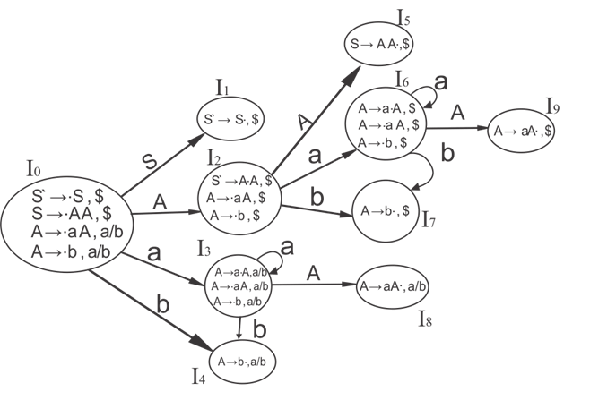
Drawing DFD:

Slide 145
Create Canonical collection of LR (1) items
I1= Go to (I0, S) = closure (S` → S•, $) = S` → S•, $
I2= Go to (I0, A) = closure ( S → A•A, $ )
Add all productions starting with A in I2 State because "." is followed by the non-terminal. So, the I2 State becomes
I2= S → A•A, $ A → •aA, $ A → •b, $

Slide 146
Create Canonical collection of LR (1) items
I3= Go to (I0, a) = Closure ( A → a•A, a/b )
Add all productions starting with A in I3 State because "." is followed by the non-terminal. So, the I3 State becomes
I3= A → a•A, a/b A → •aA, a/b A → •b, a/b
Go to (I3, a) = Closure (A → a•A, a/b) = (same as I3) Go to (I3, b) = Closure (A → b•, a/b) = (same as I4)

Slide 147
Create Canonical collection of LR (1) items
I4= Go to (I0, b) = closure ( A → b•, a/b) = A → b•, a/b
I5= Go to (I2, A) = Closure (S → AA•, $) =S → AA•, $
I6= Go to (I2, a) = Closure (A → a•A, $)
Add all productions starting with A in I6 State because "." is followed by the non-terminal. So, the I6 State becomes
I6 = A → a•A, $ A → •aA, $ A → •b, $
Go to (I6, a) = Closure (A → a•A, $) = (same as I6) Go to (I6, b) = Closure (A → b•, $) = (same as I7)

Slide 148
Create Canonical collection of LR (1) items
I7= Go to (I2, b) = Closure (A → b•, $) = A → b•, $
I8= Go to (I3, A) = Closure (A → aA•, a/b) = A → aA•, a/b
I9= Go to (I6, A) = Closure (A → aA•, $) = A → aA•, $
Production number for reduce state.
S → AA ... (1)
A → aA ....(2)
A → b ... (3)

Slide 149
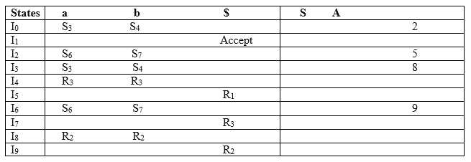
CLR (1) Parsing Table
1

Slide 150
CLR (1) Parsing table:
The placement of shift node in CLR (1) parsing table is same as the SLR (1) parsing table. Only difference in the placement of reduce node.
I4 contains the final item which drives ( A → b•, a/b), so action {I4, a} = R3, action {I4, b} = R3.
I5 contains the final item which drives ( S → AA•, $), so action {I5, $} = R1.
I7 contains the final item which drives ( A → b•,$), so action {I7, $} = R3.
I8 contains the final item which drives ( A → aA•, a/b), so action {I8, a} = R2, action {I8, b} = R2.
I9 contains the final item which drives ( A → aA•, $), so action {I9, $} = R2.

Slide 151
LALR (1) Parsing(CO2)
LALR refers to the lookahead LR.
To construct the LALR (1) parsing table, we use the canonical collection of LR (1) items.
In the LALR (1) parsing, the LR (1) items which have same productions but different look ahead are combined to form a single set of items
LALR (1) parsing is same as the CLR (1) parsing, only difference in the parsing table

Slide 152
Various steps involved in the LALR (1) Parsing
For the given input string write a context free grammar
Check the ambiguity of the grammar
Add Augment production in the given grammar
Create Canonical collection of LR (1) items
Draw a data flow diagram (DFD)
Construct a LALR (1) parsing table

Slide 153
LALR (1) Parsing
LR (1) item
LR (1) item is a collection of LR (0) items and a look ahead symbol.
The look ahead is used to determine that where we place the final item.
The look ahead always add $ symbol for the argument production.
LR (1) item = LR (0) item + look ahead

Slide 154
Example
Question: S → AA
A → aA
A → b
Solution:
Add Augment Production, S` → S
Insert '•' symbol at the first position S` → •S
and also add the lookahead.
S` → •S, $
S → •AA, $
A → •aA, a/b
A → •b, a/b

Slide 155
Drawing DFD:

Slide 156
Create Canonical collection of LR (1) items
I1= Go to (I0, S) = closure (S` → S•, $) = S` → S•, $
I2= Go to (I0, A) = closure ( S → A•A, $ )
Add all productions starting with A in I2 State because "." is followed by the non-terminal. So, the I2 State becomes
I2= S → A•A, $ A → •aA, $ A → •b, $

Slide 157
Create Canonical collection of LR (1) items
I3= Go to (I0, a) = Closure ( A → a•A, a/b )
Add all productions starting with A in I3 State because "." is followed by the non-terminal. So, the I3 State becomes
I3= A → a•A, a/b A → •aA, a/b A → •b, a/b
Go to (I3, a) = Closure (A → a•A, a/b) = (same as I3) Go to (I3, b) = Closure (A → b•, a/b) = (same as I4)

Slide 158
Create Canonical collection of LR (1) items
I4= Go to (I0, b) = closure ( A → b•, a/b) = A → b•, a/b I5= Go to (I2, A) = Closure (S → AA•, $) =S → AA•, $ I6= Go to (I2, a) = Closure (A → a•A, $)
Add all productions starting with A in I6 State because "." is followed by the non-terminal. So, the I6 State becomes
I6 = A → a•A, $ A → •aA, $ A → •b, $
Go to (I6, a) = Closure (A → a•A, $) = (same as I6) Go to (I6, b) = Closure (A → b•, $) = (same as I7)

Slide 159
Create Canonical collection of LR (1) items
I7= Go to (I2, b) = Closure (A → b•, $) = A → b•, $
I8= Go to (I3, A) = Closure (A → aA•, a/b) = A → aA•, a/b
I9= Go to (I6, A) = Closure (A → aA•, $) = A → aA•, $
If we analyze then LR (0) items of I3 and I6 are same but they differ only in their lookahead.
I3 = { A → a•A, a/b A → •aA, a/b A → •b, a/b }
I6= { A → a•A, $ A → •aA, $ A → •b, $ }

Slide 160
Create Canonical collection of LR (1) items
Clearly I3 and I6 are same in their LR (0) items but differ in their lookahead, so we can combine them and called as I36.
I36 = { A → a•A, a/b/$ A → •aA, a/b/$ A → •b, a/b/$ }
The I4 and I7 are same but they differ only in their look ahead, so we can combine them and called as I47.
I47 = {A → b•, a/b/$}
The I8 and I9 are same but they differ only in their look ahead, so we can combine them and called as I89.
I89 = {A → aA•, a/b/$}

Slide 161
Productions are numbered as follows:
Production number for reduce state.
S → AA ... (1)
A → aA ....(2)
A → b ... (3)

Slide 162
CLR (1) Parsing Table
1

Slide 163







Converting CLR (1) Table to LALR (1) Table

Slide 164
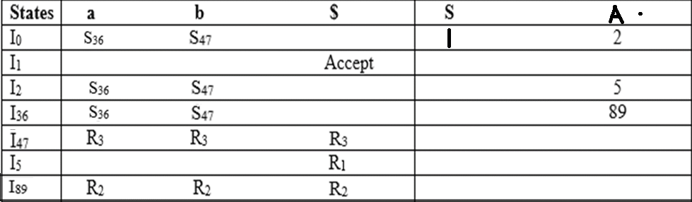
LALR(1) Parsing Table:

Slide 165
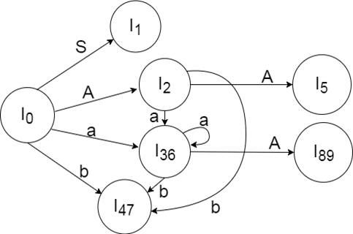
Drawing DFA:

Slide 166
Faculty Video Links, Youtube & NPTEL Video Links and Online Courses Details
Youtube/other Video Links
https://www.youtube.com/watch?v=GOlsYofJjyQ
https://www.youtube.com/watch?v=sMxqUQc_jHQ&t=360s
https://nptel.ac.in/courses/106/105/106105190/
https://nptel.ac.in/courses/106/105/106105190/

Slide 167
Daily Quiz
Calculate the first and follow function of production rules:
S → ACB / CbB / Ba
A → da / BC
B → g / ∈
C → h / ∈
Consider the following grammar and eliminate left recursion-
E → E + E / E x E / a
Do left factoring in the following grammar-
S → bSSaaS / bSSaSb / bSb / a
Consider this following grammar:
S→iEtS | iEtSeS| a
E→b
Check whether it is LL(1) grammar or not.

Slide 168
Daily Quiz
Consider the following grammar-
S → ( L ) | a
L → L , S | S
Parse the input string ( a , ( a , a ) ) using a shift-reduce parser.
Consider the following grammar-
E → EAE | id
A → + | x
Construct the operator precedence parser and parse the string id + id x id.
Consider the grammar
E -> T+E | T
T ->id
Perform SLR(1) and LR (0) parsing on above grammar.

Slide 169
Daily Quiz
Consider the grammar and find the grammar is -
E → A | B
A → a | c
B → b | c
LR(0)
LR(0) & LR(1)
LR(1), SLR(1)
none
Consider the grammar E → E + n | E × n | n. For a sentence "n + n × n," the handles in the right sentential form of reduction are
n, E + n and E + n × n
n, E + n and E + E × n
n, n + n and n + n × n
n, E + n and E × n

Slide 170
Daily Quiz
Give the Follow set for the non-terminal E in the grammar.
E’ → E
E → num
E → (+A)
A → AA
A → E
{num, (,)}
{(,) , num, $}
{(, num, $}
{), num, $}

Slide 171
Daily Quiz
Eliminate left recursion from the following grammar:
A → Bd | Aff | CB
B → Bd | Bf | df
C → h | g
a. A → Bd AI | CB AI
A1 → ff AI | ε
B → df BI
B1 → d BI | fBI | ε
C → h | g
b. A → Bd AI | CB AI
A → ff AI | ε
B → df BI
BI → d BI | fBI | ε
C → h | g
c. A → Bd AI | CB AI
AI → ff AI
B → df BI
BI → d BI | fBI
C → h | g
d. A → Bd AI | CB
AI → ff AI | ε
B → df BI
BI → d BI | fB I | ε
C → h | g

Slide 172
Daily Quiz
Consider the grammar shown below
S → iEtSS’ | a
S’ → eS | ε
E → b
In LL(1) table M of this grammar, the entries M[S’,e] and M[S’, $] are
S’ → eS , S’ → ε
S’ → eS , {}
S’ → ε , S’ → ε
{S’ → eS & S’ → ε} , S’ → ε
Give the Follow of B in the following grammar:
A → B C D
B → w | B x
C → y C z | m
D → D B | a
{x, y, m, $}
{x, y, w, $}
{x, w, m, $}
{x, y, m, w, $}

Slide 173
Daily Quiz
Using LR(0) items we can construct.
SLR parsing table
LALR parsing table
CALR parsing table
None
Which of the following is true?
every SLR(1) is LR(0)
every LL(1) is LR(1)
every LL(1) is SLR(1)
every LL(1) is LR(0)
If a grammar is SLR(1) then [ ]
it may have S/R conflict
It will not have any conflict
It may have R/R conflict
it will not have S/R but may have R/R conflict

Slide 174
Daily Quiz
Consider the grammar S → ( S ) | a. If SLR(1) has n1 states, LR(1) has n2 states, LALR(1) has n3 states, which of the following is true?
n1<n2<n3
n1=n3<n2
n1=n2=n3
n1>n3>n2

Slide 175
Weekly Assignments-1
Consider the following grammar
S → AS | b
A → SA | a
Show that the grammar is ambiguous.
Find LR(0) Canonical collections.
Construct the SLR parsing table.
Construct CLR parsing table of the grammar.
Construct LALR parsing table.

Slide 176
Weekly Assignments-2
From a given grammar remove left RECURSION E → E+T│T, T → T*F │F, F → (E) │id
2. Parse the string “abda” using Recursive Descent Parser and then remove the Left factoring and Left recursive
A → ABd│ Aa │a
B → bB│ b
3. Pasre the strings “ab” , “acdb”and “adb” using stack.
S → aABb A → c│ Ԑ
B → d│ Ԑ
4. Parse the string “ (id*id) ” and “ id+id+id ” using stack.
E → E+T│T
T → T*F │F
F → (E) │id

Slide 177
MCQ
Handle pruning forms the basis of ____________ .
(a) Bottom-up parsing
(b) Top-down parsing
(c) Both (a) and (b)
(d) None of these
Non-recursive predictive parser contains ___________ .
(a) An input buffer
(b) A parsing table
(c) An output stream
(d) All of these

Slide 178
MCQ
If A → αβ is a production and a is terminal symbol or right end marker $, then LR(1) items will be defined by the production ________.
(a) [A → α.β, a]
(b) [A → .αβ, a]
(c) [A → α.βa]
(d) [A → a.β, α]
Consider the grammar shown below
S → FR , R → *S | ε , F → id
In LL (1) table M of this grammar, the entries M[S, id] and M[R, $] are
S → FR, R → ε
S → FR & {}
S → FR & R → *S
F → id, R → ε

Slide 179
MCQ
Top-down parsing is a technique to find _________ .
(a) Leftmost derivation
(b) Rightmost derivation
(c) Leftmost derivation in reverse
(d) Rightmost derivation in reverse
Predictive parsing is possible only for __________ .
(a) LR(k) grammar
(b) LALR(1) grammar
(c) LL(k) grammar
(d) CLR(1) grammar

Slide 180
MCQ
Which two functions are required to construct a parsing table in predictive parsing technique?
(a) CLOSURE() and GOTO ()
(b) FIRST() and FOLLOW()
(c) ACTI0N() and GOTO()
(d) None of these
Which of these parsing techniques is a kind of bottom-up parsing?
(a) Shift-reduce parsing
(b) Reduce-reduce parsing
(c) Predictive parsing
(d) Recursive-decent parsing

Slide 181
MCQ
Which of the following methods is used by the bottom-up parser to generate a parse tree?
(a) Leftmost derivation
(b) Rightmost derivation
(c) Leftmost derivation in reverse
(d) Rightmost derivation in reverse
Handle pruning forms the basis of ____________ .
(a) Bottom-up parsing
(b) Top-down parsing
(c) Both (a) and (b)
(d) None of these

Slide 182
Glossary Questions
Explain the parsing techniques with a hierarchical diagram.
2. What are the problems associated with Top Down Parsing?
3. Write the production rules to eliminate the left recursion and left factoring problems.
4. Consider the following Grammar:
A-> ABd|Aa|a B-> Be|b
Remove left recursion.
5. Do left factoring in the following grammar: A-> aAB|aA|a B-> bB|b
6. Write a short note on:
Ambiguity (with example)
b. Recursive Descent Parser
c. Predictive LL(1) parser (working)
d. Handle pruning
e. Operator Precedence Parser
7. Write Rules to construct FIRST Function and FOLLOW Function.

Slide 183
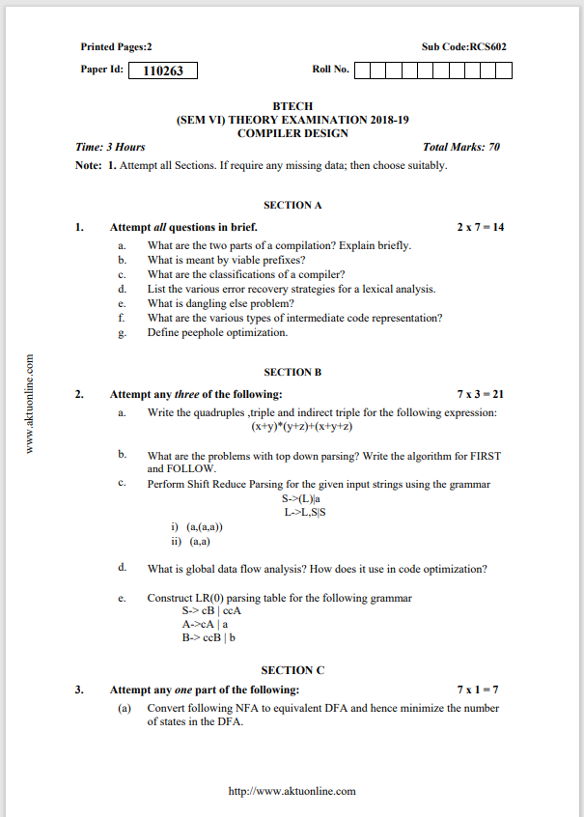
Old Question Paper

Slide 184
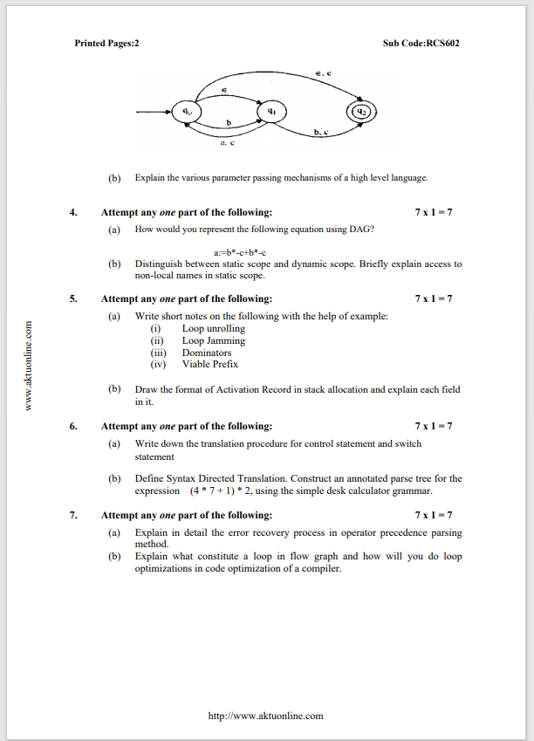
Old Question Paper

Slide 185
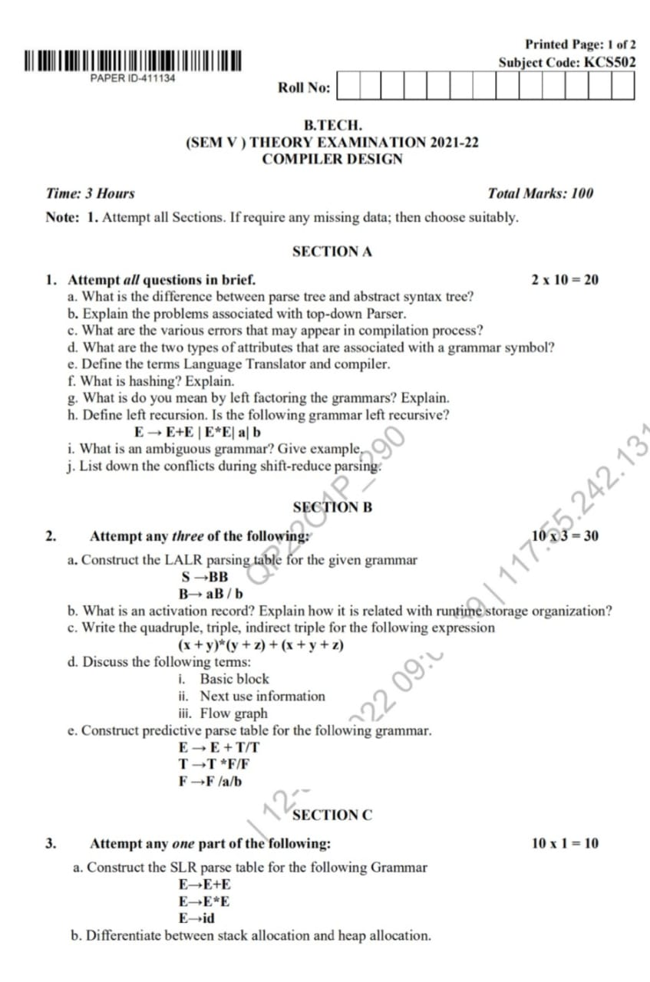
Old Question Paper

Slide 186
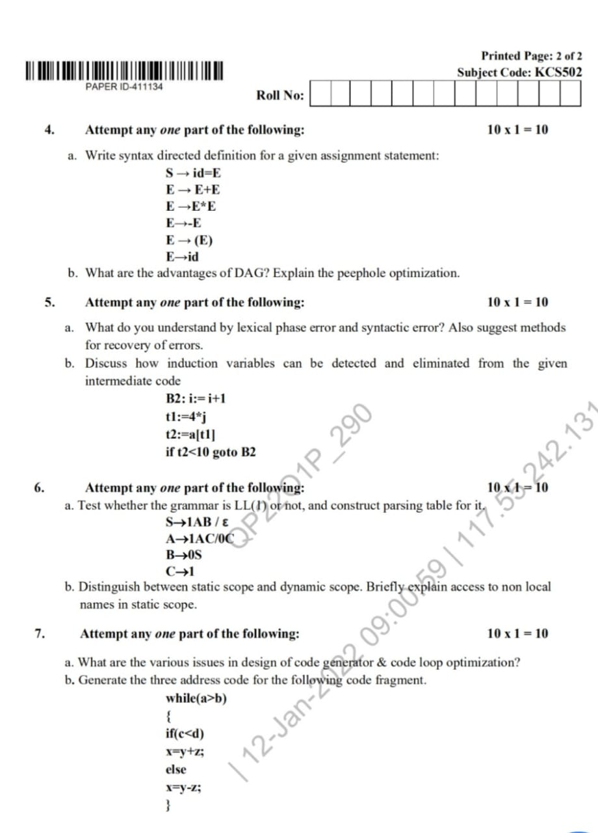
Old Question Paper

Slide 187
Expected Question for University Exam
Consider the following grammar S-AS|b A-SA|a. Construct the SLR parse table for the grammar. Show the actions of the parser for the input string “abab”.
What is a syntax tree? Draw the syntax tree for the following statement: c b c b a − ∗ + − ∗ =
Perform Shift Reduce Parsing for the given input strings using the grammar
S->(L)|a
L->L,S|S
i) (a,(a,a))
ii)(a,a)

Slide 188
Recap of Unit
Syntax Analyzer
creates the syntactic structure of the given source program.
This syntactic structure is mostly a parse tree
.Syntax Analyzer is also known as parser
LR parsers can be constructed to recognize virtually all programming-language constructs for which context-free grammars can be written.
Bottom-up parsers for a large class of context-free grammars can be easily developed using operator grammars.Operator grammars have the property that no production right side is empty or has two adjacent nonterminals.
A shift-reduce parser uses a parse stack which (conceptually) contains grammar symbols. During the operation of the parser, symbols from the input are shifted onto the stack. If a prefix of the symbols on top of the stack matches the RHS of a grammar rule which is the correct rule to use within the current context, then the parser reduces the RHS of the rule to its LHS,replacing the RHS symbols on top of the stack with the nonterminal occurring on the LHS of the rule.
This shift-reduce process continues until the parser terminates, reporting either success or failure. It terminates with success when the input is legal and is accepted by theparser.

Slide 189
References
K. Muneeswaran,Compiler Design,First Edition,Oxford University Press.
J.P. Bennet, “Introduction to Compiler Techniques”, Second Edition, Tata McGraw-Hill,2003.
Henk Alblas and Albert Nymeyer, “Practice and Principles of Compiler Building with C”, PHI, 2001.
Aho, Sethi & Ullman, "Compilers: Principles, Techniques and Tools”, Pearson Education
V Raghvan, “ Principles of Compiler Design”, TMH
Kenneth Louden,” Compiler Construction”, Cengage Learning.
Charles Fischer and Ricard LeBlanc,” Crafting a Compiler with C”, Pearson Education

Slide 190
Thank You

