Slide 1



Noida Institute of Engineering and Technology, Greater Noida
Syntax Directed Translation
Unit: 3
Subject:
Compiler Design
Vivek Kumar Sharma
Assistant Professor
CSE Department
Course Details B Tech CSE 5th Sem

Slide 2
Faculty Profile
Vivek Kumar Sharma
Designation: Assistant Professor CSE Department
NIET, Grater Noida
Qualification:
B.Tech (CSE) in 2010
M.Tech (CSE) in 2013
Teaching experience: 10 year +
Research Publications
Particulars | Journals(UGC) | Conference(IEEE)
International | 04 | 01
National | 02 | 00

Slide 3
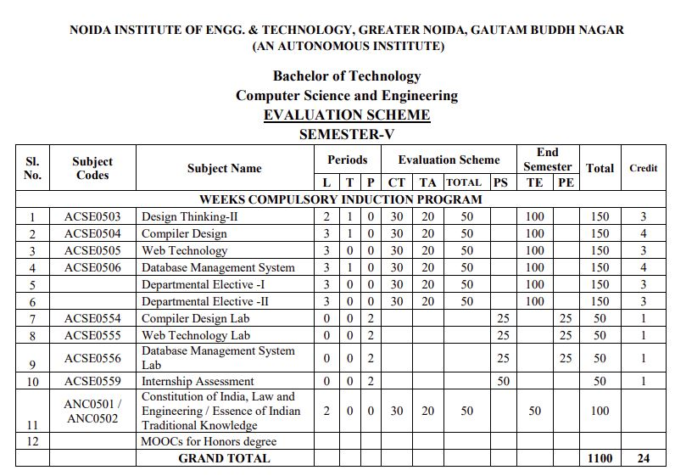
Evaluation Scheme

Slide 4
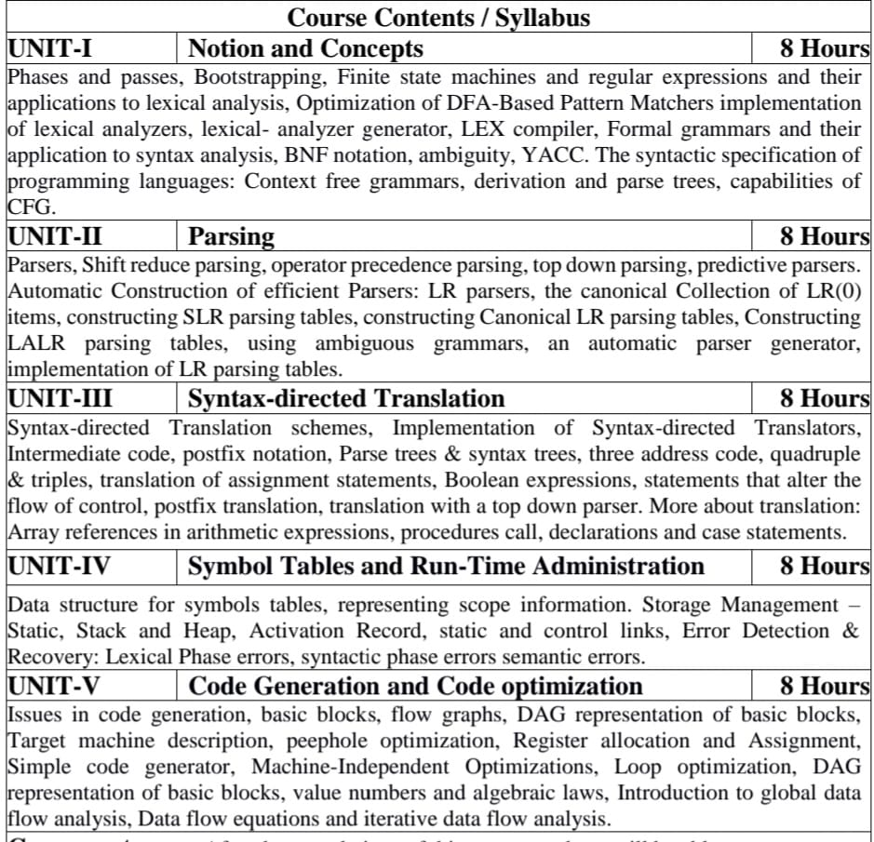
Syllabus

Slide 5
Branch wise Applications
Computer Science
Compiler technology can be used to translate the binary code for one machine to that of another, allowing a machine to run programs originally compiled for another instruction set. Binary translation technology has been used by various computer companies to increase the availability of software for their machines
Implementations of High Level Programming
Optimization of Computer Architecture
Design of New Computer Architecture
Program Translation
Software Productive tools

Slide 6
Course Objectives
A course in Compiler Design aims to impart comprehensive knowledge and skills essential for designing, implementing, and optimizing compilers. Students learn the theoretical foundations including formal languages, automata theory, and parsing techniques, which are applied practically in understanding compiler structure and components such as lexical analysis, syntax analysis, semantic analysis, intermediate code generation, optimization, and code generation. They gain proficiency in using tools like lex/yacc and others to implement these concepts in real-world scenarios. Emphasis is placed on error handling, debugging techniques, and the application of optimizations to improve the efficiency of generated code. By the end of the course, students are prepared to tackle challenges in compiler development, contributing to language design.

Slide 7
Course Outcomes
CO1: To have the knowledge of patterns, tokens, regular expressions and finite automata to develop a scanner or lexical analyzer.
CO2: To design and develop various parser by parsing LL parser and LR parser
CO3: To apply various design & conduct experiments for Intermediate Code Generation in compiler.
CO4: To design and develop various Data structure for symbols tables and Error Detection & Recovery at every phases
CO5: To apply various new code optimization techniques to improve the performance of a program in terms of speed & space.

Slide 8
Program Outcomes (PO)
PO1: Engineering Knowledge
PO2: Problem Analysis
PO3: Design/Development of solutions
PO4: Conduct Investigations of complex problems
PO5: Modern tool usage
PO6: The engineer and society
PO7: Environment and sustainability
PO8: Ethics
PO9: Individual and team work
PO10: Communication
PO11: Project management and finance
PO12: Life-long learning

Slide 9
CO-PO Mapping
Sr. No | Course Outcome | PO1 | PO2 | PO3 | PO4 | PO5 | PO6 | PO7 | PO8 | PO9 | PO10 | PO11 | PO12
1 | ACSE0504.1 | 3 | 3 | 2 | 3 | 1 | - | - | - | 1 | - | - | 2
2 | ACSE0504.2 | 3 | 3 | 3 | 3 | 1 | - | - | 1 | 1 | - | - | 2
3 | ACSE0504.3 | 3 | 3 | 3 | 3 | - | - | - | 1 | 1 | - | - | 2
4 | ACSE0504.4 | 3 | 2 | 2 | 2 | - | - | - | 1 | 1 | - | - | 2
5 | ACSE0504.5 | 3 | 3 | 3 | 3 | - | - | - | 1 | 1 | - | - | 2
6 | Average | 3 | 2.8 | 2.6 | 2.8 | .4 | - | - | .8 | 1 | - | - | 2

Slide 10
Program Specific Outcomes (PSO)
PSO1: The ability to identify, analyze real world problems and design their ethical solutions using artificial intelligence, robotics, virtual/augmented reality, data analytics, block chain technology, and cloud computing.
PSO2: The ability to design and develop the hardware sensor devices and related interfacing software systems for solving complex engineering problems.
PSO 3:The ability to understand inter-disciplinary computing techniques and to apply them in the design of advanced computing.
PSO 4:The ability to conduct investigation of complex problems with the help of technical, managerial, leadership qualities, and modern engineering tools provided by industry-sponsored laboratories.

Slide 11
CO-PSO Mapping
 | PSO1 | PSO2 | PSO3 | PSO4
ACSE0504.1 | 3 | 2 | 3 | 2
ACSE0504.2 | 3 | 3 | 3 | 2
ACSE0504.3 | 3 | 3 | 3 | 2
ACSE0504.4 | 3 | 2 | 2 | 2
ACSE0504.5 | 3 | 2 | 3 | 2
Average | 3 | 2.2 | 2.8 | 2

Slide 12
Program Educational Objectives
PEO1: To have an excellent scientific and engineering breadth so as to comprehend, analyze, design and provide sustainable solutions for real-life problems using state-of-the-art technologies.
PEO2:To have a successful career in industries, to pursue higher studies or to support entrepreneurial endeavors and to face global challenges.
PEO3:To have an effective communication skills, professional attitude, ethical values and a desire to learn specific knowledge in emerging trends, technologies for research, innovation and product development and contribution to society.
PEO4: To have life-long learning for up-skilling and re-skilling for successful professional career as engineer, scientist, entrepreneur and bureaucrat for betterment of society

Slide 13
Result Analysis
Compiler Design :
2022-2023 : Section D :100%
2023-2024 : Section A : 100%
Section D : 100%

Slide 14
End Semester Question Paper Template
B TECH
(SEM-V) THEORY EXAMINATION 20__-20__
COMPILER DESIGN
Time: 3 Hours Total Marks: 100
Note: 1. Attempt all Sections. If require any missing data; then choose suitably.
SECTION A
Attempt all questions in brief. 2 x 10 = 20
Q.No. | Question | Marks | CO
1 |  | 2
2 |  | 2
. |  | .
10 |  | 2

Slide 15
End Semester Question Paper Templates
SECTION B
2. Attempt any three of the following: 3 x 10 = 30
SECTION C
3. Attempt any one part of the following: 1 x 10 = 10
Q.No. | Question | Marks | CO
1 |  | 10
2 |  | 10
. |  | .
5 |  | 10
Q.No. | Question | Marks | CO
1 |  | 10
2 |  | 10

Slide 16
End Semester Question Paper Templates
4. Attempt any one part of the following: 1 x 10 = 10
5. Attempt any one part of the following: 1 x 10 = 10
6. Attempt any one part of the following: 1 x 10 = 10
Q.No. | Question | Marks | CO
1 |  | 10
2 |  | 10
Q.No. | Question | Marks | CO
1 |  | 10
2 |  | 10
Q.No. | Question | Marks | CO
1 |  | 10
2 |  | 10

Slide 17
End Semester Question Paper Templates
7. Attempt any one part of the following: 1 x 10 = 10
Q.No. | Question | Marks | CO
1 |  | 10
2 |  | 10

Slide 18
Prerequisite
Algorithms
Languages and machines
Operating systems
Computer architectures
Theory of Automata

Slide 19
Recap
Grammar symbols are associated with attributes
Translation Schemes gives a little bit information about implementation details.

Slide 20
Unit Content
Syntax Directed Translation
Attributes
Synthesize attributes
Inherit attributes
Implementation of Syntax-directed Translators
Intermediate Code Representation
Postfix notation
Parse Tree & Syntax Tree
Three Address Code: Quadruple & triples
Translation of assignment statements
Generating three-address code for Boolean Expression
Translation of Control Flow Statements
Translation of simple switch case
Translation with a top down parser
Array references in arithmetic expressions
Procedures call
Declarations and Case statements
Back Patching

Slide 21
Applications and Use Cases
Here are concise applications and use cases of Syntax Directed Translation (SDT):
Intermediate Code Generation: SDT facilitates the direct generation of intermediate code (like ASTs or TAC) during parsing, bridging high-level source code to target machine code.
Semantic Analysis: It performs checks (like type checking, scope rules) during parsing, annotating syntax trees or symbols with semantic information.
Optimization: SDT integrates simple optimizations (like constant folding) into code generation or intermediate code construction.
Error Handling: It includes error detection and reporting mechanisms during parsing, providing developers with meaningful error messages.
Target-specific Code Generation: SDT tailors code generation for different architectures, emitting assembly code or optimized intermediate representations.
Tool Integration: SDT is used with parser generators (e.g., yacc/Bison) to automate compiler development, simplifying language implementation or modifications.

Slide 22
Unit Objective(CO3)
Introduce students to the concepts underlying the design of intermediate code generation in the process of designing the compiler .

Slide 23
Topic Objective(CO3)
Introduce students to the concepts of syntax directed translation
The attributes are evaluated by the semantic rules used in SDT

Slide 24
Syntax-Directed Translation(CO3)
Grammar symbols are associated with attributes to associate information with the programming language constructs that they represent.
Values of these attributes are evaluated by the semantic rules associated with the production rules.
Evaluation of these semantic rules:
may generate intermediate codes
may put information into the symbol table
may perform type checking

Slide 25
Syntax-Directed Translation
When we associate semantic rules with productions, we use two notations:
Syntax-Directed Definitions
Translation Schemes
Syntax-Directed Definitions:
give high-level specifications for translations
hide many implementation details such as order of evaluation of semantic actions.
We associate a production rule with a set of semantic actions, and we do not say when they will be evaluated.

Slide 26
Syntax-Directed Translation
Translation Schemes:
indicate the order of evaluation of semantic actions associated with a production rule.
In other words, translation schemes give a little bit information about implementation details.

Slide 27
Attributes(CO3)
Attribute grammar is a special form of context-free grammar where some additional information (attributes) are appended to one or more of its non-terminals in order to provide context-sensitive information.
Each attribute has well-defined domain of values, such as integer, float, character, string, and expressions.
E → E + T { E.value = E.value + T.value }
Semantic attributes may be assigned to their values from their domain at the time of parsing and evaluated at the time of assignment or conditions.
Based on the way the attributes get their values, they can be broadly divided into two categories : synthesized attributes and inherited attributes.

Slide 28
Synthesized attributes(CO3)
These attributes get values from the attribute values of their child nodes.
Each of the non-terminals has a single synthesized attribute, called val.
An SDD that involves only synthesized attributes is called S-attributed
Each rule computes an attribute for the non-terminal at the head of a production from attributes taken from the body of the production.

Slide 29
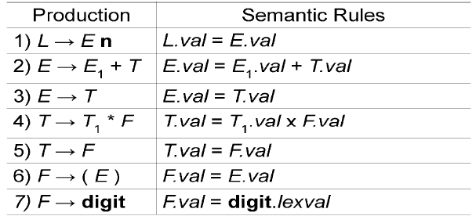
Synthesized attributes
A parse tree, showing the value(s) of its attribute(s) is called an annotated parse tree.
With synthesized attributes, evaluate attributes in bottom-up order.

Slide 30
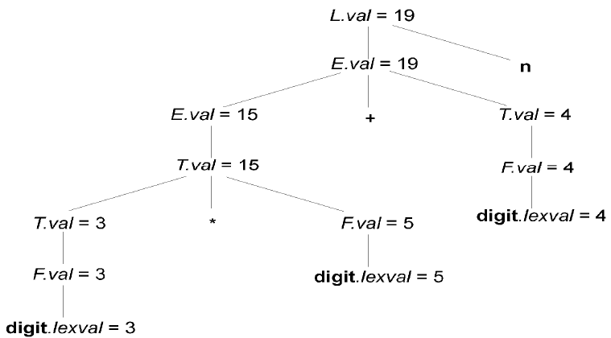
Synthesized attributes
Annotated Parse Tree of 3*5+4n

Slide 31
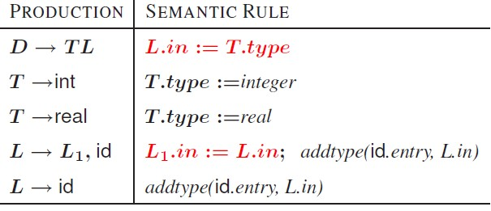
Inherited attributes(CO3)

Slide 32
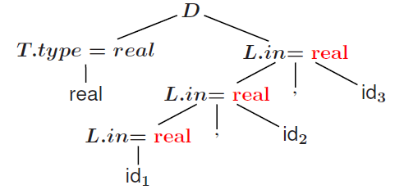
Inherited attributes
Annotated parse tree of real id, id, id

Slide 33
Daily Quiz
1. The combination of grammar and semantic rules are called as:
Syntax directed translation
semantic directed translation
Syntax translator
None of these
2. In syntax directed translation, along with the grammar we associate some informal notation are called as:
Semantic Rules
Syntax Rules
parsing Rules
None of these

Slide 34
Daily Quiz
Which mapping is described by the implementation of the syntax-directed translator?
Parse table
Input
Output
Input-Output

Slide 35
Recap
An SDD that involves only synthesized attributes is called S-attributed
An SDD that involves only inherit attributes is called L-attributed
A parse tree, showing the value(s) of its attribute(s) is called an annotated parse tree

Slide 36
Topic Objective(CO3)
Introduce students to the concepts of syntax directed translation
Example of evaluating the SDT with the help of attributes

Slide 37
Implementation of desk calculator(CO3)
Production Semantic Actions
S →E$ {print val[Top]}
E→E+E {val[Top]}= val[Top-1]+ val[Top]}
E→E*E {val[Top]}= val[Top-1]* val[Top]}
E→I { }
I→I.digit {val[Top]}= val[Top-1]*10+lex.val}
I→digit {val[Top]}= val[Top]=lex.val}

Slide 38
Implementation of desk calculator(CO3)
Design and implement a desk calculator that can perform basic arithmetic operations (+, -, *, /) and handle parentheses for precedence.
Solution Approach:
Understanding Requirements:
The calculator should handle basic arithmetic operations: addition (+), subtraction (-), multiplication (*), and division (/).
It should respect operator precedence, where multiplication and division take precedence over addition and subtraction.
Parentheses should be used to enforce precedence.
Example Calculation: Consider the expression: 2+3∗(4−1)2 + 3 * (4 - 1)2+3∗(4−1).
Step-by-Step Evaluation:
Evaluate inside the parentheses first: 4−1=34 - 1 = 34−1=3.
Substitute back into the expression: 2+3∗32 + 3 * 32+3∗3.
Perform multiplication first: 3∗3=93 * 3 = 93∗3=9.
Add the result to 2: 2+9=112 + 9 = 112+9=11.
Execution Strategy:
Start from left to right, respecting parentheses and operator precedence.
Use a separate line or space for each step of calculation to maintain clarity.
Handling Errors:
Ensure division by zero is not attempted.
Recognize and correct input errors like missing operators or parentheses.

Slide 39
Implementation of desk calculator(CO3)
Example Calculation:
Given the expression 2+3∗(4−1), follow these steps:
Compute 4−1
4−1=3
Substitute into the original expression:
2+3∗3
Perform multiplication:
3∗3=9
Add to the initial number:
2+9=11

Slide 40
Recap
Implementation of desk Calculator

Slide 41
Topic Objective(CO3)
Introduce students to the concepts of intermediate code generation
Very useful in the concept of how high level program is stored in address form

Slide 42
Intermediate Code representation(CO3)
Front end of a compiler is efficient and can be automated
Back end is generally hard to automate and finding the optimum solution requires exponential time
Intermediate code generation can affect the performance of the back end
Goal: Generate a Machine Independent Intermediate Form that is Suitable for Optimization and Portability
Facilitates retargeting: enables attaching a back end for the new machine to an existing front end
Enables machine-independent code optimization

Slide 43
Intermediate Code representation
Graphical representations
e.g. Abstract Syntax Tree
Postfix notation: operations on values stored on operand stack (similar to JVM byte code)
Three-address code: (e.g. triples and quads)
x := y op z
Two-address code:
x := op y

Slide 44
Parse Tree
A parse tree, also known as a concrete syntax tree, represents the syntactic structure of a string according to the rules of a formal grammar. It's constructed during the parsing process of a compiler or interpreter. Parse trees are hierarchical structures where nodes represent terminals (tokens) and non-terminals (grammar rules). Here's an example to illustrate:
Example of a Parse Tree
Consider the grammar and input expression:
Grammar:
E -> E + E
E -> E * E
E -> (E)
E -> num
Input Expression: 2+3∗(4−1)
+
/ \
2 *
/ \
3 -
/ \
4 1

Slide 45
Syntax Tree (Abstract Syntax Tree, AST)
A syntax tree, or abstract syntax tree (AST), represents the syntactic structure of a program or expression after the parsing phase. Unlike parse trees, syntax trees abstract away from specific syntactic details and focus on the program's logical structure. They are used for semantic analysis, optimization, and code generation phases in compilers and interpreters. Here's how it differs from a parse tree:
Example of a Parse Tree
Consider the grammar and input expression:
Grammar:
E -> E + E
E -> E * E
E -> (E)
E -> num
Input Expression: 2+3∗(4−1)
+
/ \
2 *
/ \
3 -
/ \
4 1

Slide 46
Recap
Graphical representations e.g. Abstract Syntax Tree
Postfix notation: operations on values stored on operand stack (similar to JVM byte code)
Three-address code: (e.g. triples and quads)
x := y op z
Two-address code:
x := op y
Syntax Tree
mknode (op, left, right) – creates an operator node with label op and pointers left and right which point to operand nodes
mkleaf(id, entry) – creates an identifier node with label

Slide 47
Daily Quiz
Postfix notation is a linear representation of a …..
Syntax tree
binary tree
AVL tree
None of the above
The triples have three fields to implement the ------ address code
Three
Two
One
None of these

Slide 48
Daily Quiz
................. uses only synthesized attributes.
L-attribute grammar
S-attribute grammar
inherited attribute
None of these
Intermediate code representation form are..
Syntax tree
Postfix notation
Three address code
all of these

Slide 49
Topic Objective(CO3)
Introduce students to the concepts of intermediate code generation
Here we will discuss different methods to generate the three address code and their storing concept

Slide 50
Three address code(CO3)
In a three address code there is at most one operator at the right side of an instruction
Example:
+
t1 = b – c
t2 = a * t1
t3 = a + t2
t4 = t1 * d
t5 = t3 + t4
+
*
*
d
a
b
c

Slide 51
Forms of three address instructions(CO3)
x = y op z
x = op y
x = y
goto L
if x goto L and ifFalse x goto L
if x relop y goto L
Procedure calls using:
param x
call p,n
y = call p,n
x = y[i] and x[i] = y
x = &y and x = *y and *x =y

Slide 52
Data structures for three address codes(CO3)
Quadruples
Has four fields: op, arg1, arg2 and result
Triples
Temporaries are not used and instead references to instructions are made
Indirect triples
In addition to triples we use a list of pointers to triples

Slide 53
Three address codes Example(CO3)
Three address code
Example
b * minus c + b * minus c
t1 = minus c
t2 = b * t1
t3 = minus c
t4 = b * t3
t5 = t2 + t4
a = t5
Quadruples
Triples
Indirect Triples
op | arg1 | arg1 | result
minus | c |  | t1
* | b | t1 | t2
minus | c |  | t3
* | b | t3 | t4
+ | t2 | t4 | t5
= | t5 |  | a
 | op | arg1 | arg1
0 | minus | c
1 | * | b | 0
2 | minus | c
3 | * | b | 2
4 | + | 1 | 3
5 | = | a | 4
 | op
0 | 0
1 | 1
2 | 2
3 | 3
4 | 4
5 | 5
 | op | arg1 | arg1
0 | minus | c
1 | * | b | 0
2 | minus | c
3 | * | b | 2
4 | + | 1 | 3
5 | = | a | 4

Slide 54
Quadruples Example(CO3)
a := b * -c + b * -c
 | op | arg1 | arg2 | result
(0) | uminus | c |  | t1
(1) | * | b | t1 | t2
(2) | uminus | c |  | t3
(3) | * | b | t3 | t4
(4) | + | t2 | t4 | t5
(5) | := | t5 |  | a

Slide 55
Triples Example(CO3)
a := b * -c + b * -c
 | op | arg1 | arg2
(0) | uminus | c
(1) | * | b | (0)
(2) | uminus | c
(3) | * | b | (2)
(4) | + | (1) | (3)
(5) | := | a | (4)
Result is implicit in triples

Slide 56
Indirect triples(CO3)
a := b * -c + b * -c
 | op |  | op | arg1 | arg2
(0) | (14) | (14) | uminus | c
(1) | (15) | (15) | * | b | (14)
(2) | (16) | (16) | uminus | c
(3) | (17) | (17) | * | b | (16)
(4) | (18) | (18) | + | (15) | (17)
(5) | (19) | (19) | assign | a | (18)

Slide 57
Daily Quiz
Three address code statement are………………..
Assignment Statement
Copy Statement
procedure call
All of the above
Postfix notation of a + b * c is __ .
abc*+
abc+*
ba+c*
None of the above
A parse tree showing the value of attributes at each node is called----------
Syntax tree
Annotated parse tree
parse tree
All of the above.

Slide 58
Topic Objective(CO3)
Introduce students to the concepts of intermediate code generation and SDT in combine
How the semantic rules (SDT) are associated with three address code(intermediate code )

Slide 59
Assignment: Example(CO3)
x = a * b + c * d - e * f;
t1 | = | e * f;
t2 | = | c * d;
t3 | = | t2 - t1;
t4 | = | a * b;
S
id
=
E
t5 = t4 + t3;
x = t5;
E
+
E
x
E
* E
E
-
E
id
id
E
*
E
* E
E
id
id
id
id
a
b
c
d
e
f

Slide 60
Boolean Expressions: Example(CO3)
a < b or c < d and e < f
00: | if a |  | < b | goto | 03
01: | t1 = |  | 0
02: | goto |  | 04
03: | t1 = |  | 1
04: | if c |  | < d | goto | 07
05: | t2 = |  | 0
06: | goto |  | 08
07: | t2 | = | 1
08: | if | e | < f | goto | 11
09: | t3 | = | 0
E
E
or
E
id relop id
E
and
E
id relop id
id relop id
a < b
c < d e < f ^{10:} | goto | 12
11: | t3 = | 1
12: | t4 = | t2 and t3
13: | t5 = | t1 or t4

Slide 61
Boolean Expression: Short Circuit Evaluation(CO3)
a < b or c < d and e < f
E
E
E
or
id relop id
E
and
E
id relop id
id relop id
a < b
c < d
e < f

Slide 62
Boolean Expression: Short Circuit Evaluation
a < b or c < d and e < f
E
E
E
or
id relop id
E
and
E
id relop id
id relop id
a < b
 | if a goto | < b goto L1 | Ltrue
L1: L2: | if c goto if e goto | < d goto Lfalse < f goto Lfalse | L2 Ltrue
c < d
e < f

Slide 63
Combining Boolean and Control Flow Statements
while a < b do if c < d then
x = y + z else
x = y - z
S → while E do S₁ ‖
S.next = Lnext S.begin = L1
S
L1: if a < b goto L2
goto Lnext
L2:
while
E
E.true = L2
do
S
S.next = L1
E.false = Lnext
id relop id
if
E
then
S then S
id relop id
a
< b
c < d

Slide 64
Combining Boolean and Control Flow Statements
while a < b do if c < d then
x = y + z else
x = y - z
S.next = Lnext S.begin = L1
L1: if a < b goto L2 goto Lnext
S
while
E
E.true = L2
do
S
S.next = L1
L2: if c < d goto L3
E.false = Lnext
goto L4
id relop id
if
^{E} E.tru^{t}e^{h}=^{en}L3
S then S
S₂.next = L1
E.false = L4
S₁.next = L1
L3:
id relop id
a
< b
c < d

Slide 65
Combining Boolean and Control Flow Statements
while a < b do if c < d then
x = y + z else
x = y - z
S → while E do S₁ ‖
S.next = Lnext S.begin = L1
L1: if a < b goto L2 goto Lnext
L2: if c < d goto L3 goto L4
S
while
E
E.true = L2
do
S
S.next = L1
E.false = Lnext
id relop id
if
^{E} E.tru^{t}e^{h}=^{en}L3
S then S
S₂.nex
t = L1
L3: t1 = x + z
x = t1 goto L1
E.false = L4
S₁.next = L1
id relop id
a
< b
L4:
c < d

Slide 66
Combining Boolean and Control Flow Statements
while a < b do if c < d then
x = y + z else
x = y - z
S.next = Lnext S.begin = L1
L1: if a < b goto L2 goto Lnext
L2: if c < d goto L3 goto L4
S₂.next = L1
L3: t1 = x + z
x = t1
S
while
E
E.true = L2
do
S
S.next = L1
E.false = Lnext
id relop id
if
^{E} E.tru^{t}e^{h}=^{en}L3
S then S
E.false = L4
S₁.next = L1
id relop id
goto L1
a
< b
L4: t2 = x - z x = t2 goto L1
c < d
Lnext:

Slide 67
Combining Boolean and Control Flow Statements
while a < b do if c < d then
x = y + z else
x = y - z
S
L1: | if a | < b goto | L2
 | goto | Lnext
while
E
do
S
L2: if c < d goto L3 goto L4
L3: t1 = x + z x = t1 goto L1
L4: t2 = x - z x = t2 goto L1
Lnext:
id relop id
if
E
then
S then S
id relop id
a
< b
c < d

Slide 68
Topic Objective(CO3)
Introduce students to the concepts of back patching which gives the real algorithmic idea to generate three address code

Slide 69
Back Patching(CO3)
Previous codes for Boolean expressions insert symbolic labels for jumps
It therefore needs a separate pass to set them to appropriate addresses
We can use a technique named back patching to avoid this
We assume we save instructions into an array and labels will be indices in the array
For non-terminal B we use two attributes B.true list and B.false list together with following functions:
makelist(i): create a new list containing only I, an index into the array of instructions
Merge(p1,p2): concatenates the lists pointed by p1 and p2 and returns a pointer to the concatenated list
Backpatch(p,i): inserts i as the target label for each of the instruction on the list pointed to by p

Slide 70
Faculty Video Links, Youtube & NPTEL Video Links and Online Courses Details
Youtube/other Video Links
https://www.youtube.com/watch?v=nIMBA0qO684
https://www.youtube.com/watch?v=M8oQmaAfoJM
https://www.youtube.com/watch?v=yFVCw0N0nxo
https://www.youtube.com/watch?v=Bqq26obqUoU
https://www.youtube.com/watch?v=queUceGJqh0
NPTEL
https://youtu.be/MO5MGYm4v0o
https://youtu.be/7Z2VHWLJVSA
https://youtu.be/EpAzj7zXrbk
https://youtu.be/M-wIosep5Zs

Slide 71
Daily Quiz
What are the various types of three address statements?
a. Assignment Statement
b. Copy Statement
c. Assignment Instruction
d. All of the above
A "Three Address Code" consists of
a. Two operand and one result
b. Two operands and operator
c. One operand and two operators
d. None of d above.
Expressions that govern the flow of control that may be Boolean expressions containing _________ and _________ operators.
a. Arithmetic & logical
b. Relational & logical
c. Arithmetic & relational
d none of the above

Slide 72
Daily Quiz
Listing pointers to triples, rather than listing triples themselves is implementation of
a. Quadruple
b. Triple
c. Indirect Triple
d. Three address code
Quadruple is a record structure with four fields.
a. Op, arg1, arg2 and result
b. op1, op2, agr2 and result
c. agr1, arg2 , result and op
d. All of d above

Slide 73
Weekly Assignment
What are Synthesized and Inherited Attributes? [CO3]
Write the algorithm for moving forward pointer in "input buifering" scheme. [CO3]
What is the use of intermediate code during compilation? [CO3]
Explain the process of translating an assignment statement. [CO3]
What are different ways to write three address code ? [CO3]
Write the three address code for the following code segment [CO3]
WhileA<Cand B<D do
If A=l then C = g+l
else while A < = D do A= A+ 2.

Slide 74
Weekly Assignment
7. Define Syntax Directed Translation. Construct an annonated parse tree for the expression (4 * 7 + l) + 2, using the simple desk calculator grammar [CO3]
8. Define backpatching and semantic rules for boolean expression. Derive the three address code for the following expression [CO3] P<Q and R<S and T<Q
9. Generate tlree address code for the following code segment : [CO3]
While (a<b) do
if(c<d) then x=y+z
10.What is postfix translation ? Esplain it with zuitable example. [CO3]

Slide 75
MCQ s
In an L-attributed SDD , attributes may be inherited or synthesized.
a) True
b) False
Notations for associating semantic rules with productions are-------------------.
a) Syntax directed definition
b) Translation scheme
c) Both a and b
d) None of the above
The translation of token stream is result obtained by evaluated the
a) Productions
b) Syntax rules
c) Semantic rules
d) None of these

Slide 76
MCQ s
Terminals can have synthesized attributes but not inherited attributes.
a) True
b) False
An SDD without side effects is called
a) Context free grammar
b) Operator grammar
c) Attribute grammar
d) Both a and c
An SDD that involves only synthesized attributes is called-------------------.
a) S-Attributed
b) L-Attributed
c) Both a and b
d) None of the above
---------------- are useful tool for determining an evaluation order for the attribute instances in given parse tree.
a) DAG
b) Dependency graph
c) Graph coloring graph
d) None of these

Slide 77
Glossary Questions
Explain syntax directed translation with example?
Explain three address coding system and its implementation by example.
Notations for associating semantic rules with productions are-------------------.
a) Syntax directed definition
b) Translation scheme
c) Both a and b
d) None of the above
The translation of token stream is result obtained by evaluated the
a) Productions
b) Syntax rules
c) Semantic rules
d) None of these

Slide 78
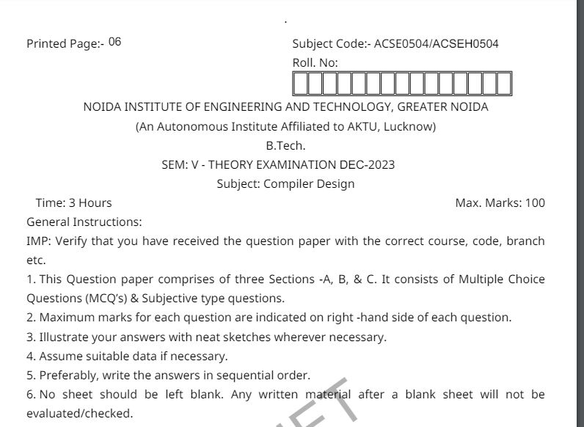
Old Question Papers

Slide 79
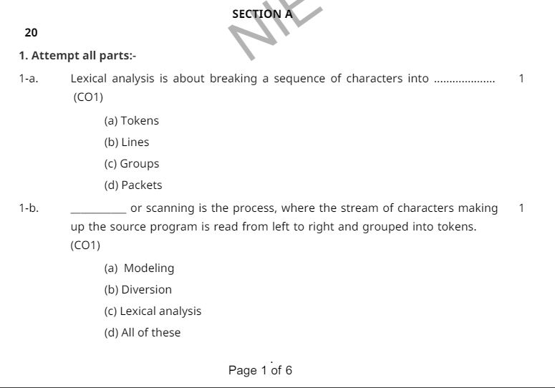
Old Question Papers

Slide 80
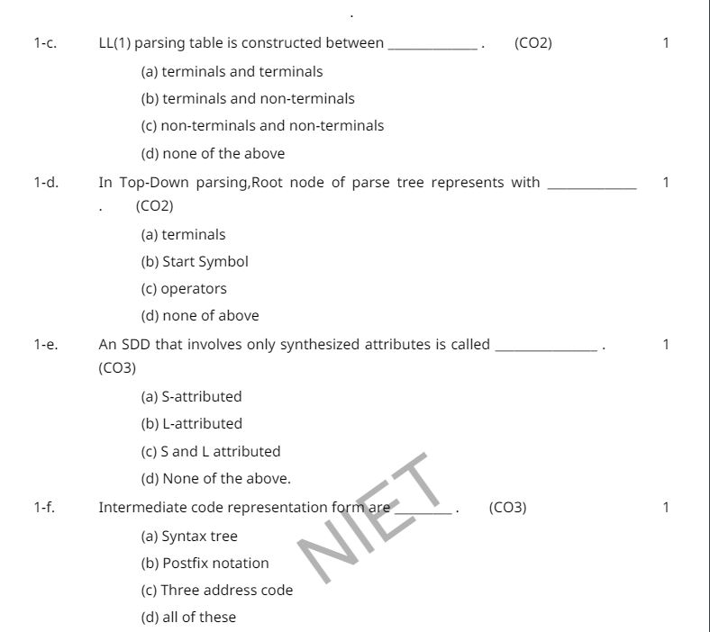
Old Question Papers

Slide 81
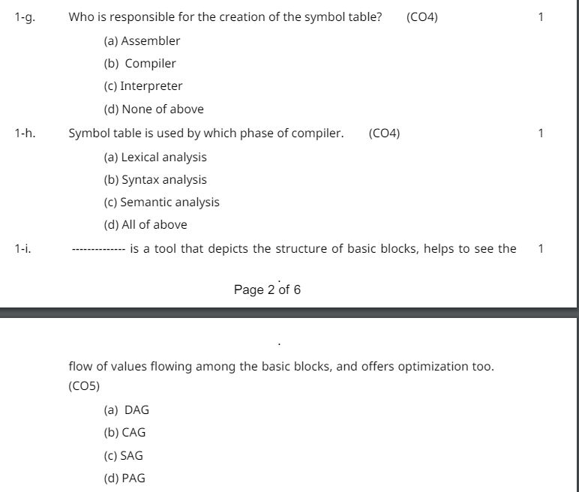
Old Question Papers

Slide 82
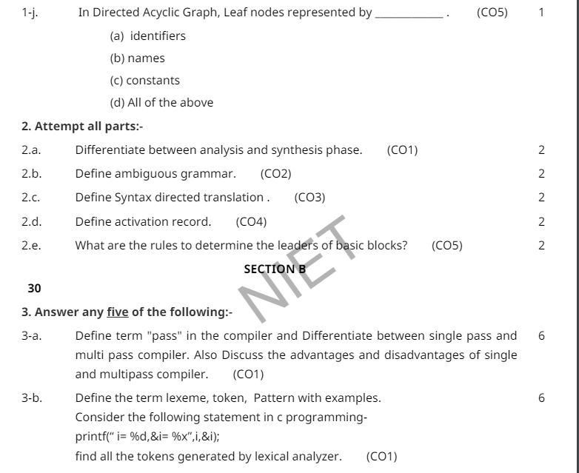
Old Question Papers

Slide 83
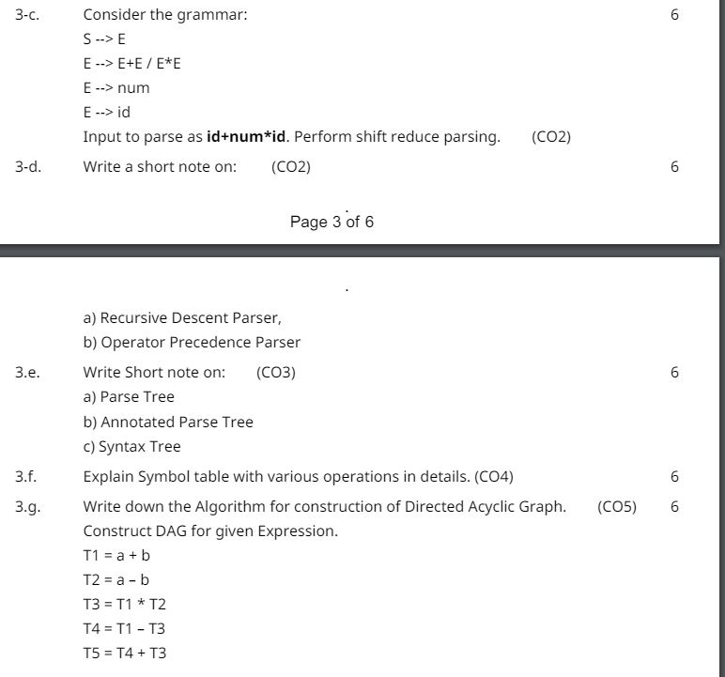
Old Question Papers

Slide 84
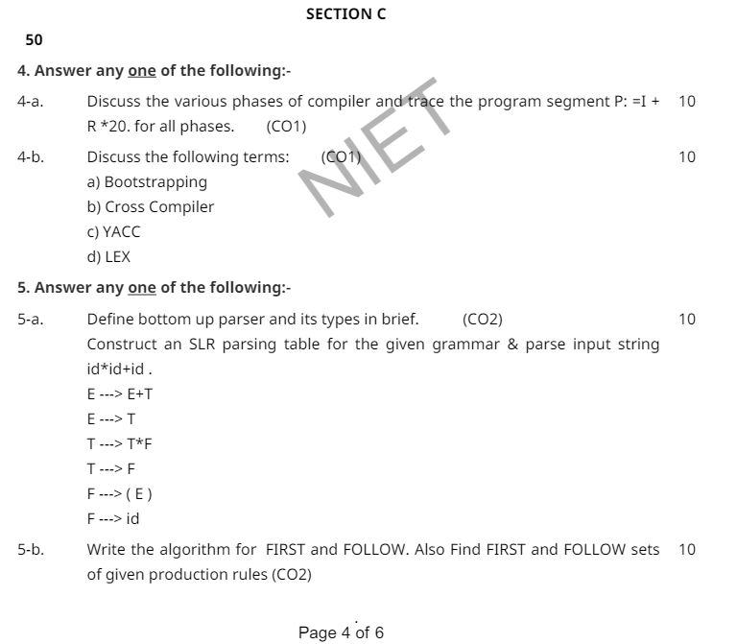
Old Question Papers

Slide 85
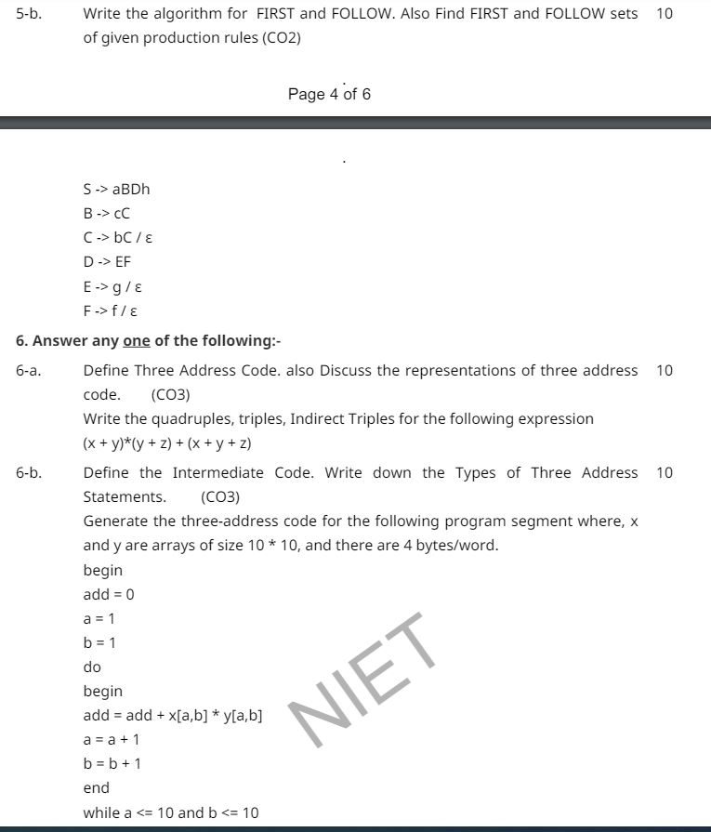
Old Question Papers

Slide 86
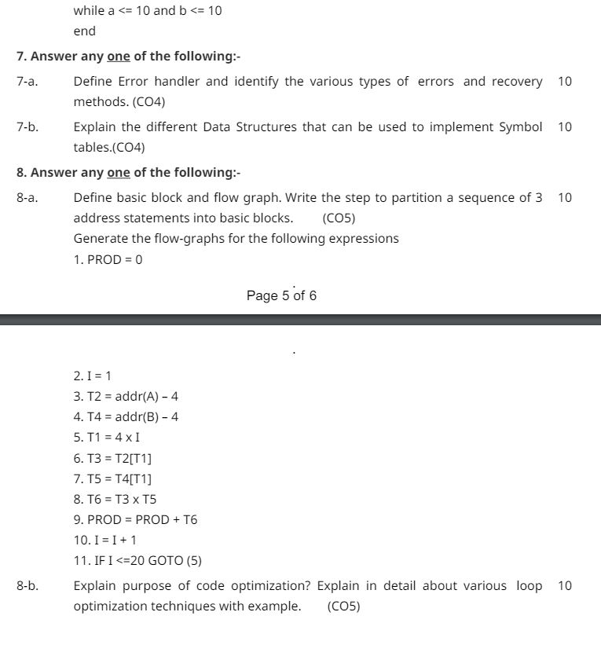
Old Question Papers

Slide 87
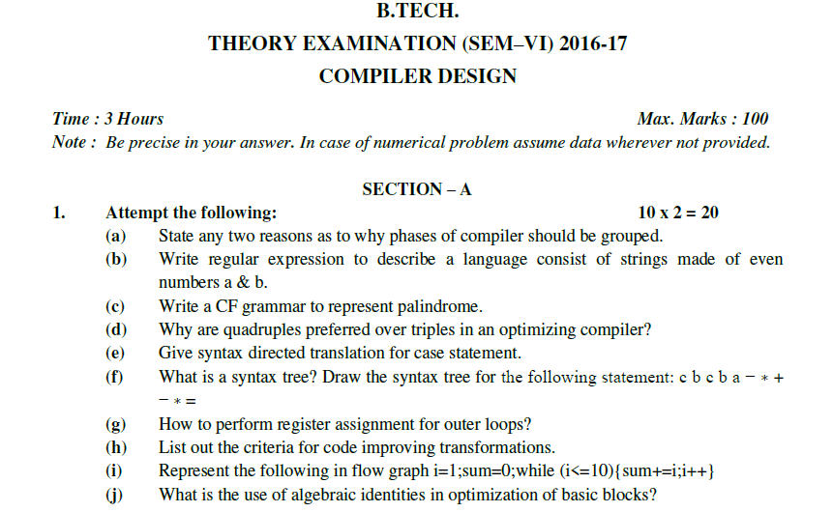
Old Question Papers

Slide 88
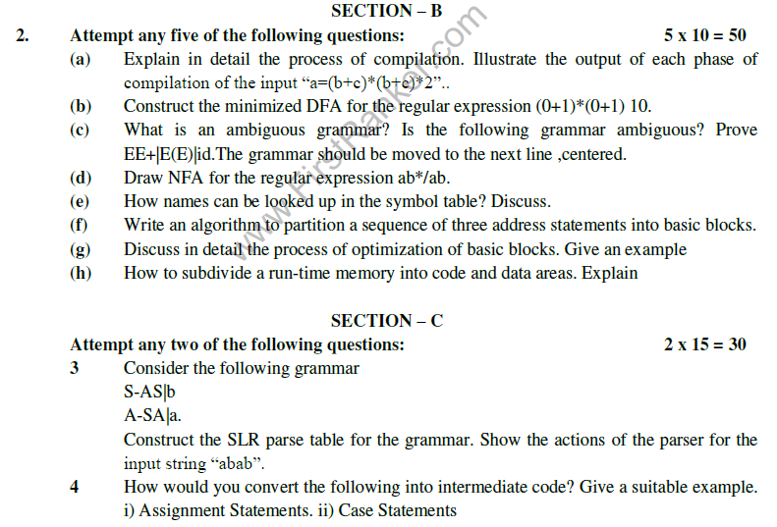
Old Question Papers

Slide 89
Old Question Papers

Slide 90
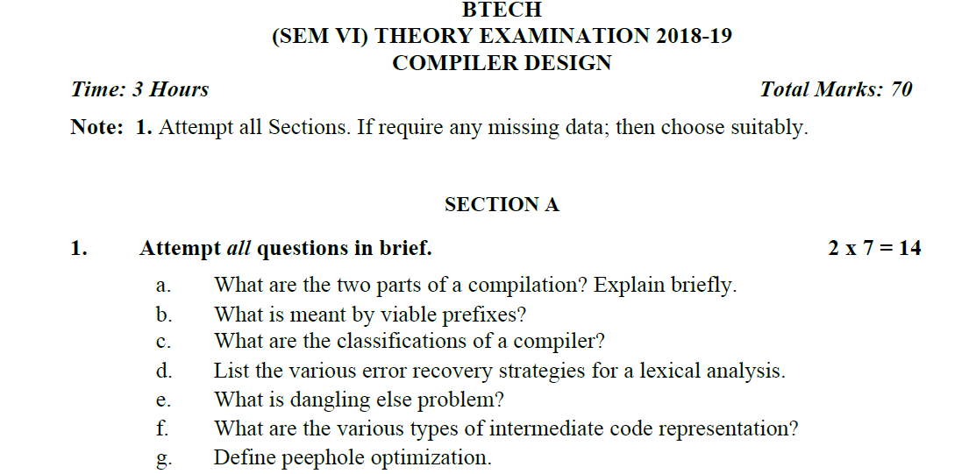
Old Question Papers

Slide 91
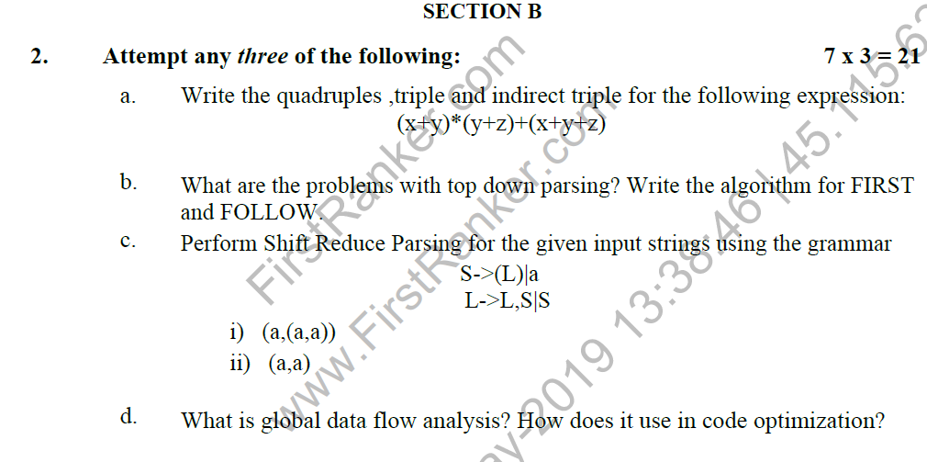
Old Question Papers

Slide 92
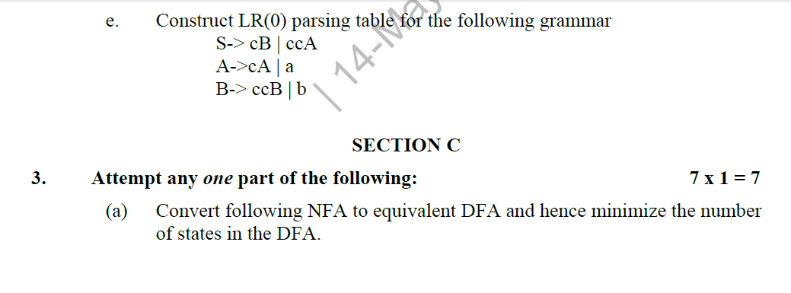
Old Question Papers

Slide 93
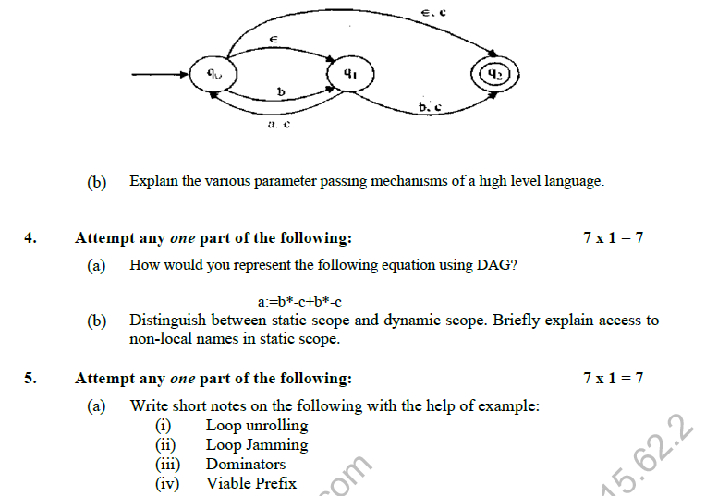
Old Question Papers

Slide 94
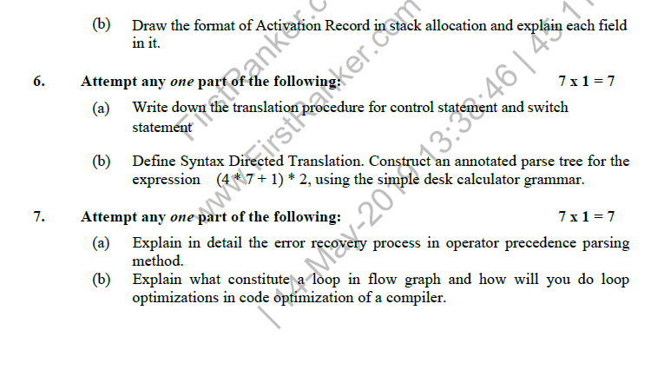
Old Question Papers

Slide 95
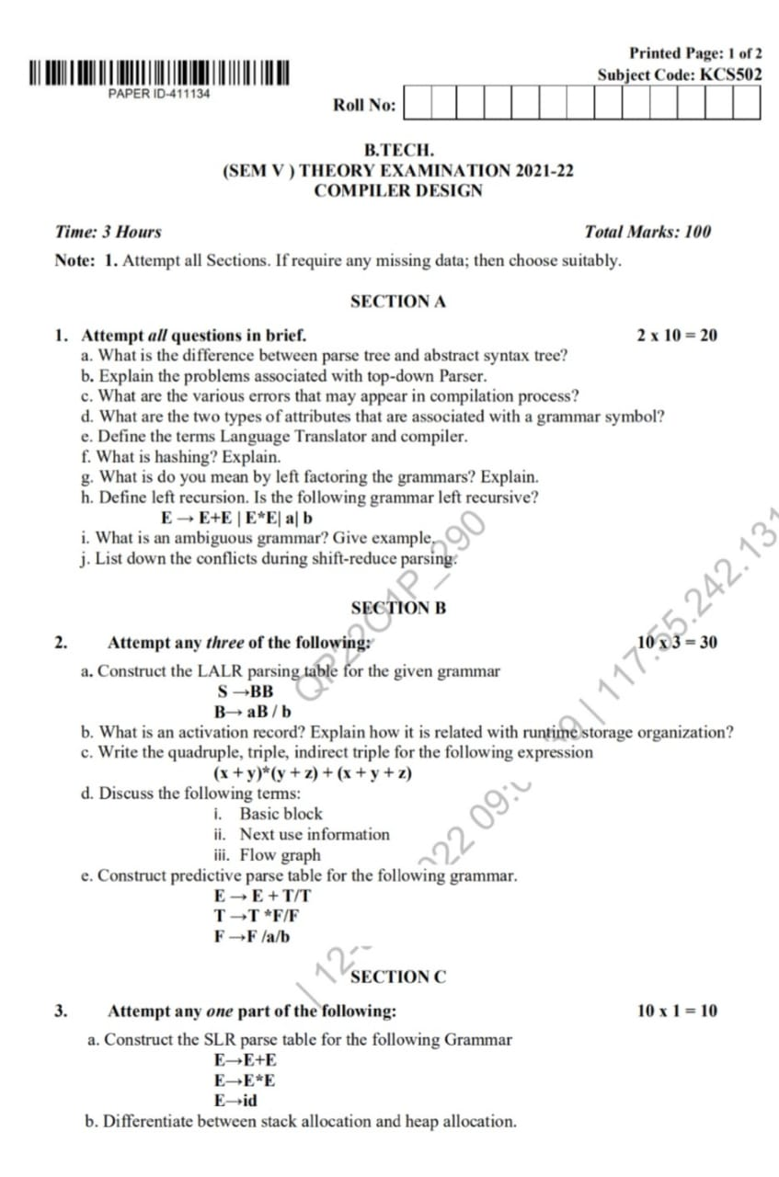
Old Question Papers

Slide 96
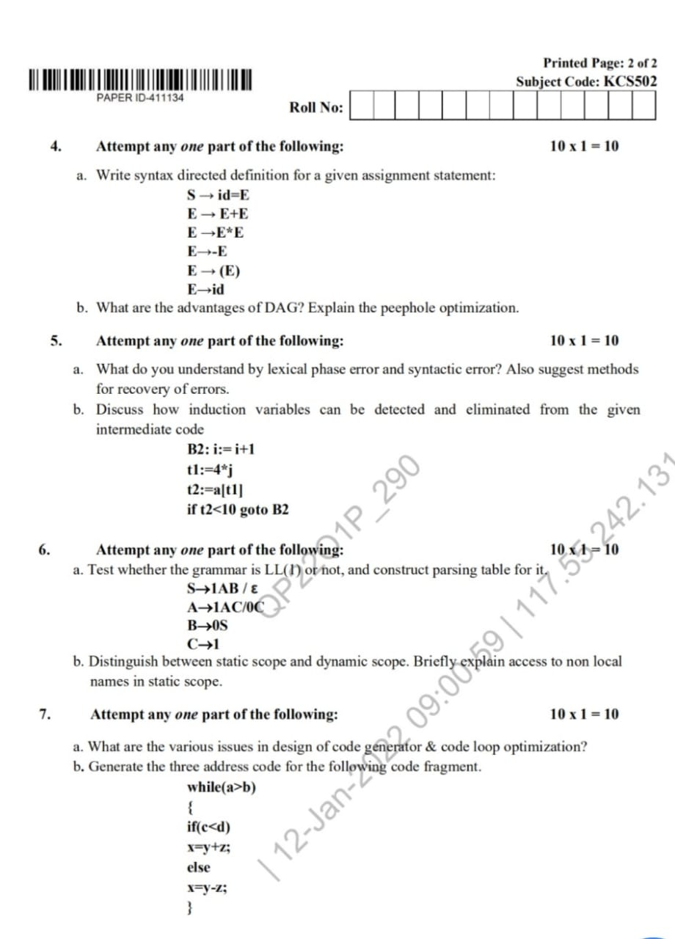
Old Question Papers

Slide 97
Expected Questions for University Exam
Explain syntax directed translation with example?
Explain three address coding system and its implementation by example.
Consider the Boolean expression x > y or ( z > k and not r < s). This expression can be parsed by using the following grammar and a marker for back patching. Build up the parse tree. Write the semantic actions for the grammar. Generate the intermediate code of expression using following grammar.
B→ B or B
B→ B and B
B→ not B
B→ (B)
B→ id
B→ id relop id

Slide 98
Expected Questions for University Exam
While (a<=b)
{
If (x<=y)
{
w= x + y * z ;
a ++;
}
Else
{
w=x-y;
b --;
}
}
Consider the above program fragment and answer the following question.
(i) Write control flow representation in postfix notation.
(ii) Write three address notations.

Slide 99
Recap of Unit
A syntax-directed translation is defined by associating a translation rule with each grammar rule.
A translation rule defines the translation of the left-hand-side nonterminal as a function of the right-hand-side nonterminals' translations, and the values of the right-hand-side terminals.
To compute the translation of a string, build the parse tree, and use the translation rules to compute the translation of each nonterminal in the tree, bottom-up; the translation of the string is the translation of the root nonterminal.

Slide 100
References
Principles of Compiler Design Textbook by Alfred Aho and Jeffrey Ullman
Principle of Compiler Design, A.V.Aho, Rabi Sethi, J.D.Ullman.
Compilers: Principles, Techniques and Tools A.V.Aho, Monica S. Lam, Rabi Sethi, J.D.Ullman
https://www.geeksforgeeks.org/compiler-design-tutorials/
https://www.javatpoint.com/compiler-tutorial
https://www.tutorialspoint.com/compiler_design/index.htm
https://nptel.ac.in/courses/106105190/

Slide 101
Noida Institute of Engineering and Technology, Greater Noida
Thank You

