Slide 1

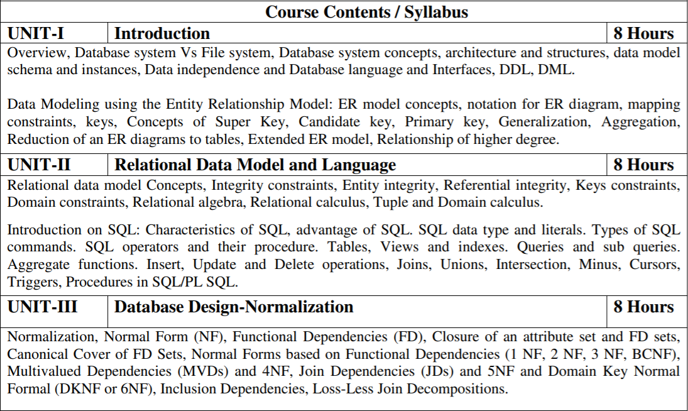
Subject Syllabus
Sana Anjum ACSE0506 DBMS Unit-3

Slide 2
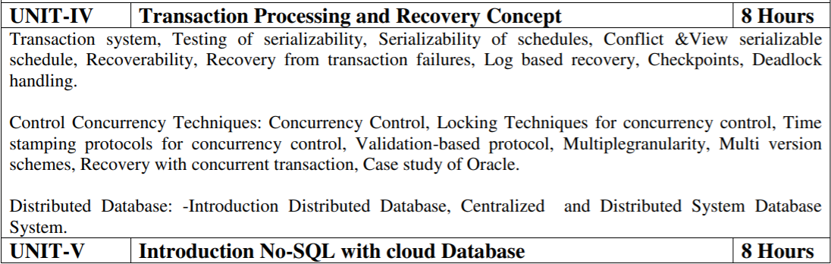
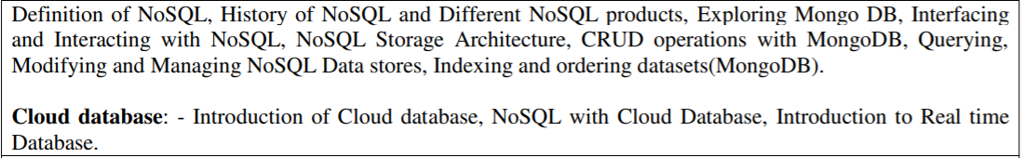
Subject Syllabus
Sana Anjum ACSE0506 DBMS Unit-3

Slide 3
Branch-wise Applications
There are various application of DBMS in different fields like Railway Reservation System, Library Management System, Banking, Universities and colleges, Credit card transactions etc
Sana Anjum ACSE0506 DBMS Unit-3

Slide 4
Course Objectives
Present an introduction to database management systems, with an emphasis on how to organize, maintain and retrieve - efficiently, and effectively - information from a DBMS.
Differentiate between database system and file system.
Knowledge of the different models like database modeling, relational, hierarchical and network models.
Explain basic issues of transaction processing and concurrency control.
Sana Anjum ACSE0506 DBMS Unit-3

Slide 5
Course Outcomes
S. NO. | Course Outcomes | Blooms’ Taxonomy
1. | Apply knowledge of database for real life applications. | K3
2. | Apply query processing techniques to automate the real time problems of databases. | K3, K4
3. | Identify and solve the redundancy problem in database tables using normalization | K2, K3
4. | Understand the concepts of transactions, their processing so they will familiar with broad range of database management issues including data integrity, security and recovery. | K2, K4
5. | Design, develop and implement a small database project using database tools. | K3, K6
Sana Anjum ACSE0506 DBMS Unit-3

Slide 6
Program Outcomes
Engineering Graduates will be able to:
1. Engineering knowledge: Apply the knowledge of mathematics, science, engineering fundamentals, and an engineering specialization to the solution of complex engineering problems.
2. Problem analysis: Identify, formulate, review research literature, and analyze complex engineering problems reaching substantiated conclusions using first principles of mathematics, natural sciences, and engineering sciences.
3. Design/development of solutions: Design solutions for complex engineering problems and design system components or processes that meet the specified needs with appropriate consideration for the public health and safety, and the cultural, societal, and environmental considerations.
4. Conduct investigations of complex problems: Use research-based knowledge and research methods including design of experiments, analysis and interpretation of data, and synthesis of the information to provide valid conclusions.
Sana Anjum ACSE0506 DBMS Unit-3

Slide 7
Program Outcomes
Contd..
5. Modern tool usage: Create, select, and apply appropriate techniques, resources, and modern engineering and IT tools including prediction and modeling to complex engineering activities with an understanding of the limitations.
6. The engineer and society: Apply reasoning informed by the contextual knowledge to assess societal, health, safety, legal and cultural issues and the consequent responsibilities relevant to the professional engineering practice.
7. Environment and sustainability: Understand the impact of the professional engineering solutions in societal and environmental contexts, and demonstrate the knowledge of, and need for sustainable development.
8. Ethics: Apply ethical principles and commit to professional ethics and responsibilities and norms of the engineering practice.
Sana Anjum ACSE0506 DBMS Unit-3

Slide 8
Program Outcomes
Contd..
9. Individual and team work: Function effectively as an individual, and as a member or leader in diverse teams, and in multidisciplinary settings.
10. Communication: Communicate effectively on complex engineering activities with the engineering community and with society at large, such as, being able to comprehend and write effective reports and design documentation, make effective presentations, and give and receive clear instructions.
11. Project management and finance: Demonstrate knowledge and understanding of the engineering and management principles and apply these to one’s own work, as a member and leader in a team, to manage projects and in multidisciplinary environments.
12. Life-long learning: Recognize the need for, and have the preparation and ability to engage in independent and life-long learning in the broadest context of technological change.
Sana Anjum ACSE0506 DBMS Unit-3

Slide 9
Program Specific Outcomes
On successful completion of graduation degree the Computer Science & Engineering graduates will be able to:
PSO1: | Work as a software developer, database administrator, tester or networking engineer for providing solutions to the real world and industrial problems. ​
PSO2: | Apply core subjects of information technology related to data structure and algorithm, software engineering, web technology, operating system, database and networking to solve complex IT problems. ​
PSO3: | Practice multi-disciplinary and modern computing techniques by lifelong learning to establish innovative career.
PSO4: | Work in a team or individual to manage projects with ethical concern to be a successful employee or employer in IT industry.
Sana Anjum ACSE0506 DBMS Unit-3

Slide 10
Program Educational Objectives
PEO1: Able to apply sound knowledge in the field of information technology to fulfill the needs of IT industry.
PEO2: Able to design innovative and interdisciplinary systems through latest digital technologies.
PEO3: Able to inculcate professional ethics, team work and leadership for serving the society.
PEO4: Able to inculcate lifelong learning in the field of computing for successful career in organizations and R&D sectors.
Sana Anjum ACSE0506 DBMS Unit-3

Slide 11
CO-PO Mapping
CO | PO1 | PO2 | PO3 | PO4 | PO5 | PO6 | PO7 | PO8 | PO9 | PO10 | PO11 | PO12
1. | 2 | 2 | 3 | 3 | 3 | 2 | 3 | 2 | 2 | 2 | 2 | 3
2. | 3 | 3 | 3 | 2 | 2 | 2 | 2 | 2 | 2 | 2 | 2 | 3
3. | 2 | 3 | 3 | 3 | 3 | 2 | 2 | 2 | 2 | 2 | 2 | 2
4. | 2 | 3 | 2 | 2 | 2 | 2 | 2 | 2 | 2 | 3 | 2 | 2
5. | 2 | 3 | 2 | 2 | 2 | 3 | 2 | 2 | 3 | 2 | 2 | 2
AVG | 2.20 | 2.80 | 2.60 | 2.40 | 2.40 | 2.20 | 2.20 | 2.00 | 2.20 | 2.20 | 2.00 | 2.40
Sana Anjum ACSE0506 DBMS Unit-3

Slide 12
CO-PSO Mapping
CO | Program Specific Outcomes
 | PSO1 | PSO2 | PSO3 | PSO4
1. | 3 | 1 | 3 | 1
2. | 3 | 1 | 3 | 1
3. | 3 | 1 | 3 | 1
4. | 3 | 1 | 3 | 1
5. | 3 | 1 | 3 | 1
AVG | 3.00 | 1.00 | 3.00 | 1.00
Sana Anjum ACSE0506 DBMS Unit-3

Slide 13
CO-PEO Mapping
CO | Program Educational Objectives
 | PEO1 | PEO2 | PEO3 | PEO4
1. | 3 | 1 | 3 | 1
2. | 3 | 1 | 3 | 1
3. | 3 | 1 | 3 | 1
4. | 3 | 1 | 3 | 1
5. | 3 | 1 | 3 | 1
AVG | 3.00 | 1.00 | 3.00 | 1.00
Sana Anjum ACSE0506 DBMS Unit-3

Slide 14
Prerequisite/Recap
A good background in DBMS fundamentals is required.
Students should be comfortable with the relational model, SQL, and the basic functions of database systems.
The proper understanding of data structures and algorithms will help you to understand the DBMS quickly.
Recap
  In last unit we studied about
    Relational Data Model
      Relational Algebra Query
      Relational Calculus Query
    Structured Query Language
Sana Anjum ACSE0506 DBMS Unit-3

Slide 15
Unit Content
Normalization
Normal Form
Functional Dependencies
Closure of an attribute set and canonical cover of FD sets
Normal forms
  1NF
  2NF
  3NF
  BCNF
  4NF
  5NF
Loss less join decompositions
Multivalued dependencies
Join dependencies
Inclusion dependencies
Sana Anjum ACSE0506 DBMS Unit-3

Slide 16
You tube Video Links
Youtube/other Video Links
https://www.youtube.com/watch?v=1yUkun2r0N4
https://www.youtube.com/watch?v=EFdvRm5nse0
Sana Anjum ACSE0506 DBMS Unit-3

Slide 17
Unit Objectives
Students will be able to learn Functional dependency that is a relationship that exists when one attribute uniquely determines another attribute.
Normalization to minimizing redundancy from a relation or set of relations. It deals with insertion, deletion, and update anomalies. So, it helps to minimize the redundancy in relations that are used to eliminate or reduce redundancy in database tables to create a good database.
Sana Anjum ACSE0506 DBMS Unit-3

Slide 18
Topic 1 Objectives
To learn the Informal Design Guidelines for Relational Databases
1.1Semantics of the Relation Attributes
1.2 Redundant Information in Tuples and Update Anomalies
1.3 Null Values in Tuples
1.4 Spurious Tuples
To Summarize the Informal database Design.
Sana Anjum ACSE0506 DBMS Unit-3

Slide 19
1.1 Normalization (CO3)
Normalization is the process of structuring and handling the relationship between data to minimize redundancy in the relational table.
It avoids the unnecessary anomalies from the database like insertion, updation and deletion.
It helps to divide large database tables into smaller tables and make a relationship between them.
It can remove the redundant data and ease to add, manipulate or delete table fields.
Sana Anjum ACSE0506 DBMS Unit-3

Slide 20
1.1 Normalization (CO3)
A normalization defines rules for the relational table as to whether it satisfies the normal form.
A normal form is a process that evaluates each relation against defined criteria and removes the multi-valued, joins, functional and trivial dependency from a relation.
If any data is updated, deleted or inserted, it does not cause any problem for database tables and help to improve the relational table' integrity and efficiency.
Sana Anjum ACSE0506 DBMS Unit-3

Slide 21
1.1 Anomalies (CO3)
Student Table:
StudReg. CourseID StudName Address Course
6204 James Los Angeles Economics
205 6247 James Los Angeles Economics
6247 TrentBolt New York Mathematics
6204 Ritchie Rich Egypt Computer
230 6208 Ritchie Rich Egypt Accounts
There are two students in the above table, 'James' and 'Ritchie Rich', whose records are repetitive when we enter a new CourseID. Hence it repeats the studRegistration, StudName and address attributes.
Sana Anjum ACSE0506 DBMS Unit-3

Slide 22
1.1 Anomalies (CO3)
Insert Anomaly: An insert anomaly occurs in the relational database when some attributes or data items are to be inserted into the database without existence of other attributes. For example, In the Student table, if we want to insert a new courseID, we need to wait until the student enrolled in a course. In this way, it is difficult to insert new record in the table. Hence, it is called insertion anomalies.
Update Anomalies: The anomaly occurs when duplicate data is updated only in one place and not in all instances. Hence, it makes our data or table in inconsistent state. For example, suppose there is a student 'James' who belongs to Student table. If we want to update the course in the Student table, we need to update the same in the course table; otherwise, the data can be inconsistent. And it reflects the changes in a table with updated values where some of them will not.
Sana Anjum ACSE0506 DBMS Unit-3

Slide 23
1.1 Anomalies (CO3)
Delete Anomalies: An anomaly occurs in a database table when some records are lost or deleted from the database table due to the deletion of other records. For example, if we want to remove Trent Bolt from the Student table, it also removes his address, course and other details from the Student table. Therefore, we can say that deleting some attributes can remove other attributes of the database table.
So, we need to avoid these types of anomalies from the tables and maintain the integrity, accuracy of the database table. Therefore, we use the normalization concept in the database management system.
Sana Anjum ACSE0506 DBMS Unit-3

Slide 24
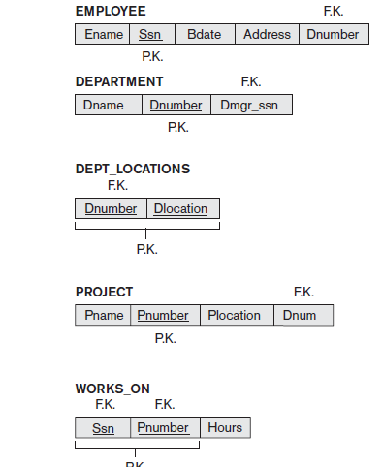
A Simplified Company Relational Database Schema (CO3)
Sana Anjum ACSE0506 DBMS Unit-3

Slide 25
Redundant Information in Tuples and Update Anomalies (CO3)
Redundant Information in Tuples
One goal of schema design is to minimize the storage space used by the database relations (and hence the corresponding files). Grouping attributes into relation schemas has a significant effect on storage space.
Sana Anjum ACSE0506 DBMS Unit-3

Slide 26
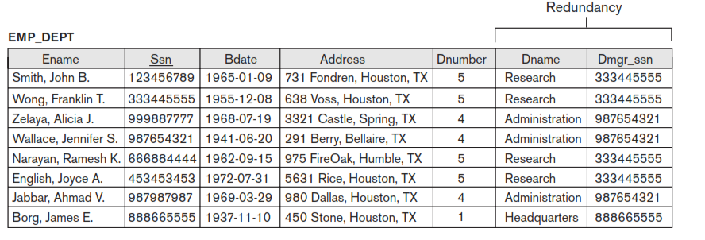
Redundant Information in Tuples and Update Anomalies (CO3)
GUIDELINE 1: Mixing attributes of multiple entities may cause problems.
1. Information is stored redundantly wasting storage, compare the space used by the two database relations EMPLOYEE and DEPARTMENT in with that for an EMP_DEPT database relation . (Wastage of Space by Emp_Dept)
Sana Anjum ACSE0506 DBMS Unit-3

Slide 27
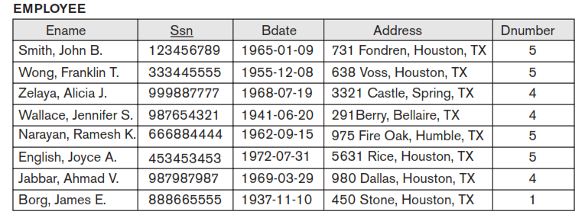
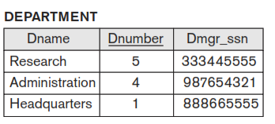
Redundant Information in Tuples (CO3)
Example :- Good database Design Approach
Sana Anjum ACSE0506 DBMS Unit-3

Slide 28
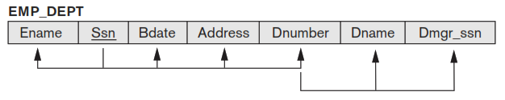
Example of Violating Guideline 1 (CO3)
Attributes of different entities should not be mixed in the same relation
Informally, each tuple in a relation should represent one entity or relationship instance.
Design a schema that can be explained easily relation by relation. The semantics of attributes should be easy to interpret.
Sana Anjum ACSE0506 DBMS Unit-3

Slide 29

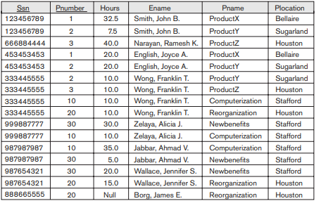
Problems with Update anomalies (CO3)
Update Anomaly:- An update anomaly is a data inconsistency that results from data redundancy and a partial update.
Consider the relation:
Update Anomaly: Changing the name of project number 1 from “ProductX” to “ProductABC” may cause this update to be made for all n employees working on project 1.
Sana Anjum ACSE0506 DBMS Unit-3

Slide 30
Types of anomalies (CO3)
  Insertion anomalies
  Deletion anomalies
  Modification anomalies
Sana Anjum ACSE0506 DBMS Unit-3

Slide 31
Insertion anomalies (CO3)
1. To insert a new employee tuple into EMP_DEPT, we must include either the attribute values for the department that the employee works for, or NULLs (if the employee does not work for a department as yet).
Example
2. But, It is difficult to insert a new department that has no employees as yet in the EMP_DEPT relation. The only way to do this is to place NULL values in the attributes for employee. This violates the entity integrity for EMP_DEPT because its primary key Ssn cannot be null.
Sana Anjum ACSE0506 DBMS Unit-3

Slide 32
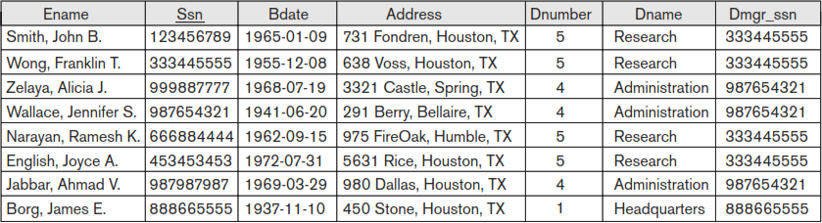
Deletion anomalies (CO3)
The problem of deletion anomalies is related to the second insertion anomaly situation just discussed. If we delete from table EMP_DEPT an employee tuple that happeInsertion anomalies (CO3)
ns to represent the last employee working for a particular department, the information concerning that department is lost accidentally from the database.
Example :- Emp_Dept
When a department is deleted, it will result in deleting all the employees who work only for that department. Alternately, if an employee is the sole employee for that department, deleting that employee would result in deleting the corresponding department.
Sana Anjum ACSE0506 DBMS Unit-3

Slide 33
Modification anomalies (CO3)
In EMP_DEPT, if we change the value of one of the attributes of a particular department—say, the manager of department 5—we must update the tuples of all employees who work in that department;
otherwise, the database will become inconsistent. If we fail to update some tuples, the same department will be shown to have two different values for manager in different employee tuples, which would be wrong.
Example :- Emp_Dept
Sana Anjum ACSE0506 DBMS Unit-3

Slide 34
Guidelines to Redundant Information in Tuples and Update anomalies (CO3)
It is easy to see that these three anomalies are undesirable and cause difficulties to maintain consistency of data as well as require unnecessary updates that can be avoided; hence, we can state the next guideline as follows:-
Guideline 2. Design the database relation schemas so that no insertion, deletion, or modification anomalies are present in the relations. If any anomalies are present, note them clearly and make sure that the programs that update the database will operate correctly.
Sana Anjum ACSE0506 DBMS Unit-3

Slide 35
No Anomaly and no redundancy exists (CO3)
Sana Anjum ACSE0506 DBMS Unit-3

Slide 36
Null Values in Tuples (CO3)
In some schema designs we may group many attributes together into a “fat” relation. If many of the attributes do not apply to all tuples in the relation, we end up with many NULLs in those tuples.
Example
This can waste space at the storage level and may also lead to problems with understanding the meaning of the attributes and with specifying JOIN operations at the logical level.
Another problem with NULLs is how to account for them when aggregate operations such as COUNT or SUM are applied
Note :- If NULL values are present, the results may become unpredictable.
Sana Anjum ACSE0506 DBMS Unit-3

Slide 37
Guideline: Null Values in Tuples (CO3)
GUIDELINE 3: As far as possible, avoid placing attributes in a database relation whose values may frequently be NULL. If NULLs are unavoidable, make sure that they apply in exceptional cases only and do not apply to a majority of tuples in the relation.
Relations should be designed such that their tuples will have as few NULL values as possible (wastage of space in storage level and difficulties in JOIN operation with NULL values).
Attributes that are NULL frequently could be placed in separate relations (with the primary key).
Sana Anjum ACSE0506 DBMS Unit-3

Slide 38
Summary of Informal Database Design (CO3)
The problems we pointed out, which can be detected without additional tools of analysis, are as follows:-
Anomalies that cause redundant work to be done during insertion into and modification of a relation, and that may cause accidental loss of information during a deletion from a relation.
Waste of storage space due to NULLs and the difficulty of performing selections, aggregation operations, and joins due to NULL values.
Generation of invalid and spurious data during joins on database relations with matched attributes that may not represent a proper (foreign key, primary key) relationship
Sana Anjum ACSE0506 DBMS Unit-3

Slide 39
Summary of Informal Database Design (CO3)
We present informal concepts and theory that may be used to define the goodness and badness of individual relation schemas more precisely.
Now we discuss functional dependency as a tool for analysis.
Sana Anjum ACSE0506 DBMS Unit-3

Slide 40
Faculty Video Links, Youtube & NPTEL Video Links and Online Courses Details
You tube /other Video Links
https://nptel.ac.in/courses/106/104/106104135/
https://nptel.ac.in/courses/106106220/
https://www.youtube.com/watch?v=1057YmExS-I
Sana Anjum ACSE0506 DBMS Unit-3

Slide 41
Topic 2 Objectives (CO3)
To understand the concept of Functional dependency.
To learn the different types of Functional dependency.
Sana Anjum ACSE0506 DBMS Unit-3

Slide 42
2.1 Functional Dependency (CO3)
We now introduce a formal tool for analysis of relational schemas that enables us to detect and describe some of the above-mentioned problems in precise terms.
The single most important concept in relational schema design theory is that of a functional dependency.
Important points for FD are
Functional dependencies is a constraint between 2 sets of attributes
Functional dependencies (FDs) are used to specify formal measures of the "goodness" of relational schema designs
FDs and keys are used to define normal forms for relations
FDs are constraints that are derived from the meaning and interrelationships of the data attributes.
Sana Anjum ACSE0506 DBMS Unit-3

Slide 43
2.1 Definition of Functional Dependency (CO3)
A functional dependency, denoted by X → Y, between two sets of attributes X and Y that are subsets of R specifies a constraint on the possible tuples that can form a relation state r of R.
The constraint is that, for any two tuples t1 and t2 in r that have t1[X] = t2[X], they must also have t1[Y] = t2[Y].
This means that the values of the Y component of a tuple in r depend on, or are determined by, the values of the X component;
Alternatively, the values of the X Component of a tuple uniquely (or functionally) determine the values of the Y component. We also say that there is a functional dependency from X to Y, or that Y is functionally dependent on X.
Sana Anjum ACSE0506 DBMS Unit-3

Slide 44
FD on key and non-key attributes (CO3)
Functional dependency exists between the primary key and non-key attribute within a table.
FD on Non Key Attribute
Thus, X functionally determines Y in a relation schema R if, and only if, whenever two tuples of r(R) agree on their X-value, they must necessarily agree on their Y-value.
FD on Key Attribute
If a constraint on R states that there cannot be more than one tuple with a given X-value in any relation instance r(R)—that is, X is a candidate key of R—this implies that X → Y for any subset of attributes Y of R (because the key constraint implies that no two tuples in any legal state r(R) will have the same value of X). If X is a candidate key of R, then X → R.
If X → Y in R, this does not say whether or not Y → X in R.
Sana Anjum ACSE0506 DBMS Unit-3

Slide 45
Example
Rollno | Name | Marks
1 | A | 10
2 | B | 20
1 | A | 10
4 | B | 20
5 | C | 30
6 | D | 30
Sana Anjum ACSE0506 DBMS Unit-3

Slide 46
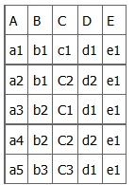
Example
Let us Consider the following table of data r(R) of the relation schema R(ABCDE) shown in
Since the values of A are unique (a1, a2, a3, etc.), it follows from the FD definition that:-
A → B, A → C, A → D, A → E,
Means A attribute uniquely identifies the B,C,D,E attribute of R relation because if we know the A we can tell the B,C,D,E associated with it.
This can be also write as A →BCDE.
From our understanding of primary keys, A is a primary key.
Sana Anjum ACSE0506 DBMS Unit-3

Slide 47
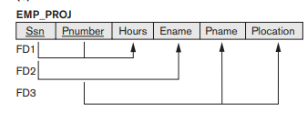
Diagrammatic Representation for displaying FD(CO3)
Consider the relation schema EMP_PROJ from the semantics of the attributes and the relation, we know that the following functional dependencies should hold:-
a. Pnumber → {Pname, Plocation}
b. Ssn → Ename
c. {Ssn, Pnumber} → Hours
Pnumber uniquely determines Pname and Plocation.
Ssn of an employee uniquely determines the Ename.
Combination of Ssn & Pnumber uniquely determines the Hours
Sana Anjum ACSE0506 DBMS Unit-3

Slide 48
Types of FD(CO3)
There are mainly two types of Functional Dependency in DBMS.
Following are the types of Functional Dependencies in DBMS:
Trivial Functional Dependency
Non-Trivial Functional Dependency
Sana Anjum ACSE0506 DBMS Unit-3

Slide 49
Trivial FD(CO3)
The Trivial dependency is a set of attributes which are called a trivial if the set of attributes are included in that attribute.
So, X -> Y is a trivial functional dependency if Y is a subset of X.
Let’s understand with a Trivial Functional Dependency Example.
For example:
{Emp_id, Emp_name} -> Emp_id is a trivial functional dependency as Emp_id is a subset of {Emp_id,Emp_name}.
Emp_id | Emp_name
AS555 | Harry
AS811 | George
AS999 | Kevin
Sana Anjum ACSE0506 DBMS Unit-3

Slide 50
Non-Trivial FD(CO3)
Non Trivial Functional Dependency in DBMS
Functional dependency which also known as a nontrivial dependency occurs when A->B holds true where B is not a subset of A. In a relationship, if attribute B is not a subset of attribute A, then it is considered as a non-trivial dependency.
Example:
(Company} -> {CEO} (if we know the Company, we knows the CEO name)
But CEO is not a subset of Company, and hence it’s non-trivial functional dependency.
Company | CEO | Age
Microsoft | Satya Nadella | 51
Google | Sundar Pichai | 46
Apple | Tim Cook | 57
Sana Anjum ACSE0506 DBMS Unit-3

Slide 51
Topic 3 Objectives
To understand the various Inference rules applied on FDs.
Sana Anjum ACSE0506 DBMS Unit-3

Slide 52
Inference Rules for functional dependency(CO3)
An inference rule is an assertion that we can apply to a set of functional dependencies to derive other functional dependencies.
We denote by F the set of functional dependencies that are specified on relation schema R.
Inference rules are sound meaning that they are an immediate consequence of the definition of FD and that only FD that can be derived from a relation from a given set of FD using them to true.
So, inference rules can be used to find all the derived FD’s logically by a set of FD is true and complete.
Sana Anjum ACSE0506 DBMS Unit-3

Slide 53
Definition and Armstrong Axioms(CO3)
Definition:
An FD X → Y is inferred from or implied by a set of dependencies F specified on R if X → Y holds in every legal relation state r of R; that is, whenever r satisfies all the dependencies in F, X → Y also holds in r.
Inference rules basically based on Armstrong axiom.
Armstrong Axiom basic inference rules are :-
1. IR1 (reflexive rule) : If X ⊇ Y, then X →Y.
2. IR2 (augmentation rule) : {X → Y} |= XZ → YZ.
3. IR3 (transitive rule): {X → Y, Y → Z} |= X → Z.
IR1, IR2, IR3 form a sound and complete set of inference rules
Sana Anjum ACSE0506 DBMS Unit-3

Slide 54
Armstrong Axioms (CO3)
There are three other inference rules that follow from IR1, IR2 and IR3.
They are as follows:
4. IR4 (decomposition, or projective, rule): {X → YZ} |=X → Y,
X →Z
5. IR5 (union, or additive, rule): {X → Y, X → Z} |=X → YZ.
6 . IR6 (pseudotransitive rule): {X → Y, WY → Z} |=WX → Z.
Note:- Rules from IR1 to IR3 are known as Armstrong Axiom rules. These rules are mainly used in FD to find complete set of all possible dependencies.
Sana Anjum ACSE0506 DBMS Unit-3

Slide 55
Continued
Note:-
Armstrong axioms are complete. As for a given set F of functional dependencies, all FD implied by F can be inferred by using rules IR1 through IR3.
Armstrong axiomS are also sound as to no additional FD or incorrect FD’s can be deduced from F by using inference rules.
Sana Anjum ACSE0506 DBMS Unit-3

Slide 56
Exercise
Prove or disprove the following inference rules:-
  {W→Y,X→Z} |= {WX→Y}
  {X→Z,Y →Z} |= {X→Y}
  {X→Y,Y →W} |= {XZ→YW}
Sana Anjum ACSE0506 DBMS Unit-3

Slide 57
Exercise
Prove or disprove the following inference rules
  {W→Y,X→Z} |= {WX→Y}
  {X→Y,X→W,WY→Z} |= {X→Z}
  {X→Y} |= {X→YZ}
  {X→Y, Z →Y} |= {XZ→Y}
Sana Anjum ACSE0506 DBMS Unit-3

Slide 58
Practice Questions
Let us consider the Universal relation schema R = ( A, B, C, G, H, I ) and the set of functional dependencies F ={ A → B, A → C, CG → H, CG → I , B → H}.
Determines the other FD’s from given set of FD F.
Answer:-
Given F= { A → B, A → C, CG → H, CG → I , B → H}.
Since A → B and B → H hold, we apply the transitivity rule that A → H
Since CG → H and CG → I , the union rule implies that CG → HI.
Since A → C and CG → I , the pseudo-transitivity rule implies that AG → I holds
Since A → B and A→ C hold, we apply the union rules that A → BC
All possible FD are:-
F’= { A → B, A → C, CG → H, CG → I , B → H, A → H, CG → HI ,A →BC, AG → I }.
Sana Anjum ACSE0506 DBMS Unit-3

Slide 59
Topic 4,5 Objectives
To calculate the closure of attribute set.
To understand the definitions of keys.
To find the super key and candidate key from FD.
Sana Anjum ACSE0506 DBMS Unit-3

Slide 60
Closure of Attribute set (CO3)
After finding a set of FD’s that are hold on a relation the next step is to find super key and candidate key for a relation and,
Also to test whether a set X is a super key, we must devise an algorithm for computing the set of attributes functionally determined by X.
Sana Anjum ACSE0506 DBMS Unit-3

Slide 61
Algorithm for closure of Attribute set (CO3)
The set of attribute that are functionally dependent on the attribute X is called attribute closure of X and it can be represented by X^{+.}
Or
For each such set of attributes X, we determine the set X⁺ of attributes that are functionally determined by X based on F;
X⁺ is called the closure of X under F.
Algorithm :- Determining X⁺, the Closure of X under F .
Input: A set F of FDs on a relation schema R, and a set of attributes X, which is a subset of R.
X⁺ := X;
repeat
old X⁺ := X⁺;
for each functional dependency Y → Z in F do
if X⁺ ⊇ Y then X⁺ := X⁺ ∪ Z;
until (X⁺ = old X⁺);
Sana Anjum ACSE0506 DBMS Unit-3

Slide 62
Example
Question 1:-
To compute the closure for relation schema R ={A,B,C,G,H,I} and F= {A → B,A → C,CG → H, CG → I,B → H,C → G).
Find the closure of A under F . Or {A⁺ =}
Question 2:-
To compute the closure for relation schema R ={A,B,C,D,E} and F= {A → BC,CD → E,B → D, E → A}.
Find the closure of A and CD under F . or {A⁺ =} and { CD ⁺ =}
Sana Anjum ACSE0506 DBMS Unit-3

Slide 63
Definition of Keys and attributes in Participating relation (CO3)
A super key of a relation schema R = {A1, A2, … , An} is a set of attributes S ⊆ R with the property that no two tuples t1 and t2 in any legal relation state r of R will have t1[S] = t2[S].
If a relation schema has more than one key, each is called a candidate key.
One of the candidate keys is designated to be the primary key, and the others are called secondary keys. In a practical relational database, each relation schema must have a primary key.
If no candidate key is known for a relation, the entire relation can be treated as a default super key.
An attribute of relation schema R is called a prime attribute of R if it is a member of some candidate key of R.
An attribute is called nonprime if it is not a prime attribute—that is, if it is not a member of any candidate key.
Sana Anjum ACSE0506 DBMS Unit-3

Slide 64
Find the super key and candidate key from FD (CO3)
Definition :- The set of attribute whose closure of attribute is set of all attribute of a relation called super key of relation and if this is set of minimal of it is called of candidate key.
Formally say ,
Let R is the relation and X is the set of attribute over R.
If X⁺ determines all the attributes of R, then X is said to be super key, or candidate key of R.
To find the candidate key first find all the super key of a relation. (because the candidate key is a minimal set of super key).
Sana Anjum ACSE0506 DBMS Unit-3

Slide 65
Steps to find the super key and candidate key from FD (CO3)
So To identify super key and candidate key, We need to follow some steps,
Compute the closure for the attribute that combination of attribute on The LHS of FD,
If any closure includes all the attribute of given relation, then that can be denoted as a key for the relation(This would be the set of super key and candidate key).
When we indentify the super key using FD’s and it has extraneous attribute in the super key then,
Now applying the given FD and reduced the set of LHS elements
Repeat Step-4,Apply till the of element of the super key when it is not functionally determines all FD, If fail Stop, otherwise
We determines all FD from a exclusive attribute of super key is true is called candidate key
Sana Anjum ACSE0506 DBMS Unit-3

Slide 66
Example
Question 1-
To find the Keys of relation R={A,B,C,D,E} with FD’s F={A →BC,CD →E,E → A,B → D}.
Question 2-
To find the Keys of relation R={A,B,C,D,E,H} with FD’s F={A →BC,CD →E,E → C,C → AEH,AH →D,DH → BC}.
Sana Anjum ACSE0506 DBMS Unit-3

Slide 67
Topic 6 Objectives
To find the equivalence set of FD.
To find the minimal cover or canonical cover of FD.
Sana Anjum ACSE0506 DBMS Unit-3

Slide 68
Equivalence Sets of FD (CO3)
Definition.
A set of functional dependencies F is said to cover another set of functional dependencies E if every FD in E is also in F+; that is, if every dependency in E can be inferred from F; alternatively, we can say that E is covered by F.
Means,
Two sets of FDs F and E are equivalent if:
- every FD in F can be inferred from E, and
- every FD in E can be inferred from F
Hence, F and E are equivalent if F ⁺ = E ⁺
F and E are equivalent if F covers E and E covers F
Sana Anjum ACSE0506 DBMS Unit-3

Slide 69
Steps to find Equivalence Sets of FD (CO3)
We can determine whether F covers E by calculating X⁺ with respect to F for each FD X → Y in E,
And then checking whether this X⁺ includes the attributes in Y. If this is the case for every FD in E, then F covers E. We determine whether E and F are equivalent by checking that E covers F and F covers E.
Note
If F and G are the two sets of functional dependencies, then following 3 cases are possible-
If all FDs of E can be derived from FDs present in F, we can say that F ⊃ E.
If all FDs of F can be derived from FDs present in E, we can say that E ⊃ F.
3. If 1 and 2 both are true, F=E.
Sana Anjum ACSE0506 DBMS Unit-3

Slide 70
Example
Q1: Given a relational schema R( X, Y, Z, W, V ) set of functional dependencies P and Q such that:
P = { X → Y, XY → Z, W → XZ, W → V} and Q = { X → YZ, W → XV }
using FD sets P and Q which of the following options are
correct?
a) P is a subset of Q
b) Q is a subset of P
c) P = Q
d) P ≠ Q
Sana Anjum ACSE0506 DBMS Unit-3

Slide 71
Example
Using definition of equivalence of FD set, let us determine the right-hand side of the FD set of P using FD set Q.
Given P = { X → Y, XY → Z, W → XZ, W → V} and Q = { X → YZ, W → XV }
Let's find closure of the left side of each FD of P using FD Q.
X+ = XYZ (using X → YZ)
XY+ = XYZ (using X → YZ)
W+ = WXVYZ (using W → XV and X → YZ)
W+ = WXVYZ (using W → XV and X → YZ)
Now compare closure of each X, XY, W and W calculated using FD
Q with the right-hand side of FD P. Closure of each X, XY, W and W
has all the attributes which are on the right-hand side of each FD of P. Hence, we can say P is a subset of Q----------1
Sana Anjum ACSE0506 DBMS Unit-3

Slide 72
Example
Using definition of equivalence of FD set, let us determine the right-hand side of the FD set of Q using FD set P.
Given P = { X → Y, XY → Z, W → XZ, W → V} and Q = { X → YZ, W → XV }
Let us find closure of the left side of each FD of Q using FD P.
X+ = XYZ (using X → Y and XY → Z)
W+ = WXZVY (using W → XZ, W → V, and X → Y)
Now compare closure of each X, W calculated using FD P with the right-hand side of FD Q. Closure of each X and W has all the attributes which are on the right-hand side of each FD of Q. Hence, we can say Q is a subset of P-----------2
From 1 and 2 we can say that P = Q, hence option c) is correct.
Sana Anjum ACSE0506 DBMS Unit-3

Slide 73
Example
Q 2: Given a relational schema R( A, B, C, D ) set of functional dependencies P and Q such that:
P = { A → B, B → C, C → D } and Q = { A → BC, C → D } using FD
sets P and Q which of the following options are correct?
a) P is a subset of Q
b) Q is a subset of P
c) P = Q
d) P ≠ Q
Sana Anjum ACSE0506 DBMS Unit-3

Slide 74
Example
Question 1:-
Let us consider a relation schema R ={A,B,C,D,E} having two functional dependency(FD) set E and F,
E= {A → B, AB → C, D → AC, D → E} and
F = {A → BC, D → AE}
Check wheteher two set are equivalent or not.
Question 2:-
Let us consider a relation schema R ={A,B,C,D,E,H} having two functional dependency(FD) set F and G,
F = {A → C, AC → D, E → AD, E → H}
G = {A → CD, E → AH}
Check wheteher two set are equivalent or not.
Sana Anjum ACSE0506 DBMS Unit-3

Slide 75
Need of Minimal Cover of Functional Dependencies (CO3)
Whenever a user updates database the system must check whether any FD are getting violated in the process, if there is a violation of dependencies in the new database state the system must rollback. If working with a huge set of FD can cause unnecessary added computational time .
Remove the extraneous attribute in FD set and also remove the redundant FD in F and get standard from of FD.
So we can reduce the effort spent in checking for violation by testing a simplified set of FDs, canonical cover comes to play big role for remove redundant FD and find the standard form of FD.
Sana Anjum ACSE0506 DBMS Unit-3

Slide 76
Continued
A minimal cover of a set of functional dependencies E is a set of functional dependencies F that satisfies the property that every dependency in E is in the closure F ⁺ of F.
In addition, this property is lost if any dependency from the set F is removed; F must have no redundancies in it, and the dependencies in F are in a standard form.
Sana Anjum ACSE0506 DBMS Unit-3

Slide 77
Definition of Minimal Cover of Functional Dependencies (CO3)
Definition:- An attribute in a functional dependency is considered an extraneous attribute if we can remove it without changing the closure of the set of dependencies.
Formally, given F, the set of functional dependencies, and a functional dependency X → A in F, attribute Y is extraneous in X if Y ⊂ X, and F logically implies (F − (X → A) ∪ { (X − Y) → A } ).
We can formally define a set of functional dependencies F to be minimal if it satisfies the following conditions: -
1. Every dependency in F has a single attribute for its right-hand side.
2. We cannot replace any dependency X → A in F with a dependency Y → A, where Y is a proper subset of X, and still have a set of dependencies that is equivalent to F.
3. We cannot remove any dependency from F and still have a set of dependencies that is equivalent to F.
Sana Anjum ACSE0506 DBMS Unit-3

Slide 78
Algorithm for Minimal Cover of Functional Dependencies (CO3)
Algorithm:- Finding a Minimal Cover F for a Set of Functional Dependencies E
Input: A set of functional dependencies E.
1. Set F := E.
2. Replace each functional dependency X → {A1, A2, … , An} in F by the n functional dependencies X →A1, X →A2, … , X → An.
3. For each functional dependency X → A in F for each attribute B that is an element of X if { {F − {X → A} } ∪ { (X − {B} ) → A} } is equivalent to F then replace X → A with (X − {B} ) → A in F.
(* The above constitutes a removal of the extraneous attribute B from X *)
4. For each remaining functional dependency X → A in F if {F − {X → A} } is equivalent to F, then remove X → A from F.
(*This constitutes removal of a redundant functional dependency X → A from F when possible*)
Sana Anjum ACSE0506 DBMS Unit-3

Slide 79
Example
Question 1:-
Given a relation schema R = {A,B,C,D,E,F}and a set of functional dependencies F= {AB → C, C → AB, B → C, ABC → AC, A→ C, AC → B }
To find the minimal cover for above given FD’s.
Sol.
Step 1: { AB → C, C → A, C → B, B → C, ABC→ A, ABC → C, A → C, AC → B }
Step 2: { B → C, C → A, C → B, B → C, A → C, A → B}
Step 3: {C → A, B → C, A → B }
Sana Anjum ACSE0506 DBMS Unit-3

Slide 80
Example
Question 1:-
Given a relation schema R = {A,B,C,D,E,F}and a set of functional dependencies F= {AB → C, C → A, BC → D, ACD → B, BE → C, EC → FA,CF → BD, D → E }
To find the minimal cover for above given FD’s.
Question 2:-
Given a relation schema R = {A,B,C,D,E}and a set of functional dependencies F= {A → BC, CD → E,B → D, E → A }
To find the minimal cover for above given FD’s.
Sana Anjum ACSE0506 DBMS Unit-3

Slide 81
Topic 7 Objectives
To understand the definition of Normalization and Normal forms.
To learn the need of Normalization
To analyze the practical use of Normal Forms
To understand the concept of different types of Normalization
First Normal Form(INF)
Second Normal Form (2NF)
Third Normal Form (3NF)
BCNF (Boyce Codd Normal Form)
Fourth normal Form (4NF)
Fifth Normal form (5NF)
Sana Anjum ACSE0506 DBMS Unit-3

Slide 82
Definition of Normalization and Normal Forms (CO3)
Definition :- Normalization is a process of organization the data in database with ensuring well-formed.
Or
The process of decomposing unsatisfactory "bad" relations by breaking up their attributes into smaller relations.
Normal form: Condition using keys and FDs of a relation to
certify whether a relation schema is in a particular normal
form .
Sana Anjum ACSE0506 DBMS Unit-3

Slide 83
Need of Normalization(CO3)
It is the process of analyzing the given relation schemas based on the FD’s and primary key to achieve the desirable properties are :-
Minimizing redundancy
Eliminates the anomalies(for insuring the integrity and consistency of the data).
Ensuring data dependencies make sense i.e. data is logically stored (all prime attribute in a relation )
Dependent on the primary key (Normalization generally involving splitting existing table into multiple ones).
Sana Anjum ACSE0506 DBMS Unit-3

Slide 84
Practical use of Normal Forms (CO3)
Normalization is carried out in practice so that the resulting designs are of high quality and meet the desirable properties.
The practical utility of these normal forms becomes questionable when the constraints on which they are based are hard to understand or to detect.
The database designers need not normalize to the highest possible normal form. (usually up to 3NF, BCNF or 4NF).
De normalization: the process of storing the join of higher normal form relations as a base relation—which is in a lower normal form
Sana Anjum ACSE0506 DBMS Unit-3

Slide 85
Procedure of Normalization (CO3)
In normalization we use the degree of the normal forms in a relation.
The normal form of a relation refer highest normal form condition that it meets, and hence indicate the degree to which it has been normalized.
The top-down process evaluates each relation against the criteria for normal forms and decomposing relations as necessary - relational design by analysis.
Codd proposed 3 normal forms - first, second, and third. A stronger definition of 3NF—called Boyce-Codd normal form (BCNF) - proposed by Boyce and Codd.
All these normal forms are based on a single analytical tool: the functional dependencies among the attributes of a relation.
Later, a fourth normal form (4NF) and a fifth normal form (5NF) were proposed, based on the concepts of multivalued dependencies and join dependencies
Sana Anjum ACSE0506 DBMS Unit-3

Slide 86
Procedure of Normalization (CO3)
Design the good database relation also consider two other properties.
Lossless join or additive join property – which is guarantee that no spurious tuples are generated after the decomposition to the relation reconstructed.
Dependency preservation property :- it is ensure that each FD’s represented in some individual relation resulting after decomposition.
Note :- In practice INF,2NF and 3NF are enough for database normalization.
Sana Anjum ACSE0506 DBMS Unit-3

Slide 87
1. First Normal Form(1NF) (CO3)
A relation will be 1NF if it contains an atomic value.
It states that an attribute of a table cannot hold multiple values. It must hold only single-valued attribute.
First normal form disallows the multi-valued attribute, composite attribute, and their combinations.
EMPLOYEE table:
EMP_ID EMP_NAME EMP_PHONE EMP_STATE
14 John 7272826385, UP
9064738238
20 Harry 8574783832 Bihar
12 Sam 7390372389, Punjab
8589830302
Sana Anjum ACSE0506 DBMS Unit-3

Slide 88
1. First Normal Form(1NF) (CO3)
The decomposition of the EMPLOYEE table into 1NF has been shown below:
EMP_ID EMP_NAME EMP_PHONE EMP_STATE
14 John 7272826385 UP
14 John 9064738238 UP
20 Harry 8574783832 Bihar
12 Sam 7390372389 Punjab
12 Sam 8589830302 Punjab
Sana Anjum ACSE0506 DBMS Unit-3

Slide 89


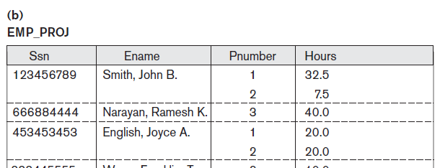
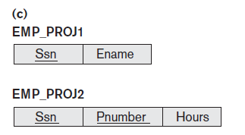
Normalization nested relations into 1NF (CO3)
1. Let us Consider following relation Schema EMP_PROJ.
2. Sample State of relation schema EMP_PROJ.
3. Solution 1NF version relation EMP_PROJ
Sana Anjum ACSE0506 DBMS Unit-3

Slide 90
2. Second Normal Form(2NF) (CO3)
In the 2NF, relation must be in 1NF.
There should not be any partial dependency present.
In the second normal form, all non-key attributes are fully functional dependent on the primary key.
TEACHER table
TEACHER_ID SUBJECT TEACHER_AGE
25 Chemistry 30
25 Biology 30
47 English 35
83 Math 38
83 Computer 38
In the given table, non-prime attribute TEACHER_AGE is dependent on TEACHER_ID which is a proper subset of a candidate key. That's why it violates the rule for 2NF.
Sana Anjum ACSE0506 DBMS Unit-3

Slide 91
2. Second Normal Form(2NF) (CO3)
To convert the given table into 2NF, we decompose it into two tables:
TEACHER_DETAIL table:
TEACHER_ID TEACHER_AGE
25 30
47 35
83 38
TEACHER_SUBJECT table:
TEACHER_ID SUBJECT
25 Chemistry
25 Biology
47 English
83 Math
83 Computer
Sana Anjum ACSE0506 DBMS Unit-3

Slide 92
2. Second Normal Form(2NF) (CO3)
1NF meets the relationship, and no partial functional dependencies are present.
Partial Dependency occurs when a non-prime attribute is functionally dependent on part of a candidate key.
The 2nd Normal Form (2NF) eliminates the Partial Dependency.
<StudentProject>
StudentID ProjectNo StudentName ProjectName
S01 199 Katie Geo Location
S02 120 Ollie Cluster Exploration
In the above table, we have partial dependency; let us see how −
The prime key attributes are StudentID and ProjectNo, and
StudentID = Unique ID of the student
StudentName = Name of the student
ProjectNo = Unique ID of the project
ProjectName = Name of the project
Sana Anjum ACSE0506 DBMS Unit-3

Slide 93
2. Second Normal Form(2NF) (CO3)
As stated the non-primes attributes i.e. StudentName and ProjectName should be functionally dependent on part of a candidate key, to be Partial Dependent.
The StudentName can be determined by StudentID, which makes the relation Partial Dependent.
The ProjectName can be determined by ProjectNo, which makes the relation Partial Dependent.
Therefore, the <StudentProject> relation violates the 2NF in Normalization and is considered a bad database design.
To remove Partial Dependency and violation on 2NF, decompose the tables −
<StudentInfo>
StudentID ProjectNo StudentName
S01 199 Katie
S02 120 Ollie
<ProjectInfo>
ProjectNo ProjectName
199 Geo Location
120 Cluster Exploration
Now the relation is in 2nd Normal form of Database Normalization.
Sana Anjum ACSE0506 DBMS Unit-3

Slide 94
2. Second Normal Form(2NF) (CO3)
Definition :-
A FD X -> Y is full functional dependency, if removal of any attribute A from X, the dependency does not hold any more.
That is for any attribute A ∈ X,(X-{A}) does not functionally determines Y, else it is partial FD. :- (X-{A}) -> Y(NOT hold )
Examples:-
{SSN, PNUMBER} -> HOURS is a full FD since neither SSN -> HOURS nor PNUMBER -> HOURS hold .
Partial Function Dependency :- A FD X -> Y, is a partial functional dependency if some attribute A ∈ X, can be removed from X and dependency still hold.
A ∈ X, (X-{A}) -> Y(hold )
Sana Anjum ACSE0506 DBMS Unit-3

Slide 95
2. Second Normal Form(2NF) (CO3)
A relation schema R is in second normal form (2NF) if every non-prime attribute A in R is fully functionally dependent on the primary key or candidate key of R.(means all non key attribute cannot be dependent on a subset of the primary key or candidate key ).
Otherwise ,
R can be decomposed into 2NF relations via the process of 2NF normalization .
Note :- The test for 2NF involves testing for functional dependencies whose left-hand side attributes are part of the primary key. If the primary key contains a single attribute, the test need not be applied at all.
If a primary key is not a composite primary key, such case all non key attribute are always fully dependent on the primary key .
Sana Anjum ACSE0506 DBMS Unit-3

Slide 96
Example 2NF
Let us Consider the following relation schema EMP_PROJ {SSN,Pnumber,hours,ename,pname,plocation}
with FD Set F=
FD1= {SSN,Pnumber} -> hours
FD2= {SSN} -> ename
FD3={Pnumber} -> {Pname,plocation}
Check for 2NF,if it is not in 2NF then converted into 2NF.(Relation have composite primary key {SSN, Pnumber}).
Sana Anjum ACSE0506 DBMS Unit-3

Slide 97
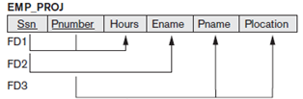
Example 2NF
FD1= {SSN,Pnumber} -> hours (Fully Functional dependency)
FD2= {SSN} -> ename (Partial Functional dependency)
Therefore ename is partial dependent on SSN, which is only the part of the primary key. Therefore FD2 is not satisfied second normal form.
FD3={Pnumber} -> {Pname, plocation} (Partial Functional dependency)
{Pname,Plocation } is also partial dependent on Pnumber, which is only the part of the primary key. Therefore FD3 is not satisfied second normal form
FD1= {SSN,Pnumber} -> hours
FD2= {SSN} -> ename
FD3={Pnumber} -> {Pname,plocation}
Sana Anjum ACSE0506 DBMS Unit-3

Slide 98
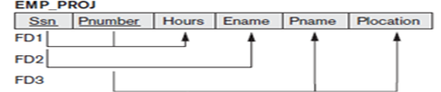

Example 2NF
Solution :-
To bring relation EMP_PROJ into second normal form, We decompose the relation
Sana Anjum ACSE0506 DBMS Unit-3

Slide 99
3. Third Normal Form(3NF) (CO3)
Third Normal Form (3NF):
A relation is in third normal form, if there is no transitive dependency for non-prime attributes as well as it is in second normal form.
A relation is in 3NF if at least one of the following condition holds in every non-trivial function dependency X –> Y:
X is a super key.
Y is a prime attribute (each element of Y is part of some candidate key).
In relation STUDENT given in Table 4,
Sana Anjum ACSE0506 DBMS Unit-3

Slide 100
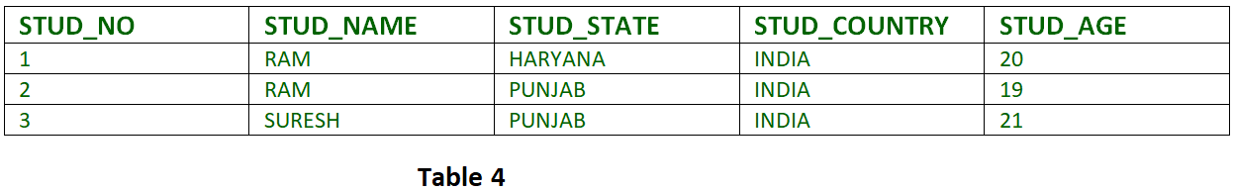
3. Third Normal Form(3NF) (CO3)
FD set:
{STUD_NO -> STUD_NAME, STUD_NO -> STUD_STATE, STUD_STATE -> STUD_COUNTRY, STUD_NO -> STUD_AGE}
Candidate Key:
{STUD_NO}
For this relation in table 4, STUD_NO -> STUD_STATE and STUD_STATE -> STUD_COUNTRY are true. So STUD_COUNTRY is transitively dependent on STUD_NO.
It violates the third normal form. To convert it in third normal form, we will decompose the relation STUDENT (STUD_NO, STUD_NAME, STUD_STATE, STUD_COUNTRY_STUD_AGE) as:
STUDENT (STUD_NO, STUD_NAME, STUD_STATE, STUD_AGE) STATE_COUNTRY (STUD_STATE, STUD_COUNTRY)
Sana Anjum ACSE0506 DBMS Unit-3

Slide 101
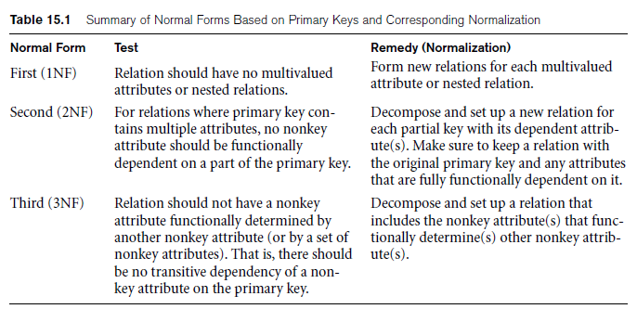
General Definition of 1NF,2NF and 3NF (CO3)
Sana Anjum ACSE0506 DBMS Unit-3

Slide 102
4. Boyce Codd Normal Form(3.5 NF) (CO3)
BCNF (Boyce Codd Normal Form) is the advanced version of 3NF. A table is in BCNF if every functional dependency X->Y, X is the super key of the table. For BCNF, the table should be in 3NF, and for every FD, LHS is super key.
Consider a relation R with attributes (student, subject, teacher).
Student Teacher Subject
Jhansi P.Naresh Database
Jhansi K.Das C
Subbu P.Naresh Database
Subbu R.Prasad C
F: { (student, Teacher) -> subject (student, subject) -> Teacher Teacher -> subject}
Candidate keys are (student, teacher) and (student, subject).
The above relation is in 3NF [since there is no transitive dependency]. A relation R is in BCNF if for every non-trivial FD X->Y, X must be a key.
Sana Anjum ACSE0506 DBMS Unit-3

Slide 103
4. Boyce Codd Normal Form(3.5 NF) (CO3)
The above relation is not in BCNF, because in the FD (teacher->subject), teacher is not a key. This relation suffers with anomalies −
For example, if we try to delete the student Subbu, we will lose the information that R. Prasad teaches C. These difficulties are caused by the fact the teacher is determinant but not a candidate key.
Decomposition for BCNF
Teacher-> subject violates BCNF [since teacher is not a candidate key].
If X->Y violates BCNF then divide R into R1(X, Y) and R2(R-Y).
So R is divided into two relations R1(Teacher, subject) and R2(student, Teacher).
R1 R2
Teacher Subject Student Teacher
P.Naresh database Jhansi P.Naresh
K.DAS C Jhansi K.DAS
R.Prasad C Subbu P.Naresh
Subbu R.Prasad
Sana Anjum ACSE0506 DBMS Unit-3

Slide 104
Lossless Join Decomposition (CO3)
Lossless-join decomposition is a process in which a relation is decomposed into two or more relations. This property guarantees that the extra or less tuple generation problem does not occur and no information is lost from the original relation during the decomposition. It is also known as non-additive join decomposition.
When the sub relations combine again then the new relation must be the same as the original relation was before decomposition.
Consider a relation R if we decomposed it into sub-parts relation R1 and relation R2.
The decomposition is lossless when it satisfies the following statement −
If we union the sub Relation R1 and R2 then it must contain all the attributes that are available in the original relation R before decomposition.
Intersections of R1 and R2 cannot be Null. The sub relation must contain a common attribute. The common attribute must contain unique data.
Sana Anjum ACSE0506 DBMS Unit-3

Slide 105
Lossless Join Decomposition (CO3)
The common attribute must be a super key of sub relations either R1 or R2.
Here,
R = (A, B, C)
R1 = (A, B)
R2 = (B, C)
The relation R has three attributes A, B, and C. The relation R is decomposed into two relation R1 and R2. . R1 and R2 both have 2-2 attributes. The common attribute is B.
The Value in Column B must be unique. if it contains a duplicate value then the Lossless-join decomposition is not possible.
R (A, B, C)
A B C
12 25 34
10 36 09
12 42 30
Sana Anjum ACSE0506 DBMS Unit-3

Slide 106
Lossless Join Decomposition (CO3)
It decomposes into the two sub relations −
R1 (A, B)
A B
12 25
10 36
12 42
R2 (B, C)
B C
25 34
36 09
42 30
Now, we can check the first condition for Lossless-join decomposition.
The union of sub relation R1 and R2 is the same as relation R.
R₁U R₂ = R
A B C
12 25 34
10 36 09
12 42 30
Sana Anjum ACSE0506 DBMS Unit-3

Slide 107
Continued
The formal definition of BCNF differs from the definition of 3NF in that clause (b) of 3NF, which allows functional dependency having the RHS as a prime attribute, is absent from BCNF. That makes BCNF a stronger normal form compared to 3NF.
(LHS of every functional dependency must be super key or candidate key and RHS prime attribute condition not allowed in BCNF)
Note:- Every relation in BCNF is in 3NF,but it is not necessary that every relation in 3NF is in BCNF.
Sana Anjum ACSE0506 DBMS Unit-3

Slide 108
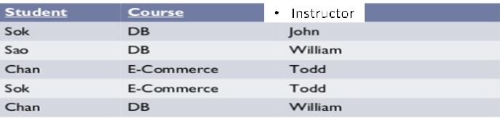
Example
Let us consider the following relation TEACH= {student,Course,Instructor}
with the following dependencies: -
FD1: {Student, Course} → Instructor
FD2: Instructor → Course
{Student, Course}. Check this relation in BCNF or not. is a candidate key for this relation
Sana Anjum ACSE0506 DBMS Unit-3

Slide 109
Example
Instructor is not super keys but determines course. So student relation in 3NF.
But student relation is not in BCNF because in FD Instructor → Course, Instructor is not super key or candidate key or primary key.
Solution :-
Therefore the relation Teach decompose in
1. Teach1 {Student, Instructor}
2. Teach 2 {Instructor, Course}
Teach1 Teach 2
Sana Anjum ACSE0506 DBMS Unit-3

Slide 110

Continued
All three decompositions will lose functional dependency . We have to settle for sacrificing the functional dependency preservation. But we cannot sacrifice the non-additivity property after decomposition.
Out of the above three, only the 3rd decomposition will not generate spurious tuples after join.(and hence has the non-additivity property).
Sana Anjum ACSE0506 DBMS Unit-3

Slide 111
Multi-valued Dependency (CO3)
Multi-valued dependency (MVD)
Consequence of first normal form (1NF) which diasallow an attribute in a tuple to have a set of values.
A multivalued dependency always requires at least three attributes because it consists of at least two attributes that are dependent on a third attribute .
Let us consider a relation R =(A,B,C) and value of A there is a set of value of B & a set of value of C. However the set of value for B & C are independent of each other.
We write A →→ B and
A →→ C.
Sana Anjum ACSE0506 DBMS Unit-3

Slide 112
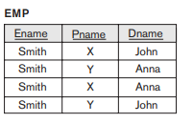
Example
Example :- Employee whose name is ename work on project Pname and has dependent dname. An employee may work on several projects and have several dependents & both project and dependents are independent from each other.
Problem
Multivalued dependencies (MVDs) express a condition among tuples of a relation that exists when the relation is trying to represent more than one to many or many to many relationship.
Sana Anjum ACSE0506 DBMS Unit-3

Slide 113
Formal Definition of Multi-valued Dependency (CO3)
A multivalued dependency X →→ Y specified on relation schema R, where X and Y are both subsets of R, specifies the following constraint on any relation state r of R:
If two tuples t1 and t2 exist in r such that t1[X] = t2[X], then two tuples t3 and t4 should also exist in r with the following properties,
t1[X] = t2[X] = t3[X] = t4[X]
t1[Y] = t3[Y] and t2[Y] = t4[Y]
t1[Z] = t4[Z] and t3[Z] = t2[Z]
Where X →→ Y holds, we say that X multi-determines Y, or Y is multi-dependent on X.
Sana Anjum ACSE0506 DBMS Unit-3

Slide 114
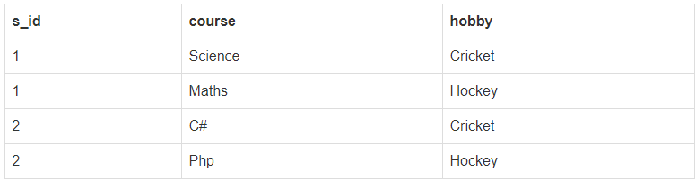
5.Fourth Normal Form (CO3)
The official qualification for 4NF are:-
A table is already in BCNF.
A table contain no multi-valued functional dependency .
Example :- Let us consider following relation student:-
Key:- {s_id,course,hobby}
MVD, s_id →→ course,hobby
To check relation is in 4NF or not.
Sana Anjum ACSE0506 DBMS Unit-3

Slide 115
Example
As you can see in the above table , student with s_id 1 has opted for two courses, Science and Maths, and has two hobbies, Cricket and Hockey.
You must be thinking what problem this can lead to, right?
Problem:- Well the two records for student with s_id 1& 2, will give rise to two more records, because for one student, two hobbies exists, hence along with both the courses, these hobbies should be specified.
Sana Anjum ACSE0506 DBMS Unit-3

Slide 116
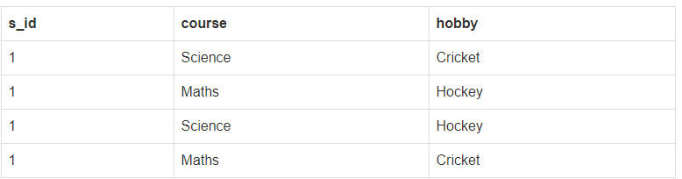
Continued
In the above table , there is no relationship between the columns course and hobby. They are independent of each other.
So there is multi-value dependency, which leads to un-necessary repetition of data and other anomalies as well.
Sana Anjum ACSE0506 DBMS Unit-3

Slide 117

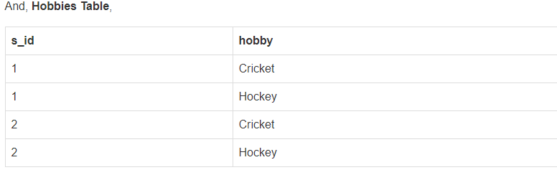
Solution
Solution:- To make the above relation satisfy the 4th normal form, we can decompose the table into 2 tables.
Now this relation satisfies the fourth normal form.
Sana Anjum ACSE0506 DBMS Unit-3

Slide 118
6.Fifth Normal Form (CO3)
The 5NF (Fifth Normal Form) is also known as project-join normal form (PJNF).
A relation is in Fifth Normal Form (5NF), if
it is in 4NF, and
won’t have lossless decomposition into smaller tables.
Definition:- A join dependency (JD), denoted by JD(R1, R2, … , Rn), specified on relation schema R, specifies a constraint on the states r of R.
The constraint states that every legal state r of R should have a non-additive join decomposition into R1, R2, … , Rn.
Hence, for every such r we have * (πR1 (r), πR2 (r), … , πRn (r)) = r
Sana Anjum ACSE0506 DBMS Unit-3

Slide 119
Fifth Normal Form (CO3)
5NF is of little practical use to the database designer, but it is of interest from a theoretical point of view.
In all of the further normal forms discussed so far, no loss decomposition was achieved by the decomposing of a single table into two separate tables.
Note :- In considering 5NF, consideration must be given to tables where this non-loss decomposition can only be achieved by decomposition into three or more separate tables.
Sana Anjum ACSE0506 DBMS Unit-3

Slide 120
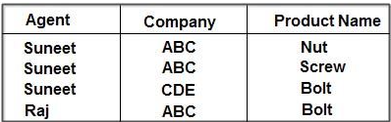
Example
Let us consider the following relation person with attribute ((Agent, Company, Product _Name))
The table is in 4NF because it contains no multi-valued dependency.
It does, however, contain an element of redundancy in that it records the fact that Suneet is an agent for ABC twice. But there is no way of eliminating this redundancy without losing information.
Sana Anjum ACSE0506 DBMS Unit-3

Slide 121
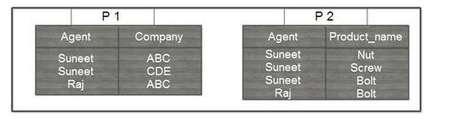
Continued
Suppose that the Relation Person is decomposed into two relation P1 and P2.
The redundancy has been eliminated, but the information about which companies make which products and which of these products they supply to which agents has been lost.
Sana Anjum ACSE0506 DBMS Unit-3

Slide 122
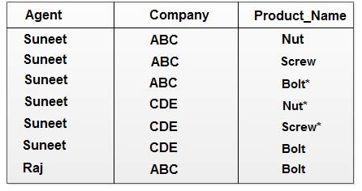
Continued
The natural join of these projections over the ‘agent’ columns is:
The table resulting from this join is spurious, since the asterisked row of the table contains incorrect information.
Solution :- When we decompose the relation such case common attribute must be a candidate key.
Sana Anjum ACSE0506 DBMS Unit-3

Slide 123
Continued
Now suppose that the original table were to be decomposed into three tables, the two projections, P1 (agent,company)and P2(agent,product) which have already shown, and the final, possible projection, P3 (company,product).
P3
Company | Product_name
ABC | Nut
ABC | Scew
CDE | Bolt
ABC | Bolt
Sana Anjum ACSE0506 DBMS Unit-3

Slide 124
Continued
If a join is taken of all three projections, first of P1 and P2 with the (spurious) result shown above, and then of this result with P3 over the ‘Company’ and ‘Product name’ column, the following table is obtained:-
This still contains a spurious row. The order in which the joins are performed makes no difference to the final result. It is not simply possible of decompose the ‘AGENT_COMPANY_PRODUCT’ table, populated as shown, without losing information. Thus, it has to be accepted that it is not possible to eliminate all redundancies using normalization techniques, because it cannot be assumed that all decompositions will be non-lossy.
Agent | Company | Product_Name
Suneet | ABC | Nut
Suneet | ABC | Screw
Suneet | ABC | Bolt
Suneet | CDE | Bolt
Raj | ABC | Bolt
Sana Anjum ACSE0506 DBMS Unit-3

Slide 125
Decomposition of Relation Schema(CO3)
Decomposition of relation schema R consists of replacing the relation schema by two or more sub relations schemas. So that each contain subset of attributes of relation schema R and which together include all attribute or R.
Decomposition of relation R= {A1,A2,A3,…….An} is the replacement of R by a collection D={R1,R2…….Rm} where Ri is subset of R such that R={ R1 U R2 U…….RN}
Example :- R= { Eid,position,salary}
D1= {Eid,position}
D2= {Postion,Salary}
Using the functional dependencies we can decompose a given relation schema R= {A1,A2,……AN} into a set of relation schema represented by D={R1,R2…..RN} to remove anomalies present in a database(Relations).
Sana Anjum ACSE0506 DBMS Unit-3

Slide 126
Properties of Decomposition of Relation(CO3)
There are three properties of decomposition of relation are
Attribute Preservation
Dependency Preservation
Lossless Join decomposition
Sana Anjum ACSE0506 DBMS Unit-3

Slide 127
Attribute Preservation(CO3)
We must make sure that each attribute in R will appear in at least one relation schema Ri in the decomposition so that no attributes are lost; formally, we say this is called attribute preservation.
Example :- R={A,B,C,D,E,F}
Decompose relation are
R1={A,B,C,D}
R2={A,E,F}
Note :- Union of all decompose relation will give all attribute of universal relation R.
R1 U R2= R{A,B,C,D,E,F}.
Sana Anjum ACSE0506 DBMS Unit-3

Slide 128
Dependency Preservation(CO3)
It would be useful if each functional dependency X → Y specified in F either appeared directly in one of the relation schemas Ri in the decomposition D or could be inferred from the dependencies that appear in some Ri. Informally, this is the dependency preservation condition.
We want to preserve the dependencies because each dependency in F represents a constraint on the database. If one of the dependencies is not represented in some individual relation Ri of the decomposition, we cannot enforce this constraint by dealing with an individual relation.
Sana Anjum ACSE0506 DBMS Unit-3

Slide 129
Continued
If we decompose a relation R into relations R1 and R2, All dependencies of R either must be a part of R1 or R2 or must be derivable from combination of FD’s of R1 and R2.
A Decomposition D = { R1, R2, R3….Rn } of R is dependency preserving write E a set F of Functional dependency if
(F1 ∪ F2 ∪ … ∪ Fm) ⁺ = F⁺ .
Sana Anjum ACSE0506 DBMS Unit-3

Slide 130
Practice Questions
Question 1 :- Let a relation R (A, B, C, D ) and functional dependency {AB –> C, C –> D, D –> A}. Relation R is decomposed into R1( A, B, C) and R2(C, D).
Check whether decomposition is dependency preserving or not.
Question 2:- Let us consider a relation R (A, B, C, D,E,F ) with functional dependency set F= {D –> AB, C–> EF,}and relation R is decomposed into R1( A,C,D), R2(A,D,B), R3(D,E,F), R4(C,E,F).
Check whether decomposition is dependency preserving or not.
Sana Anjum ACSE0506 DBMS Unit-3

Slide 131
Lossless Join Property of Decomposition(CO3)
Another property that a decomposition D should possess is the nonadditive join property, which ensures that no spurious tuples are generated when a NATURAL JOIN operation is applied to the relations resulting from the decomposition.
Definition. Formally, a decomposition D = {R1, R2, … , Rm} of R has the lossless (nonadditive) join property with respect to the set of dependencies F on R if, for every relation state r of R that satisfies F, the following holds, where * is the NATURAL JOIN of all the relations in D: *(πR1(r), … , πRm(r)) = r.
Sana Anjum ACSE0506 DBMS Unit-3

Slide 132
Procedure
Procedure :- Decomposition of R into R1 and R2 from a lossless join decomposition if at least one of the following dependencies in F⁺
First condition) = (ABC) U (AD) = (ABCD) = Att(R). holds true as Att(R1) U Att(R2
R1 ∩ R2= R1 , that is: all attributes common to both R1 and R2 functionally determine ALL the attributes in R1.
OR
R1 ∩ R2= R2 that is: all attributes common to both R1 and R2 functionally determine ALL the attributes in R2
3. In other word R1 ∩ R2 from a super key or candidate key of either R1 or R2 or both , The decomposition of R is a lossless join decomposition.
Sana Anjum ACSE0506 DBMS Unit-3

Slide 133
Example
Question 1 :- Let a relation R (A, B, C, D ,E) and functional dependency {A –> BC, CD –> E, B –> D, E> A}.
Relation R is decomposed into R1( A, B, C) and R2(A, D,E).
Check whether decomposition is lossless or lossy decomposition.
Question 2 :- Let a relation R (A,B,C,D,E,F) and functional dependency {AB –> C, C –> D, D –> EF, F -> A,D ->B}.
Relation R is decomposed into R1( A,B,C) , R2(C,D,E),R3(E,F).
Check whether decomposition is lossless or lossy decomposition.
Sana Anjum ACSE0506 DBMS Unit-3

Slide 134
Testing for non-additive join property
A Universal relation R , decomposition D {R1,R2,……Rm} of R and a set of Functional dependencies
Step 1:- Create a matrix by the given set of FD’s (initially matrix will one row i for each relation Ri in D, and one column J for each attribute Aj in R ).
Step 2:- Set s(i,j) = by for all matrix entries:-
  Put the symbol ‘a’ for those element which are present in the given set D. And
  Put the symbol ‘b’ for those element which are not present in the given set D.
  Setp3:- Now apply the given FD’s and developed new matrix by changing the symbol ‘b’ to ‘a’ if the element functionally dependent.
  Step 4:- Check whether any raw is filled with all ‘a’.
  Step 5:- if any raw is filled with all ‘a’ element then It is lossless join decomposition otherwise lossy decomposition.
Sana Anjum ACSE0506 DBMS Unit-3

Slide 135
Example
Question 1:- Let us consider a relation Schema R ={SSN, PNumber, PName, PLocation,Hours} and functional dependency set f=
SSN –> Ename,
Pnumber –> {Pname,Plocation}
{SSN,Number} –> Hours } and
Decompose a relation D = {R1,R2,R3} where R1= {SSN, Ename}, R2= {Pnumber, Pname,Plocation} and R3= {SSN, Pnumber, Hours} .
show whether decomposition is lossy or lossless join decomposition .
Sana Anjum ACSE0506 DBMS Unit-3

Slide 136
Continued
Question 2:- Let us consider a relation Schema R ={A,B,C,D,E,} and functional dependency set f=
AB –> CD,
A –> E
C –> D } and
Decompose a relation D = {R1,R2,R3} where R1= {A,B,C}, R2= {B,C,D}, and R3= {C,D,E} .
show whether decomposition is lossy or lossless join decomposition .
Sana Anjum ACSE0506 DBMS Unit-3

Slide 137
Inclusion Dependencies(CO3)
MVDs and JDs can be used to guide database design, as we have seen, although they are less common than FDs and harder to recognize and reason about.
In contrast, inclusion dependencies are very intuitive and quite common. However, they typically have little influence on database design
The main point to bear in mind is that we should not split groups of attributes that participate in an inclusion dependency.
Most inclusion dependencies in practice are key-based, that is, involve only keys.
Sana Anjum ACSE0506 DBMS Unit-3

Slide 138
Daily Quiz
Question 1: When you normalize a relation by breaking it into two smaller relations, what must you do to maintain data integrity?
Please select all the correct answers.
A. Link the relations by a common field
B.Remove any functional dependencies from both relations
C .Assign both relations the same primary key field(s)
D .Create a primary key(s) for the new relation
Question 2: A relation is in 1NF if it doesn't contain any ____________?
A. Determinants
B. Repeating groups
C. Null values in primary key fields
D. Functional dependencies
Sana Anjum ACSE0506 DBMS Unit-3

Slide 139
Daily Quiz
Question 3:A functional dependency that exist between two non-key attributes is called _____
(a) Non-transitive dependency (b) Transitive dependency
(c) Partial transitive dependency (d) None of the above
Question 4:In the __________ normal form, a composite attribute is converted to individual attributes.
a) First
b) Second
c) Third
d) Fourth
Sana Anjum ACSE0506 DBMS Unit-3

Slide 140
Daily Quiz
Question 5: By normalizing relations or sets of relations, one minimizes ___.
Data
Fields
Redundancy
Database
Question 6:A common approach to normalization is to ___ the larger table into smaller tables and link them together by using relationships.
Add
Subtract
Multiply
Divide
Sana Anjum ACSE0506 DBMS Unit-3

Slide 141
Daily Quiz
Question 7: If a relation has a 4NF and no join dependency, and when it joins, it should be___, it is considered 5NF.
Lossful
Lesser
Lossless
Full
Question 8: Neither multivalued nor composite attributes, nor their combinations, may be used in the ___ normal form.
First
Second
Third
fourth
Sana Anjum ACSE0506 DBMS Unit-3

Slide 142
Daily Quiz
Question 9: Non-prime attributes cannot be transitively dependent, so the relation must have the ___ normal form.
First
Second
Third
Fourth
Question 10: What is TRUE about BCNF?
The advanced version of 3NF is BCNF.
BCNF is stricter than 3NF.
The super key is X for any functional dependency of X -> Y in the table.
All of the above
Sana Anjum ACSE0506 DBMS Unit-3

Slide 143
MCQs
Which forms simplifies and ensures that there are minimal data aggregates and repetitive groups:
a) 1NF
b) 2NF
c) 3NF
d) All of the mentioned
For any pincode, there is only one city and state. Also, for given street, city and state, there is just one pincode. In normalization terms, empdt1 is a relation in
a) 1 NF only
b) 2 NF and hence also in 1 NF
c) 3NF and hence also in 2NF and 1NF
d) BCNF and hence also in 3NF, 2NF and 1NF
Sana Anjum ACSE0506 DBMS Unit-3

Slide 144
MCQs
In the __________ normal form, a composite attribute is converted to individual attributes.
a) First
b) Second
c) Third
d) Fourth
Functional Dependencies are the types of constraints that are based on______
a) Key
b) Key revisited
c) Superset key
d) None of the mentioned
Sana Anjum ACSE0506 DBMS Unit-3

Slide 145
MCQs
In practical applications, how many types of Normal Forms are there?
a)3
b)4
c)5
d)6
When a relation contains an atomic value, it is a ___ relation.
a)1NF
b)2NF
c)3NF
d)BCNF
Sana Anjum ACSE0506 DBMS Unit-3

Slide 146
Weekly Assignment
What do you mean by BCNF ? Why it is used and how it differ from 3 NF ? (CO3)
Discuss the various normal forms in normalization with suitable examples? Why is concurrency control needed? Explain lost update, Inconsistent retrievals and uncommitted dependency anomalies. (CO3)
Explain the Codd’s Rule in detail.(CO3)
Explain Normalization with example. (CO3)
What are the rules of 1NF,2NF,3NF. (CO3)
Discuss Boyce Codd Normalization Form. (CO3)
Sana Anjum ACSE0506 DBMS Unit-3

Slide 147
Glossary Questions
Choose the correct option:
1.When a relation is in 2NF and there is ___, it is in 3NF.
2.A relation is in ___ if it is in Boyce Codd normal form and does not have any multivalued dependencies.
3.If a relation has a 4NF and no join dependency, and when it joins, it should be___, it is considered 5NF.
4.Non-prime attributes cannot be transitively dependent, so the relation must have the ___ normal form.
a) 4NF
b) No Transition Dependency
c) Third
d) Lossless
Sana Anjum ACSE0506 DBMS Unit-3

Slide 148
Old Exam Question Papers
http://www.aktuonline.com/papers/btech-cs-5-sem-data-base-management-system-rcs501-2020.pdf
http://www.aktuonline.com/papers/btech-cs-5-sem-database-management-system-KCS501-2018-19.pdf
http://www.aktuonline.com/papers/btech-cs-5-sem-database-management-system-ncs-502-2017-18.pdf
http://www.aktuonline.com/papers/btech-cs-5-sem-database-management-system-ncs-502-2016-17.pdf
Sana Anjum ACSE0506 DBMS Unit-3

Slide 149
Expected Questions for University Exam
Explain normalization. What is normal form?
Describe the following terms :
  (i) Multivalued dependency
  (ii) Trigger
Why do we normalize database?
Define partial functional dependency. Consider the following two sets of functional dependencies F= {A ->C, AC ->D, E ->AD, E ->H} and G = {A ->CD, E ->AH}. Check whether or not they are equivalent.
Discuss Loss-less join decomposition with an example.
Write difference between BCNF Vs 3 NF.
Sana Anjum ACSE0506 DBMS Unit-3

Slide 150
Recap of Unit
Knowledge of database design.
Knowledge of functional dependencies.
Knowledge of Normal forms.
Knowledge of Loss-less join decomposition,Multivalued dependency and join dependency.
Sana Anjum ACSE0506 DBMS Unit-3

