Slide 1
Finding the best place in Toronto to open an Indian restaurant
The Battle of Neighborhoods

Slide 2
Problem Statement
Finding the right market and targeted customers is very important to start a new business or business at new place and could be a challenging task if sufficient data is not available. Fortunately, for this study the required data is available on different platforms. We will analyze these data and find the neighborhood in the Toronto which will have the most common Indian restaurants.

Slide 3
Who will be interested about this project
People who are interested in opening a new Indian restaurants.
Food companies like KFC, McDonald’s, Starbucks etc.
The people who wants to taste Indian food

Slide 4
Data source
https://en.wikipedia.org/wiki/List_of_postal_codes_of_Canada:_M
https://cocl.us/Geospatial_data
Foursquare location Data.

Slide 5
Data cleaning
The data extracted from the Wikipedia page contains ‘Not assigned’ boroughs and neighborhood. All the rows which contains not assigned borough will be dropped from the dataset. In case the neighborhoods are having not assigned value but having assigned borough, the borough will be assigned to the corresponding neighborhood.

Slide 6
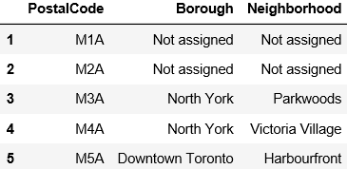
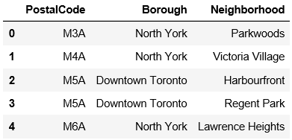
Data cleaning Contd…

Slide 7
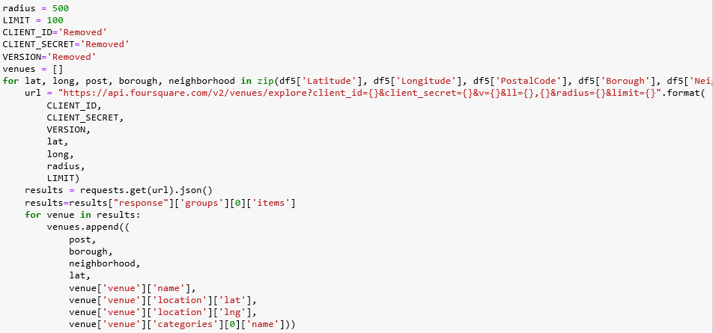
Extracting information about neighborhoods using Foursquare

Slide 8
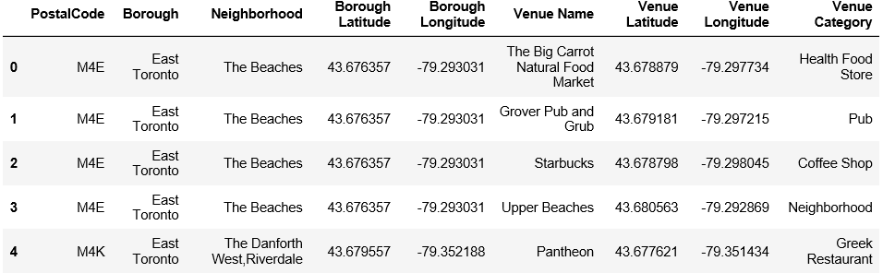
Extracting information about neighborhoods using Foursquare contd…
Extracted Foursquare location data

Slide 9
Methodology
Exploratory Data Analysis
The data of venues in each neighborhood were extracted using foursquare. In exploring the neighborhood we limited the maximum number of venues to 100 and searched in the radius of 500m only which resulted in total of 2245 venues and 275 unique venues.

Slide 10
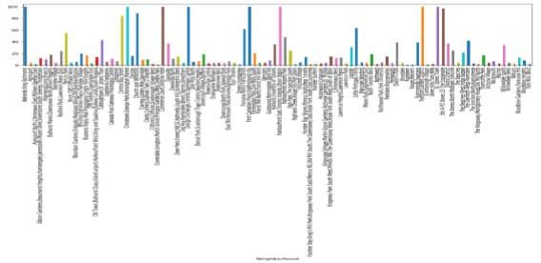
Methodology Contd…
Bar graph of No of Venues per neighborhood

Slide 11
Methodology Contd…
Machine Learning Technique used
We used KMeans clustering machine learning technique to group the neighborhoods into clusters based on their mean of frequency of occurrence

Slide 12
Results
The data is divided into three clusters with centers at 0.20168067, 0.02992809 and 0.00044822 top two neighborhoods are grouped into cluster label 0, next top 6 are grouped into cluster label 1 and rest are grouped into cluster label 2 as show in Fig.7. In this study it is found that Dorset Park,Scarborough Town Centre,Wexfordare are the neighborhoods where mean frequency is highest 0.285714 followed by Thorncliffe Park on the second number 0.117647

Slide 13
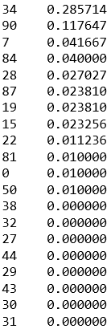
Results Contd…
The mean of frequency of occurrence of Indian restaurant in each neighborhood in descending order

Slide 14
Discussion & Conclusion
In this study it is found that neighborhoods in the cluster label 0 which contains Dorset Park, Scarborough Town Centre, Wexfordareand Thorncliffe Park have highest values of frequency of occurrence of Indian restaurant, this means the Indian restaurants are more popular in these neighborhoods than others.
According to the findings of this study it is advisable to open the Indian restaurants in the neighborhoods which belongs to the cluster label 0.

