Slide 1

Case Study Presentation : Geospatial & Socio-Economic Risk Analysis of Kiva Microloan Default Risk
Transforming Data into Sustainable Lending Strategies
Presented By :
Amiya Kshitij Shukla

Slide 2
Introduction
Kiva's Vision :
Kiva is a non-profit organization that allows people to lend money via the internet to low-income entrepreneurs and students in over 70 countries. Their mission is to alleviate poverty through microloans.
The Challenge :
Despite high funding success, understanding and mitigating potential default risk is crucial for sustainable lending and maximizing impact. Our project aimed to analyze the complex interplay of geographical, socio-economic, and loan-specific factors influencing microloan default risk.

Slide 3
Project Objectives
The Primary Objectives were :
Develop a Robust Data Foundation : Perform extensive SQL-based data engineering (cleaning, transformation, structuring) on raw Kiva datasets.
Uncover Key Risk Drivers : Analyze geospatial, socio-economic, and loan-specific attributes to identify factors correlated with default risk.
Build an Intuitive BI Solution : Design and deploy an interactive Power BI dashboard to visualize insights and facilitate data-driven decision-making.
Provide Actionable Recommendations : Translate complex analytical findings into practical strategies for Kiva to enhance financial inclusion and manage risk.

Slide 4
Key Performance Indicators (KPIs)
Our dashboard leverages precise KPIs and data points derived from SQL to provide a holistic view of Kiva's performance and risk landscape :
Overall Loan Performance :
Total Loans Funded: (e.g. 619K loans) - Direct measure of Kiva's reach.
Total Funded Amount: (e.g. $494 Million) - Overall financial impact.
Overall Funding Success Rate: (e.g. 100%) - Efficiency of the lending process.
Average Time to Fund: (e.g. X days) - Speed of capital deployment.
Geospatial & Socio-Economic Impact :
Loans by Country/World Region : Geographic distribution of Kiva's operations.
MPI Correlation : Relationship between poverty levels and loan metrics.

Slide 5
Key Performance Indicators (KPIs)
Lending Dynamics :
Loans by Sector/Activity : Categorization of where loans are utilized.
Borrower Demographics : Distribution and impact of `borrower_genders`.
Partner Performance : Contribution of individual `partner_id`s.
Temporal Trends : Loan volume and funding speed changes over time.

Slide 6
SQL Analysis & Data Engineering
Data Sources : Raw Kiva loan data (kiva_loans_utf8) and corresponding geographical/MPI (Multidimensional Poverty Index) data (kiva_mpi_region_locations).
Ingestion & ETL Prep : Data was meticulously ingested into MS SQL Server, serving as our central data repository. A critical phase of SQL-driven ETL was performed:
Initial Exploration : SELECT TOP N, COUNT(*), COUNT(DISTINCT Column), MIN/MAX(DateColumn) queries for schema understanding, basic distributions, and gap identification.
Data Cleaning :
Handled missing values (funded_amount, borrower_genders) via imputation or exclusion.
Detected and removed duplicate loan entries using ROW_NUMBER() OVER (PARTITION BY ... ORDER BY ...) with CTEs.
Performed explicit data type conversions (e.g., VARCHAR to DATETIME/DATE using CONVERT, ensuring numerical precision for loan_amount).
Standardized country names for consistency across datasets.

Slide 7
SQL Analysis & Data Engineering
Feature Engineering :
Calculated time_to_fund_days using DATEDIFF(day, posted_time, funded_time).
Created YearMonth keys (FORMAT([DateColumn], 'yyyyMM')) for time-series analysis.
Parsed and extracted insights from tags column using string functions.
Advanced SQL Querying :
Aggregations: Used SUM(), AVG(), COUNT(), with GROUP BY and HAVING to calculate KPIs by country, sector, gender, etc.
Complex Joins: Leveraged INNER JOIN and LEFT JOIN to combine loan data with MPI data, linking poverty levels to loan performance.
Subqueries & CTEs: Employed for multi-step logic (e.g., identifying top-performing partner_ids, or loans funded faster than regional average).
Window Functions: Applied ROW_NUMBER(), LAG(), LEAD() for ranking, month-over-month comparisons, and trend analysis.
Performance Tuning: Created appropriate INDEXES on frequently joined and filtered columns (country, sector, posted_time, funded_time) to optimize query execution speed.

Slide 8
Tools & Technologies
Our Analytical Ecosystem
MS SQL Server: Primary database for data ingestion, cleaning, transformation, and complex analytical querying.
Power BI Desktop: The core tool for data modeling, DAX calculations, interactive dashboard design, and visualization.
Power Query (M-Code): Integral for ETL processes within Power BI, connecting to SQL and further refining data for specific dashboard needs.
DAX (Data Analysis Expressions): Used for creating custom measures and calculated columns in Power BI, enabling powerful aggregations and time intelligence.

Slide 9
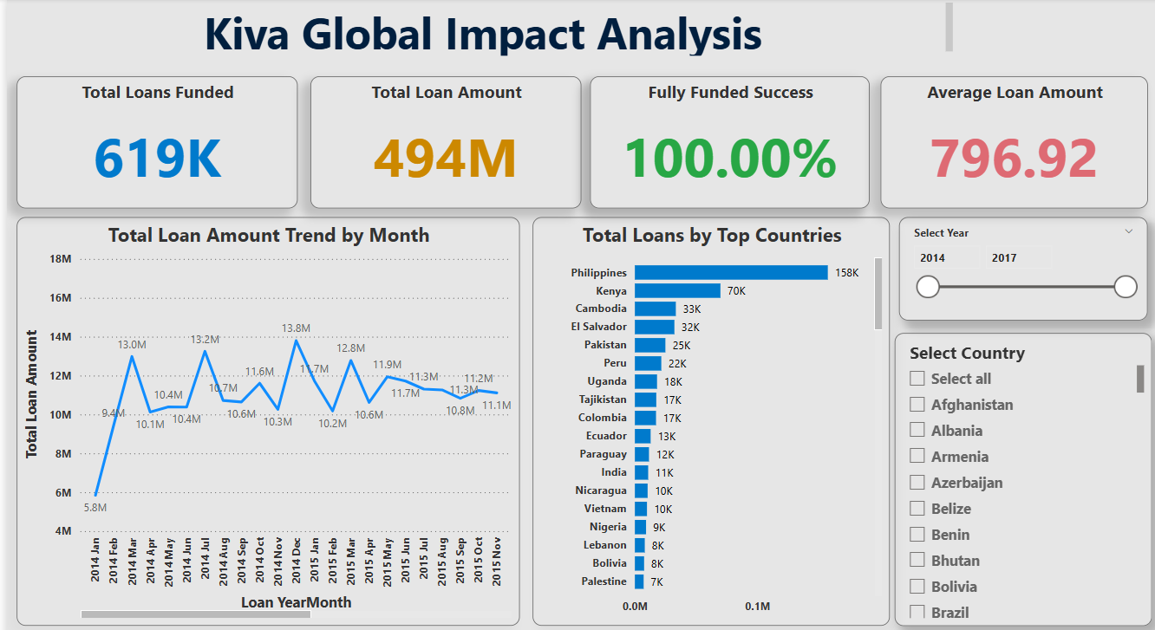
Dashboard Overview : Core Insights
KEY INSIGHTS :
Remarkable Funding Success: Confirmed 100% Fully Funded Success rate, indicating high project reliability.
Significant Global Reach: Over 619K Total Loans Funded for a Total Loan Amount of $494 Million, demonstrating Kiva's vast impact.
Consistent Average Loan Size: The average loan amount stands at $796.92, suggesting a consistent microfinance scale.
Steady Loan Growth : The "Total Loan Amount Trend by Month" shows a generally increasing trend in funded amounts from 2014 to 2015, with monthly fluctuations but consistent growth.
Top Lending Countries: Philippines leads significantly with 158K loans, followed by Kenya (70K) and Cambodia (33K), highlighting key operational regions.

Slide 10
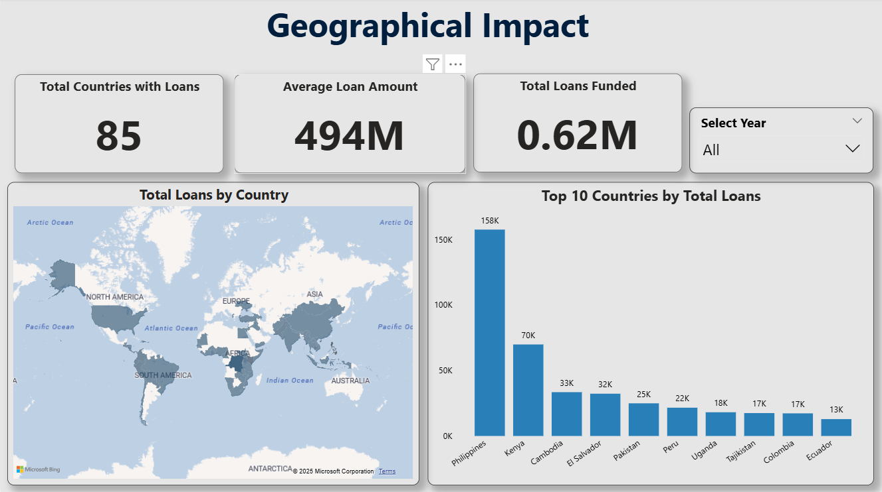
Geospatial & Socio-Economic Analysis
KEY INSIGHTS :
Broad Global Footprint : Kiva operates in 85 Total Countries with Loans, showing extensive reach.
Major Contribution from Key Nations: Top countries like Philippines (158K loans), Kenya (70K), and Cambodia (33K) drive a significant portion of the total 0.62M Loans Funded.
Consistent Average Loan Amount : The overall Average Loan Amount of $494M (from the dashboard, likely referring to total value) maintains the scale of microfinance.
Geographic Distribution Visualized : The world map clearly illustrates the spread and modelling concentration of loans across different continents and regions, allowing for quick identification of high-impact areas.

Slide 11
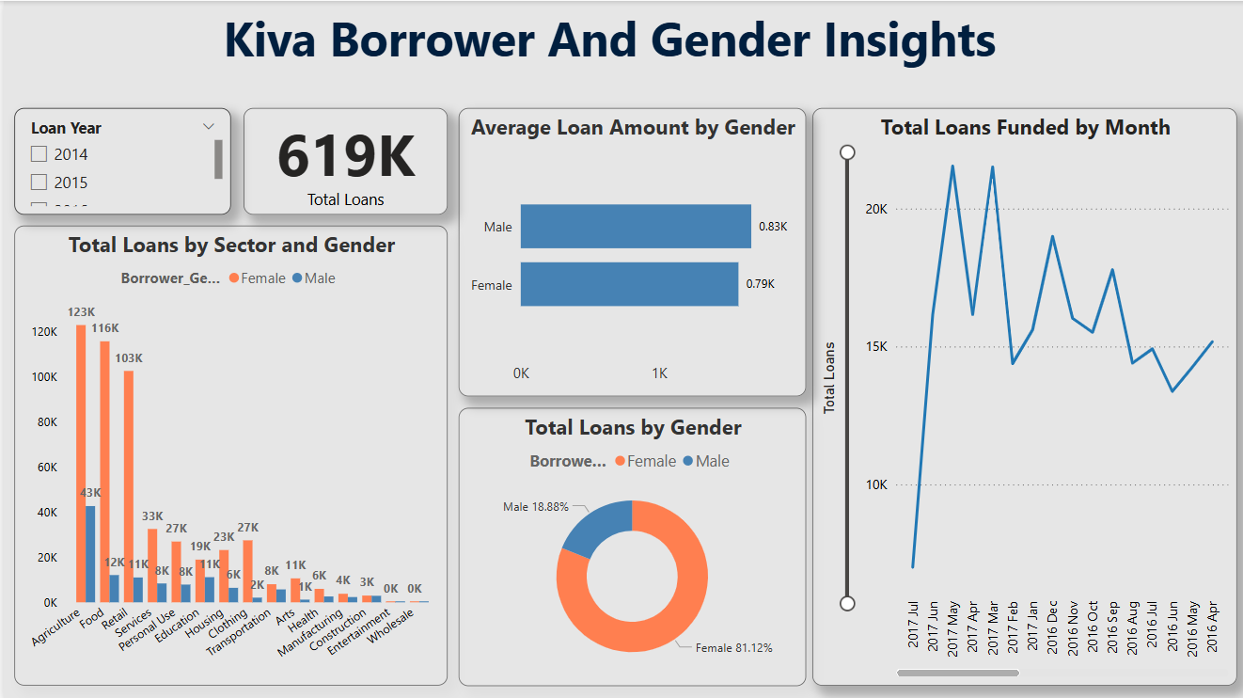
Borrower & Gender Insights
KEY INSIGHTS :
Female-Centric Lending: A significant 81.12% of Total Loans are by Female borrowers, highlighting Kiva's focus on empowering women entrepreneurs.
Similar Average Loan Amounts : Despite gender differences in loan count, the Average Loan Amount by Gender is fairly similar ($0.83K for Male vs. $0.79K for Female), indicating equitable funding sizes.
Sector-Specific Gender Distribution : The "Total Loans by Sector and Gender" chart reveals specific sectors where female borrowers heavily outnumber male borrowers (e.g., Agriculture, Retail, Food).
Monthly Loan Volume Trends : The "Total Loans Funded by Month" line chart shows clear monthly fluctuations in loan volume, peaking around March/April 2017 with over 20K loans.

Slide 12
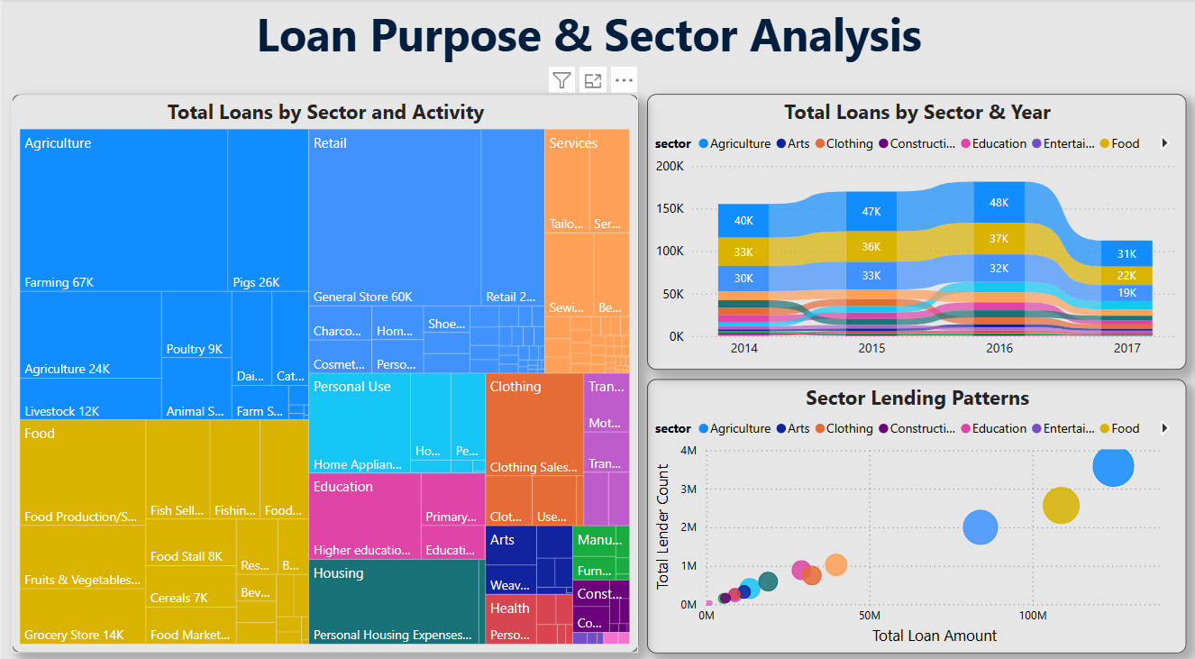
Loan Purpose & Sector Analysis
KEY INSIGHTS :
Dominant Sectors : Agriculture and Retail are consistently the largest sectors by loan count and activity, followed by Services and Food. This indicates where Kiva's impact is most concentrated.
Detailed Activity Breakdown : The Tree map provides granular insight into specific activities within each sector (e.g., "Farming 67K", "Pigs 26K" within Agriculture, "General Store 60K" within Retail).
Sectoral Trends Over Time : The stacked area chart "Total Loans by Sector & Year" shows the evolution of lending across sectors from 2014-2017, with Agriculture consistently leading, but other sectors like Retail and Services also showing strong contributions.
Lender Engagement by Sector : The scatter plot "Sector Lending Patterns" illustrates the relationship between Total Loan Amount and Total Lender Count for each sector, indicating which sectors attract more lenders or larger loan volumes.

Slide 13
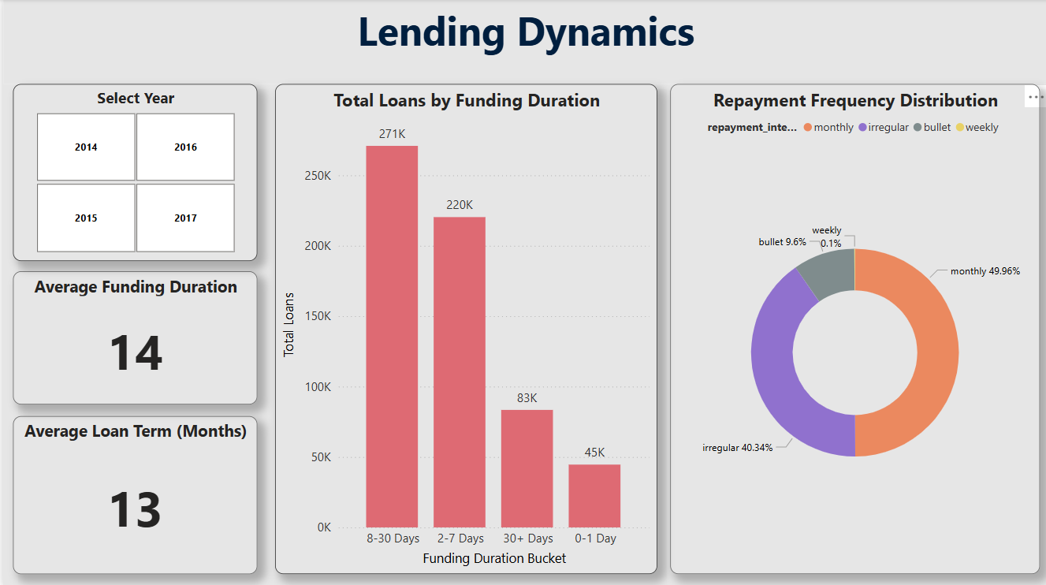
Lending Dynamics & Repayment Patterns
KEY INSIGHTS :
Efficient Funding : The Average Funding Duration is 14 days, indicating a relatively quick process for loans to get fully funded.
Majority Funded Quickly : The "Total Loans by Funding Duration" bar chart shows that the vast majority of loans (271K and 220K) are funded within 8-30 Days and 2-7 Days respectively, with a smaller portion taking 30+ Days.
Dominant Repayment Intervals : The "Repayment Frequency Distribution" donut chart reveals that Monthly (49.96%) and Irregular (40.34%) are the primary repayment intervals, with Weekly (9.6%) and Bullet (0.1%) being less common.
Average Loan Term : The average loan term is 13 Months, providing context to the repayment frequencies.

Slide 14
Conclusion & Future Enhancements
Project Impact : Successfully transformed complex Kiva data into a robust, interactive BI solution, providing invaluable insights into global microloan performance and associated risk factors. This empowers Kiva to make more informed decisions, fostering sustainable financial inclusion.
Future Enhancements :
Integration of external economic indicators (e.g., GDP, inflation) to enrich socio-economic analysis.
Development of a predictive model (e.g., using Python/R) for explicit default probability scores per loan, integrating results into the dashboard.
Enhanced drill-through capabilities to individual loan profiles for deeper investigation.
Sentiment analysis on loan use descriptions for qualitative insights.

