Slide 1

COVID-19 Data Analytics Case Study Analyzing Regional Crude Death Rates & Jurisdictional Trends
Presented By-
Amiya Kshitij Shukla​

Slide 2
Executive Summary
This project investigates COVID-19 death trends across U.S. jurisdictions using a combination of SQL for data engineering and Power BI for interactive visualization.
Key areas of focus include :
- Identifying jurisdictions with the highest and lowest crude death rates
- Comparing regional mortality trends over time
- Evaluating deviations from the national COVID crude rate benchmark
- Surfacing actionable health insights via dynamic dashboards

Slide 3
Project Objectives
Clean and structure COVID-19 death data using SQL
Calculate national and jurisdiction-level crude COVID death rates
Track changes in weekly deaths and rate differences
Create a Power BI dashboard for real-time filtering and insights
Enable health policy teams to identify and monitor high-risk regions

Slide 4
SQL-Based Analytical Questions
Which jurisdiction had the most COVID deaths?
→ Query for max COVID_deaths on the latest reporting date.
Who deviates most from the national average rate?
→ Top 5 with largest % difference in aa_COVID_rate vs crude_COVID_rate.
What are the average deaths over recent weeks? → Aggregated over the last 4 data_period_end dates.
How many jurisdictions reported data with valid deaths? → Filter out nulls and zeroes for most accurate visualizations.
How did share of COVID deaths change week-over-week? → Compare COVID_pct_of_total with lagged values using DAX.
What is the cumulative death count per region? → Sum up total deaths per jurisdiction from start to latest period.

Slide 5
SQL Data Engineering & Preparation
Resolved mixed date formats using ‘CONVERT()’ and ‘CAST()’ for consistency
Excluded rows where deaths were zero or columns had missing values
Computed weekly averages using `GROUP BY` on jurisdiction + period
Derived % difference measures to compare with national averages
- Created ranking logic for crude COVID rates to identify top/bottom regions

Slide 6
Key KPIs and DAX Measures
KPI Name | Formula & Purpose
Total_Deaths | Total COVID deaths across all time
National_Crude_Rate | Overall crude death rate — comparison benchmark
Avg_Weekly_Deaths_Last4 | Average weekly deaths for latest 4 periods
Top_Crude_Region | Jurisdiction with highest death rate
Bottom_Crude_Region | Jurisdiction with lowest death rate
WoW_Change | Week-over-week % delta in COVID death share
Pct_Diff_From_National | % difference between each area’s rate vs national avg.

Slide 7
Tech Stack & Tools
SQL Server: Data ingestion, joins, filtering, grouping
Power BI: Visual creation, bookmarks, slicers, layout design
DAX: KPI calculation, time intelligence, ranking
Bookmarks & Buttons: Used for toggling between Pie/Matrix visual formats

Slide 8
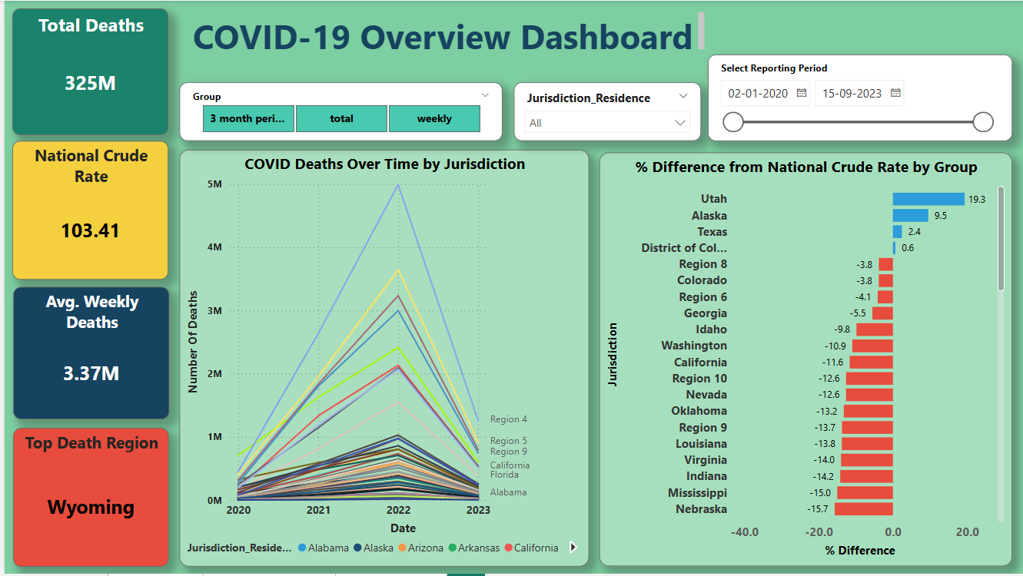
Dashboard Page 1 – National Overview
Key Observations :
COVID deaths peaked around 2022
Wyoming consistently has the highest crude death rate
Utah leads in % deviation above national average
Majority of jurisdictions fall below national rate

Slide 9
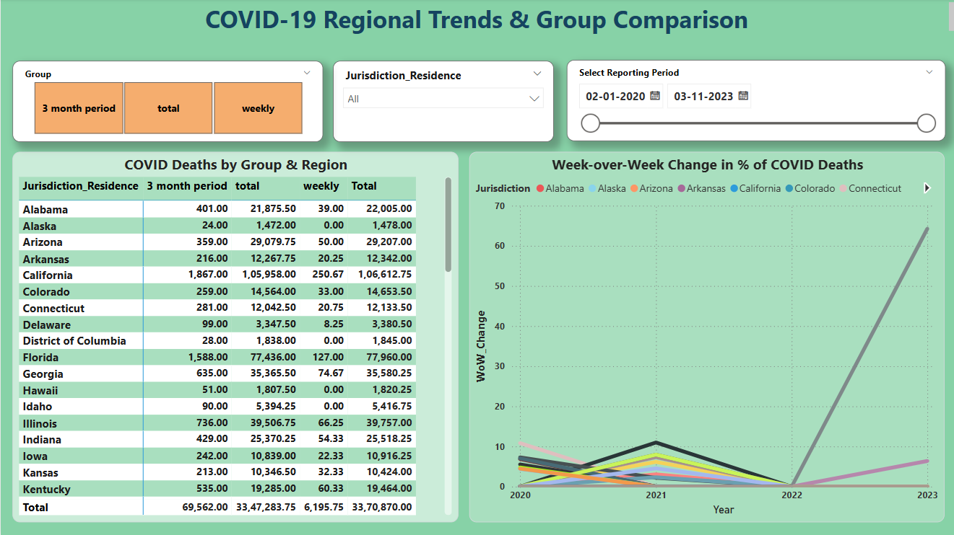
Dashboard Page 2 – Regional Trends
Key Insights :
California and Florida dominate total death counts
Recent periods show stabilizing or declining trends
Some jurisdictions (e.g., Connecticut) show minimal fluctuation
WoW changes highlight periods of health system stress

Slide 10
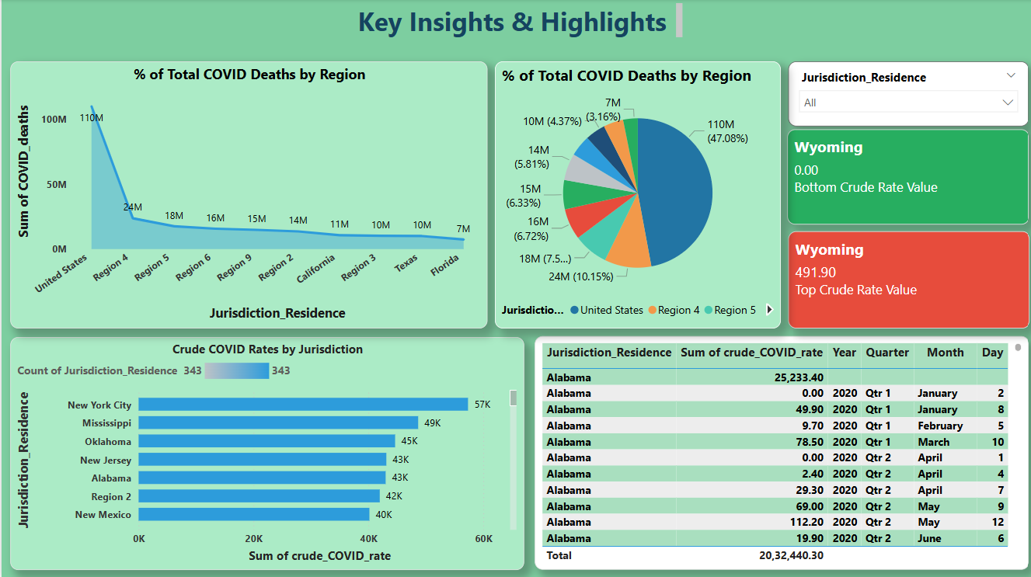
Dashboard Page 3 – Key Insights
Key Insights :
United States accounts for ~47% of reported deaths
Regional disparities evident in crude death rates
Pie chart simplifies comparison at macro level
Toggle interaction enhances user experience

Slide 11
Key Findings
Wyoming has the highest reported crude COVID rate
Mississippi and Indiana fall ~15% below the national average
2022 marked the deadliest year across all jurisdictions
National rate sits at ~103 per 100K population
Interactive filters reveal seasonal and regional shifts

Slide 12
Strategic Recommendations & Future Scope
Focus monitoring and response in high-crude-rate jurisdictions
Augment data with demographic and hospitalization inputs
Automate dashboard refresh for weekly updates
Present findings to public health agencies for allocation planning
Use slicers and ranking to identify top 10 hotspots monthly
Introduce predictive analytics to forecast surges
Normalize data per capita for fairness
Add vaccination rate overlays
Integrate hospitalization, ICU, and recovery statistics
Enable mobile-responsive dashboard version

Slide 13
Thank you

