Slide 1
Medium Blog Posts Clap Prediction
-Mihir Deshpande

Slide 2

The Data
Medium is an online platform that publishes curated content online over a range of Topics
Widely used in the Data Science Community
This Dataset Contains 337 full length blog posts on the topics of Data Science ML and AI
Sourced from Kaggle

Slide 3
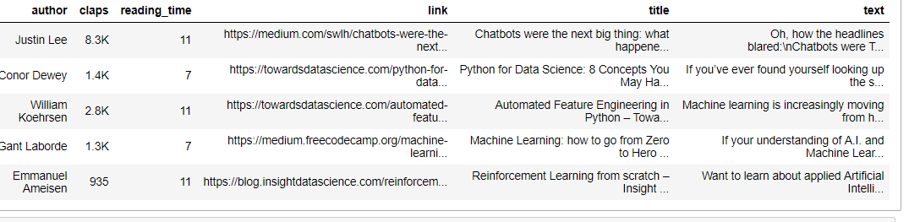
The Data
The Data has 6 columns
Author
Claps
Reading Time
Link
Title
Text

Slide 4
Classification Problem formulation
The target variable claps is our variable of interest
Claps is the medium equivalent of likes
Predicting claps can help the platform to push probable ‘winners’ and drive user engagement

Slide 5
Challenges
Claps are represented as string and have a ‘K’ for thousand
Converting this to numeric data type
Discretize the numeric variable into buckets
Deciding the intervals for discretization to make the problem balanced

Slide 6
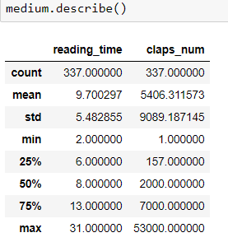
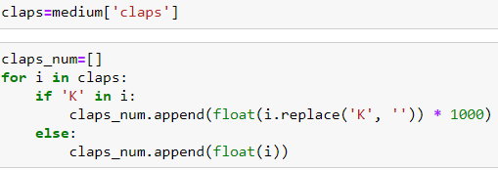
Solutions for treating Claps

Slide 7

Classification Algorithms
Naïve Bayes
Support Vector Machine

Slide 8
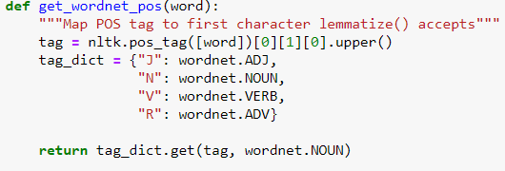
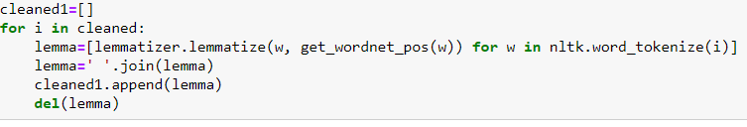
Data Cleaning and Lemmatization
Removed ‘/n’
Removed numbers
POS tagged lemmatization

Slide 9
Vectorization Options
Used TF Count Vectorizer as it works well with Naïve Bayes
Unigrams
Removed stopwords
min_df=2%
max_df=95%
Lowercase
As the instance or blogs are less, having a lot of features will lead to overfitting

Slide 10
Discretization Options for the target class
Based on Quartiles(25% values in each class)- 4 Classes
0-150
150-2K
2K-7K
7K and above
Based On Median (50% values in each class) – 2 Classes
Under 2K
Above 2K

Slide 11
Validation
Hold-Out
Training set= 70% of the data
Testing set =30 % of the data
In future K-fold cross validation can be applied to get a stable metric result

Slide 12
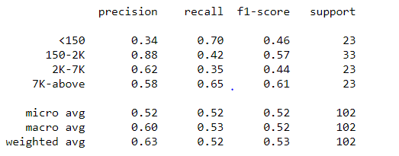

Naïve Bayes Models
With 4 classes
Accuracy: 51.96%
Random guess baseline= 25%
With 2 classes
Accuracy : 64.7%
Random guess baseline =50%

Slide 13
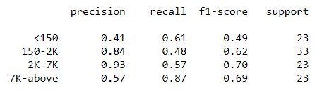

Suport Vector Machine models
Cost parameter C was chosen to 0.3
With 4 classes
Accuracy:- 61.76%
Random Guess Baseline :-25%
With 2 classes
Accuracy:- 77.45%
Random Guess Baseline:- 50%

Slide 14
How many classes to choose?
While the 4 class problem outperforms the random guess baseline by more than double, the question is do we really need such a stratified classification?
We can simply use the 2 class problem and use the signal of 2K above and below.
It gives us a decent accuracy and F1 score with the SVM algorithm as well

Slide 15
Conclusion
The SVM model performs better on both the 2 class and 4 class problems for this data
SVM 2 class model can be used to generate a signal that could be valuable to the platform in terms of driving user engagement

Slide 16
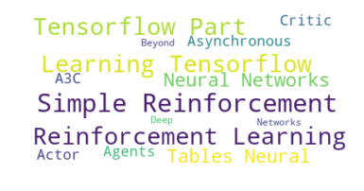
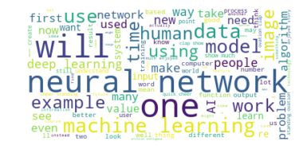
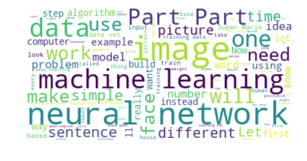
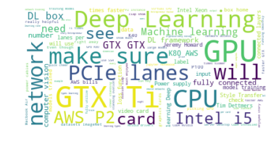
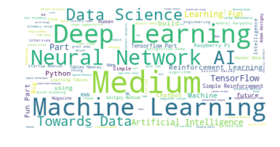
Bonus Slides

Slide 17
THANK YOU!

