Slide 1


SMART INDIA HACKATHON 2026
TITLE PAGE
Problem Statement ID – SIH26102
Problem Statement Title- AI-Powered MPLADS Anomaly and Fraud Detection System
Theme- Smart Automation
PS Category- Software
Team ID- 128747
Team Name (Registered on portal)-Data Detectives

Slide 2

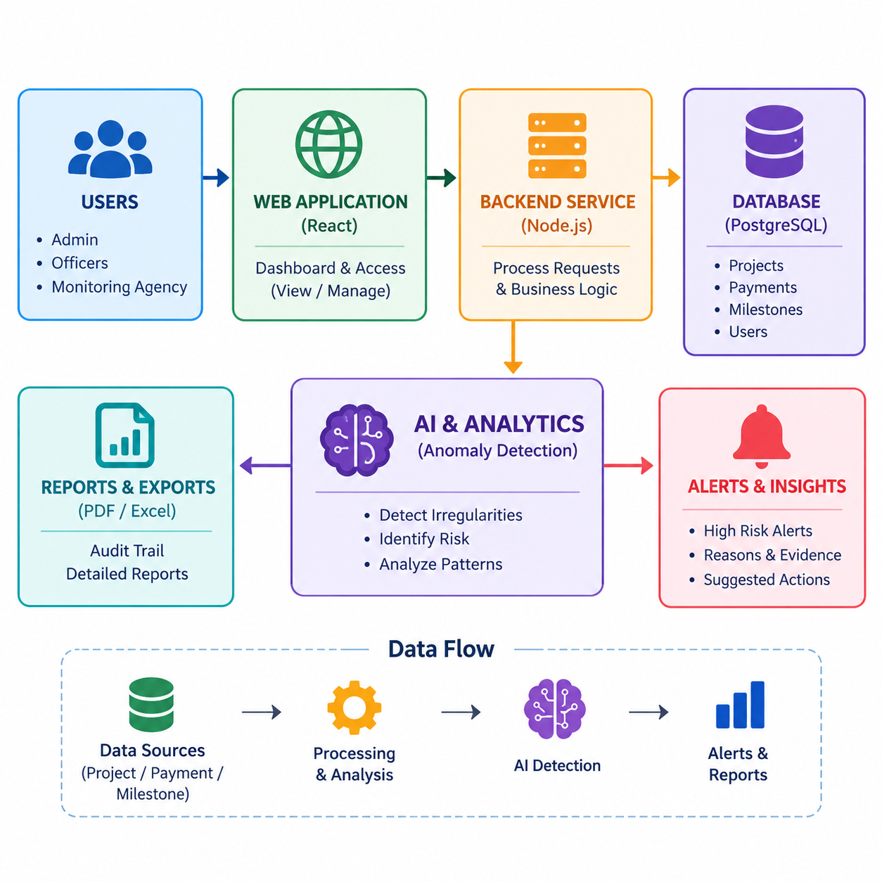
Data
Detectives
AI-Powered MPLADS Anomaly and Fraud Detection System
Problem:
MPLADS projects are vulnerable to delays and financial anomalies, putting public funds and project outcomes at risk.
Our Idea :
MPLADS Surveillance System is an AI-powered surveillance system with a data-driven approach ensuring proactive monitoring of MPLADS projects. It uses anomaly detection algorithms to identify irregularities for efficient utilization of public funds.
Proposed Solution :
• When MPLADS data is fragmented, the system uses a centralized surveillance architecture — project tracking (primary), anomaly detection (secondary), and risk analysis (tertiary).
• A smart analytics framework analyzes project, payment, and milestone data to detect anomalies and identify irregular spending patterns.
• An AI-enabled anomaly detection system with a real-time dashboard provides proactive monitoring for efficient utilization of public funds.
Innovation/Uniqueness:
• MPLADS surveillance system to monitor project lifecycle and public fund utilization.
• Transforms fragmented MPLADS project, payment, and milestone data into actionable anomaly and risk insights.
• AI-powered anomaly detection algorithm identifies unusual spending, duplicate payments, project delays, and financial irregularities.
• Real-time Smart Surveillance Dashboard enables proactive monitoring, risk prioritization, and faster investigation of suspicious projects.

Slide 3
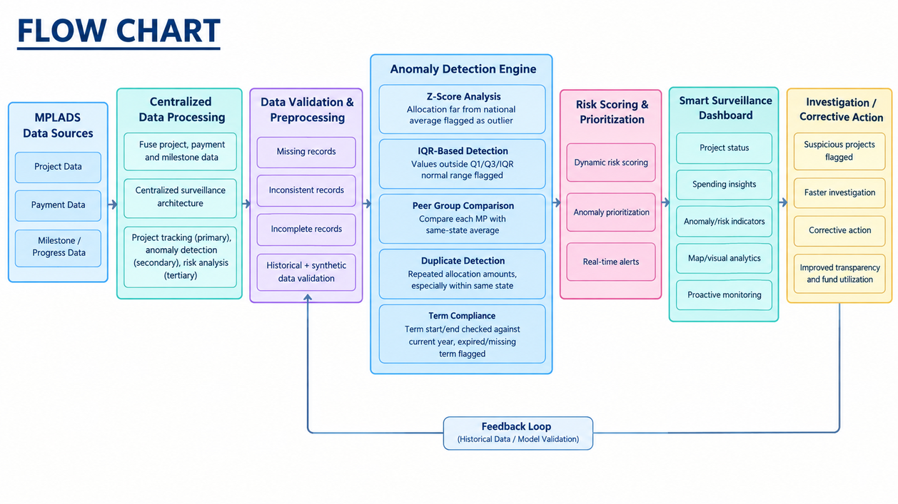
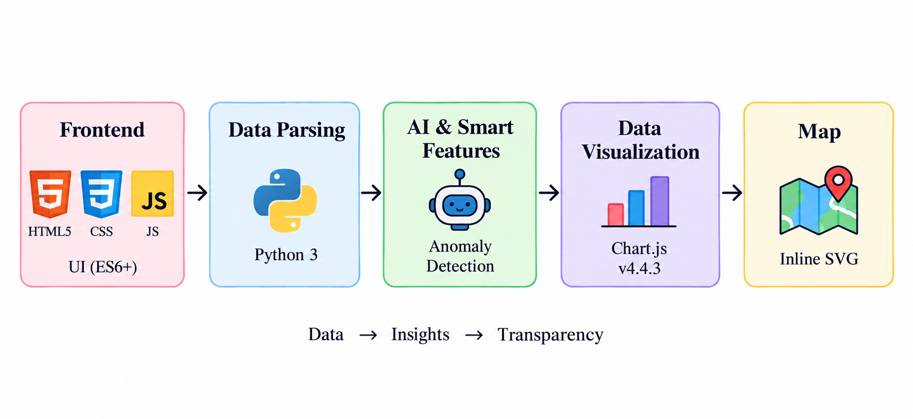
TECHNICAL APPROACH
Data Detectives
FLOW CHART
Rule-based statistical checks
1)Z-Score Analysis: Identifies allocations that are far from the national average as outliers.
2)IQR-Based Detection: Flags values outside the normal range using Q1, Q3, and IQR.
3)Peer Group Comparison: Compares each MP’s allocation with the average of MPs in the same state.
4)Duplicate Detection: Detects repeated allocation amounts, especially within the same state.
5)Term Compliance: Checks whether the MP’s term dates are valid and up to date.
Methodology
GitHub link: Link
YOUTUBE VIDEO LINK : LINK
92% – 95% Functional Working Prototype
Live Demo Link: LINK

Slide 4


FEASIBILITY AND VIABILITY
Data
Detective
Feasibility
• Uses existing MPLADS data sources, avoiding dependency on expensive or specialized hardware.
• Centralized data processing combines project, payment, and milestone data for efficient monitoring.
• Validation with historical datasets ensures accurate anomaly detection by comparing normal and abnormal spending patterns.
• Safe testing environment: All anomaly detection and risk analysis can be tested using synthetic and historical data before deployment.
Challenges
• Large-scale MPLADS data makes real-time monitoring and analysis challenging.
•Project and payment data may contain missing, inconsistent, or incomplete records.
•Complex anomaly patterns require accurate detection with minimal false alerts.
•Continuous data updates can make risk scores .
Commercial feasibility:
• No new infrastructure: Reads from [named source] already collected under the MPLADS Guidelines; needs no new hardware or a new data-collection process.
• Configurable, not hardcoded: Limits like the 75-day sanction window and one-year completion norm sit in a config file, so a revised Guidelines edition means a settings change, not a rebuild
Incremental adoption:Can run on one state or one financial year first, since each rule works independently of the others.
AI-based anomaly detection trained on historical MPLADS data to identify irregular spending patterns.
• Statistical pattern recognition using Z-Score, IQR, and peer variance to detect financial anomalies.
• Risk-optimized analytics with dynamic risk scoring, anomaly prioritization, and real-time alerts.
• Fuse project, payment, and milestone data; implement anomaly detection to flag suspicious activities.
Strategy:

Slide 5


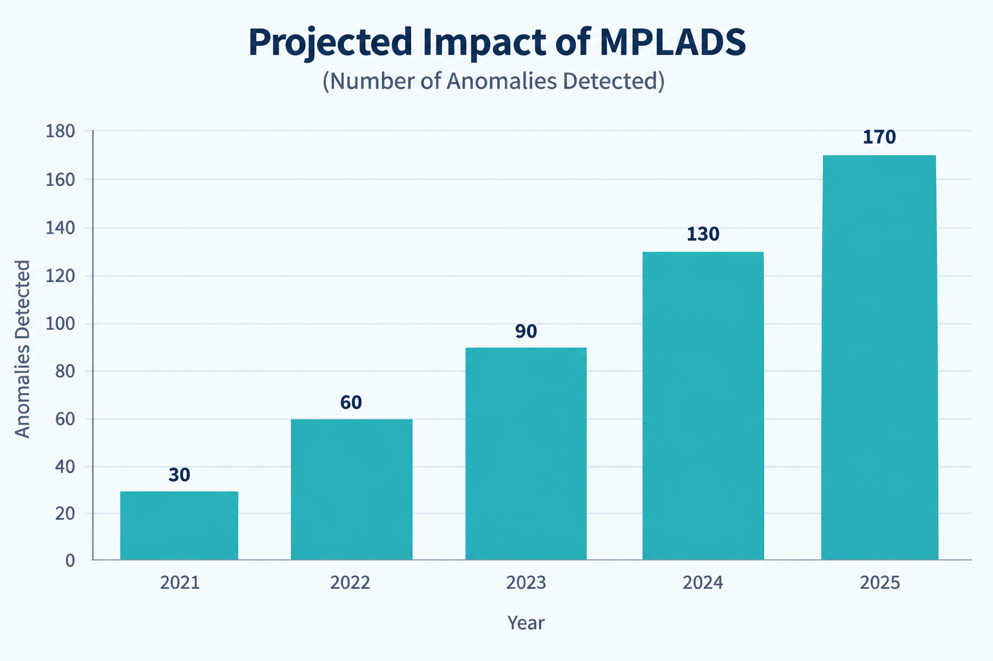
IMPACT AND BENEFITS
Data Detectives
Direct Impact on Target Users
• Government Authorities: Enables proactive monitoring of MPLADS projects, improving transparency and fund utilization.
• Members of Parliament (MPs): Provides real-time project insights, helping track progress, spending, and implementation status.
• District Administration & Implementing Agencies: Enables early detection of delays and financial irregularities, improving corrective action.
• Citizens & Public: Ensures greater transparency and accountability in public-funded development projects.
Strategic Impact
• Offers AI-driven MPLADS surveillance, highly effective in detecting financial anomalies, project delays, and irregularities.
• Strengthens India’s transparency and accountability in public fund management and development projects.
• Impact: Contributes to Digital India by establishing indigenous AI-powered monitoring capability for efficient public fund utilization and governance.
Economic & Strategic Benefits
• Narrows a large search space: Instead of an officer checking every work in a district by hand, the ranked queue surfaces the [n] highest-risk works first, out of [total] loaded.
• Consistent thresholds across a district: The same 75-day sanction limit and one-year completion norm apply to every work, removing officer-to-officer variation in what gets flagged.
• Traceable evidence, not a black box: Each flag cites the exact rule and the Guidelines paragraph or peer benchmark it violated, so a reviewing officer can accept or reject it in minutes rather than starting from scratch.

Slide 6

Data Detectives
RESEARCH AND REFERENCES
MPLADS Guidelines — Ministry of Statistics and Programme Implementation (MoSPI)
The governing document for the scheme, setting the sanction timeline, completion norm, District Authority responsibilities, and SC/ST fund earmarks that define what counts as "on time" and "compliant" for any MPLADS work. Link
CAG Performance Audit of MPLADS
The Comptroller and Auditor General's 2010 audit documents real irregularities in fund management and work selection across District Authorities — the closest thing to ground-truth examples of anomalies in MPLADS. Link
Closest Method Analogue: Unlabeled Expense Anomaly Detection
This 2026 study applies ensemble anomaly detection to unlabeled Brazilian parliamentary expense data — the same data condition MPLADS anomaly detection faces, since no fraud labels exist for dataset. Link
MPLADS Data Portal
The ministry's own portal listing recommended, sanctioned, and completed works, fund releases, and utilisation status per constituency — the primary data source the system would need to run on. Link
Machine Learning for Public-Sector Cost Anomalies
This 2025 IMF working paper explores how cost accounting and machine learning can support budget credibility and corruption detection in public financial management, including anomaly detection in cost data. Link

