Slide 1
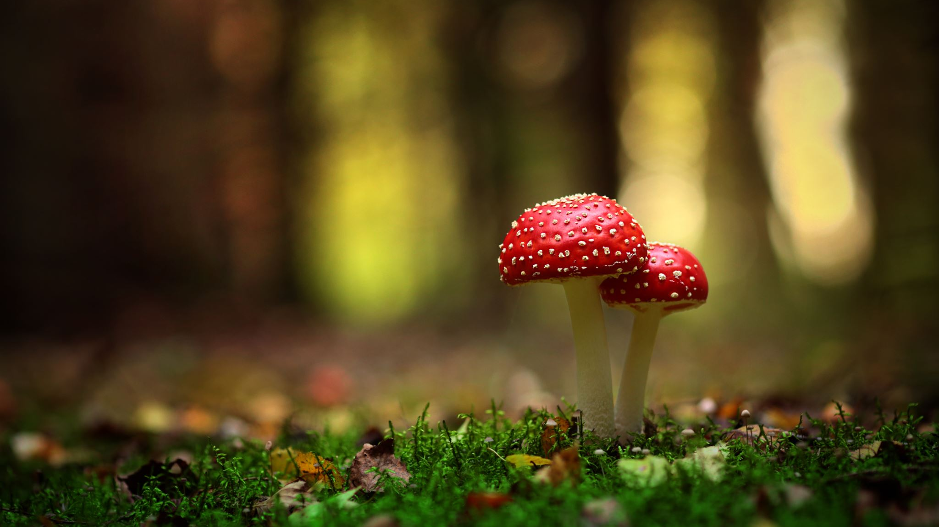
Identifying Poisonous Mushrooms based on their characteristics

Slide 2
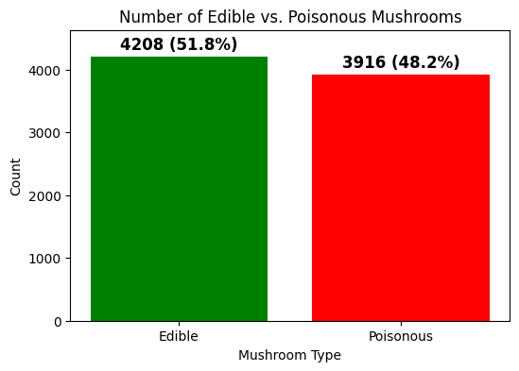
8124 total samples in the data set.
Fairly balanced data set which will prevent bias.

Slide 3
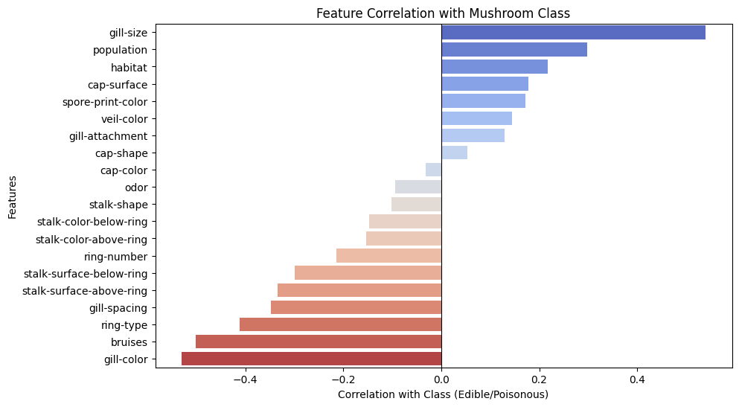
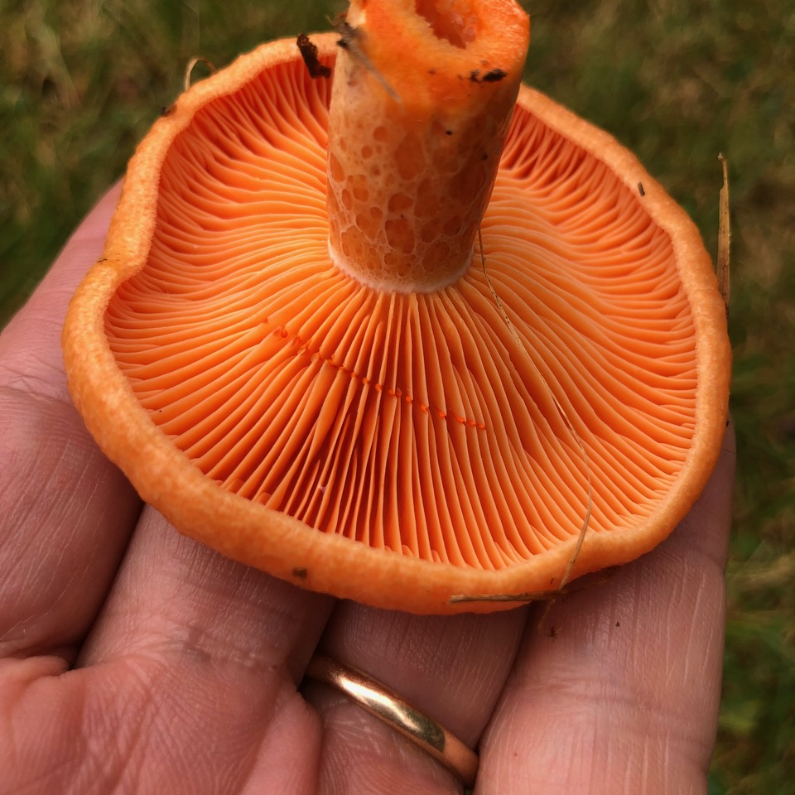
We can see that the gills of the mushroom have a big say in whether it is poisonous or edible, with the colour and size being strongly correlated with our target variable Mushroom Class. The presence of bruises is also a big factor, let’s explore these relationships further…

Slide 4
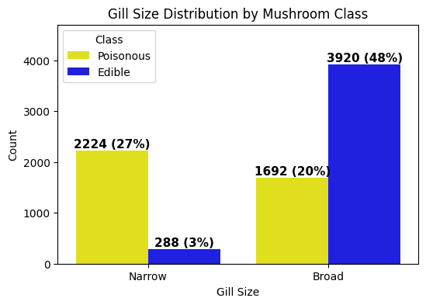
Mushrooms with a narrow gill size are more likely to be poisonous.
However, there is a considerable portion of poisonous mushrooms with a broad gill size as well.

Slide 5
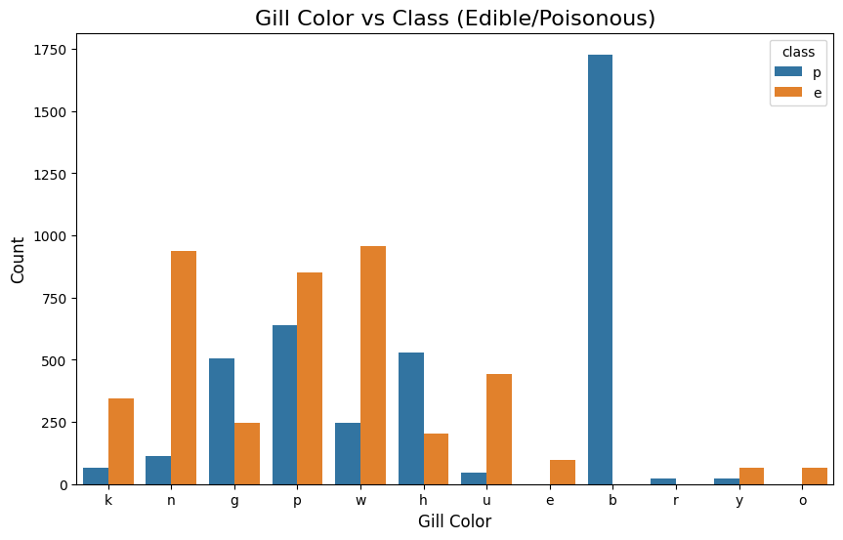
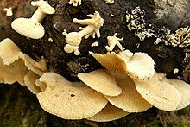
Out of the 1728 mushrooms from the data set with gill colour buff, all of them turned out to be poisonous.

Slide 6
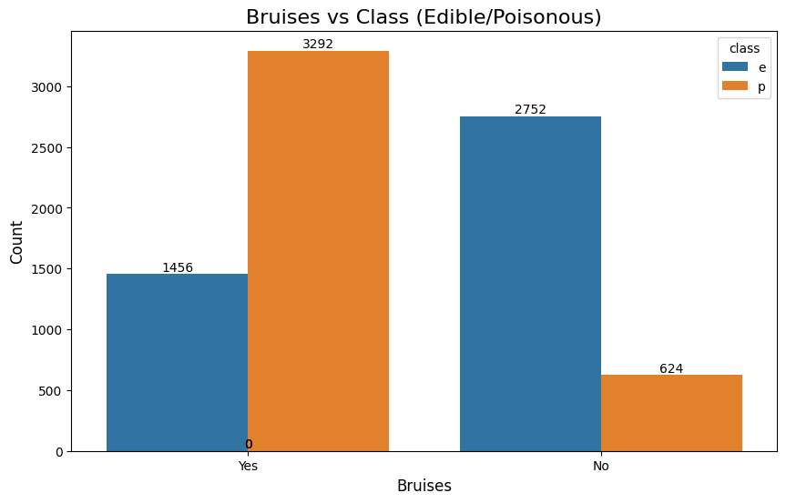
We can see from this graph that most of the poisonous mushrooms were bruised, and that if a mushroom is bruised, there is a 69% chance of it being poisonous.

Slide 7
Preparing the data
Two columns dropped: Stalk-root as there are 3916 missing values, and veil type as each mushroom from the data has a partial veil type, so this would have no effect on the classification process.
Label encoding: Due to all the variables being categorical features, they had to be transformed into numerical columns so they can be processed by the machine learning algorithm.

Slide 8
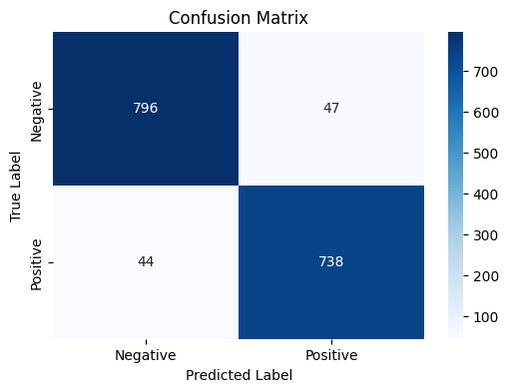
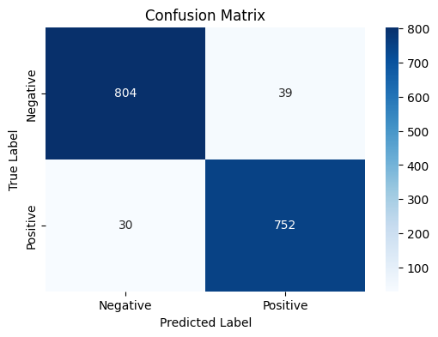
Logistic Regression 80/20 split SVM
Accuracy Score: 95.75%
14 False negatives became True positives.
8 False positives became True negatives.
Accuracy Score: 94.4%

Slide 9
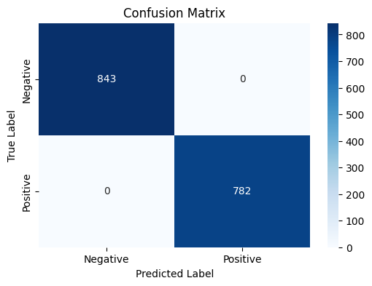
Random Forest
This method uses Ensemble Learning, combining multiple decision trees for better accuracy. The model is able to detect patterns from the many features that we have in our data set. Due to there not being many outliers and a finite number of types of mushrooms, the model was able to predict the poisonous and edible ones with 100% accuracy.

Slide 10
Conclusion
Random Forest Classifier outperformed Logistic Regression and Support Vector Machines, achieving 100% accuracy in predicting poisonous and edible mushrooms from the data set.
Due to all the variables being categorical, and the fact that there are only a finite number of types of mushrooms, it is not much of a surprise that this sophisticated method was able to be 100% accurate.
The Random Forest model should do a good job when presented with new data.

Slide 11
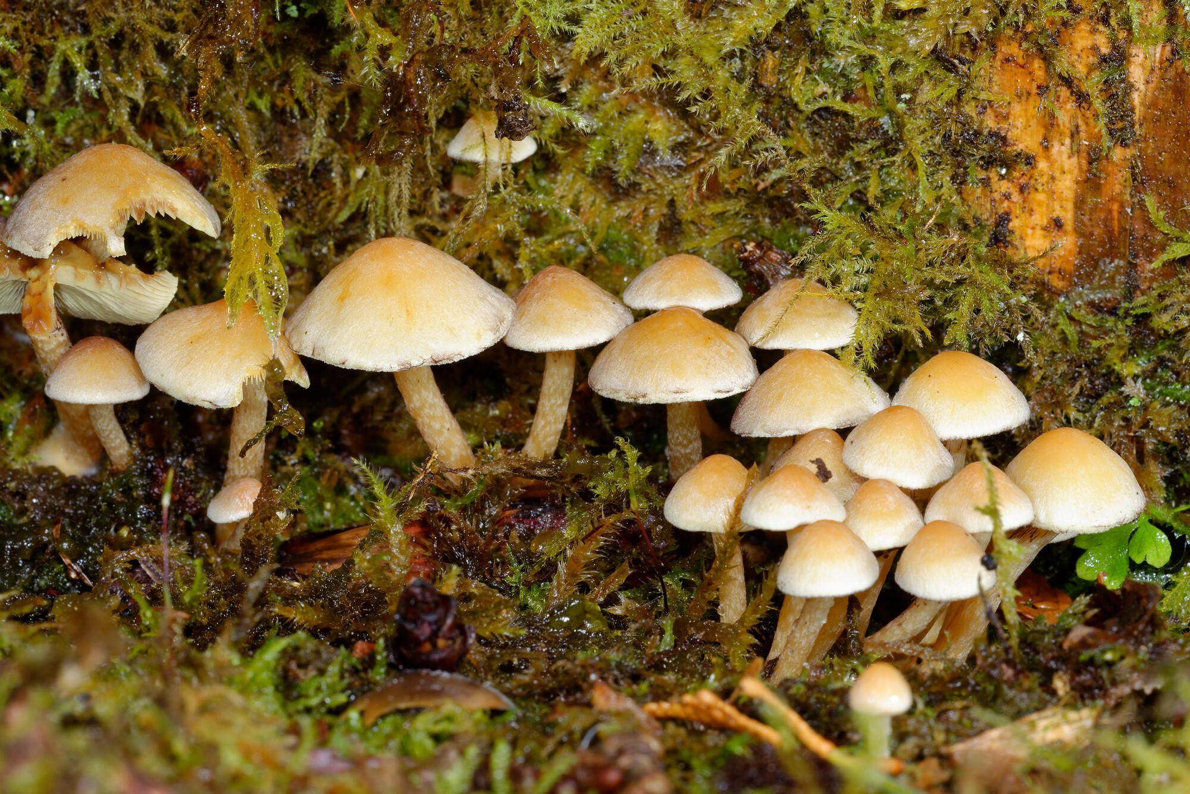

So… next time you’re in a Random Forest, you can be certain that you won’t be poisoned!
Thanks for listening!

